Slide 1

Even Semester Presentation ( 2nd Sem)
Deep Learning and Optimization Laboratory
Department of Computer Science of Engineering
National Institute of Technology Silchar , Assam, India
Course Code : CS-5310

Slide 2
Plant (wheat) disease classification
Using Deep Learning
Presented by :-
Mukesh ku Sahu – 2322308
Subham Gupta – 2322301
M.Tech CSE(DSE)

Slide 3
Outline:
Introduction of the problem
Why do we choose Deep learning over Machine Learning?
Literature Review
Summary of Literature Review
Data-Set description
Information of Various Models
Model Architecture (Description)
Model Evaluation
Conclusion
Drawbacks
References

Slide 4
Introduction of Problem
The problem entails training a deep learning model to recognize various symptoms and patterns associated with different plant (wheat) diseases, enabling early detection and intervention to mitigate crop losses. By analyzing images of leaves, stems, or fruits exhibiting signs of diseases such as blight, rot, or fungal infections, the model can provide farmers with timely information to take appropriate actions, whether it's targeted pesticide application, crop rotation, or other preventive measures.
Agricultural workers, and even some researchers can be a significant driver for the adoption of deep learning (DL) algorithms in this domain as it becomes too tedious and time taking to actually look at the plants and classify them.
Why do we choose this problem :- Due to the lack of expertise in plant disease detection among farmers, the accuracy of the manual prediction depends upon the experience and knowledge of the person

Slide 5
Why do we choose Deep learning over Machine Learning?
Feature Learning: DL models, particularly convolutional neural networks (CNNs), are capable of automatically extract intricate features from raw images, eliminating the need for manual feature engineering, which is often required in traditional ML methods.
Complexity Handling: Plant diseases can exhibit complex patterns and variations, making them challenging to classify accurately. DL models excel at handling high-dimensional data and capturing intricate relationships between features.
Scalability: DL models can scale well with large datasets, as datasets of plant images grow in size and diversity, DL algorithms can exploit this abundance to improve their performance
Transfer Learning: DL models trained on large-scale image datasets (e.g., ImageNet) can leverage transfer learning to adapt their learned representations to the task of plant disease classification. By fine-tuning pre-trained models on smaller plant disease datasets, researchers can achieve competitive performance with less labeled data, reducing the annotation burden.
Continuous Improvement : DL research is a rapidly evolving field, with ongoing advancements in model architectures, optimization techniques, and training strategies. This continuous progress offers the potential for further improvements in plant disease classification accuracy and robustness over time.

Slide 6
Literature Review
Serial Number. | Author | Paper Title | DataSet | Review
1. | Akshai KP J.Anitha 021 3rd International Conference on Signal Processing and Communication (ICPSC) | 13 – 14 May 2021 | Coimbatore | Plant disease classification using deep learning | Plant Village dataset consists of more than 55,000 images with 38 classes of 14 different plant species. Out of 38 classes, 12 are healthy, and 26 are diseased leaf classes. The classes are healthy, black rot, Esca (Black Measles), and Leaf blight (Isariopsis Leaf Spot). | proposed EfficientNet model's performance is compared with other state-of-the-art CNN models such as ResNet, VGG, AlexNet, and Inception model.

Slide 7
Serial Number. | Author | Paper Title | DataSet | Review
2. | Sachin D. Khirade; A.B. Patil 2015 International Conference on Computing Communication Control and Automation | Plant Disease Detection Using Image Processing | - No information Provided | A SOFM with back propagation neural network is implemented to recognize colors of disease leaf
3. | Sachin D. Khirade; A.B. Patil 2015 International Conference on Computing Communication Control and Automation | PlantDoc: A Dataset for Visual Plant Disease Detection | PlantDoc :- dataset contains 2,598 data points in total across 13 plant species and up to 17 classes of diseases, involving approximately 300 human hours of effort in annotating internet scraped images. | Created a new dataset called “PlantDoc”

Slide 8
Serial Number. | Author | Paper Title | DataSet | Review
4. | Mamta Gehlot, Rakesh Kumar Saxena, ,Geeta Chhabra Gandhi | “Tomato-Village”: a dataset for end-to-end tomato disease detection in a real-world environment | dataset contains 10,892 photos of ten leaves - no more information is available | propose the creation of a new dataset called “Tomato-Village” with three variants: (a) multiclass tomato disease classification, (b) multilabel tomato disease classification, and (c) object detection-based tomato disease detection.

Slide 9
Observations of Literature review
Agriculture plays a crucial role in the Indian economy. Early detection of plant diseases is very much essential to prevent crop loss and further spread of diseases. Most plants such as apple, tomato, cherry, grapes show visible symptoms of the disease on the leaf. Besides, the decision of which model to select – the right dataset must be collected as it is also a very crucial part of the job . Keeping in mind the following features which must be looked into before selecting the right Data-Set
Data Quality: Ensure that the dataset is of high quality, with accurate and reliable annotations or labels. Inaccurate or noisy labels can significantly impact the model's performance and generalization ability.
Dataset Size: The size of the dataset matters, especially for deep learning models like CNNs, which typically require large amounts of data to learn meaningful representations. A larger dataset can help prevent overfitting and improve the model's ability to generalize to new, unseen data.
Data Diversity: The dataset should cover a wide range of variations and scenarios relevant to the target application. For example, in image classification tasks, diverse viewpoints, lighting conditions, backgrounds, and object orientations should be represented in the dataset to ensure robustness.
Balanced Classes: If the dataset is for a classification task, ensure that the classes are balanced, meaning that each class has a similar number of samples. Class imbalance can bias the model towards the majority class and lead to poor performance on minority classes.

Slide 10
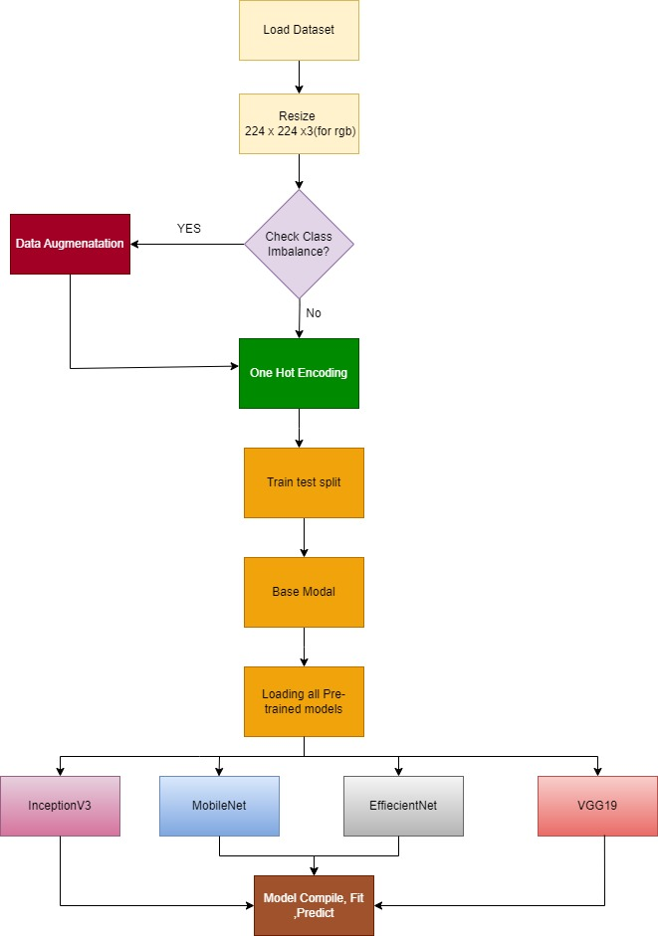
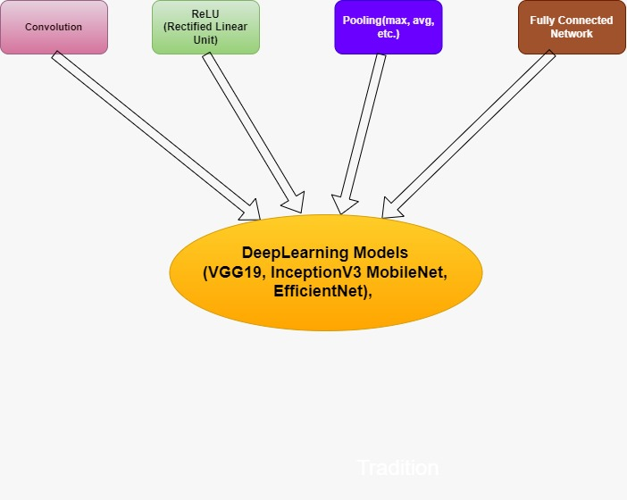
Workflow:

Slide 11
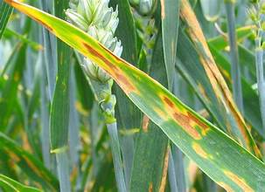
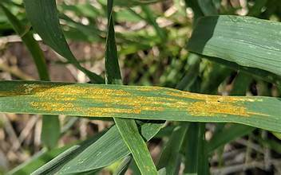
Data-Set Used in the Proposed Model- Wheat Leaf
The dataset contains 102 healthy, 208 stripe rust, and 97 septoria detected wheat leaf.
The image has three categories i.e. ‘Healthy Wheat Leaf’, ‘Strip Rust’, and ‘Septoria Disease’.
The location of the data collection is at Holeta wheat farm, Ethiopia, and it was captured in a real wheat farm in an uncontrolled environment. Besides, it was sorted into three classes with the assistance of plant pathologists: the classes are Stripe Rust, Septoria, and Healthy. The camera used is Canon EOS 5D Mark III, it is a high-resolution digital camera capable of showing the detail of the leaf.
Image of “Septoria” Leaf Spot
Image of Stripe Rust of Wheat

Slide 12
Information of Proposed Model
Since the 3 classes have varying no. of images so we use Image augmentation to add a few extras keeping the no of images to a total of 600 for all the three classes ('Healthy’, 'septoria', 'stripe_rust’}.
Then we use various Deep Learning Models ( VGG19, InceptionV3 ,Mobile Net, Efficient Net ) :-
VGG19 : VGG19 is a CNN architecture proposed by the Visual Geometry Group (VGG) at the University of Oxford. It is characterized by its simplicity and uniform architecture, consisting of 19 layers (16 convolutional layers and 3 fully connected layers). VGG19 achieves good performance on image classification tasks but has a large number of parameters, making it computationally expensive.
2. InceptionV3 : InceptionV3 is part of the Inception family of CNN architectures developed by Google. It is designed to improve computational efficiency while maintaining high accuracy. InceptionV3 uses a combination of 1x1, 3x3, and 5x5 convolutions along with max-pooling and global average pooling to capture spatial hierarchies at different scales.
3. MobileNet : MobileNet is a lightweight CNN architecture specifically designed for mobile and embedded devices with limited computational resources. It utilizes depth wise separable convolutions to reduce the number of parameters and computational cost while maintaining good accuracy.
,

Slide 13
4. EfficientNet : EfficientNet is a family of CNN architectures proposed by Google that systematically scales the model's depth, width, and resolution to achieve better efficiency and accuracy. It uses a compound scaling method to balance model size and performance across different scales. EfficientNet models have achieved state-of-the-art results on various image classification benchmarks while being computationally efficient.

Slide 14
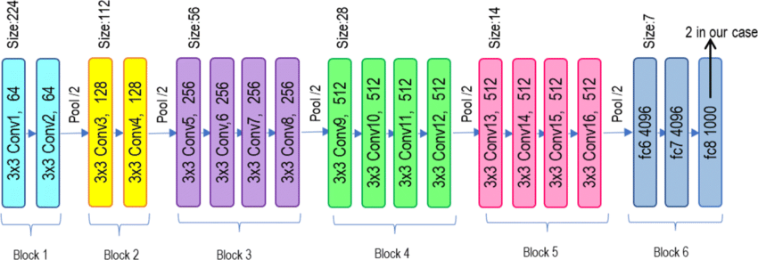
Model Architecture (Description)
VGG19

Slide 15
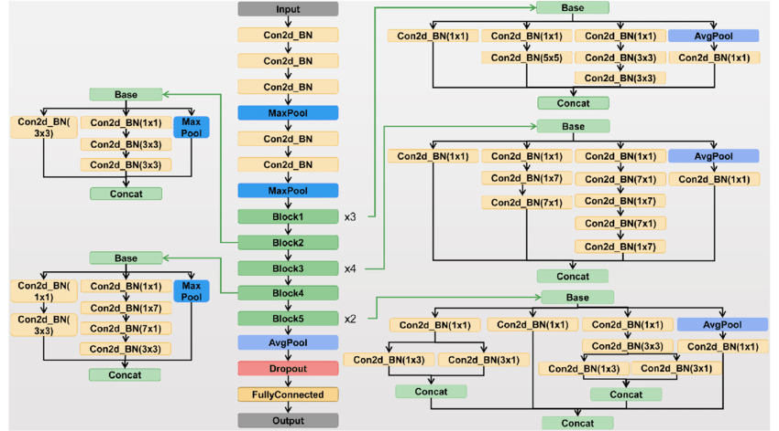
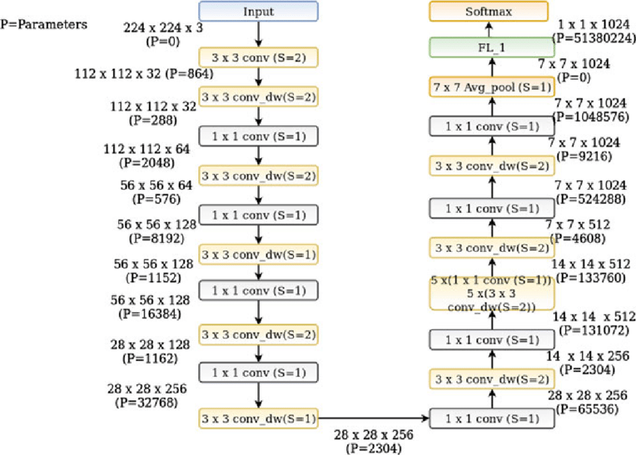
InceptionV3
ImageNet

Slide 16
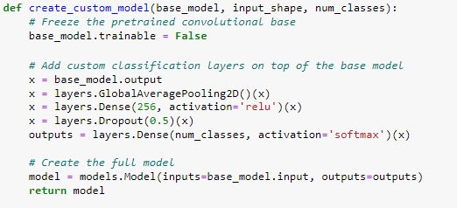
Adding a Base_Layer to all the pre-trained models

Slide 17
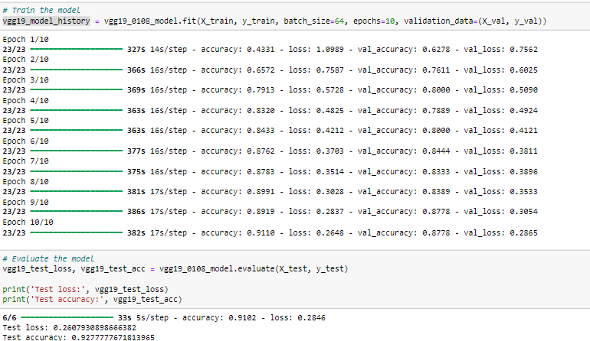
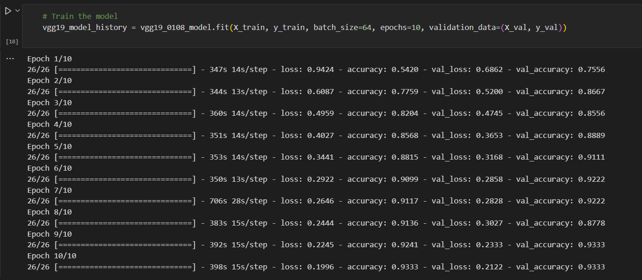
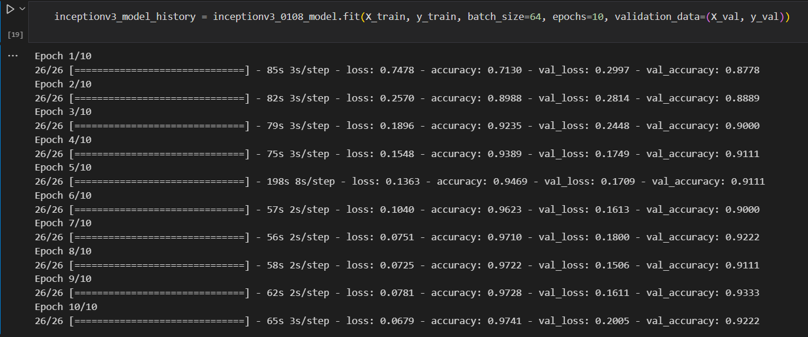
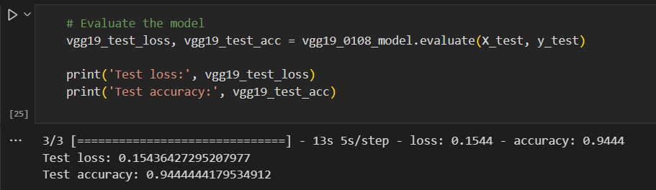
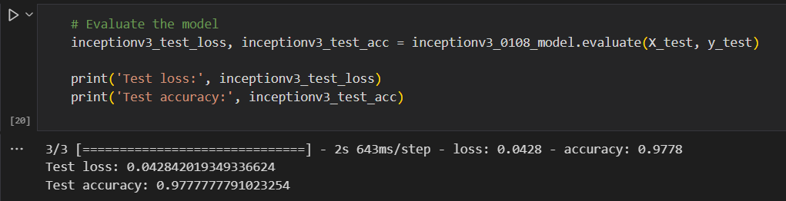
Model Evaluation

Slide 18
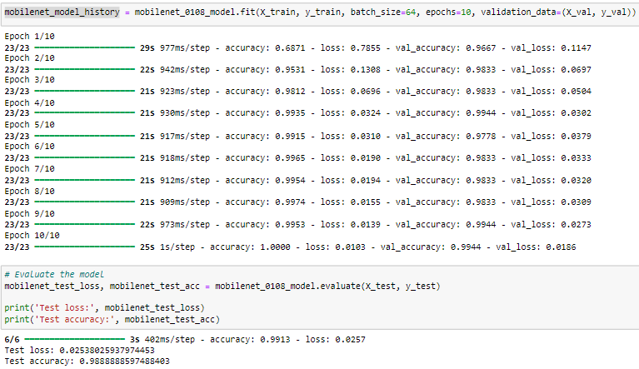
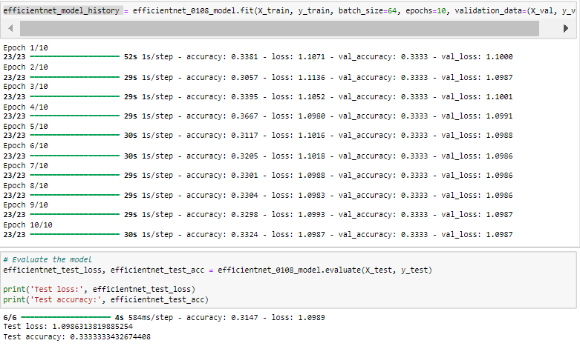
MobileNet
EfficientNet

Slide 19
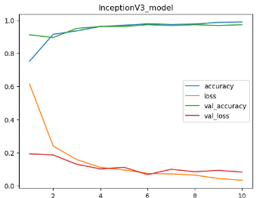
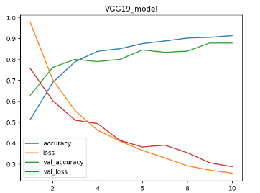
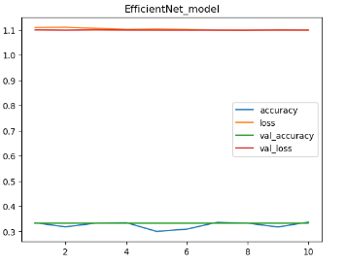
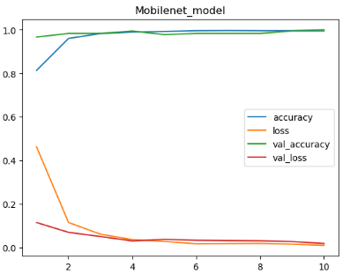

Slide 20
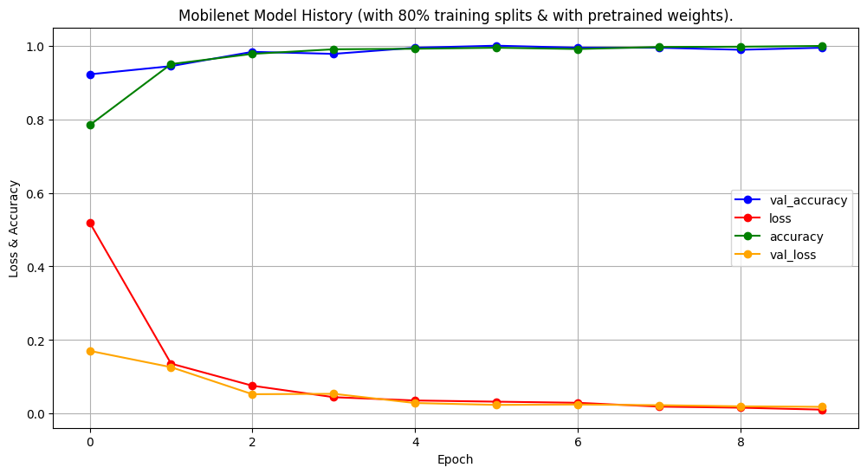
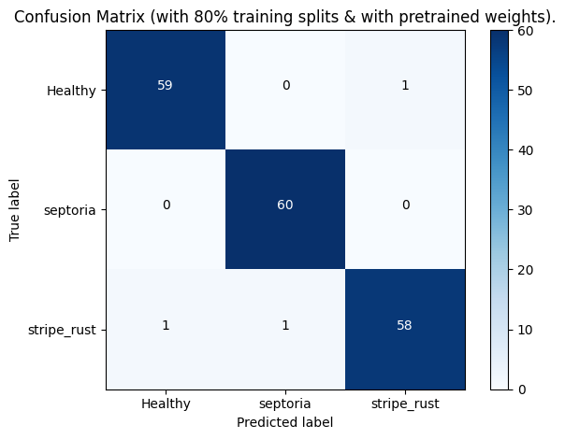
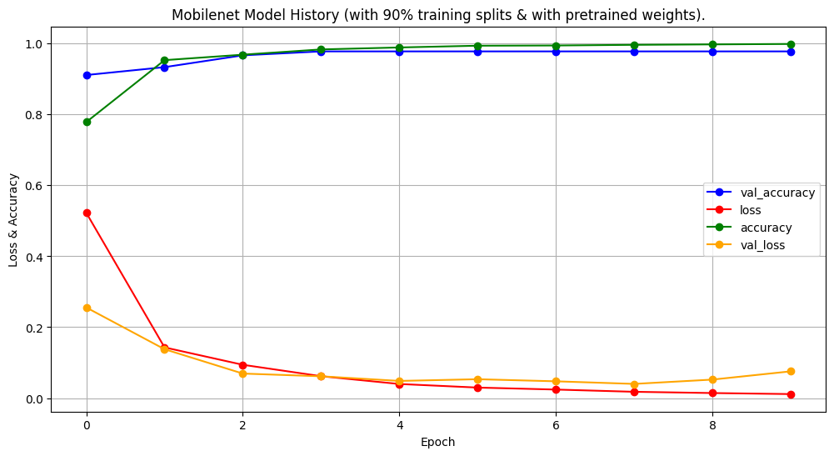
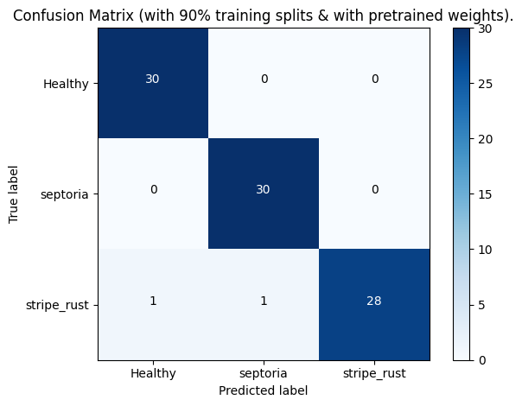

Slide 21
Conclusion…
Serial no. | Model Used | Test Accuracy | Test loss
1. | Vgg19 | 0. 9277777671813965 | 0. 2607930898666382
2. | Inception | 0.9444444179534912 | 0.07961222529411316
3. | MobileNet | 0.9888888597488403 | 0.02538025937974453
4. | Efficient net | 0.3333333432674408 | 1.0986313819885254
After comparing various Models with the right kind of necessary steps we conclude :
MobileNet is the one with the highest testing Accuracy of 98.8%
with total images per class = 600
loss function = categorical_crossentropy
optimizer = Adam
train_test_split = 80 : 10 : 10
train : validation : test

Slide 22
Drawbacks…
Never enough data - Lack of more data will always be a problem
All the pre-trained models use here are subjected to inputs of size (224 x 224 x 3),there may
be some information loss due to reshaping of the images, as all the images which are available or are captured
for the dataset are not of the same size
3. Hyper parameter tuning is computationally very expensive and time taking.
4.Choice of base modal to bring down the classes to anything less than 1000 (the no of output
neurons of most of the pre-trained models used) is subjective i.e., varies from user to user

Slide 23
References
Plant disease classification using deep learning -Akshai KP ,J.Anitha 3rd International Conference on Signal Processing and Communication (ICPSC) | 13 – 14 May 2021 | Coimbatore
Plant Disease Detection Using Image Processing Sachin D. Khirade; A.B. Patil
2015 International Conference on Computing Communication Control and Automation
Tomato-Village”: a dataset for end-to-end tomato disease detection in a real-world environment -Mamta Gehlot , Rakesh Kumar Saxena , Geeta Chhabra Gandhi
PlantDoc: A Dataset for Visual Plant Disease Detection 23 Nov 2019 · Davinder Singh, Naman jain, Pranjali Jain, Pratik Kayal, Sudhakar Kumawat, Nipun Batra
DataSet taken from kaggle : https://www.kaggle.com/datasets/olyadgetch/wheat-leaf-dataset/

Slide 24
Thank You

