Slide 1
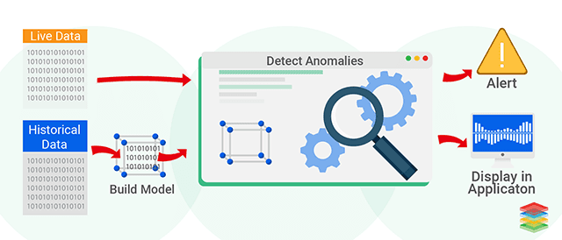
Outlier Detector Application

Slide 2
Application setup
The code can be found at the below GitHUB URL
https://github.com/mukesh300/Outlier_Detection_app
Follow the setup from README.md file
Once done you can start using the application

Slide 3
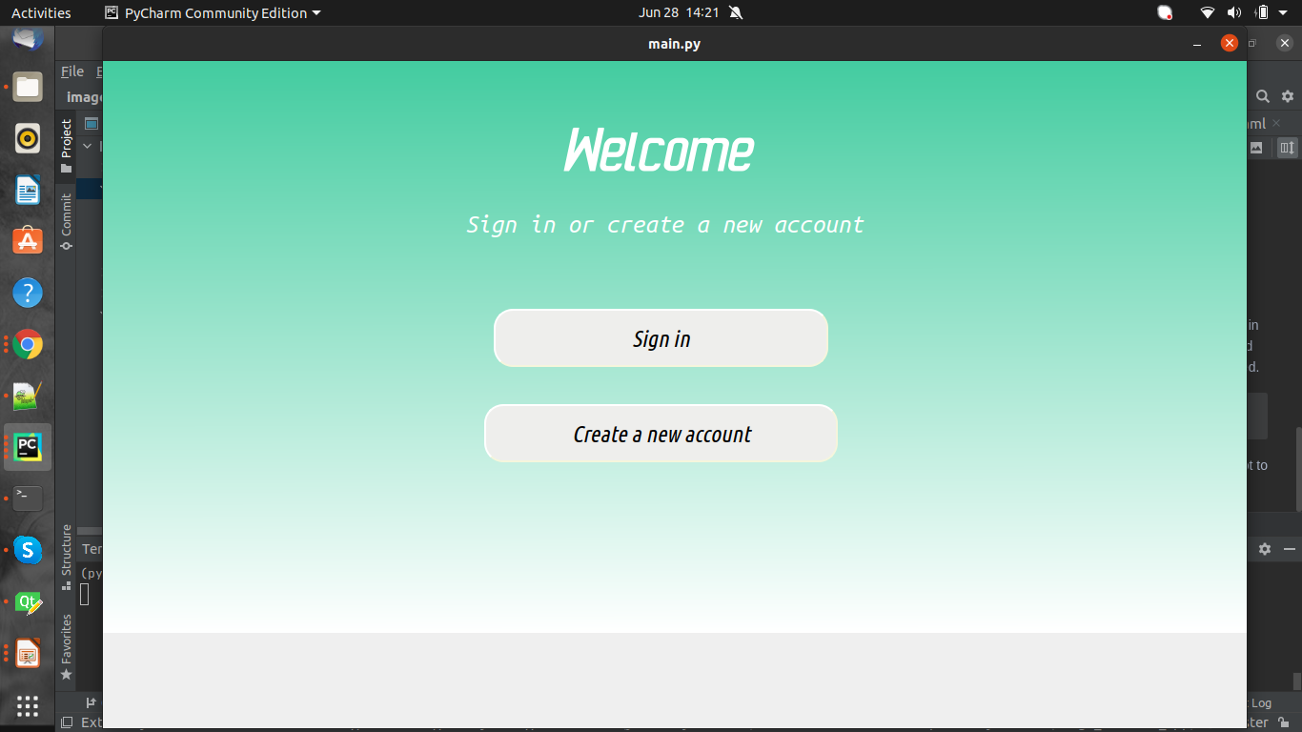

Slide 4
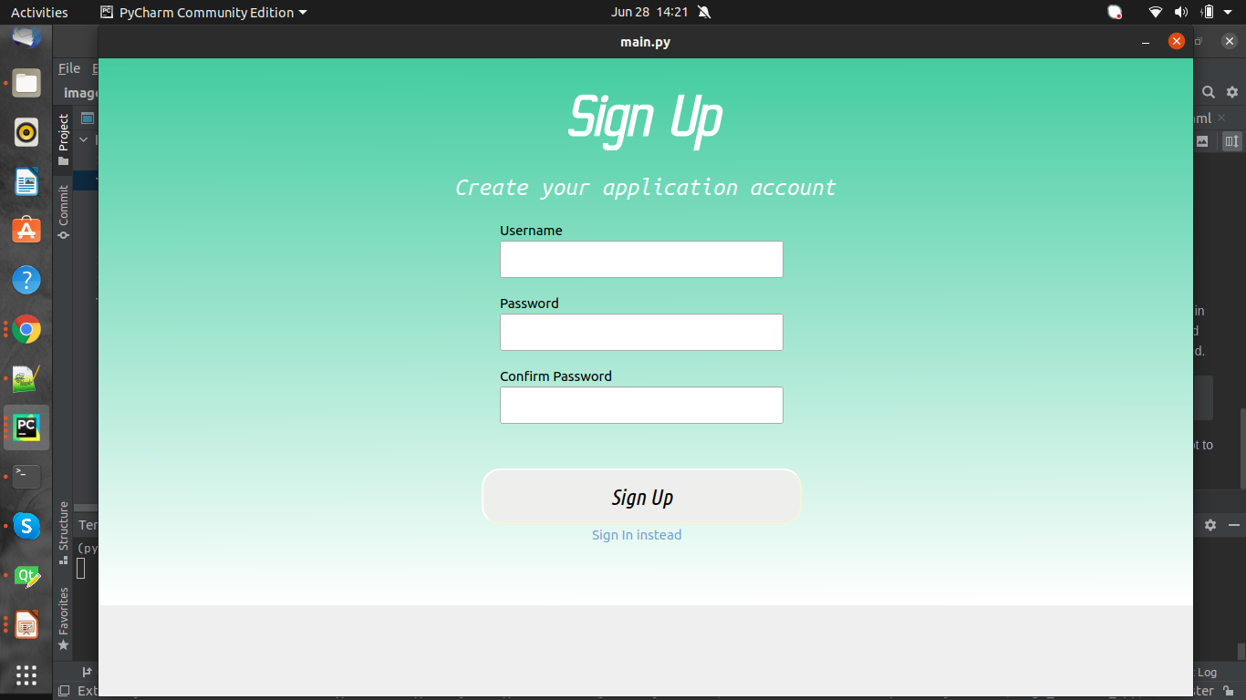

Slide 5
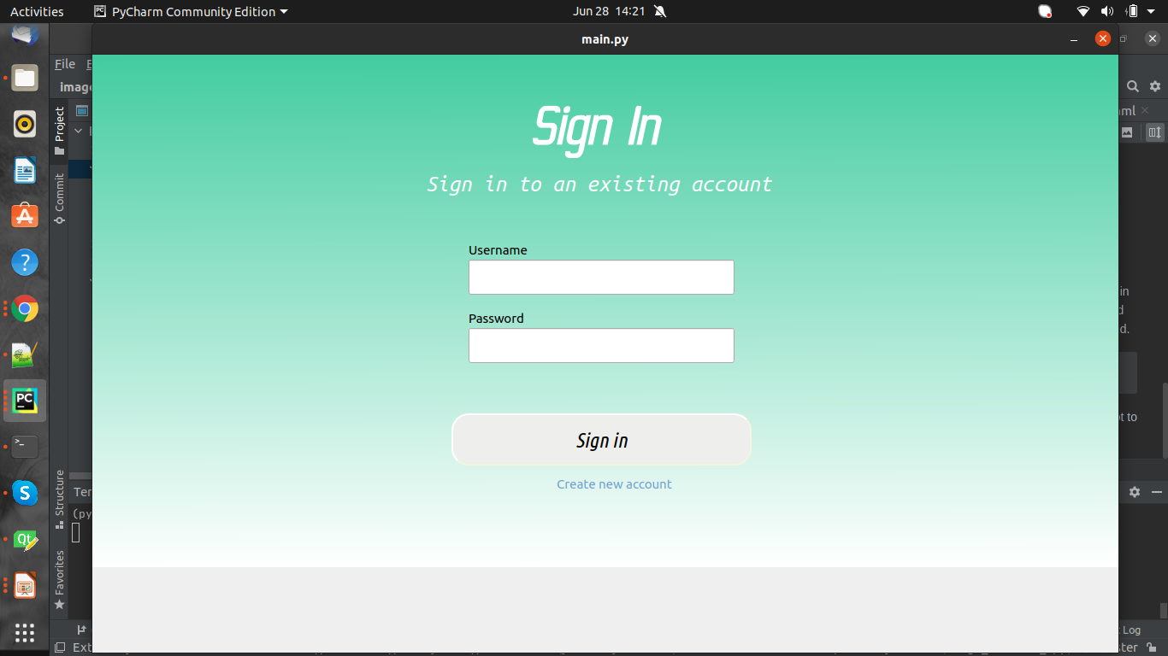

Slide 6
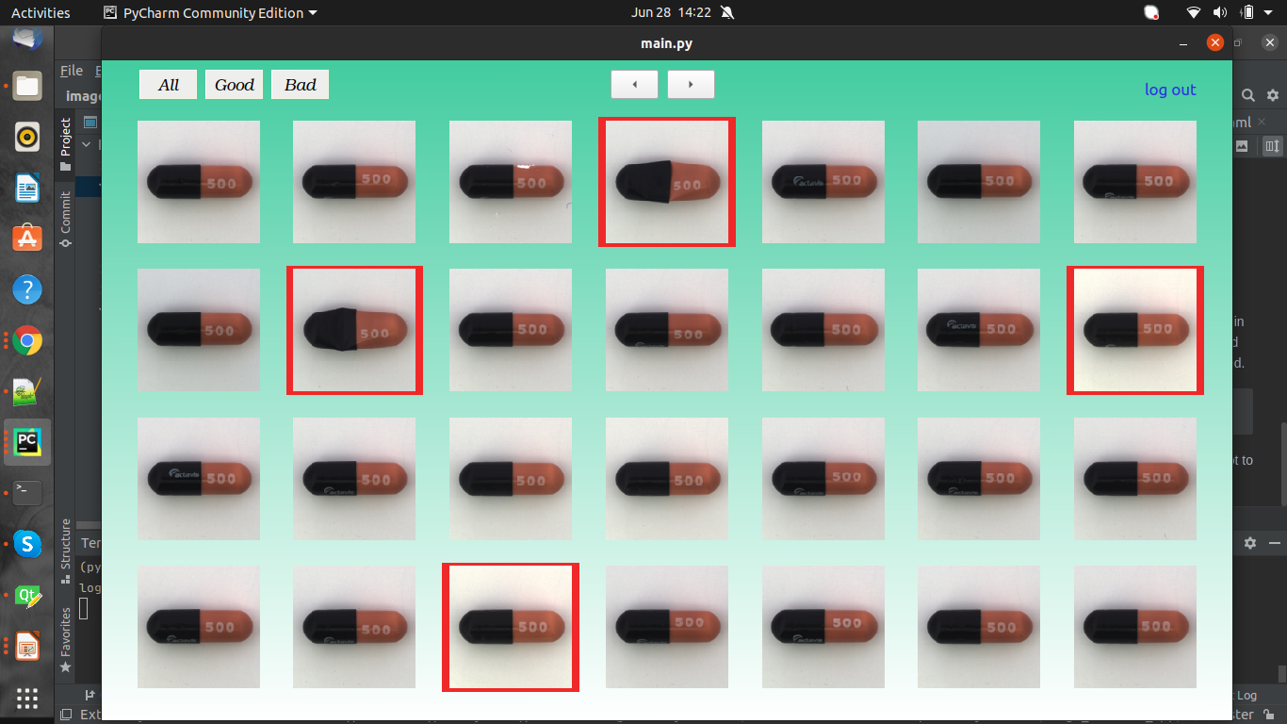

Slide 7
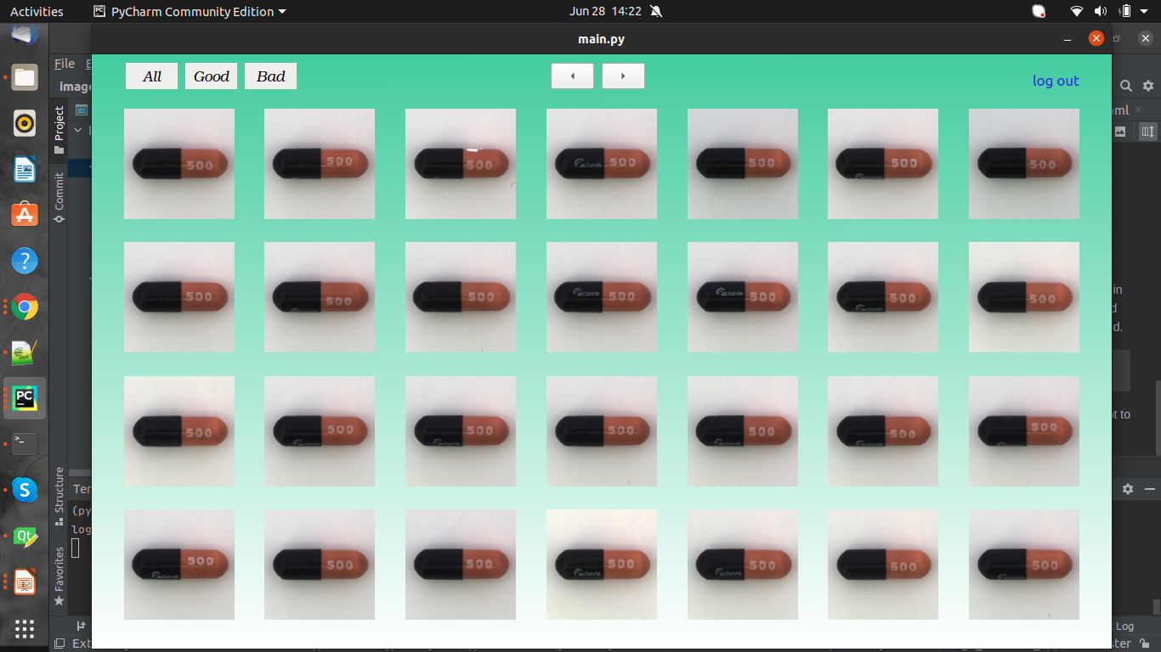

Slide 8
