Slide 1
webRAG: Web-based Retrieval-Augmented Generation
Submitted by:
Mukesh Kumar Pandey
Registration Number: 12409414

Slide 2
Introduction to webRAG
What is webRAG?
An AI-powered Q&A bot that answers questions using the live content of real websites — not its own static training data.
Uses Retrieval-Augmented Generation (RAG) to fetch relevant chunks of content from documents.
Makes the model accurate, up-to-date, and highly hallucination-resistant.

Slide 3
Tech Stack & Pipeline
Technologies Used:
Streamlit: Web UI / Frontend
LangChain: Core RAG framework & orchestration
ChromaDB: Local vector database for semantic search
Models: gpt-4o-mini (LLM) & text-embedding-3-small (Embeddings)
Pipeline: Scrape URLs → Chunk text → Compute Embeddings → Store in ChromaDB → Retrieve relevant chunks → Generate Grounded Answer.

Slide 4
Feature 1: Grounded Q&A Chat
Strict Adherence to Source Context
Answers are generated exclusively from the indexed web pages, preventing hallucination.
If information is not on the indexed page, the bot refuses to answer.
Provides an expandable 'Sources' section showing exactly which chunks of text were used to construct the answer.

Slide 5
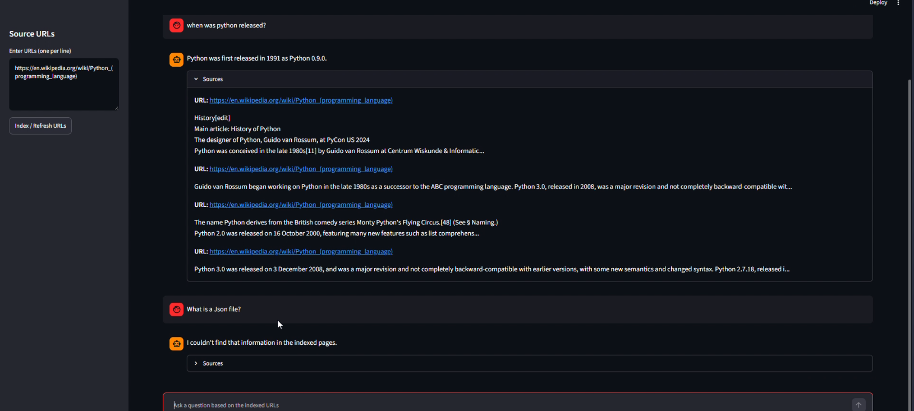

Slide 6
Feature 2: Dynamic Answer Updates
Synchronized with the Live Web
As source web pages are updated, the bot's knowledge base updates as well.
Eliminates the problem of stale data commonly found in statically trained models.
When asked the same question after a page update, the bot will instantly provide the newly updated answer.

Slide 7
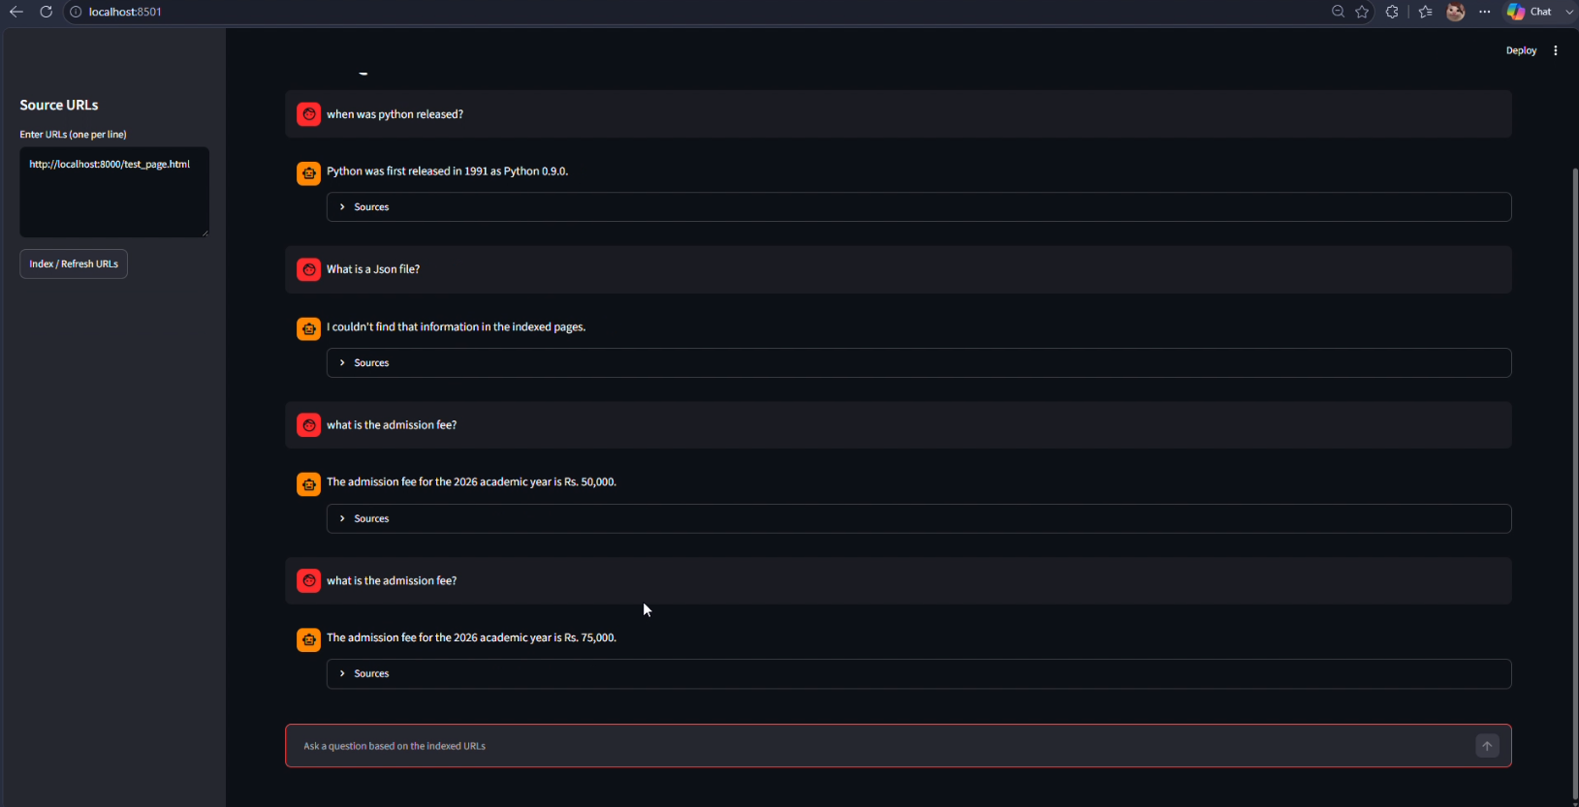

Slide 8
Feature 3: Freshness Handling & Diff Viewer
Intelligent Page Tracking
Tracks changes on pages using SHA-256 hashing to detect even a single character change.
Generates a 'Freshness Report' in the UI (New, Unchanged, or Changed).
For changed pages, it automatically computes and displays a Unified Diff to highlight exact additions and deletions.

Slide 9
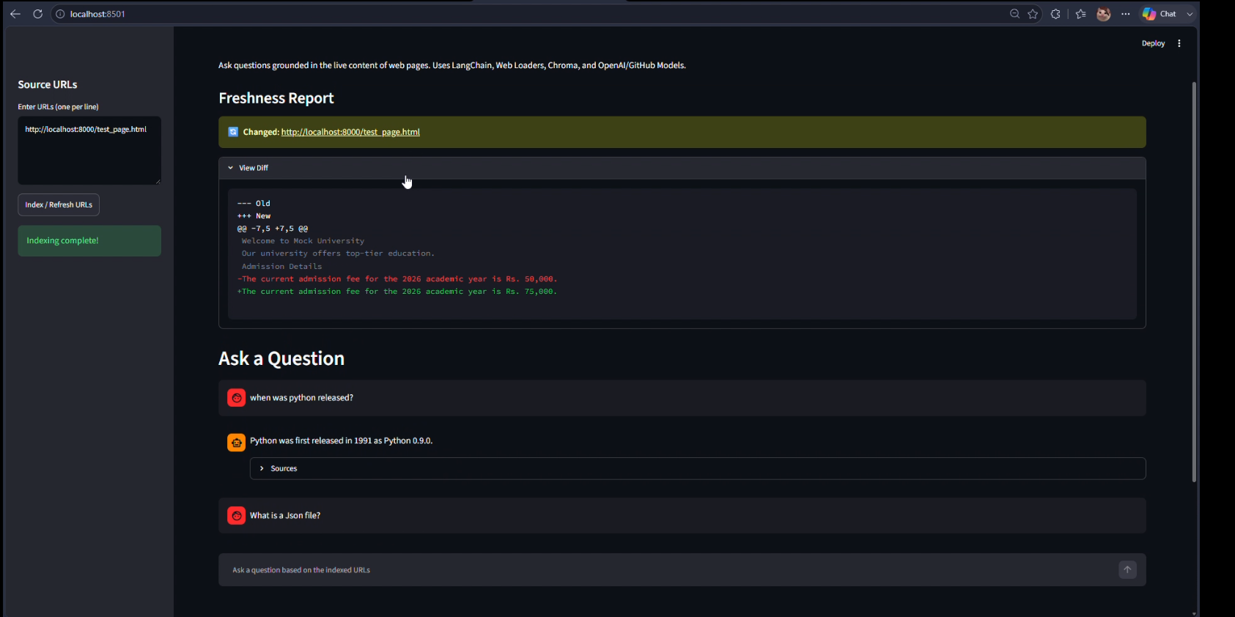

Slide 10
Thank You

