Slide 1
MAJOR PROJECT PRESENTATION
webRAG
Web-Based Retrieval-Augmented Generation for Grounded Question Answering
SUBMITTED BY
Mukesh Kumar Pandey
Registration Number: 12409414
LangChain · ChromaDB · Ollama · Streamlit

Slide 2
OVERVIEW
Agenda
01
The Problem
05
Technology Stack
Why answers grounded in live web content matter
Every library and its role
02
What is RAG
06
Feature Walkthrough
Retrieval-Augmented Generation, in brief
Grounded Q&A, live updates, freshness & diff
03
System Architecture
07
Application in Action
Component view of the webRAG pipeline
UI screenshots from a working test run
04
Data Flow Diagrams
08
Learnings & Future Scope
Context (Level 0) and detailed (Level 1) views
What we took away, what comes next
webRAG — Agenda
01

Slide 3
MOTIVATION
Why Standard Chatbots Fall Short
The Core Problem
Our Objective
— Stale knowledge. General-purpose LLMs are frozen at their training cut-off and cannot see today's website content.
— Hallucination risk. Without grounding, models can state incorrect facts with full confidence.
— No source trail. Standard chatbots rarely tell you which document an answer came from.
— Manual re-reading. Tracking whether a source page changed is normally a manual, error-prone task.
— Ground every answer strictly in the live text of user-supplied URLs.
— Detect page changes automatically via content hashing, no manual diffing.
— Refuse to guess when the answer is not present in the indexed content.
— Cite sources so every answer can be verified against the original page.
webRAG — Problem Statement
02

Slide 4
CONCEPT
What Is Retrieval-Augmented Generation?
Instead of relying on a model's memorised training data, RAG retrieves the most relevant real content first, then asks the model to answer using only that evidence.
1
2
3
Retrieve
Augment
Generate
Search a vector database for the text chunks most similar in meaning to the question.
Insert those chunks into the prompt as the model's only source of truth.
The LLM composes an answer using exclusively the retrieved evidence.
Why it matters for webRAG
The system prompt explicitly instructs the model to answer ONLY from retrieved context, and to say so plainly when the answer is not present — turning RAG into a hallucination-resistant, verifiable Q&A engine.
webRAG — RAG Concept
03

Slide 5
DESIGN
System Architecture
PRESENTATION LAYER — Streamlit UI (app.py)
URL sidebar & indexing controls · chat interface · freshness report · source viewer
index_urls()
ask_question()
APPLICATION LOGIC LAYER — webrag.py
WebBaseLoader
Fetch & parse HTML
Hash Tracker
SHA-256 change detection
Text Splitter
1000-char chunks, 200 overlap
Embeddings
nomic-embed-text
Retrieval Chain
LangChain RAG pipeline
Ollama Server
LLM + embedding inference (local)
ChromaDB
Persistent vector store · ./chroma_db
page_states.json
URL hash & text snapshot store
Live Web Pages
External HTTP sources
webRAG — System Architecture
04

Slide 6
DESIGN
Data Flow Diagram — Level 0 (Context)
0.0
webRAG System
index & answer engine
USER
Researcher / Analyst
URLs + Questions
HTTP Fetch
WEB PAGES
External HTTP sources
Answers + Freshness Report
HTML Content
Reading the diagram
At the highest level, webRAG sits between two external entities: the User, who supplies URLs and questions, and the target Web Pages, which are fetched over HTTP. All indexing and retrieval logic is encapsulated inside the single process shown above.
webRAG — Data Flow Diagram · Level 0
05

Slide 7
DESIGN
Data Flow Diagram — Level 1 (Detailed)
INDEXING FLOW
User
1.0
Fetch Pages
WebBaseLoader
2.0
Detect Change
SHA-256 hash
3.0
Split Text
1000 / 200 chunks
4.0
Embed Chunks
nomic-embed-text
D1 page_states.json
reads / writes D1
D2 ChromaDB Vector Store
QUERY FLOW
User
5.0
Embed Query
nomic-embed-text
6.0
Retrieve Top-K
k = 4 chunks
7.0
Build Prompt
context + question
8.0
Generate Answer
gemma4 : 31b-cloud
Answer + Source Docs → User
webRAG — Data Flow Diagram · Level 1
06

Slide 8
FOUNDATIONS
Technology Stack
Library / Tool
Role
What It Does Here
Streamlit
Application UI
Sidebar for indexing, chat interface, freshness report
LangChain
Orchestration
Loaders, splitters, prompt templates, retrieval chains
langchain-community
Web ingestion
WebBaseLoader scrapes and cleans page HTML
Chroma / chromadb
Vector database
Local, persistent semantic search over embeddings
Ollama + langchain-ollama
Model runtime
Serves the LLM and embedding model locally
BeautifulSoup4
HTML parsing
Strips tags/scripts to plain readable text
tiktoken
Tokenisation
Accurate token counting during text splitting
python-dotenv
Configuration
Loads environment variables from .env
webRAG — Technology Stack
07

Slide 9
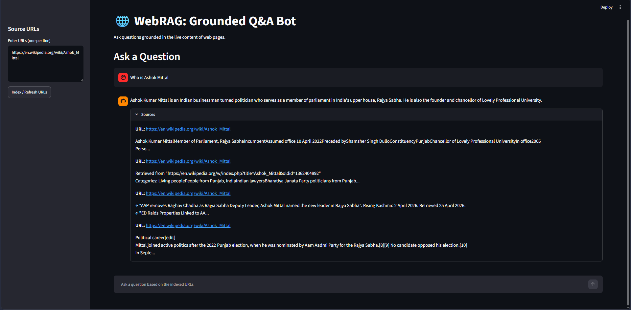
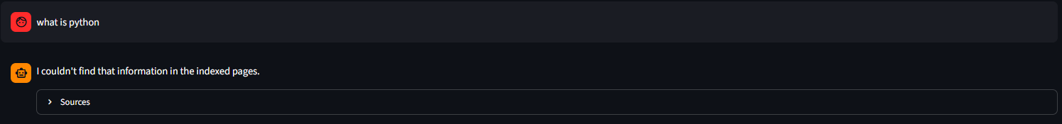
FEATURE 01
Grounded Question Answering
— Strictly sourced. Every answer is generated only from the top-4 retrieved chunks of indexed pages.
— Refuses to guess. If the context lacks the answer, the bot states it plainly instead of inventing facts.
— Cited evidence. Each response ships with an expandable Sources panel linking back to the origin URL.
System Prompt (excerpt)
Fig 1: grounded answer with an expandable Sources panel citing the origin URL
“Answer the question based ONLY on the following context. If the answer is not contained in the context, say I couldn't find that information in the indexed pages.”
Fig 2: an off-topic question — the bot declines rather than hallucinating
webRAG — Feature 1 · Grounded Q&A
08

Slide 10


FEATURE 02
Answers Stay Synchronised With Live Pages
— Re-index on demand. Clicking Index / Refresh re-fetches every URL and rebuilds the vector store from the current page content — no stale answers.
Fig 1: source page — original content, first indexed
Fig 2: same page after edits — re-indexed, answers now reflect the change
webRAG — Feature 2 · Dynamic Updates
09

Slide 11
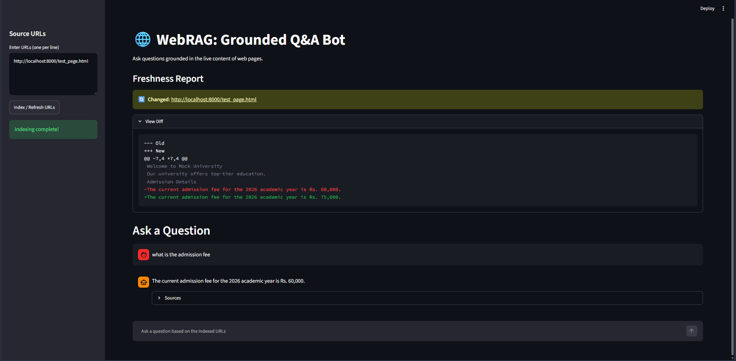
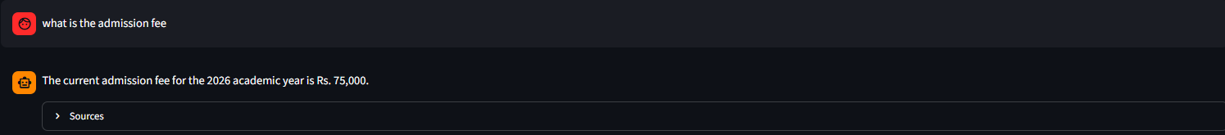
FEATURE 03
Freshness Report & Diff Viewer
— SHA-256 fingerprint. Every page's full text is hashed after each fetch.
— Three-way status. Compared against the stored hash: New, Unchanged, or Changed.
— Unified diff. When changed, a line-level diff of exactly what was added or removed is rendered inline.
- Rs. 50,000
+ Rs. 75,000
Fig 1: Freshness Report flags the page as Changed and displays the diff
Fig 2: chat answer updates to reflect the new page content
webRAG — Feature 3 · Freshness & Diff
10

Slide 12
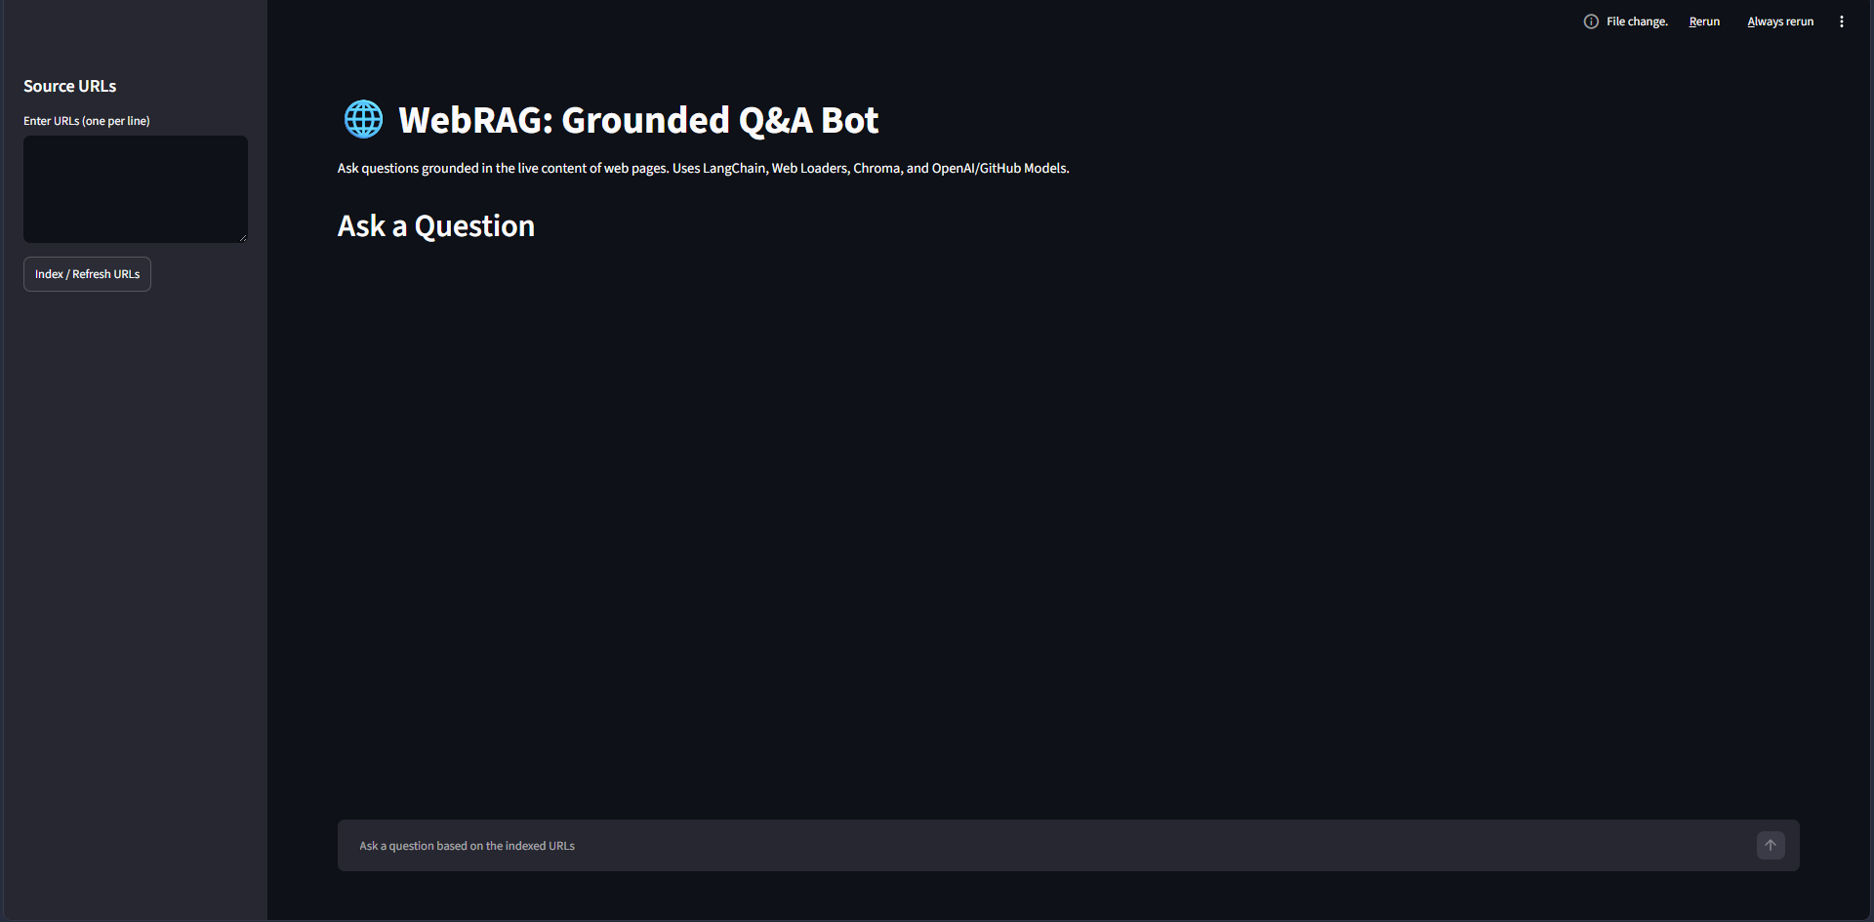
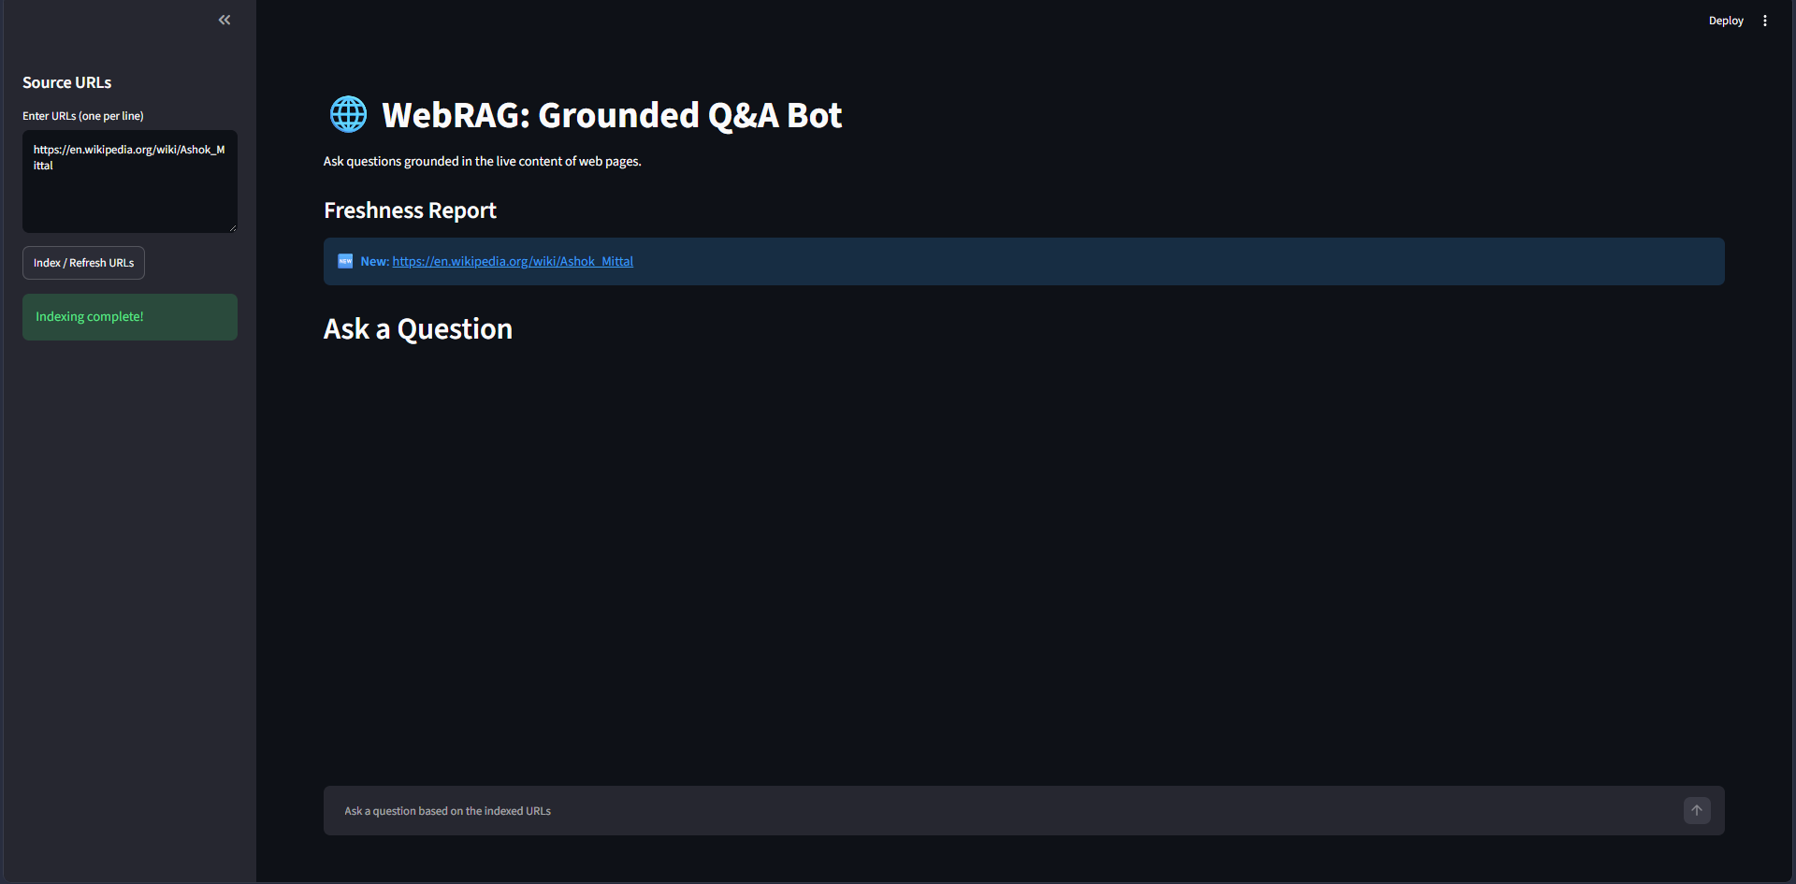
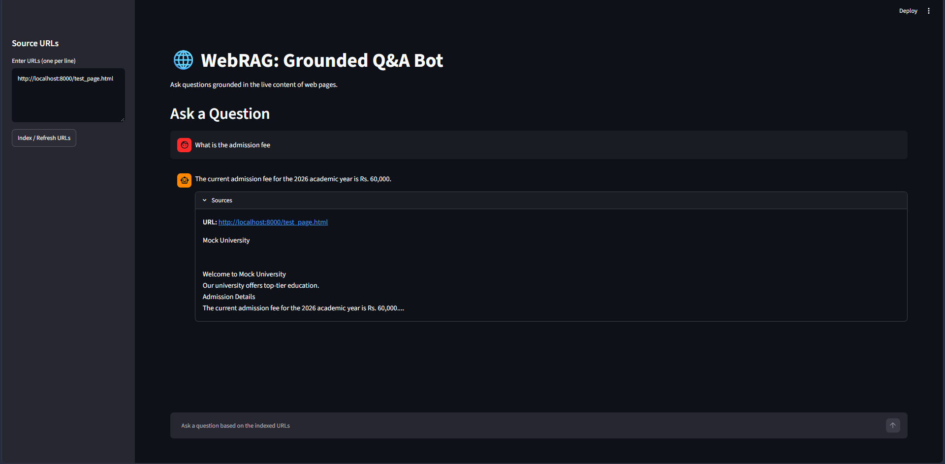
DEMONSTRATION
Application Walkthrough
Home — chat + indexing sidebar
Indexing a URL in progress
Local test page indexed for grading
End-to-end user journey
— Paste one or more URLs into the sidebar and click Index / Refresh URLs.
— Ask a natural-language question in the chat box — the bot retrieves and answers grounded in the indexed pages.
— Edit the source page, re-index, and watch the Freshness Report + chat answers update automatically.
webRAG — Application in Action
11

Slide 13
DESIGN DECISIONS
Engineering Highlights
Chunking: 1000 / 200
Clean re-index
Local-first models
A 200-character overlap between adjacent 1000-character chunks prevents a key sentence at a boundary from being lost from both halves.
The Chroma collection is deleted and rebuilt on every re-index, so the vector store never accumulates duplicate or stale chunks.
gemma4:31b-cloud and nomic-embed-text run via Ollama — no API keys, no per-call billing, fully self-hostable.
Strict grounding prompt
Content-hash diffing
Source attribution
The system prompt forces the LLM to answer only from supplied context, directly reducing hallucination.
SHA-256 over full page text gives a cheap, reliable signal for New / Unchanged / Changed without storing full history.
Every retrieved chunk keeps its originating URL in metadata, enabling a verifiable Sources panel.
webRAG — Engineering Highlights
12

Slide 14
REFLECTION
Learnings & Current Limitations
What We Learned
Current Limitations
— Grounding is a prompt-level guarantee. It only works as well as the retrieval quality feeding it.
— Chunking strategy directly affects answer quality. Too small loses context; too large dilutes relevance.
— Local LLM serving via Ollama removes API cost and latency concerns during iterative testing.
— Hash-based change detection is a lightweight but effective substitute for full version control on web content.
— Full re-index on any change. A single changed URL still rebuilds the entire collection.
— No authentication or multi-user isolation — all sessions share one vector store.
— Static pages only. Heavy JavaScript-rendered sites are not fully captured by WebBaseLoader.
— Single embedding/LLM pairing is hard-coded; swapping models requires a code change.
webRAG — Learnings & Limitations
13

Slide 15
ROADMAP
Future Scope
01
02
03
Incremental indexing
Scheduled re-crawling
Multi-user workspaces
Only re-embed chunks belonging to URLs that actually changed.
Background jobs to auto-refresh sources on a timer.
Isolated collections per user or project.
04
05
06
Pluggable model backends
JS-rendered page support
Answer confidence scoring
Swap LLM / embedding provider via configuration, not code.
Headless-browser fetching for dynamic sites.
Surface retrieval-similarity scores alongside each answer.
webRAG — Future Scope
14

Slide 16
Thank You
Questions & Discussion
Mukesh Kumar Pandey · Registration Number: 12409414
webRAG — Web-Based Retrieval-Augmented Generation

