Slide 1
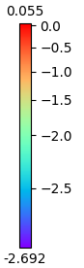
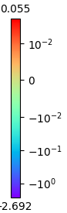
Changing atom colors based on external values including bader charges, magnetic moments etc
PowerNorm colors scalling
SymLogNorm colors scalling

Slide 2
Changing atom colors based on external values including bader charges, magnetic moments etc
Values.txt file:
-0.8
0.9
1.0
-0.7
0.68
-0.57
-0.8
0.9
-1.0
-0.7
-0.6
0.7
-0.8
-0.5
-0.4
0.3
-0.6
-0.7
-0.8
-0.5
Initial vesta plot
Final vesta plot after including external data eg. magnetic moments or bader charge etc

