Slide 1

Sales prediction for small basket

Slide 2
Problem statement
Sales forecast for the year 2019 for a company called small basket
Objective : To help the management and operation team take right decision based on the estimates for the year 2019
Tasks :
To collect and explore the past data
Preprocess the data
Build an ML model & tune the model
Predict/forecast sales for year 2019
Data analysis / insights

Slide 3
Data collection
Train data:
Date
Location Id
Item Id
Unit sales
On promotion details
Location data:
Location Id
City
State
Type
Cluster
Item data:
Item Id
Category of item
perishable
class
transaction data:
Date
Location Identifier
Transactions
Above data was augmented with the original train data to get more features. The target variable was identified as unit_sales for forecasting the sales data.
Forecast model is regression model.
Models that can be used for forecast are Time series, Linear Regression, Decision Tree, ANN, XGBoost & LSTM.
Data volume is huge; hence memory management has to be done for preprocessing, model building and predictions.
Bigdata Hadoop cluster can be used to process the complete data and to build the model.

Slide 4
EDA(Exploratory data analysis)
2015
- Sales data from Jan to Dec 2015
2018
- Sales data from Jan to Dec 2018
2019
- Sales forecast for the year 2019 from Jan to Aug
2016
2017
- Sales data from Jan to Dec 2017
- Sales data from Jan to Dec 2016
- 14783796 rows of data available
- 19894529 rows of data available
- 25254347 rows of data available
- 32233160 rows of data available
- Total 101688779 rows of sales data is available to build the models
- 23517680 rows of test data was given to forecast the sales in the year 2019

Slide 5
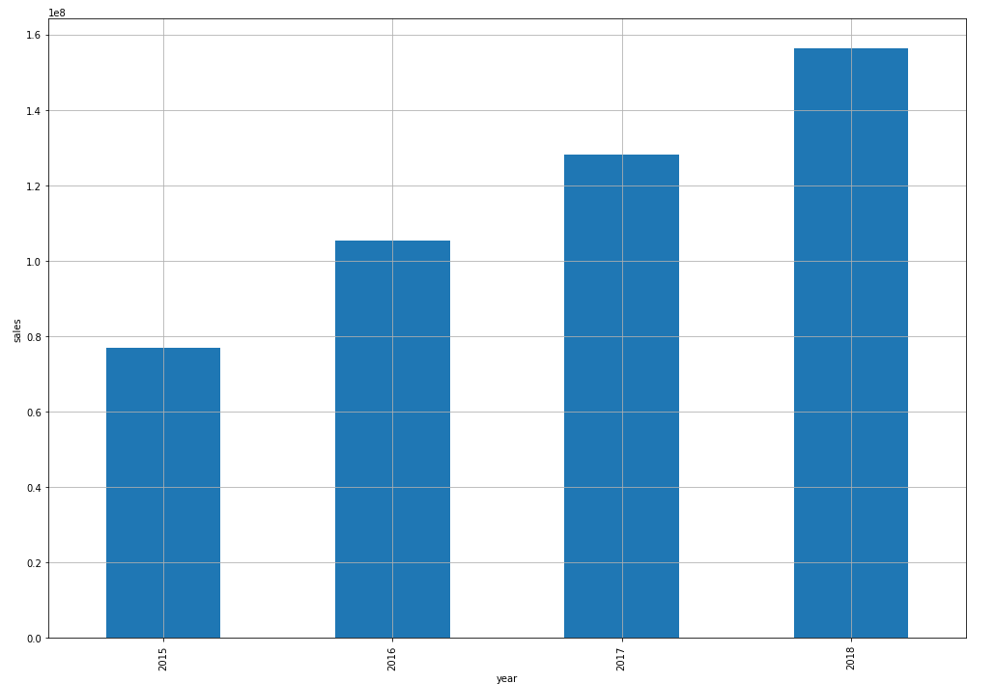
Data exploration( yearly sales)
We can observe from the data that sales shows consistent
We observe 203% growth in the sales from the year 2015 to year 2018

Slide 6
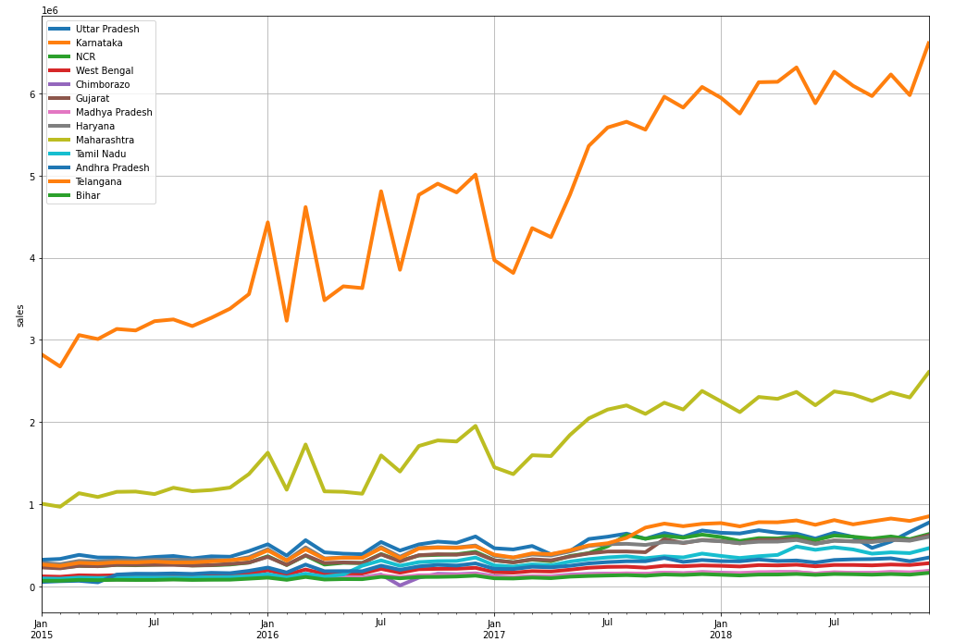
Data exploration (State wise sales data from 2015 to 2018)
We can observe Karnataka has the highest monthly sales among other states.
Maharashtra has second highest sales from 2015 to 2018

Slide 7
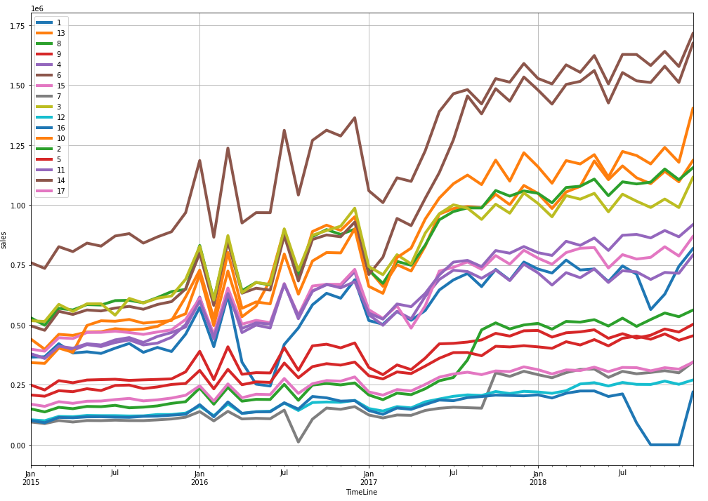
Cluster wise sales data from 2015 to 2018
We can observe cluster no.14 has high sales from 2015 to 2018
Also we can observe cluster no. 6 under performs among other clusters till sept 2017 and in subsequent month the sales increases significantly.
For cluster No. 1 & 16 we observe sudden drop of sales by the end of 2018

Slide 8
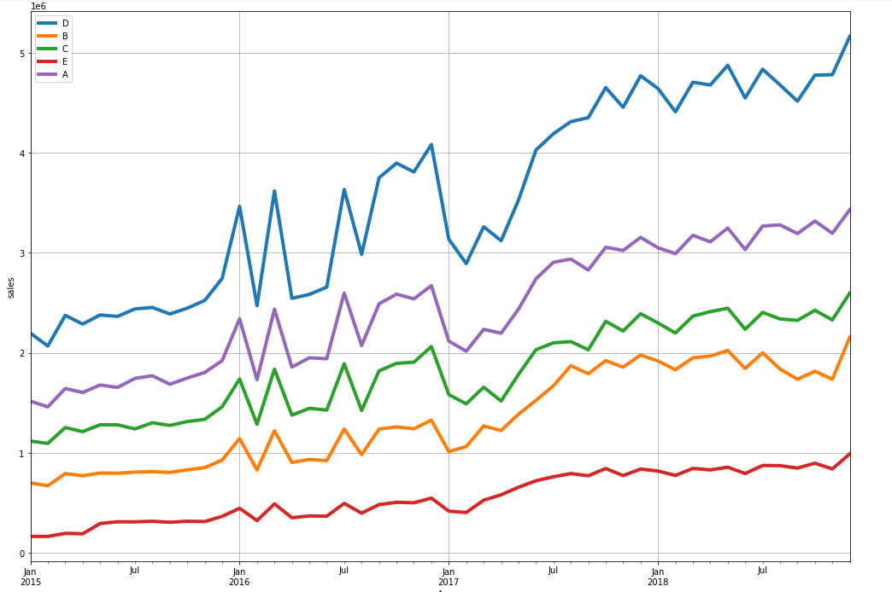
Business unit wise sales data
We can observer business type D consistently performs better than other business units
Type E business unit does not perform well from 2015 to 2018

Slide 9
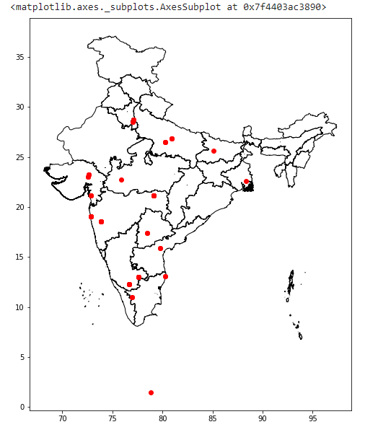
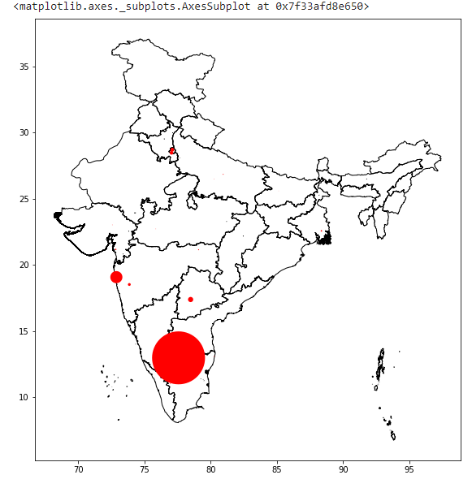
Presence of small basket in cities
The plot shows the cities in which the company is operating currently

Slide 10
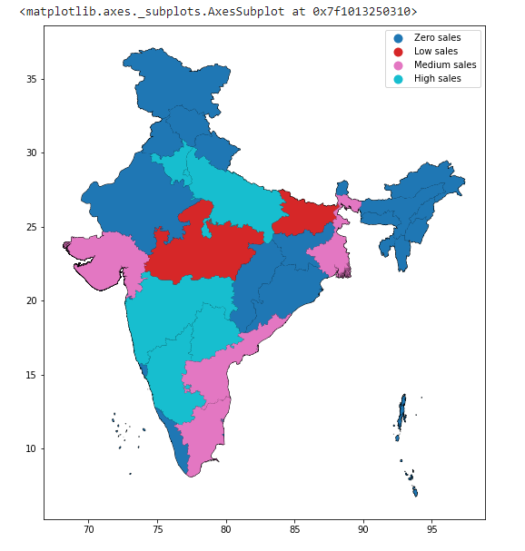
Categorization of states with respect to sales from 2015 to 2018

Slide 11
Data preprocessing
Observed outliers in the unit sales column in train data.
Removed outliers using quantile cut method
All records grater than Q3+1.5IQR and Q1-1.5IQR values removed from the train data set.
Observed negative values in the sales , hence converted negative values to positive values.
Replaced the null values of on promotion with FALSE assuming no data as no promotion on the particular day
Removed the values for the months of sept, oct, Nov & December
Apart from target value all other features are of categorical data types hence approached with 2 methods as following for converting the categorical to numeric data.
Dummfication
Target encoding with mean target value
Issues with dummfying the categorical data created huge number of features and was increasing the complexity of the models
Target encoding approach was much efficient by keeping the dimensionality same as the augmented train data.

Slide 12
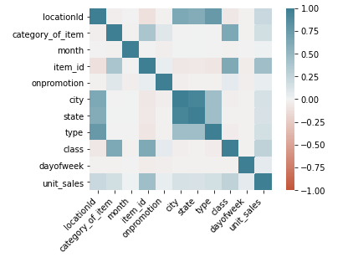
Data preprocessing
Following features were used from the augmented train dataset
locationId
category_of_item
month
item_id
onpromotion
city
state
type
class
dayofweek
Lag_1
Lag_2

Slide 13
Model building
Built Timeseries, Decision tree, ANN, XGBoost & RandomForest models to train the data after preprocessing.
Created multiple files for EDA, model building & predictions
Decision Tree model and ANN model performed the best among all models.
Tuned the ANN model using different learning rates from [1,0.01] and using multilayer perceptrons. Tried with tanh & relu activation function
Timeseries (auto ARIMA, SARIMA) performed bad among all the models
The model after training was saved to a pickle file and transferred to prediction for predicting the values for test data.
Improved prediction score (MAPE ) with every submission.

Slide 14
Prediction & results
Used test file and augmented the test file with the additional data provided.
Applied target encoder for preprocessing test data.
Predicted the sales based on the trained model.
Exported results csv and checked for the MAPE.
I was able to achieve MAPE of 83.75 as the best attempt.
Could have improved with additional features.

Slide 15
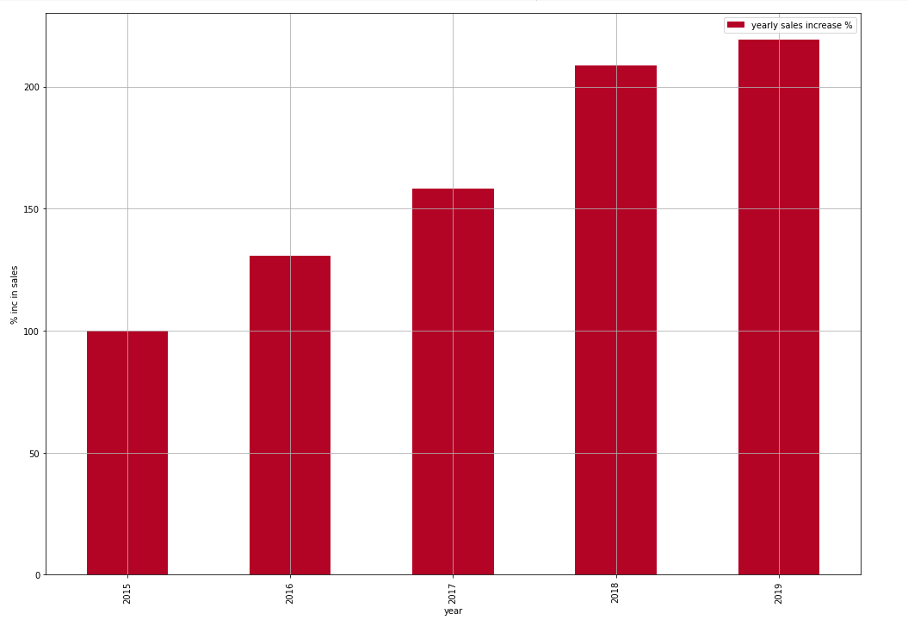
Yearly sales prediction
It is estimated that the total sales from Jan till Aug 2019 is expected to be 108401233.413.
Sales is expected to increase by 219% from the year 2015 during the period [Jan, Aug]
Only 9% increase is expected for the year 2019 as compared to 2018 sales which was 208%

Slide 16
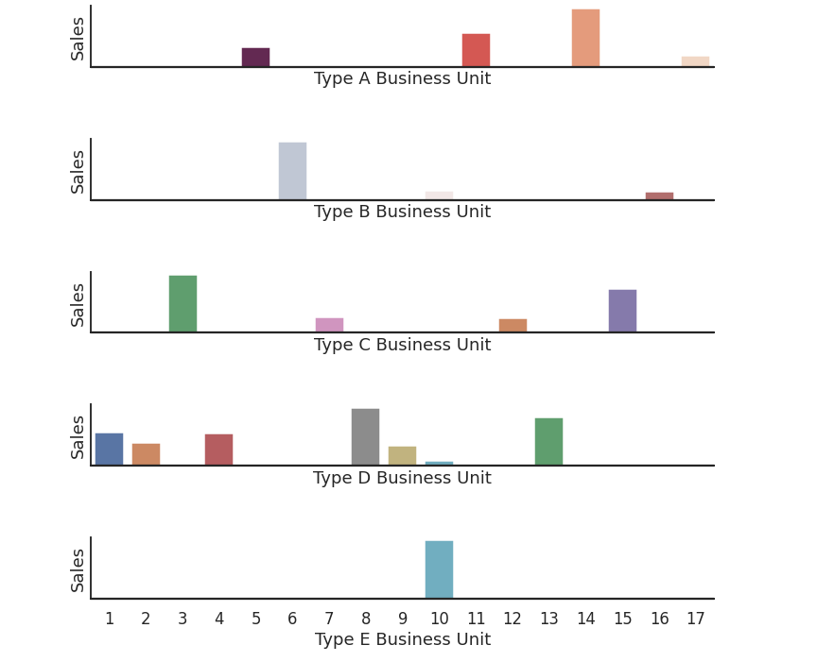
Sales base on business type and cluster for 2019
We can observe the clusters that have highest sale for each type of business units.
It is estimated that for type A business unit, cluster 14 has highest sales
Similarly for Type B,C,D & E has highest sales in the cluster 6,3,8 & 10 respectively

Slide 17
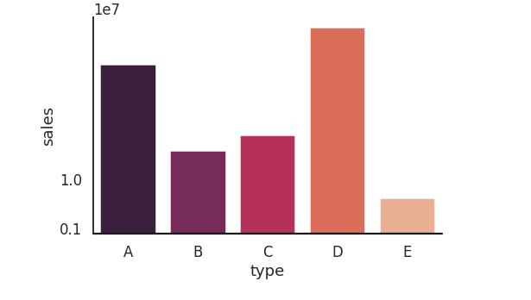
Sales estimation based on business type
Business type D has highest sales estimation among all business type units in the year 2019.
This is mainly because type D has many clusters which contribute to the sales significantly

Slide 18
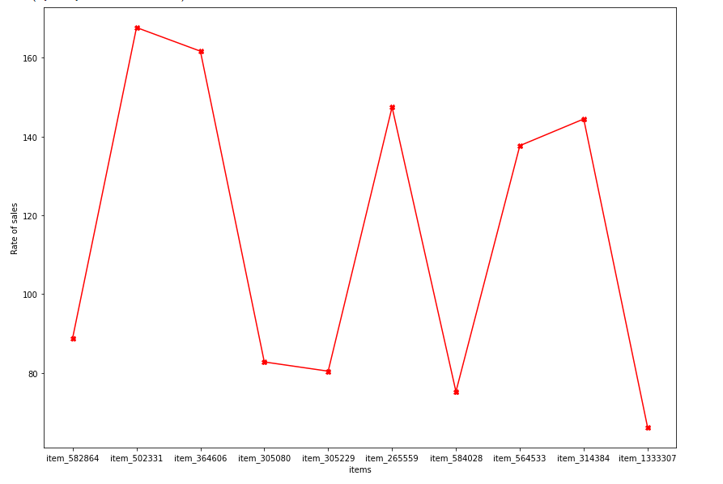
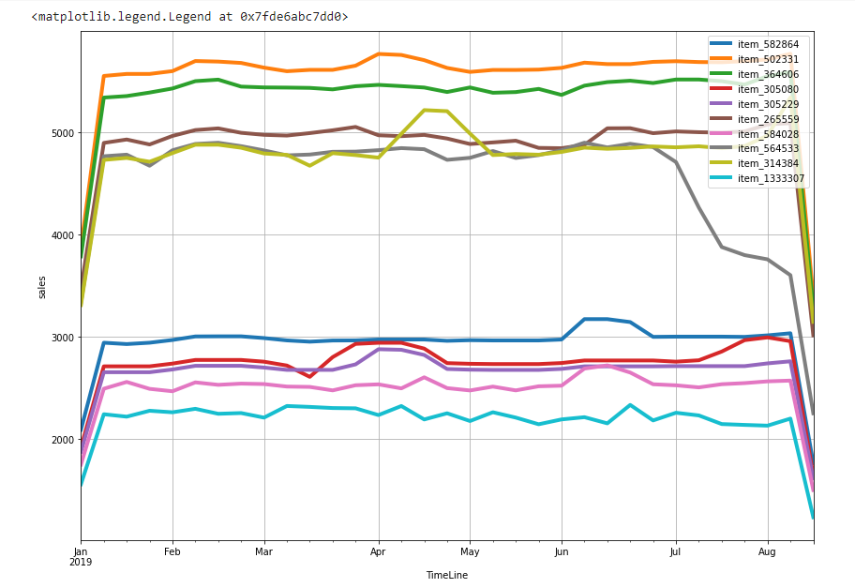
Top 10 items sold in 2019 in cluster 14 and its weekly rate of sales
Item_502331 has highest weekly rate of sales In the year 2019
Item_1333307 has lowest weekly rate of sales in the year 2019

Slide 19
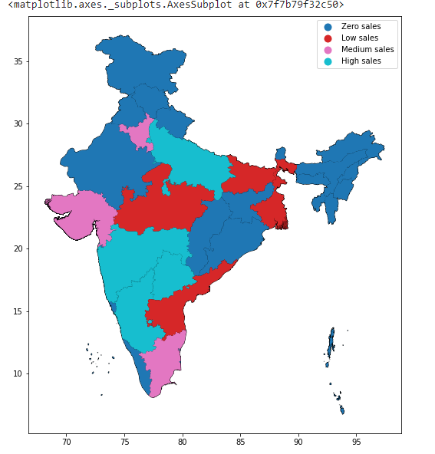
Analysis of predictions
We can observe that Andhra Pradesh is seeing low sales for the year 2019 as compared the past data

Slide 20
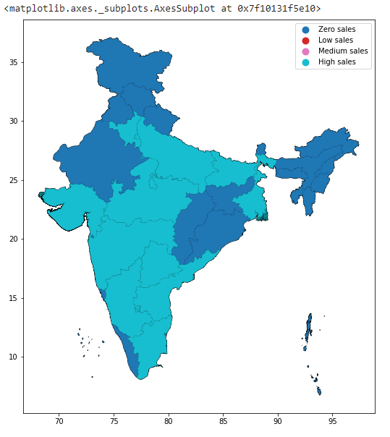
Expansion plans
From the sales plot company can expand in the states where there are no sales and states like Kerala, Odisha, Rajasthan etc., which has good transport infrastructure to support.
It is observed that, there was no expansion plan since 5 years with respect to states

Slide 21
Take away points
Data Handling
Transferring files & models between multiple ipynb files
usage of Pyspark to work on big data
Usage of new python libraries
Timeseries & forecasting problems

Slide 22

Thank you

