Slide 1





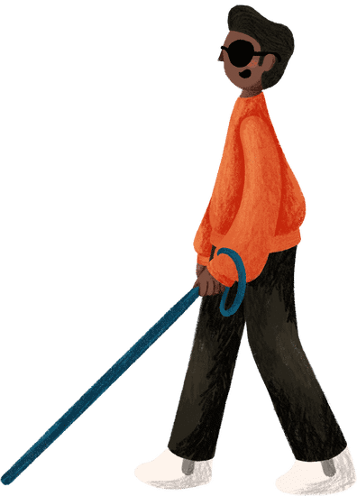

INNOTECH
~ SOLVE-A-THON
BlindGo
A VOICE BRIDGE
BY TEAM:
Nexus

Slide 2
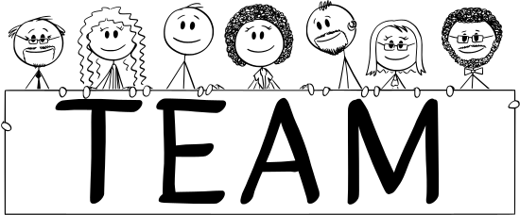

Nexus
Details:
Team Leader Name: P Mukesh Sai
Team Leader Mobile Number: 8008623582
Team Leader Email: mukesh19222326@gmail.com
No of Team Members: 3
  Other Team members details:
  - S.Somesh Kumar - P.Balaram Varma
Institute Name: Vignan's Institute Of Information Technology ,DUVVADA

Slide 3


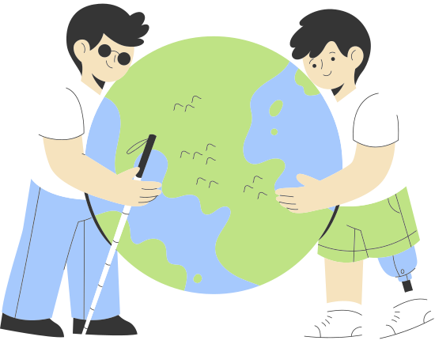

Voice Bridge and Making blind see the world
Millions of visually impaired individuals face significant challenges in accessing printed or digital content. This lack of access affects not only their education and employment opportunities but also their ability to engage in daily life independently.
Real-World Impact: According to the World Health Organization, over 285 million people worldwide are visually impaired, and nearly 90% of them live in low-income settings where assistive technologies are often unaffordable or unavailable. This highlights a pressing need for inclusive and cost-effective accessibility solutions.

Slide 4

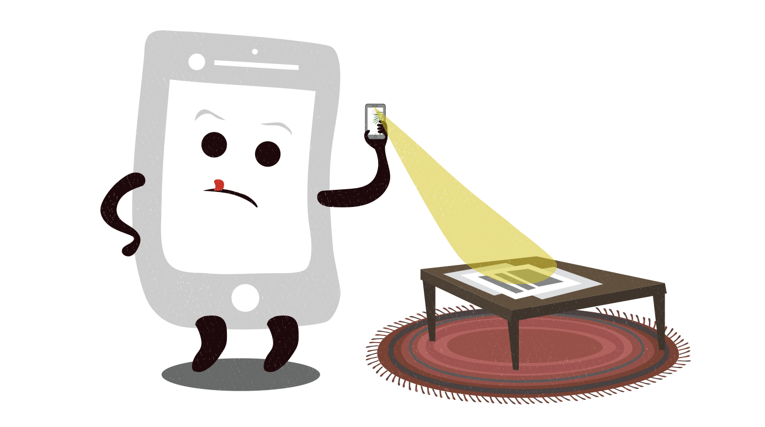

Solution Overview
To build an AI-powered system that transforms printed and digital text, live camera input, and environmental cues into expressive, natural-sounding speech in real time—enabling visually impaired individuals to navigate, read, and interact with their world effortlessly and independently.
Goal: Empower visually impaired users with seamless access to text from documents, images, live feeds, and various file formats while providing real-time navigation guidance and trusted-person identification—ultimately enhancing their independence, safety, learning, and quality of life.

Slide 5

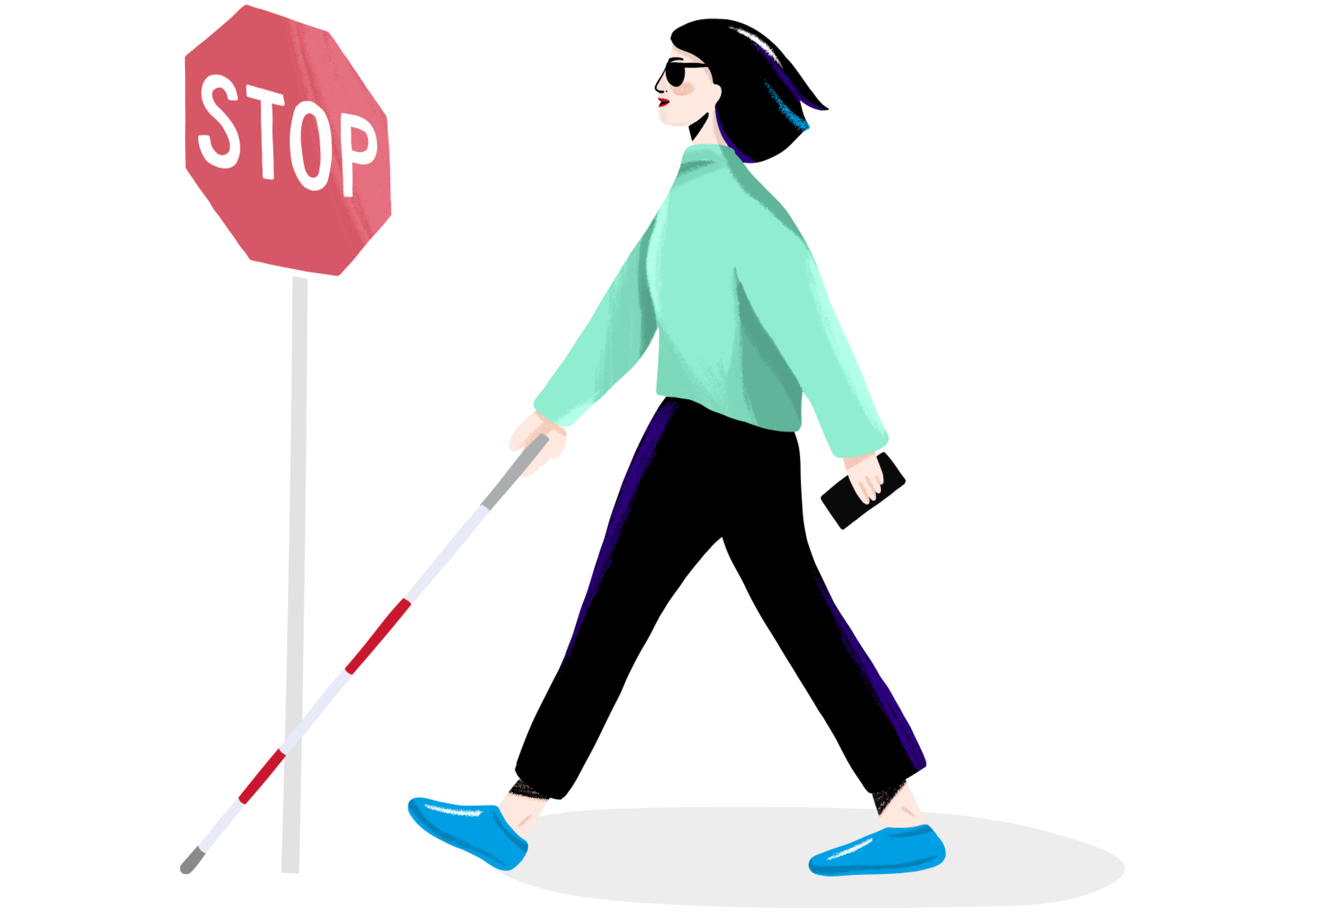


Motivation
Inspired by the challenges visually impaired individuals face in accessing everyday information—such as reading signs, books, documents, or digital screens—without assistance.
Existing tools are often costly, limited in features, or lack real-time interaction and natural, expressive voices.
Aiming to make accessibility affordable, effective, user-friendly, and highly customizable for various levels of visual impairment.
Driven by the desire to close the digital divide and promote inclusion through innovative, AI-powered assistive technologies.

Slide 6

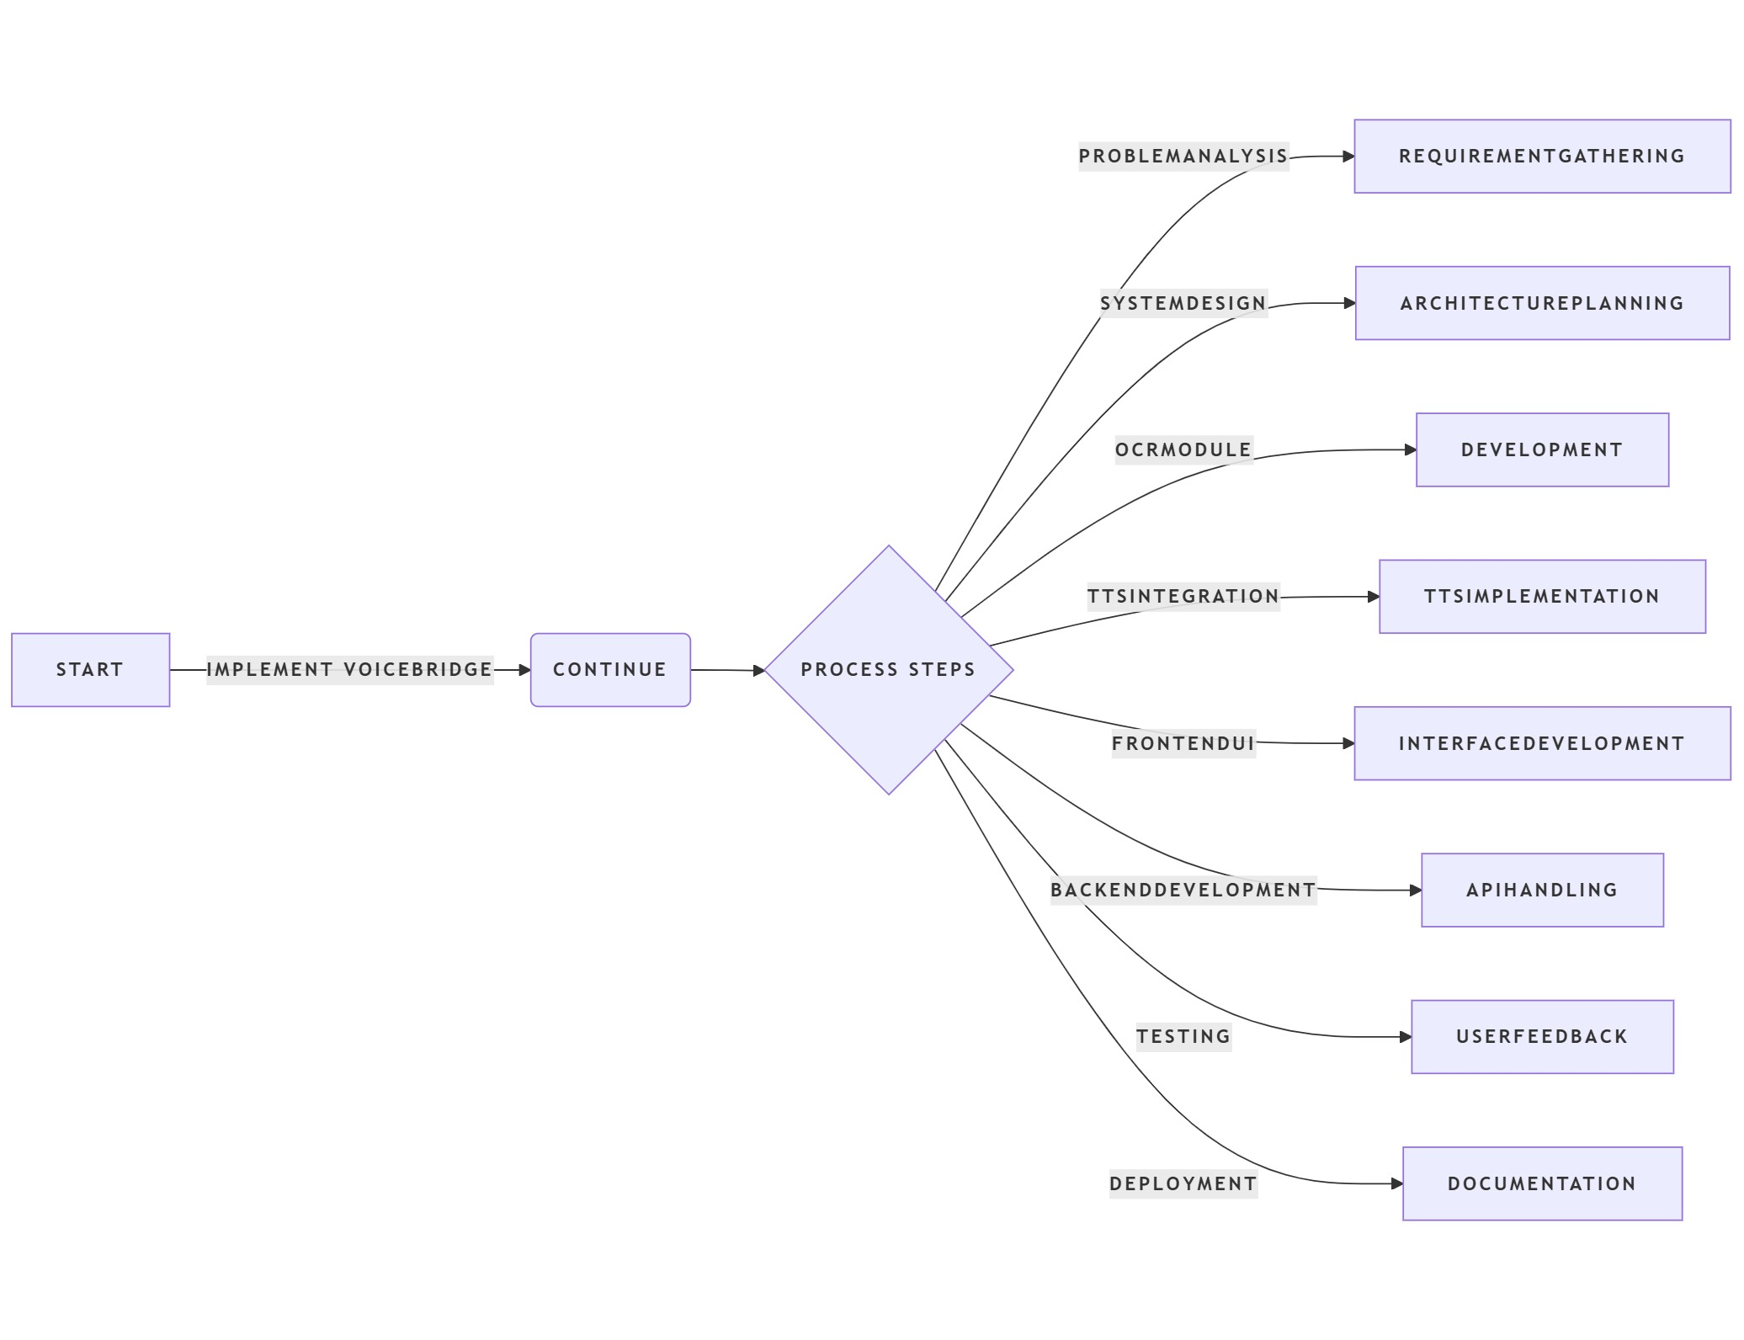

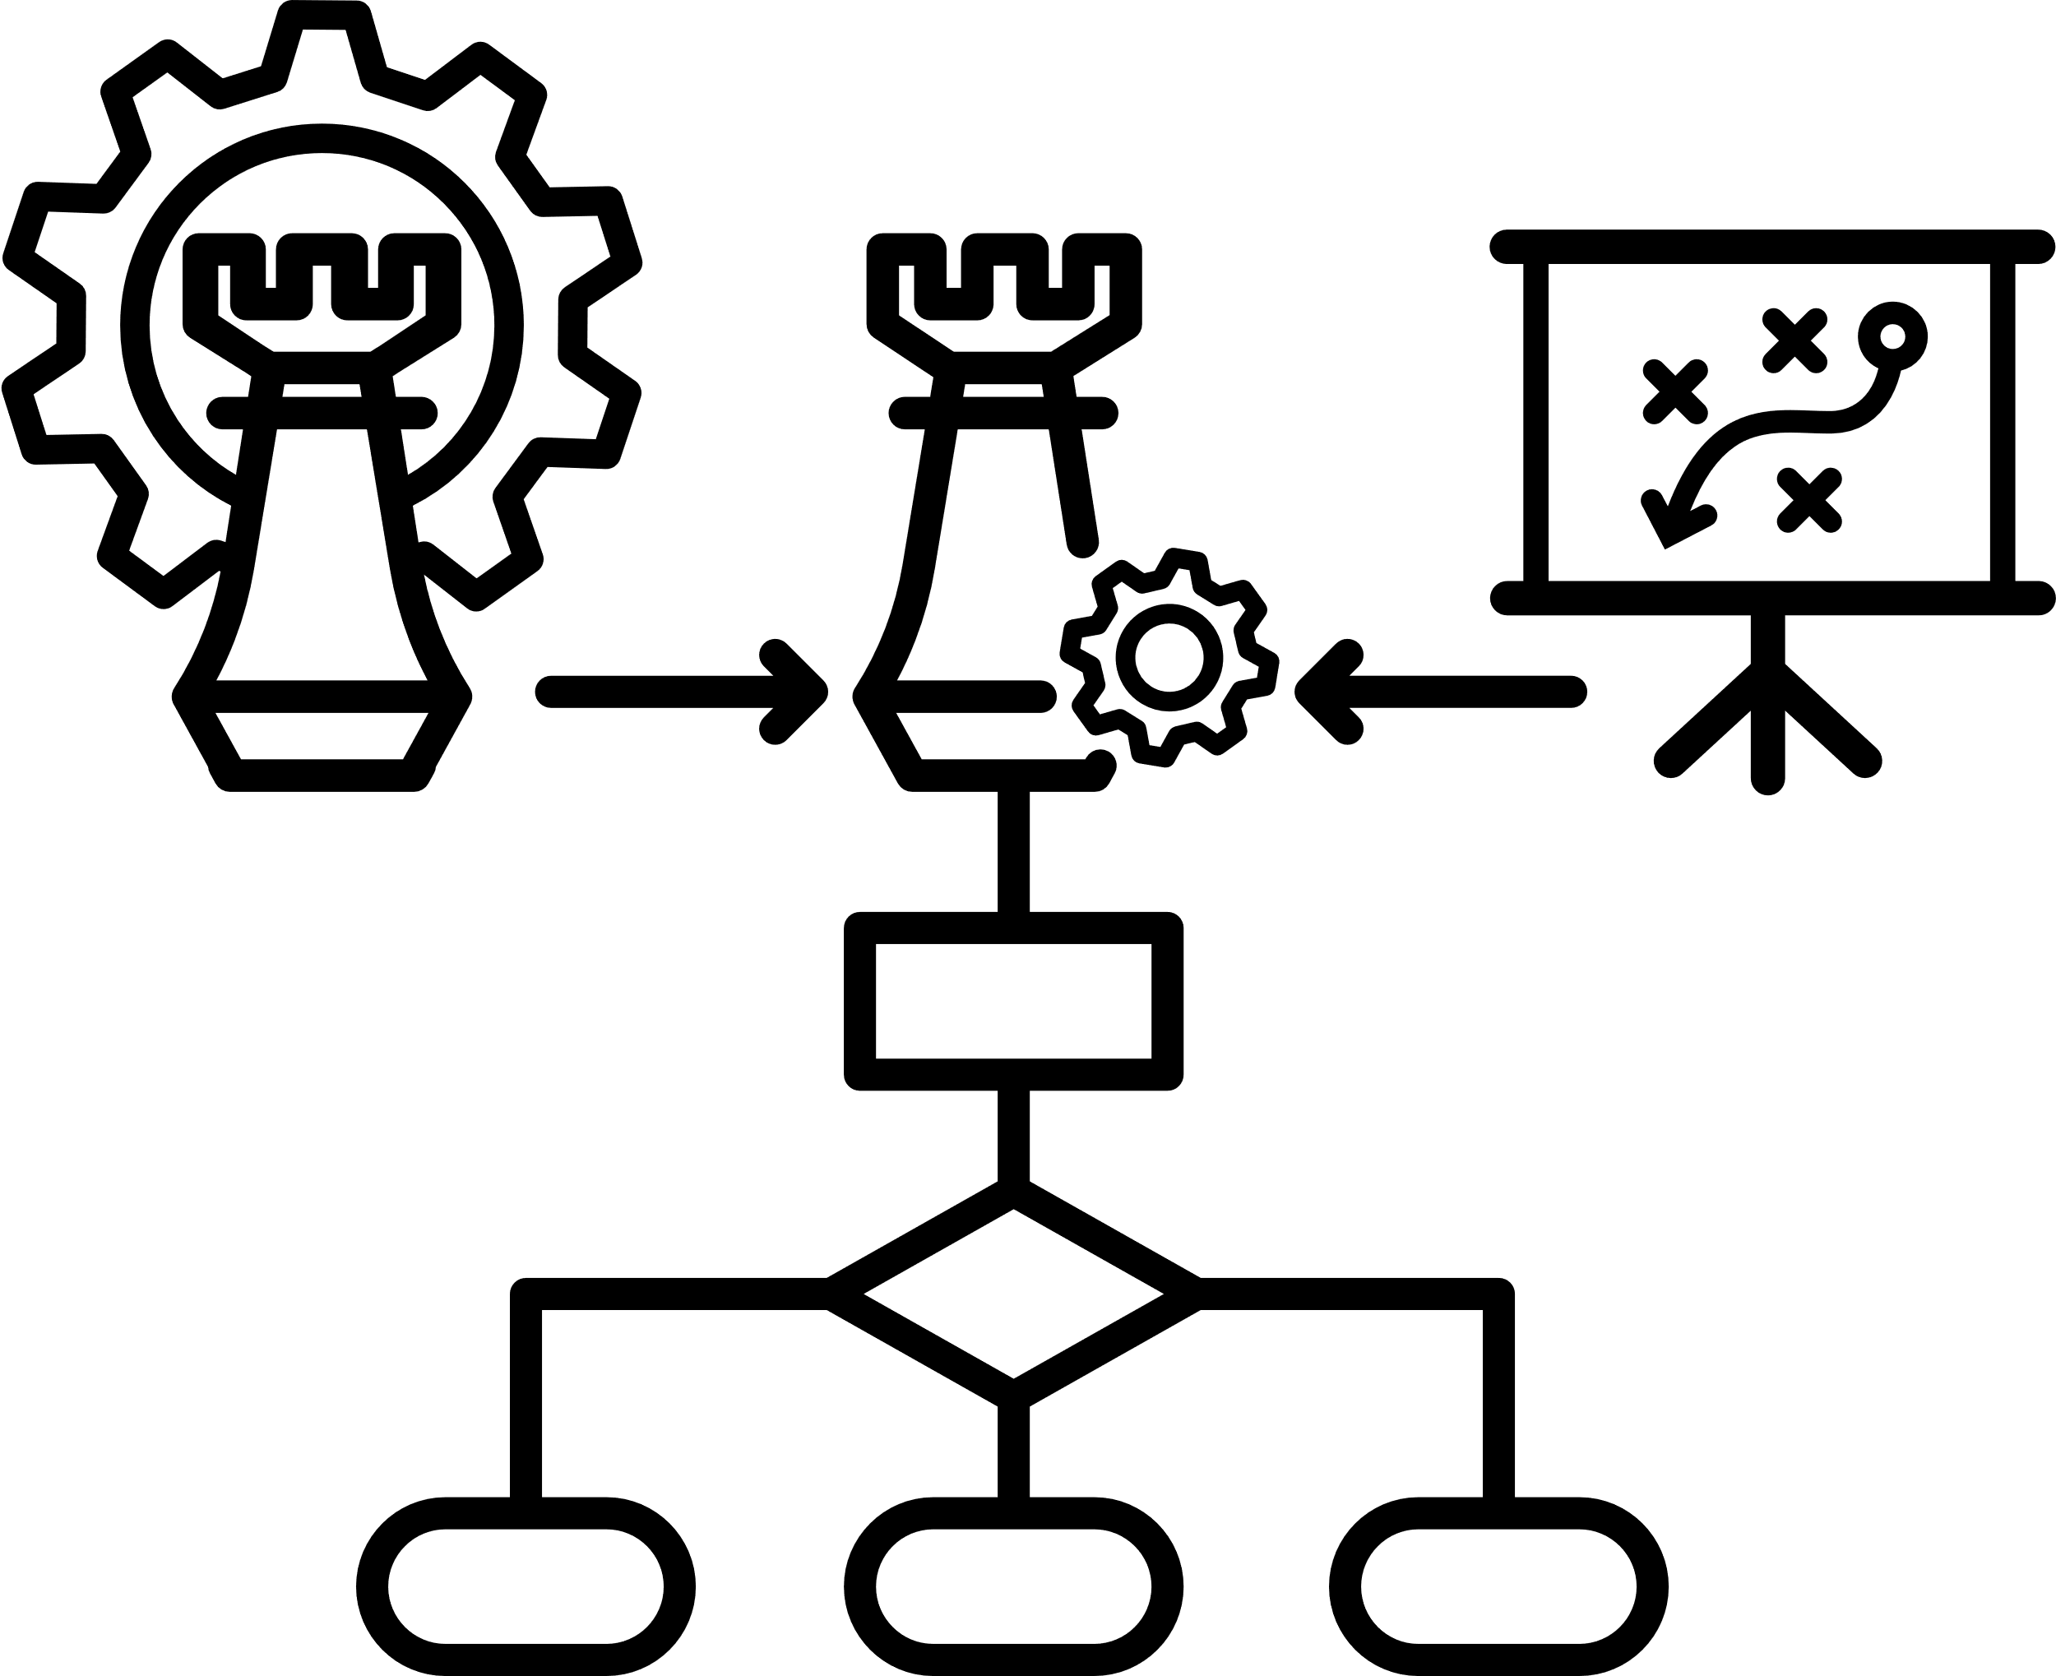

Methodology and process for implementation

Slide 7





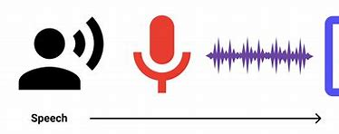

Tech Stacks
Backend: Python (Flask) – handles API requests, orchestrates OCR processes, and connects frontend with backend logic.
TTS: gTTS / pyttsx3 – Offline natural-sounding speech.
Web Speech API – Online expressive, adjustable speech.
Navigation: Geolocation API – Live location, Google Maps API / OSM – Route data & directions.
Frontend: HTML, CSS, JavaScript (for building a clean, accessible user interface that supports interaction and customization of voice output)
OCR: pytesseract, OpenCV – extracts and processes text from images and live camera feeds in multiple languages.
Face Recognition: dlib / face_recognition – Identifies known faces, MediaPipe – Enhances landmark tracking accuracy.

Slide 8


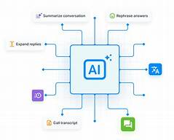


Future Scope
Integration with Braille Output Devices
Mobile App for On-the-Go Use
Cloud-Based Storage and History Tracking
AI-based Language Translation and Summarization
Voice Command Interaction for Hands-Free Operation
Contextual Text Understanding
AR-enabled smart navigation through enhanced spectacles
Educational tools with math and diagram recognition

Slide 9
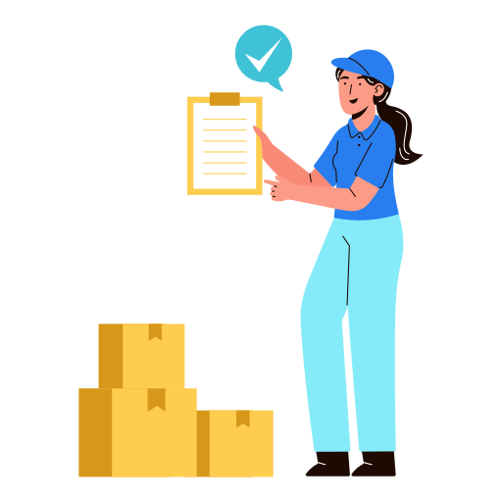

Completion Status
Current Project Stage
Prototype:
The project is in the prototype stage. Core features are implemented and testable via web interface, but not yet packaged as a full Android application.
Finished Milestones:
Voice Assistant: Wake word detection, voice command handling, speech synthesis/recognition.
Navigation: Google Maps integration, real-time location tracking.
Text Reading: Webcam capture, OCR, text-to-speech.
Face Recognition: Training and live detection with voice announcements.
Accessibility & UI: Large buttons, colorful animated design
Pending Tasks:
Android App Development
Voice Assistant Improvements
Braille Touch Integration
Advanced Accessibility

Slide 10
THANK YOU!
FROM
NEXUS

