Slide 1


JAVA
Parking Management System
Name –

Slide 2
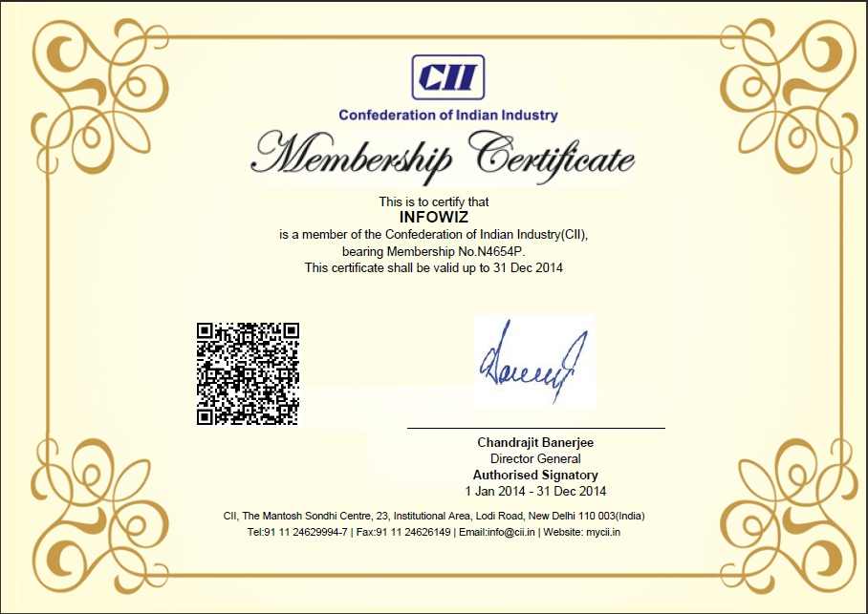

Slide 3
What is Java?
It is an object-oriented language developed by Sun in the mid 1990s.
Original language called Oak
Intended for embedded systems
Unlike C++, it was developed from scratch.
The syntax is very similar to C.
Sun describes it as
"A simple, object-oriented, distributed, interpreted, robust, secure, architecture neutral, portable, high-performance, multi-threaded and dynamic language."

Slide 4
What is Java? (cont)
Object-Oriented
Designed to support Object-Oriented concepts
However, does contain non-Object-Oriented primitive data types
Distributed
Applications are constructed using objects. Objects can be distributed in multiple locations within a network environment.
Extensive integration with TCP/IP
Interpreted
Java compiles to byte-code (not machine code). Byte code is interpreted.
Most Java versions after 1.2 include a JIT (Just-In-Time) compiler which compiles byte code to machine code.

Slide 5
What is Java? (cont)
Robust
Memory management is done automatically
Use of pointers is limited
Secure
All Java code subject to security model.
Architecture-Neutral/Portable
Compiled Java (byte code) will run on any platform which has a Java Virtual Machine
The Java Virtual Machine is available for almost all platforms...
Even mainframes.

Slide 6
Platform Independence. How does Java do it?
Java has been described as WORA (Write once, Run Anywhere)
In most cases, this is true.
Not always true with GUI.
Doesn't always come for free. Can require a lot of testing.
Because Java source code is compiled to byte code and the byte code is interpreted, Java code can be executed anywhere an interpreter is available.
The "Interpreter" is call the Java Virtual Machine

Slide 7
The Java Virtual Machine.
Traditionally, source code had to be compiled for the target hardware and OS platform:
Windows
Compiler
i386 binary
Solaris
Compiler
SPARC binary
Source.cpp
Mac
Compiler
PPC binary

Slide 8
The Java Software Development Kit (SDK)
The Java SDK comes in three versions:
J2ME - Micro Edition (for handheld and portable devices)
J2SE - Standard Edition (PC development)
J2EE - Enterprise Edition (Distributed and Enterprise Computing)
The SDK is a set of command line tools for developing Java applications:
javac - Java Compiler
java - Java Interpreter (Java VM)
appletviewer - Run applets without a browser
javadoc - automated documentation generator
jdb - Java debugger
The SDK is NOT and IDE (Integrated Development Environment)
Command line only. No GUI.

Slide 9

Abstract:The main objective of this project is to avoid the congestion in the car parking area by implementing a parking management system. Normally at public places such as multiplex theaters, market areas, hospitals, function-halls, offices and shopping malls, one experiences the discomfort in looking out for a vacant parking slot, though it’s a paid facility with an attendant/ security guard. The parking management system is proposed to demonstrate hazel free parking for 32 cars, with 16 slots on each of the two floors. The proposed system uses 32 infrared transmitter-receiver pairs that remotely communicate the status of parking occupancy to the microcontroller system and displays the vacant slots on the display at the entrance of the parking so that the user gets to know the availability /unavailability of parking space prior to his/her entry into the parking place. In this system the users are guided to the vacant slot for parking using Bi-colored LEDs and the ultrasonic sensors enable the drivers to park the vehicle safely. The parking charges are automatically deducted from the user’s account using RFID technology. From security point of view a daily log-book of entry/exit along with the vehicle details is also registered in the computer’s memory.Implementation of concept of green communication and exception handling facility make the system concept unique and innovative.
Keywords: parking management system, RFID-tags, ultrasonic sensors, green communication

Slide 10
Introduction
Now days in many public places such as malls, multiplex systems, hospitals, offices, market areas there is a crucial problem of car parking. The car-parking area hasmany lanes/slots for car parking. So to park a car one has to look for all the lanes. Moreover this involves a lot of manual labour and investment. So there is a need to develop an automated parking system that indicates directly the availability of vacant parking slots in any lane right at the entrance. The project involves a system including infrared transmitter- receiver pair in each lane and an LED/ LCD display outside the car parking gate. So the person desirous to park his vehicle is well informed about the status of availability of parking slot.Conventional parking systems do not haveany intelligent monitoring system and the parking lots are monitored by security guards. A lot of time is wasted in searching vacant slot for parking and many a times it creates jams. Conditions becomeworse when there are multipleparking lanes and each lane with multiple parkingslots. Useofparking management system would reduce the human efforts and time with additional comfort. In the proposed system, the display unit and the LEDsindicate the status of the parking lanes viz. a GREEN LED indicates a vacant slotand a RED LED indicates the unavailability. The system would not only save time but the software and hardware would also manage the Check-in and check-outs of the cars under the control of RFID readers/ tags with additional features of automatic billing, green communication, entry/exit data logging and obstacle indication during parking using ultrasonic sensors.

Slide 11
Literature Survey
The concept of the automated parking system is driven by two factors: need for parking space and scarcity of available land.The earliest use of an Automated parking system(APS) was in Paris, France in 1905 at the Garage Rue de Pontius[1].The APS consisted of a groundbreaking multi-story concrete structure with an internal elevator to transport cars to upper levels where attendants parked the cars[2]. In the 1920s, a Ferris wheel-like APS (for cars rather than people) called a paternoster system became popular as it could park eight cars in the ground space normally used for parking two cars. Mechanically simple with a small footprint, the paternoster was easy to use in many places, including inside buildings. In 1957, 74 Bowser, Pigeon Hole systems were installed, and some of these systems remain in operation. However, interest in APS in the U.S. waned due to frequent mechanical problems and long waiting times for patrons to retrieve their cars[3]. Interest in APS in the U.S. was renewed in the 1990s, and there are 25 major current and planned APS projects (representing nearly 6,000 parking spaces) in 2012 [4]. While interest in the APS in the U.S. languished until the

Slide 12
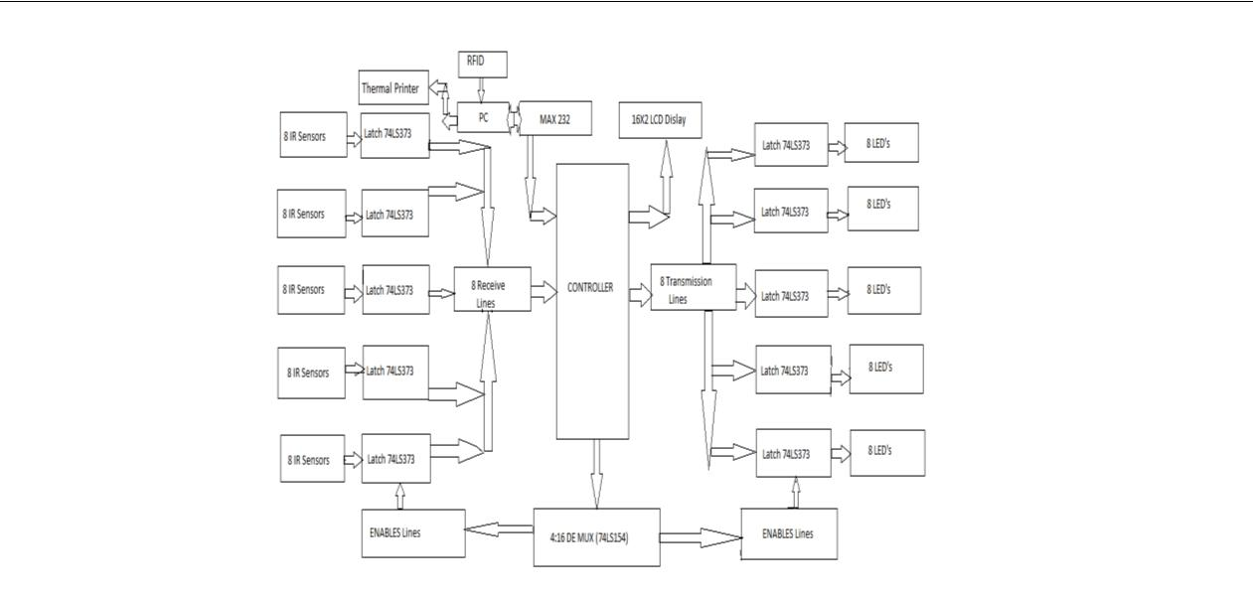

Slide 13
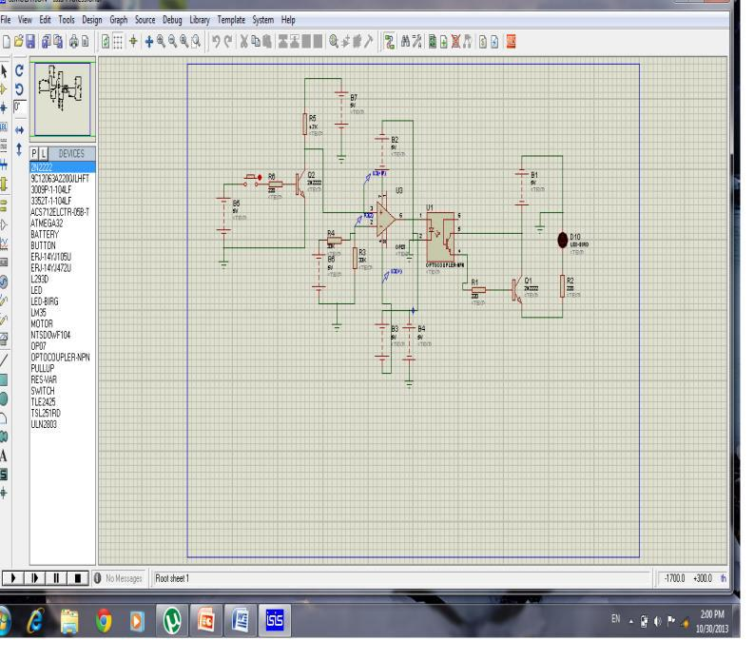

Slide 14
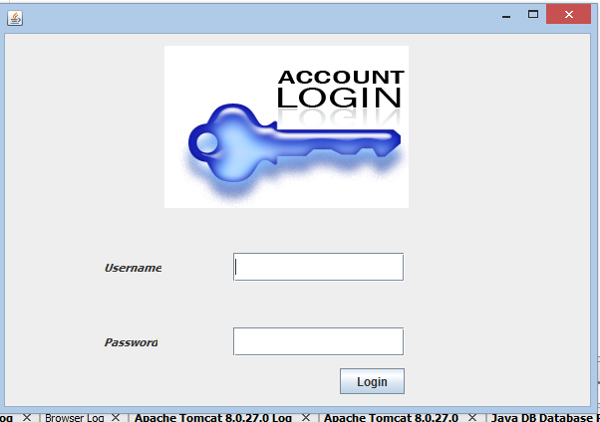

Slide 15
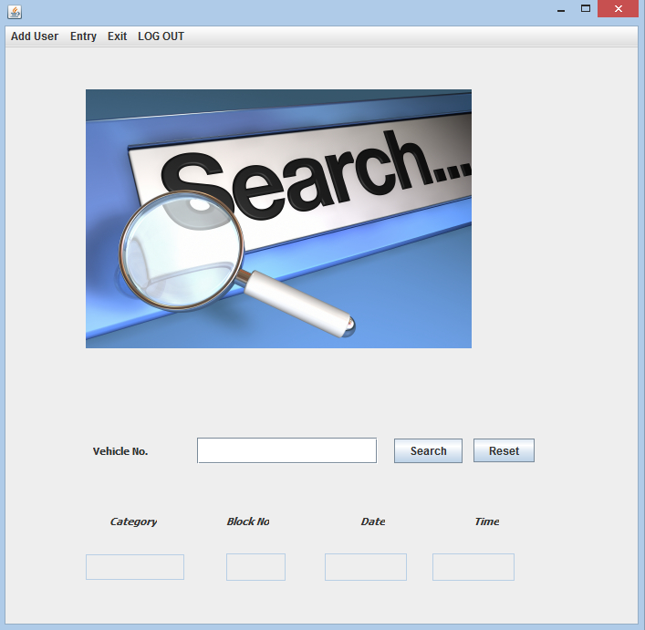

Slide 16
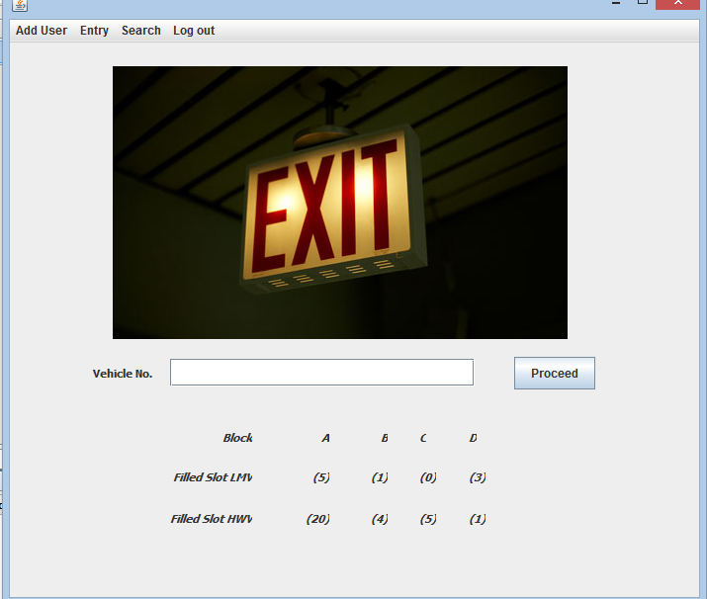

Slide 17
