Slide 1

Computer Engineering Department
A.P. Shah Institute of Technology
G.B.Road,Kasarvadavli, Thane(W), Mumbai-400615
UNIVERSITY OF MUMBAI
Academic Year 2019-2020

Slide 2
A Project Report on
Product Comparison System
Submitted in partial fulfillment of the degree of
Bachelor of Engineering(Sem-7)
in
Computer Engineering
By
Mukesh Singh(15102041)
Radheshyam Yadav(15102048)
Raj Surve(16202015)
Under the Guidance of
Prof. Sukhada Aloni

Slide 3
1.Project Conception and Initiation

Slide 4
1.1 Abstract
In this large growing e-commerce industry there are so many products with different brand’s price range are available in e-commerce store such as Amazon, flipkart, snapdeal, etc. e-commerce websites there may be some seasonal offers on product or on that store due to which price may vary. In this busy digital environment searching about same product in different e-commerce websites may be time consuming for consumers to ease that effectively and efficiently we are creating a Product Comparison System named as buy smart which will compare product price from different e-commerce websites with their offers and current availability

Slide 5
1.2 Objectives
The primary objective is to build a system to compare product prices and accordingly show their availability with a respective portal’s buy link.
To provide a platform to different users to buy products online .
To use a single website to view same product price and details from different websites at a same time .

Slide 6
1.3 Literature Review
A Price Comparison System Based on Lucene : DOI 10.1109/ICCSE.2013.6553894 : This paper presents a product price comparison oriented product search engine, inorder to show all possible prices of products for customers.
METHOD AND SYSTEM FOR PROVIDING ONLINE COMPARISON SHOPPING : The system provides online comparison shopping through a designated website accessible by a user via a communication network Such as the Internet. The method includes the steps of compiling a shopping list identifying specific items to be purchased.

Slide 7
1.4 Problem Definition
Current comparison system does not show the availability of product, user has to go to the actual shopping site to check whether the product is deliverable to user's locations or it is in stock or not.

Slide 8
1.5 Scope
Our project will provide the availability of product directly rather than checking availability on particular shopping site
It will help user to compare product’s details from different shopping sites.

Slide 9
1.6 Technology stack
PHP
Javascript
NodeJS
MySql

Slide 10
1.7 Benefits for environment & Society
Instead of browsing multiple shopping sites user can access them by using one webportal .
It will save user’s time and data .

Slide 11
2. Project Design

Slide 12
2.1 Proposed System
Our system will show the availability status of product.
Once, the link of shopping site is pressed it will directly rediect to user’s respective account user wont need to enter its login-id again.

Slide 13
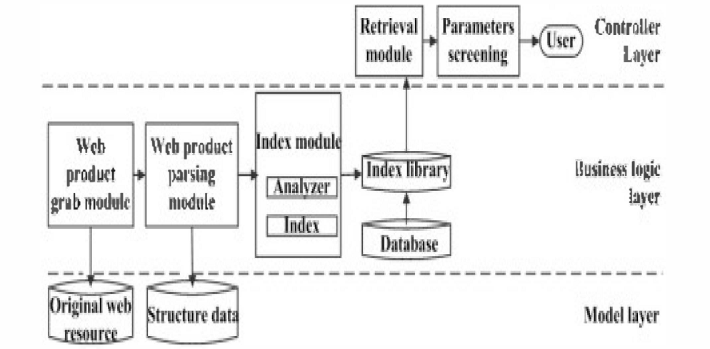
2.2 Design(Flow Of Modules)

Slide 14
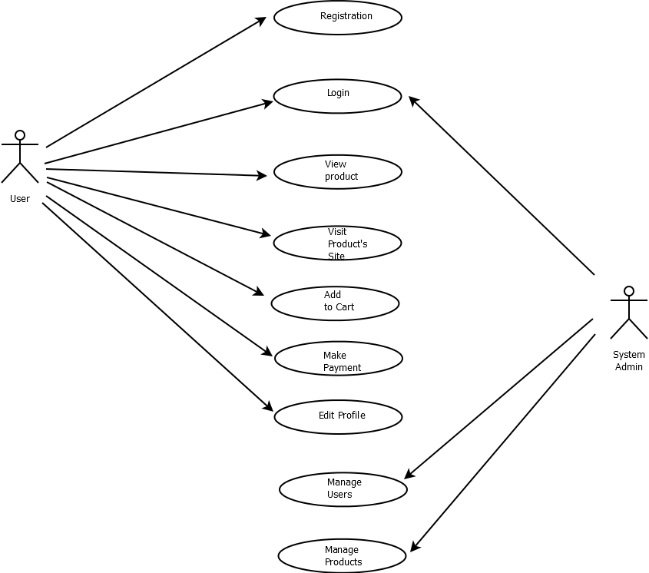
2.3 Description Of Use Case

Slide 15
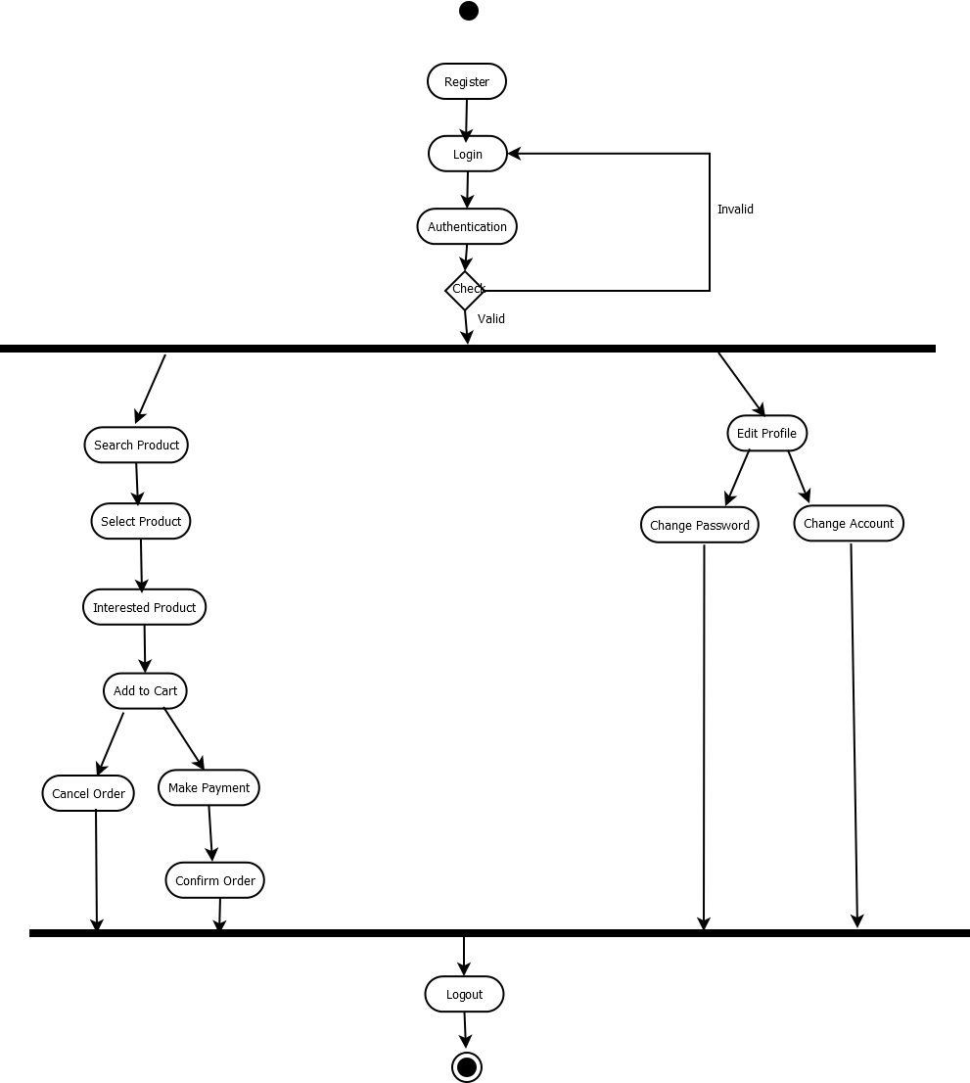
2.4 Activity diagram

Slide 16
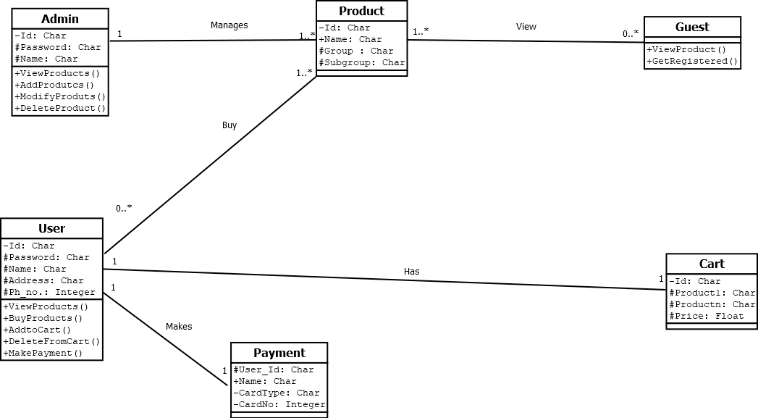
2.5 Class Diagram

Slide 17
2.6 Module-1
Stores User Info in Database from Input Form

Slide 18
Module-2
It will define User Interface in which user will be able to search and compare product prices

Slide 19
Module-3
It will redirect to the respective shopping website after clicking on the buy link and user will be able to buy product through redirected website

Slide 20
2.7 References
A Price Comparison System Based on Lucene : DOI 10.1109/ICCSE.2013.6553894
Comparison-Shopping Services and Agent Designs
https://ieeexplore.ieee.org/Xplore

Slide 21
3.Planning for next semester

Slide 22
Planning
We are planning to extract data from various shopping sites using scraping method by using python library beautifulsoup 4 and iframe.

Slide 23
Thank You

