Slide 1
Online Quiz Application
HTML • CSS • JavaScript • Bootstrap
Mukesh Kumar

Slide 2
Introduction
A responsive web-based quiz application to test user knowledge using MCQs.

Slide 3
Objective
• Interactive quiz
• Score calculation
• Timer based questions
• Practical use of web technologies

Slide 4
Technologies Used
HTML
CSS
JavaScript
Bootstrap 5

Slide 5
Key Features
• MCQ based quiz
• Timer with sound effect
• Previous / Next navigation
• Score & rank system

Slide 6
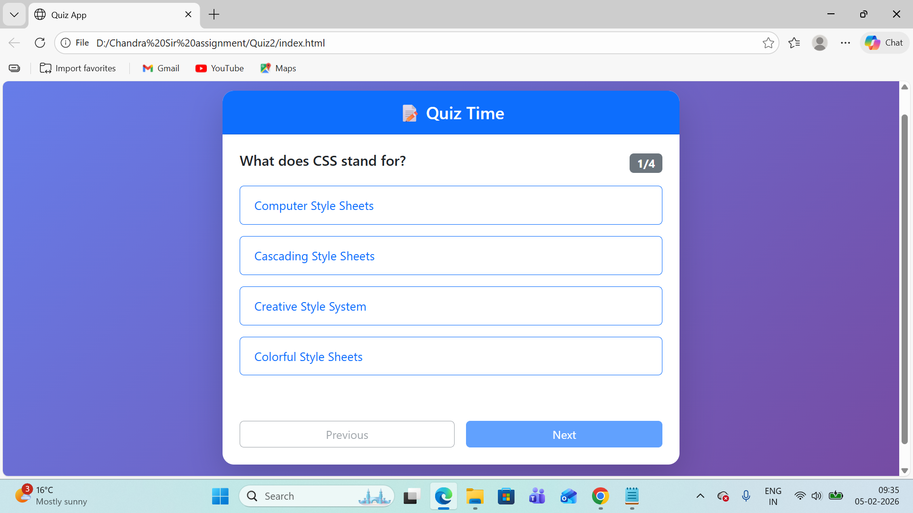
Quiz Question Screen

Slide 7
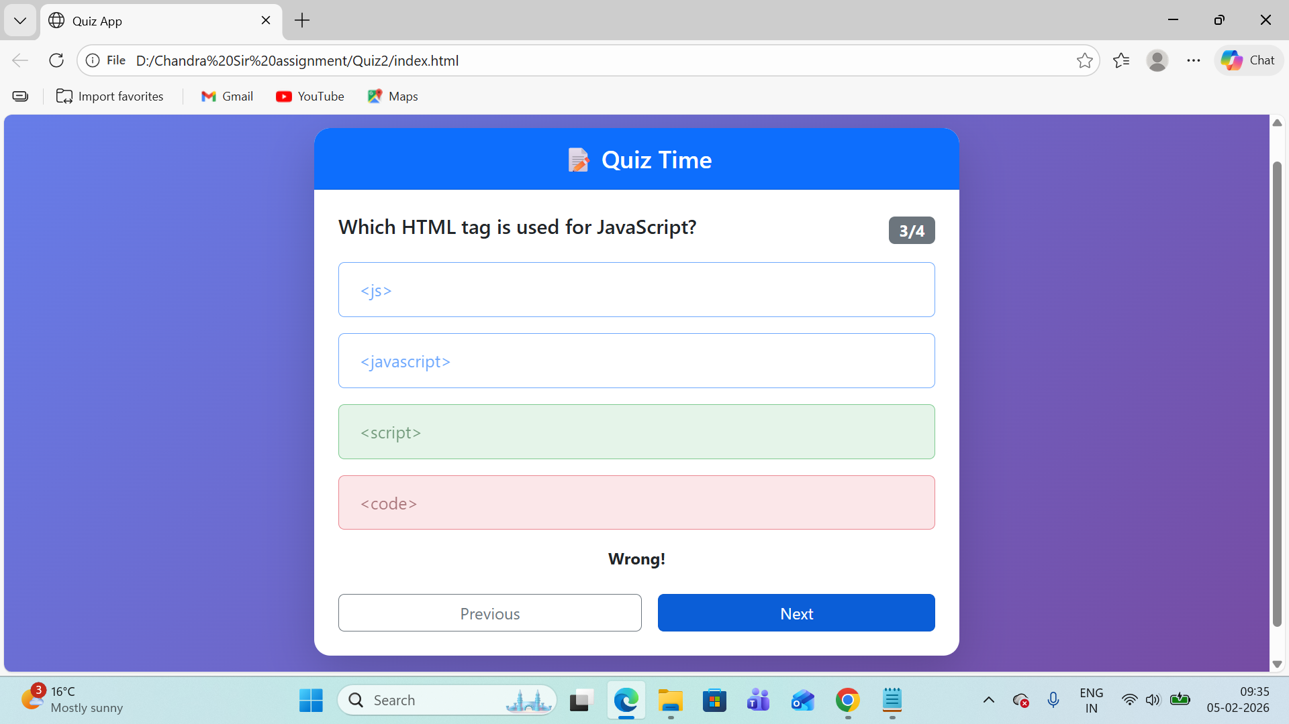
Answer Validation (Correct / Wrong)

Slide 8
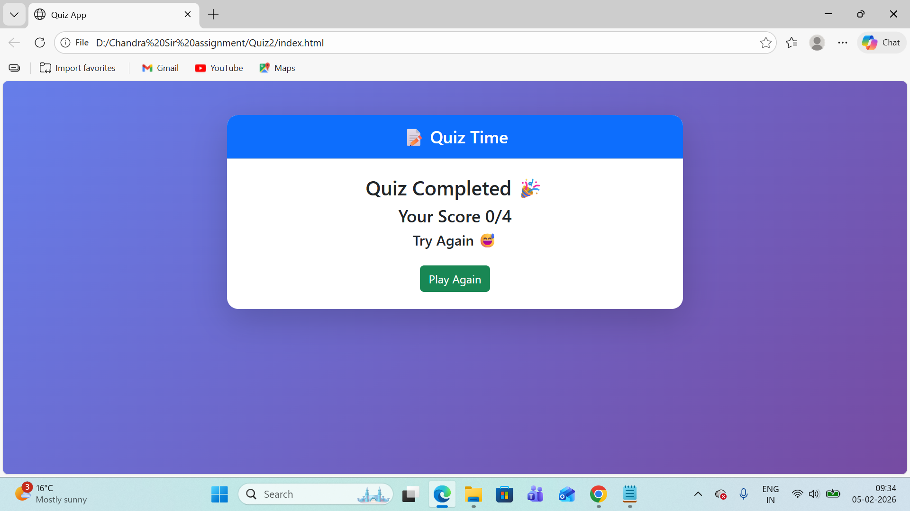
Final Result Screen

Slide 9
JavaScript Logic
• Question array
• Timer & sound logic
• Score calculation
• Dynamic DOM manipulation

Slide 10
Future Scope
• Login system
• Database integration
• More questions
• Admin panel

Slide 11
Conclusion
This project improved my understanding of frontend development using HTML, CSS, JavaScript and Bootstrap.

