Slide 1
CI/CD Pipeline Design
Databricks + AWS MWAA Multi-Environment Deployment

Slide 2
Agenda
• Overview & Objectives
• Environment Configuration
• CI/CD Architecture
• Branch Strategy & Workflow
• Deployment Pipeline Steps
• Approval Gates & Security
• Monitoring & Rollback
• Implementation Roadmap

Slide 3
CI/CD Objectives
• Automated Deployments
• - Push-based deployment to all envs
• - No manual intervention required
•
• Quality Assurance
• - Automated unit/integration tests
• - Code quality gates (lint, format)
• - Security scanning (CodeQL)
• Environment Isolation
• - Separate Databricks workspaces
• - Environment-specific configs
•
• Reliability & Safety
• - Automated rollback on failure
• - Manual approval for PROD
• - Audit trail for all deployments

Slide 4
Environment Configuration
Environment | Databricks Workspace | MWAA S3 Bucket | Catalog
DEV | dbc-xxx-dev.cloud.databricks.com | project-dev-mwaa-us-east-1 | pop_dev
QA | dbc-xxx-qa.cloud.databricks.com | project-qa-mwaa-us-east-1 | pop_qa
UAT | dbc-xxx-uat.cloud.databricks.com | project-uat-mwaa-us-east-1 | pop_uat
STG | dbc-xxx-stg.cloud.databricks.com | project-stg-mwaa-us-east-1 | pop_stg
PROD | dbc-xxx-prod.cloud.databricks.com | project-prod-mwaa-us-east-1 | pop_prod

Slide 5
Current CI/CD Architecture

Slide 6
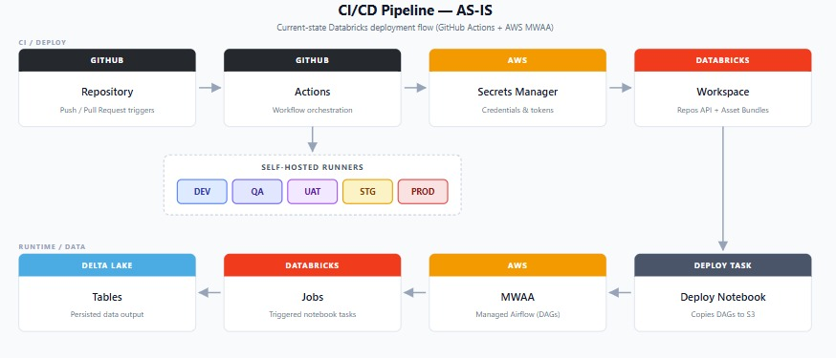
Current CI/CD Architecture

Slide 7
Branch Strategy
main (protected - release tags) │ └── prod ◀─────── Production (Release Manager approval) │ └── stg ◀─── Staging (Tech Lead approval) │ └── uat ◀── UAT testing (Tech Lead approval) │ └── qa ◀── QA integration (auto-deploy) │ └── dev ◀── Development (auto-deploy) │ └── feature/* ── Feature branches (PR)

Slide 8
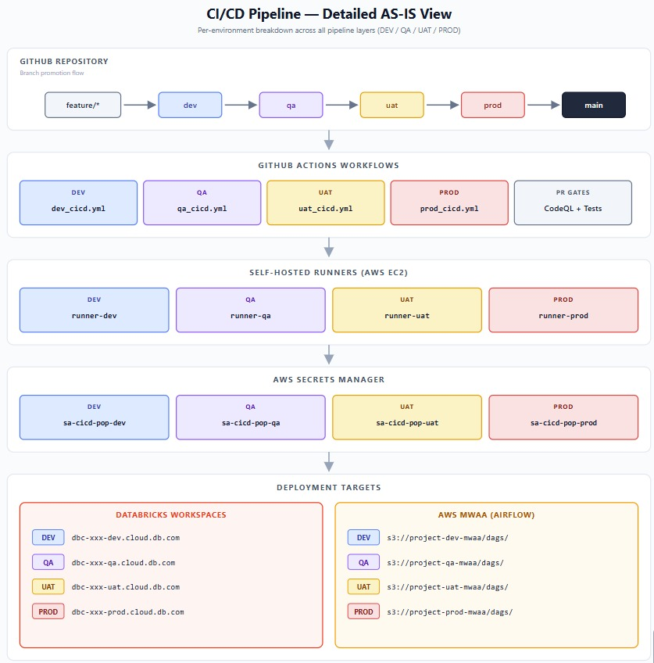
Workflow Components

Slide 9
Deployment Pipeline Steps
• 1. Checkout code from triggered branch
• 2. Set cluster configuration (environment-specific)
• 3. Fetch Databricks API token from AWS Secrets Manager
• 4. Backup current commit ID (for rollback capability)
• 5. Run unit tests (conditional based on environment)
• 6. Update Databricks workspace repo via REST API
• 7. Execute deployment notebook (copies artifacts to MWAA S3)
• 8. Deploy Databricks Asset Bundles (workflows, jobs)
• 9. Verify deployment success
• 10. Auto-rollback on failure (restore previous commit)

Slide 10
Approval Gates & Testing
Environment | Unit Tests | Integration | Manual Approval | Approvers
DEV | Optional | No | No | -
QA | Required | Yes | No | -
UAT | Required | Yes | Yes | Tech Lead
STG | Required | Yes | Yes | Tech Lead
PROD | Required | Yes | Yes | Release Manager

Slide 11
Security & Secrets Management
• GitHub Secrets
• • DATABRICKS_DEV_HOST
• • DATABRICKS_DEV_REPO_ID
• • DATABRICKS_QA_HOST
• • DATABRICKS_UAT_HOST
• • DATABRICKS_STG_HOST
• • DATABRICKS_PROD_HOST
• AWS Secrets Manager
• • sa-cicd-pop-dev
• • sa-cicd-pop-qa
• • sa-cicd-pop-uat
• • sa-cicd-pop-stg
• • sa-cicd-pop-prod
•
• Contains: databricks-apikey

Slide 12
Monitoring & Rollback
• Monitoring
• • GitHub Actions dashboard
• • Databricks workflow runs
• • MWAA Airflow UI
• • CloudWatch logs
•
• Notifications
• • Email alerts on failure
• • Slack integration (optional)
• Automatic Rollback
• • Triggered on deploy failure
• • Restores previous commit
• • Notifies team
•
• Manual Rollback
• • Via Databricks Repos API
• • Git revert + push
• • scripts/rollback.sh

Slide 13
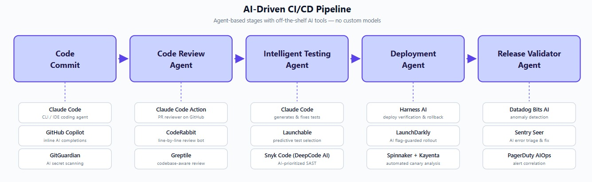
Future State AI-Driven CI/CD Overview
Continuous Monitoring
Predictive Alerts
Drift detection
Cost Optimizer
Self Healing

Slide 14
Thank You

