Slide 1
Weekly Status Report (WSR):
Pop Advyzer Modernization
Jun 05, 2026

Slide 2
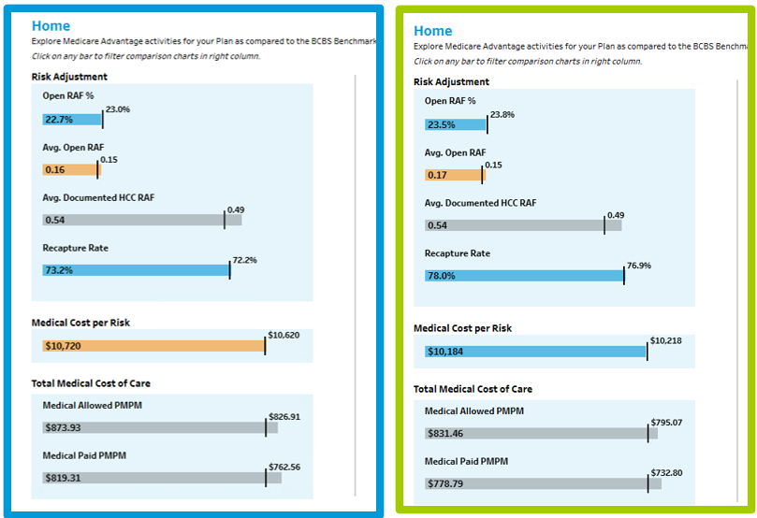


MA Analytics Dashboard – Cloud PopA
MA analytics Dashboard powered by Cloud PopA engine reached go-live, next refresh would be April 2026 BDR data
CLOUD ON_PREM
Achieved a major milestone with dashboard validation showing highly consistent results and strong performance in Tableau.
The cloud pipeline is delivering beyond expectations, reinforcing confidence in a scalable and modern analytics foundation.
Notes:
14- 12 completed and 2 are in progress(low & moderate)
29 – 80% are fixed, 20% are in progress(25, 4 in progress)

Slide 3
Population Advyzer Cloud Migration – Current Status & Planned Tasks
Planned Tasks & Timeline
Complete Open Items [UAT] : June 2025 [On Track - QA Complete]
Supplemental [With Interim Rules] Validation Complete : End of June [On Track - DEV]
MA pipeline in Production + Supplemental Dashboard [UAT] : July [On Track - DEV]
Dashboards With Supplemental [With Golden Rules] in Production : End of August [Yet to start]

Slide 4
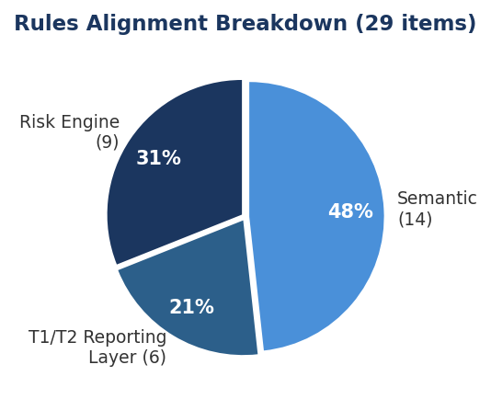
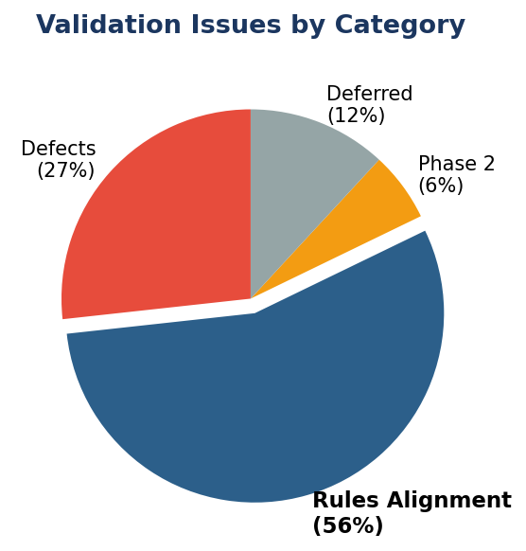
Retrospective — Timeline Drivers & Overall Gains
Issue Category | Count | % of Total
Defects | 14 | 27%
Rules Alignment | 29 | 56%
Phase 2 | 3 | 6%
Deferred | 6 | 12%
Total | 52 | 100%
Overall Gains
Engine Run Time: 1+ week (legacy) → 2 days (cloud)
Transparency: Rules documented; intermediate outputs auditable
Flexibility: Majority of rules driven by reference data — configurable without code changes
Supplemental Data: New capability to process supplemental data sources
Semantic Layer: Cost & Utilization aligned with enterprise Semantic Layer
Provider SAM: Provider information sourced from standardized SAM module
Rules Alignment Examples (29 items – 56%):
Risk Engine: Claim decay logic, multi-claim selection,
Chronic HCC Flag – SubCC VS HCC level
T1/T2: Additional claim count and diagnosis count rules
Semantic: ER visit definitions and stay logic differ
Defect Examples (14 items -27% ):
Suspect status flags inconsistent with open risk values
Eligible members in T1/T2 missing from upstream Risk_Member output
Recommendations to reach the finish line
Finalize business rules
Establish validation criteria upfront
Prioritize features driving the functionality

Slide 5
June Release
Suspecting engine priority backlog(Jun)
Add Disease Interaction rows for Suspected GAPs (ready for UAT)
Add HCC Count Payment rows for Suspected GAPs(ready for UAT)
Include additional 5 ICD Procedure Codes in addition current Principal Procedure code for Method 10 GAP Suspecting(QA)
Apply HCC Suppression for GAPs suspected across all methods for a given member, year & version.(QA)
Use Chronic DIAG code instead of Chronic HCC for method 4 suspecting.(QA)
Supplemental data pipeline needs to be finalized, including(June):
MMR, MAO - UAT of scoring for 2 plans(370, 030) (interim rules)
Creation of T1, T2 metrics (MLR, chart review, recapture, segment flags)

Slide 6
Jul Release
Supplemental data pipeline:
Creation of BI layer
Connection to tableau and testing of new tableau
Final MMR ‘golden record’ transformation, testing, integration
Pipeline stabilization steps to streamline refresh execution
Automated QA steps need to be developed and implemented
Determine refresh strategy (e.g., rerun all three years or subset)

Slide 7
Thank you Mukesh Kumar Technical Lead

