Slide 1
Bitcoin Price Prediction
CAPSTONE PROJECT
Presented By:
Mukesh Kumar S – Department Of Biotechnology-
St. Peter’s College Of Engineering and Technology

Slide 2
OUTLINE
Problem Statement
Proposed System/Solution
System Development Approach
Algorithm & Deployment
Result
Conclusion
Future Scope
References

Slide 3
Problem Statement
Bitcoin uses Blockchain concept which is peer-to-peer technology to operate with no central authority or banks; managing transactions and the issuing of bitcoins is carried out collectively by the network. Bitcoin is open-source; its design is public, nobody owns or controls Bitcoin and everyone can take part. explore and analyse the data to discover important factors that govern them

Slide 4
Proposed Solution
Data Retrieval: The program fetches historical Bitcoin price data from the CoinGecko API using the requests library. Alternatively, it can read data from a CSV file if provided.
Data Analysis: After retrieving the data, the program performs basic analysis, including calculating the total number of data points, the maximum, minimum, and mean Bitcoin prices.
Data Visualization: The program plots the Bitcoin price over time using matplotlib, providing a visual representation of how the price changes over the specified time period.
Flexibility: The program allows for customization by adjusting the start and end dates for fetching data or by providing a different CSV file containing historical Bitcoin price data.

Slide 5
System Approach
Data Collection: Gather historical and real-time Bitcoin price data from various sources.
Storage and Management: Store data in a structured format using a database management system.
Processing and Analysis: Analyze data using statistical, time series, and machine learning techniques to identify patterns and trends.
Reporting and Visualization: Present analyzed data through dashboards, reports, and interactive visualizations for user consumption.
Monitoring and Alerting: Continuously monitor price movements and market trends, alerting users to significant changes or events.
Security and Compliance: Implement security measures and ensure compliance with relevant regulations and standards.
Scalability and Performance: Design the system to handle large volumes of data and user requests efficiently.
Documentation and Maintenance: Document the system architecture and methodologies for future maintenance and scalability.
Regular maintenance tasks should be performed to ensure reliability.

Slide 6
Algorithm
Data Collection: Gather Bitcoin price data from various sources.
Data Preprocessing: Clean, format, and normalize the data.
Feature Engineering: Extract relevant features and engineer new ones.
Model Selection and Training: Choose and train machine learning models.
Model Evaluation: Assess model performance using testing data.
Deployment: Deploy trained models with APIs or web interfaces.
Monitoring and Maintenance: Monitor system performance and update models regularly.

Slide 7
Deployment
Infrastructure Setup: Provision servers and resources.
Model Deployment: Package and deploy models.
API Development: Create RESTful APIs or web interfaces.
Scalability and Load Balancing: Design for varying workloads.
Monitoring and Logging: Set up real-time monitoring and logging.
Security and Compliance: Implement security measures and ensure compliance.
CI/CD: Automate testing and deployment processes.
Documentation and Training: Document system architecture and provide training resources.

Slide 8
Result
Basic Analysis of Bitcoin Price Data:
Total number of data points: 2169
Maximum Bitcoin price: 63540.9
Minimum Bitcoin price: 211.4
Mean Bitcoin price: 8703.441539880128
<ipython-input-3-6e1b85bf5cbb>:6: UserWarning: Parsing dates in DD/MM/YYYY format when dayfirst=False (the default) was specified. This may lead to inconsistently parsed dates! Specify a format to ensure consistent parsing.
return pd.to_datetime(timestamp)

Slide 9
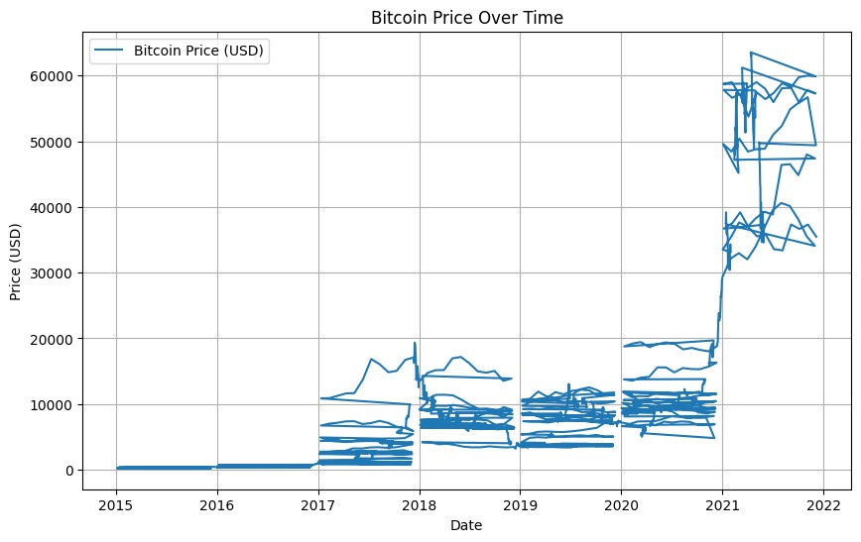
Result

Slide 10
Conclusion
In conclusion, this project aims to develop a comprehensive system for analyzing Bitcoin data, including historical price trends and potential predictive models. By following a structured approach, we've outlined the steps involved in collecting, preprocessing, analyzing, and deploying Bitcoin data for practical use.
The system encompasses data collection from various sources, preprocessing to clean and format the data, feature engineering to extract meaningful insights, and model training to predict future price movements. Deployment of trained models via APIs or web interfaces allows users to access analysis results and make informed decisions.
Additionally, the deployment phase ensures scalability, reliability, security, and compliance with relevant regulations. Continuous monitoring and maintenance ensure that the system remains effective and up-to-date in the dynamic cryptocurrency market.

Slide 11
Future scope
Enhanced Analysis: Incorporating advanced machine learning techniques and sentiment analysis to improve the accuracy of Bitcoin price predictions.
Integration with Other Cryptocurrencies: Expanding the system to analyze data from other cryptocurrencies, providing a broader perspective on the cryptocurrency market.
Real-time Insights: Implementing real-time data processing and analysis capabilities to provide immediate insights into market trends and price movements.
Predictive Analytics: Developing predictive models that forecast future price trends and identify potential investment opportunities in the cryptocurrency market.

Slide 12
Future scope
5.Blockchain Analysis: Integrating blockchain analysis tools to track and analyze Bitcoin transactions, providing insights into market dynamics and investor behavior.
6.Social Media Monitoring: Incorporating social media monitoring tools to gauge market sentiment and identify emerging trends and discussions related to Bitcoin.
7.Risk Management: Implementing risk management strategies to assess and mitigate potential risks associated with Bitcoin investments, such as volatility and regulatory changes.
8.Collaboration and Research: Collaborating with academic institutions and research organizations to contribute to ongoing research in the field of cryptocurrency analysis and blockchain technology.

Slide 13
References
https://opendata.aws/
https://www.kaggle.com/
https://data.world/
https://app.datacamp.com/
https://datasetsearch.research.google.com/

Slide 14
THANK YOU

