Slide 1
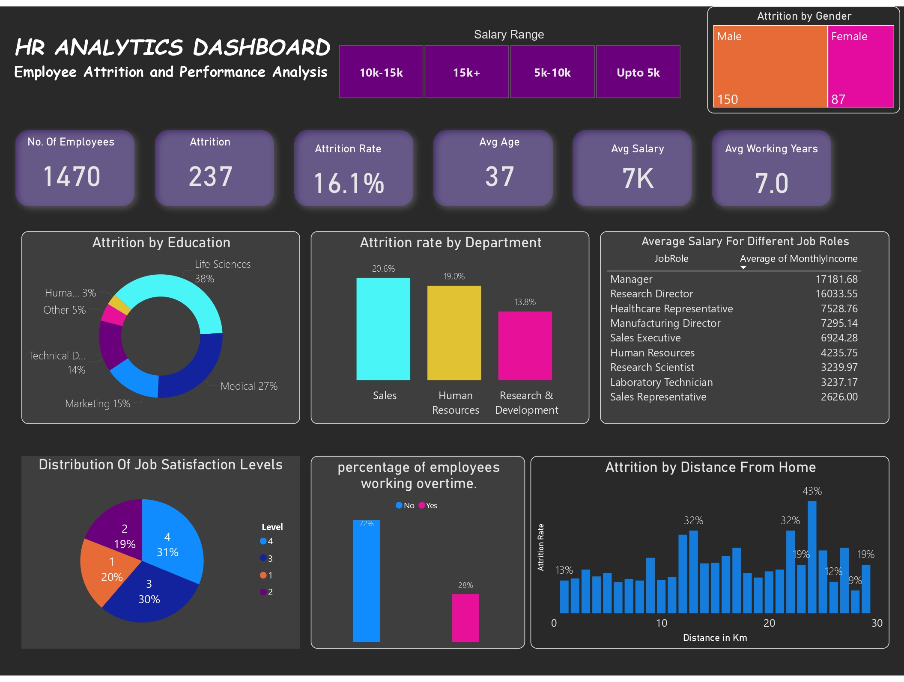

Slide 2
HR Analytics Dashboard - Employee Attrition Report
Key Insights and Recommendations

Slide 3
1. Attrition Rate by Department
Sales has the highest attrition rate (20.6%)
Human Resources (19.0%) and R&D (13.8%) follow
Sales and HR may have higher stress or job dissatisfaction

Slide 4
2. Job Satisfaction Levels
Only 31% rated highest satisfaction (4)
More than 39% have low satisfaction (1 or 2)
HR should investigate workplace issues impacting morale

Slide 5
3. Average Salary by Job Role
Managers ($17,181) and Research Directors ($16,033) earn highest
Sales Representatives and Lab Technicians earn the least ($2,626 - $3,237)
Salary gaps may impact retention in lower-paying roles

Slide 6
4. Attrition Rate by Distance from Home
Higher attrition for employees commuting 24-28 km (19%-43%)
The highest attrition (43%) is for employees at 24 km
Remote work or relocation assistance could reduce turnover

Slide 7
5. Overtime and Attrition
72% of employees do NOT work overtime
Those who work overtime (28%) have higher attrition risk
Companies should adjust work-life balance policies

Slide 8
Overall Business Recommendations
Improve Work-Life Balance: Reduce long hours & commuting strain
Enhance Employee Engagement: Address low job satisfaction
Review Compensation: Salary adjustments for low-paid roles
Targeted Department Strategies: Support Sales and HR employees

