Slide 1



High Level Architecture
Pdf to Text Extractor
Text Summarizer
Q&A System
Chatbot

Slide 2


Inference Architecture
Downloader
Cleaner
arXiv Search
Text Extractor
Query
Paper Title
PDF
Raw Text
Cleaned Raw Text
Paper URL
Summary Text
Text Summarizer
Cleaned Raw Text
Chat Text
Chatbot
Q&A Text
Question Answer
Cleaned Raw Text

Slide 3













AWS Summarizer Architecture
AWS CloudWatch
Elastic Beanstalk
Container
Amazon API Gateway
Text Extractor
SageMaker
User
Search arXiv
Clean Text
PDF Meta
PDF Meta
Mphasis Text Summarizer
Clean Text
Summary
200
Summary Text
Invoke Summary endpoint
Session Data
Session Data
Data Lake
Amazon Aurora
AWS Lambda
Amazon Simple Notification Service
Amazon Simple Storage Service

Slide 4

AWS Chat Architecture
AWS Step Functions workflow
Elastic Beanstalk
Container
Text Extract
Mphasis Text Summarizer
User
Search arXiv
Amazon API Gateway
PDF URL
PDF URL
Clean Text
Summary Text
Summary Text
Summary Text
Data Lake
Clean Text
Summary Text
Amazon Aurora
AWS Lambda
Amazon Simple Notification Service
Amazon Simple Storage Service

Slide 5
AWS CI/CD Architecture
AWS Step Functions workflow
Elastic Beanstalk
Container
Text Extract
Mphasis Text Summarizer
User
Search arXiv
Amazon API Gateway
PDF URL
PDF URL
Clean Text
Summary Text
Summary Text
Summary Text
Data Lake
Clean Text
Summary Text
Amazon Aurora
AWS Lambda
Amazon Simple Notification Service
Amazon Simple Storage Service

Slide 6
AWS Train Architecture
AWS Step Functions workflow
Elastic Beanstalk
Container
Text Extract
Mphasis Text Summarizer
User
Search arXiv
Amazon API Gateway
PDF URL
PDF URL
Clean Text
Summary Text
Summary Text
Summary Text
Data Lake
Clean Text
Summary Text
Amazon Aurora
AWS Lambda
Amazon Simple Notification Service
Amazon Simple Storage Service

Slide 7
Papyri Architecture
AWS Step Functions workflow
Elastic Beanstalk
Container
Text Extract
Mphasis Text Summarizer
User
Search arXiv
Amazon API Gateway
PDF URL
PDF URL
Clean Text
Summary Text
Summary Text
Summary Text
Data Lake
Clean Text
Summary Text
Amazon Aurora
AWS Lambda
Amazon Simple Notification Service
Amazon Simple Storage Service

Slide 8
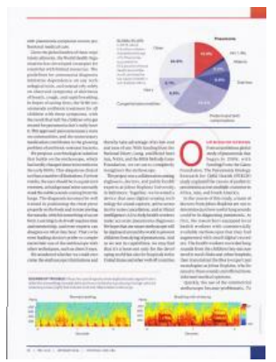
AWS Architecture
Layout Recognition
Page Segmentation
Region Classification
Text Recognition
Text Summarizer
Q&A System
Chatbot

Slide 9
Mithra OCR Architecture
Layout Recognition
Handwritten Recognition
Symbol Recognition

