Slide 1

Introduction to Data Analytics. Current Challenges. Course Outline.
Thilanka Munasinghe
Data Analytics
ITWS-4600/ITWS-6600/MATP-4450/CSCI-4960 BCBP-4960/MGM-4962/MGMT-6962
Group 1 Module 1, January 13th , 2020

Slide 2
Admin information
Class: ITWS-4600/ITWS 6600/MATP-4450/CSCI-4960
Dates: Tuesdays/ Fridays
Location: Section1 : VORHES SOUTH ; Time: 10am – 11:50am
Section2 : EATON - 215 ; Time: 2 pm – 3:50pm
Instructor: Thilanka Munasinghe
Instructor contact: munast@rpi.edu
Instructor office hours: Tue/Thurs 12:30pm – 1:30pm or by appointment via email
Instructor office location: Room 133, Amos Eaton building
TA: Mia Price; pricem4@rpi.edu
TA Office hours: TBA
Web site: LMS = http://lms.rpi.edu and see also Course Webpage: https://tw.rpi.edu/web/Courses/DataAnalytics/2020Spring
Schedule, lectures, syllabus, reading, assignments, etc.
Location of data and R script fragments, other documents - http://aquarius.tw.rpi.edu/html/DA/

Slide 3
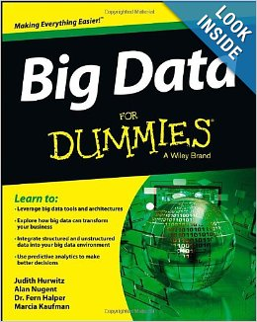
Contents
Intro – about this course
Learning objectives
Outline of the course
Definitions and why Analytics is more than Analysis
What skills are needed
What is expected

Slide 4
Assessment and Assignments
Via written assignments with specific percentage of grade allocation provided with each assignment
Via individual oral presentations with specific percentage of grade allocation provided
Via participation in lectures and labs (not to exceed 5% of total, start with 5% and lose % by not participating)
Late submission policy: first time with valid reason – no penalty, otherwise 20% of score deducted each late day. Talk to me EARLY if you are having schedule problems in completing assignments

Slide 5
Assessment and Assignments
Reading assignments
Are given when needed to support key topics or to complete assignments
Will not be discussed in class unless there are questions
You will mostly perform individual work that is assessed but you are encouraged to work with others in the lab sessions (except assignment 2)

Slide 6
Project options (examples)
Social networks
Financial
Social-economic, marketing
Network/ security data
Linked data
Competitions (Web and local)****
Movie databases
Transportation
Research Projects****
Research Projects & Competitions**** : Need the Instructor’s approval for the datasets
Notes:
Competitions**** : Need the Instructor’s approval.

Slide 7
Objectives
Introduce students to relevant methods to recognize and apply quantitative algorithms, techniques and interpretation
To develop students' strategic thinking skills, combined with a solid technical foundation in data and model-driven decision-making.
Develop ability to apply critical and analytical methods to formulate and solve science, engineering, medical, and business problems
In groups, students will identify qualitative problems and apply content analytics
Students will examine real-world examples to place data-mining techniques in context, to develop data-analytic thinking, and to illustrate that proper application is as much an art as it is a science.
Making decision under uncertainty, how to optimize models, sequential decision making, weak models, mixed models
By the end of the course, students can effectively communicate analytic findings to non-specialists

Slide 8
Learning Objectives
Through class lectures, practical sessions, written and oral presentation assignments and projects, students should:
Students to demonstrate knowledge of relevant analytic methods, and to recognize and apply quantitative algorithms, techniques and interpret results
Students to demonstrate strategic thinking skills, combined with a solid technical foundation in data and model-driven decision-making.
Students to develop ability to apply critical and analytical methods to formulate and solve science, engineering, medical, and business problems
Students will examine real-world examples to place data-mining techniques in context, to develop data-analytic thinking, and to illustrate that proper application is as much an art as it is a science.
Students must effectively communicate analytic findings to non-specialists.
[6600 level] Students must develop and demonstrate a working knowledge of decision making under uncertainty, be able to optimize models that incorporate random parameters: static stochastic optimization, two-stage optimization with recourse, chance-constrained optimization, and sequential decision making.

Slide 9
4450/ 4600/ 4960 versus 6600
6600 students are assessed at:
Higher level of demonstration
Additional questions or tasks in assignments
4450/4400/4960 students are welcome to complete these higher requirements for an extra grade
Extra points for outstanding/ above and beyond are given**

Slide 10
Academic Integrity
Student-teacher relationships are built on trust. For example, students must trust that teachers have made appropriate decisions about the structure and content of the courses they teach, and teachers must trust that the assignments that students turn in are their own. Acts, which violate this trust, undermine the educational process. The Rensselaer Handbook of Student Rights and Responsibilities defines various forms of Academic Dishonesty and you should make yourself familiar with these. In this class, all assignments that are turned in for a grade must represent the student’s own work. In cases where help was received, or teamwork was allowed, a notation on the assignment should indicate your collaboration.
Submission of any assignment that is in violation of this policy will result in a penalty. If found in violation of the academic dishonesty policy, students may be subject to two types of penalties. The instructor administers an academic (grade) penalty of full loss of grade for the work in violation, and the student may also enter the Institute judicial process and be subject to such additional sanctions as: warning, probation, suspension, expulsion, and alternative actions as defined in the current Handbook of Student Rights and Responsibilities.
Second violation will result in failure of the course.
If you have any question concerning this policy before submitting an assignment, please ask for clarification.

Slide 11
Current Syllabus/Schedule
Web site: https://tw.rpi.edu/web/Courses/DataAnalytics/2020Spring
Note: in general lectures are on Monday, labs on Fridays ***
Attendance is taken – the labs are for you to work through tasks that prepare for assignments

Slide 12
Questions so far?

Slide 13
Introductions
MATP-4450, CSCI 4960, ITWS-4400, ITWS-6600, MGMT-4962, MGMT-6962
Who you are, background (data science, database, programming)?
Why you are here?
What you expect to learn?
Your interests/hobbies ?

Slide 14
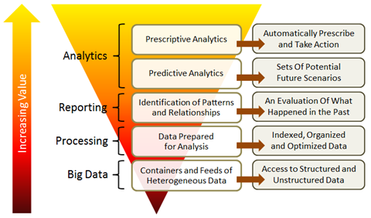
The nature of the challenge

Slide 15
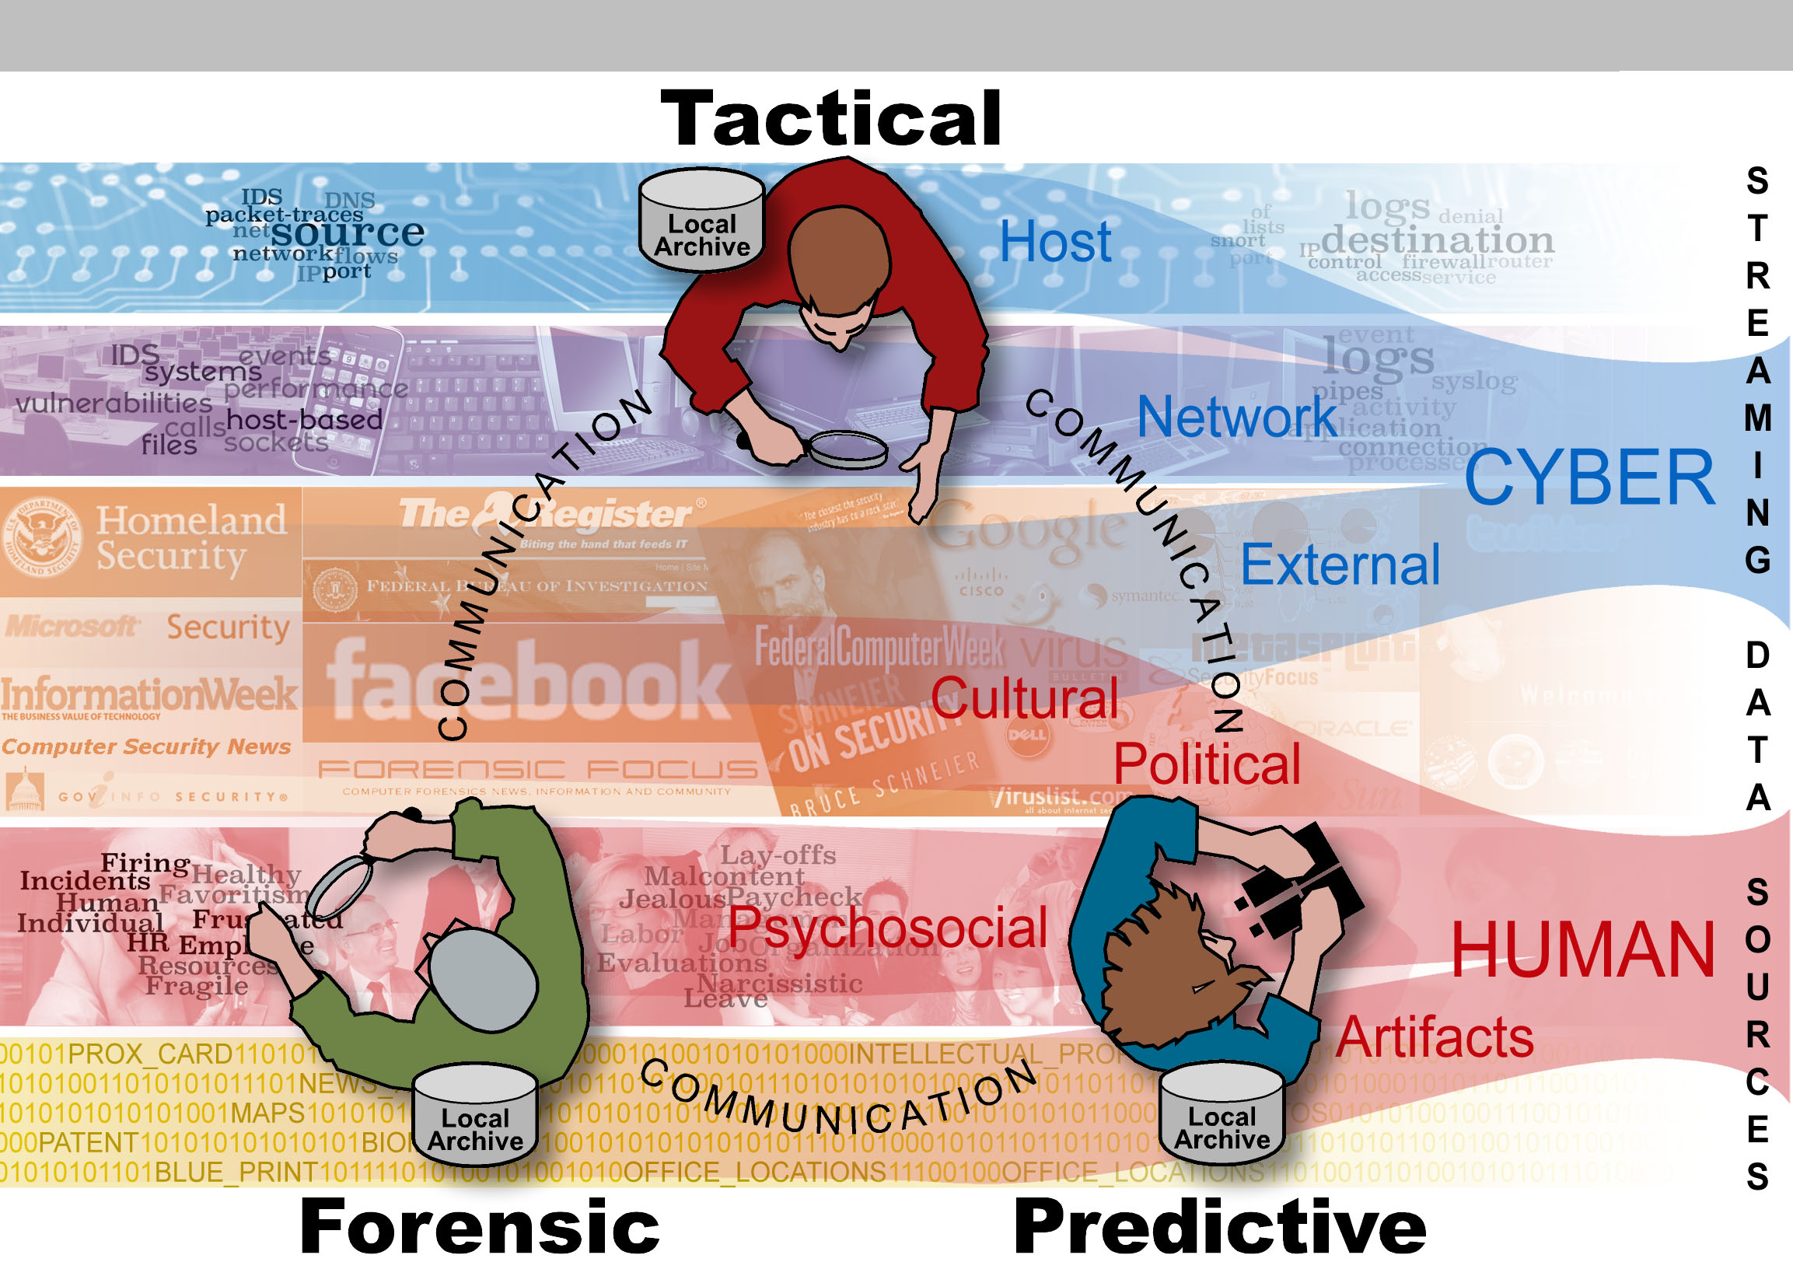

Slide 16
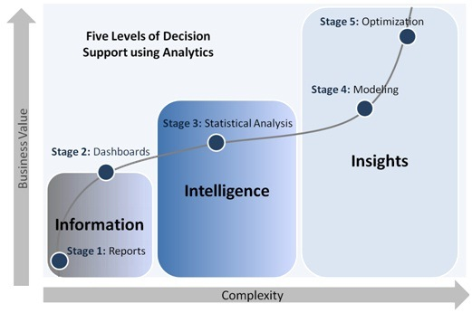
Notes:
http://www.defiance-tech.com/sites/default/files/services_solutions/Enterprise_Analytics_Service_4.jpg

Slide 17
Perspective
People make decisions every day and increasingly they are using resources/ services (that run on computers) to assist or decide for them.
Knowledge can translate to “power”:
Or accurate/ reliable knowledge is actionable
Gaining knowledge and how to use that knowledge - from (often multiple sources) information and data sources
A model = formula/ equation that could depend on parameters and variables

Slide 18

So what* are we talking about?
Notes:
https://www.youtube.com/watch?v=r7E1TJ1HtM0

Slide 19
Definitions (at least for this course)
Data - are encodings that represent the qualitative or quantitative attributes of a variable or set of variables.
Data (plural of "datum", which is seldom used) - are typically the results of measurements, computations, or observations and can be the basis of graphs, images of a set of variables.
Data - are often viewed as the lowest level of abstraction from which information and knowledge are derived***
Notes:
*** we will learn that this is not as simple as it seems.

Slide 20
And then there is Big Data
5 V’s: volume, variety, veracity, velocity, value
https://en.wikipedia.org/wiki/Big_data
Journals/ conferences: IEEE, http://www.liebertpub.com/big
In short: crawl before you walk, before you run, before you become famous ;-)
Notes:
Big data is a term used to refer to data sets that are too large or complex for traditional data-processing application software to adequately deal with.

Slide 21
A view from IBM …
“Anyone who wants to learn something about data analytics should take a road trip. Myriad real-time decisions must be made based on analysis of static information as well as ever-changing conditions. Data about traffic, weather, road construction, fuel, time, current location and available funds are just a few of the factors.”
This information and much more are needed to answer questions like:
If I skip this gas station, will I run out of gas before the next one?
Is it worth driving 50 miles out of the way to see the Corn Palace? How late will that side trip make us?
Can I make it to Billings, Mont., by sunset or should I look for a place to stop?
Notes:
http://www.ibmsystemsmag.com/mainframe/Editor-s-Desk/editor_analytics_redefined/

Slide 22
Case Studies (warming up)
Sports Analytics – Moneyball (http://www.imdb.com/title/tt1210166/), Nate Silver (http://en.wikipedia.org/wiki/Nate_Silver)
Marketing Analytics – products for pregnant (women)
Amazon Recommender – “If you liked, …”
http://www.slideshare.net/lsakoda/case-studies-utilizing-real-time-data-analytics

Slide 23
Analysis
Software packages / environments:
Gnu R
Rstudio
Extensive libraries
<Jupyter Notebooks, Jupyter Labs>
Going from preliminary to initial analysis…
Parametric (assumes or asserts a probability distribution) and non-parametric statistics

Slide 24
What is "statistics"?
The term "statistics" has two common meanings, which we want to clearly separate: descriptive and inferential statistics.
But to understand the difference between descriptive and inferential statistics, we must first be clear on the difference between populations and samples.
See Module 2 (during this course)
Courtesy Marshall Ma (and prior sources)
24
Notes:
Courtesy Marshall Ma (and prior sources)
Inferential Statistics: Definition, Uses
Statistics Definitions > Inferential Statistics
What is Inferential Statistics?
Descriptive statistics describes data (for example, a chart or graph) and inferential statistics allows you to make predictions (“inferences”) from that data. With inferential statistics, you take data from samples and make generalizations about a population.
https://www.statisticshowto.datasciencecentral.com/inferential-statistics/

Slide 25
Summary
We’ll work our way through the stages of analytics
We’ll use current both laptop installed software and potentially some server data infrastructures for analytics to give you practical experience
We’ll cover algorithms, parameter choices, models, results, interpretation, and the software
This is a fast paced course…

Slide 26
Skills needed
Database or data structures?
Literacy with computers and applications that can handle the data we will use
Pick up R programming, terminology and syntax, and some refinement
Ability to access internet, servers and retrieve/ acquire data, install/ configure software
Presentation of proposal projects and assignment results

Slide 27
Current assignment structure (no exam)
Assignment 1: Review of a DA Case Study. End of week 2. 5% (written/ discuss?);
Assignment 2: Datasets and data infrastructures – graded lab assignment. In ~ week 3. 10% (in lab**);
Assignment 3: Preliminary and Statistical Analysis. In ~ week 4. 15% (written);
Assignment 4: Pattern, trend, relations: model development and evaluation. In ~ week 6. 15% (written);
Assignment 5: Term project proposal. In ~ week 7. 5% (oral or written**);
Assignment 6 = Term project. In ~ week 13. 30% (25% written, 5% presentation/oral);
Assignment 7: Predictive and Prescriptive Analytics. Due ~ week 10. 15% (15% written);
5% participation

Slide 28
What is expected
Attend class, complete assignments, participate
Ask questions, offer answers in class
Work individually on assignments
In a group at/ around your table, learn from each other, help each other especially with software
Work constructively in class labs

Slide 29
Reading/ watching
Sports Analytics – Moneyball (http://www.imdb.com/title/tt1210166/),
Nate Silver (http://en.wikipedia.org/wiki/Nate_Silver)
http://www.slideshare.net/lsakoda/case-studies-utilizing-real-time-data-analytics
http://www.marketquotient.com/case-studies.html
http://www.ibm.com/analytics/us/en/case-studies/
More in the Assignment

Slide 30
Reference Material
On LMS and website – some via RPI Library, RCS login required
Data Analytics – various intro material
Using R (and next week)

Slide 31
Files
http://aquarius.tw.rpi.edu/html/DA/
This is where the files for assignments, exercise will be placed – data, code (fragments), and other documents, etc.

Slide 32
Assignment 1
Choose a Data Analytics case study from a) assignment readings, or b) your choice (must be approved by me)
Read it and provide a short written review/ critique of the case study (is there a solid business case, what is the area of application, what approach/ methods, tools were taken/used, what were the results, actions, benefits?). Hand in a written report.
Be prepared to discuss it in the class / lab.
Details/ submission on LMS/ Web site (under Assignments; Week 1)

Slide 33
Next?
Week 1 – Thursday - quick refresher on statistics and Intro to Labs
No Classes on Monday, January 20th 2020: Martin Luther King Jr. Day:

Slide 34
Introductions
Who you are, background?
Why you are here?
What you expect to learn?

Slide 35
Head start for lab - R
http://lib.stat.cmu.edu/R/CRAN/ - load this first
http://cran.r-project.org/doc/manuals/
http://cran.r-project.org/doc/manuals/R-lang.html
R Studio – (see R-intro.html too) https://www.rstudio.com/products/rstudio/ (desktop version)

