Slide 1
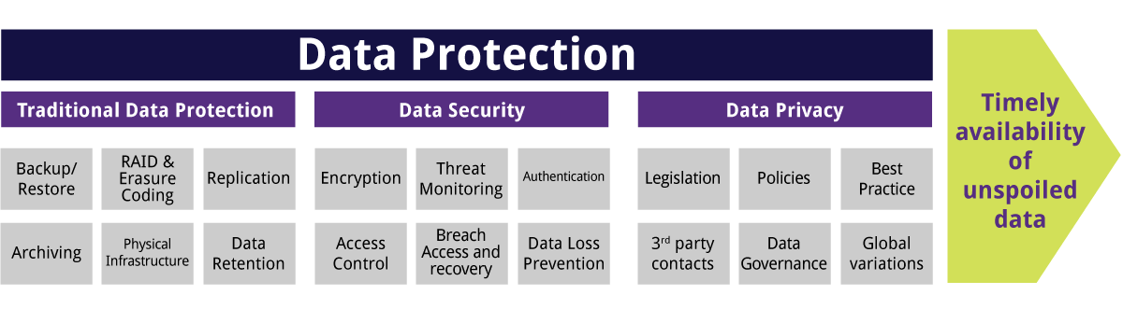
What Is Data Protection?
Data protection is a set of strategies and processes you can use to secure the privacy, availability, and integrity of your data. It is sometimes also called data security or information privacy.
A data protection strategy is vital for any organization that collects, handles, or stores sensitive data. A successful strategy can help prevent data loss, theft, or corruption and can help minimize damage caused in the event of a breach or disaster.

Slide 2
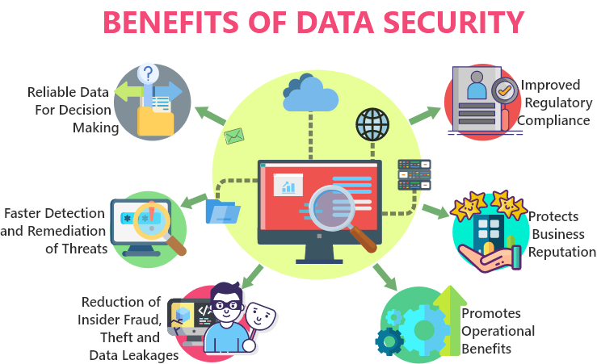
What Is Data Security?
Data security refers to the process of protecting data from unauthorized access and data corruption throughout its lifecycle. Data security includes data encryption, hashing, tokenization, and key management practices that protect data across all applications and platforms. We are implementing Backup & Recovery, Data Masking, Data Resiliency, Data Encryption In our COMPaaS Project.
Main Elements of Data Security:
Confidentiality - Ensures that data is accessed only by authorized users with the proper credentials.
Integrity - Ensure that all data stored is reliable, accurate, and not subject to unwarranted changes.
Availability - Ensures that data is readily — and safely — accessible and available for ongoing business needs.

Slide 3
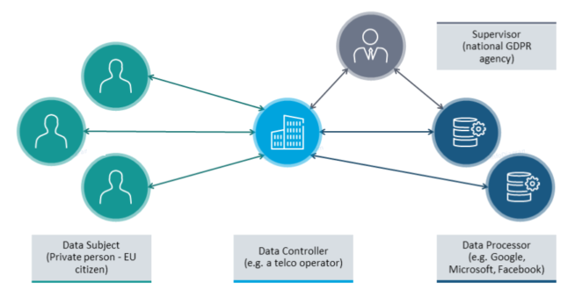
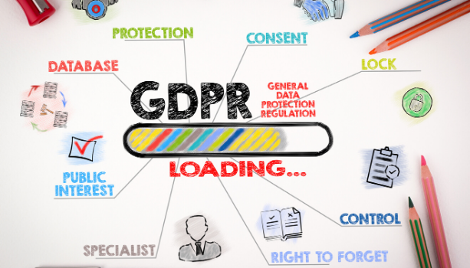
What is Data Privacy?
Data privacy is the ability of individuals to control their personal information. Read about challenges users face to protect their online privacy.
Data Privacy or Information privacy encompasses 3 elements:
Right of an individual to be left alone and have control over their personal data.
Procedures for proper handling, processing, collecting, and sharing of personal data.
Compliance with data protection laws.
€20 million ($24.1 million) or 4% of annual turnover

Slide 4
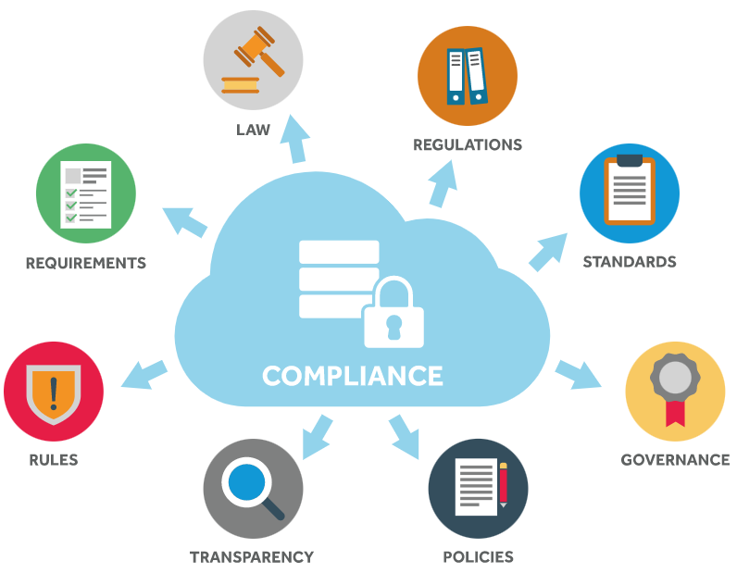
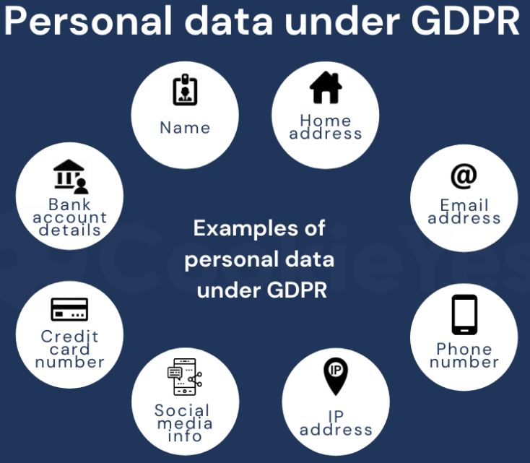
What Is GDPR and PII?
GDPR stands for General Data Protection Regulation. GDPR governs the way in which we can use, process, and store personal data (information about an identifiable, living person). It applies to all organisations within the EU, as well as those supplying goods or services to the EU or monitoring EU citizens.
PII Stands for Personal Identifiable Information. PII is any information about an individual maintained by an agency, including 1. Any information that can be used to distinguish or trace an individual‘s identity, such as name, social security number, date and place of birth or biometric records.
2. Any other information that is linked or linkable to an individual, such as medical, educational, financial, and employment information.

Slide 5
Data Protection Do’s…
Data is the lifeblood of your business. You can’t afford to lose it at any cost. That’s why you should be using a reliable and easy-to-use cloud backup solution i.e. One Drive. Having a back up of your data will ensure that all your data remains safe even if a data breach or a cyberattack occurs. Example: Configure One Drive to ensure everything on Hard Drive should be synched!!
Always use password protected excel to share information over email with restrictions and with actual stockholder only.
IT Team have enabled security policy in our systems to track the Traffic and ongoing activities in our system. ForcePoint and other monitoring tools already installed in Coforge domain machines.
Be aware of your surroundings when printing, copying, faxing or discussing sensitive information. Pick up information from printers, copiers, or faxes in a timely manner.
Do report all suspicious activity and cyber incidents to your manager and ISO/designated security representative (Security.Campus@coforge.com).
Ensure sensitive information on the computer screen is not visible to others. Example: Screen sharing over teams, Always share specific window.
A non-disclosure agreement is a legally binding contract that establishes a confidential relationship. We in Adecco legally bind a confidential relationship by acknowledge the Undertaking on conflict of interest and secrecy.
Always drop email to PMO to revoke the Client id once SM’s leave the project. We in Adecco project perform audit in every 15 day’s.
Be careful when access PII Data, Always use client jump server to connect production Database as Production DB contain PII Data. E.g. Colleague details, Candidate profile data and French data.

Slide 6
Data Protection Don’ts…
Don’t Sharing code or any sensitive information it’s a security breach.
Don’t Share passwords or leave them lying around for others to see.
Don’t give opportunities for eavesdropping—both virtual and voice.
Don’t log onto unsecure networks, such as coffee shops or public wireless networks.
Don’t share sensitive information (like password, executable script, etc.) to anyone in group.
Don’t Ignore Application Updates (they’re more important than you might think)
Don’t use Public WiFi at a hotel, restaurant, cafe, or airport is unsafe! Malicious worms or other forms of malware can transfer from one device to another if they are connected on the same network.
Don’t copy PII data in your local machine. E.g. Colleague details, Candidate profile data and French data.

