Slide 1
Problem statement
Running a MediaWiki page with fully functional frontend and backend.
First instance consists of MediaWiki, which is a PHP based frontend solution.
Second instance consists of MariaDB, which stores the content submitted by MediaWiki

Slide 2
Using Kubernetes to deploy the Mediawiki application. Kubernetes will ensure that things work reliably.
Application dependencies:
Kuberenetes Cluster
official mediawiki Docker image
official mariadb Docker image

Slide 3
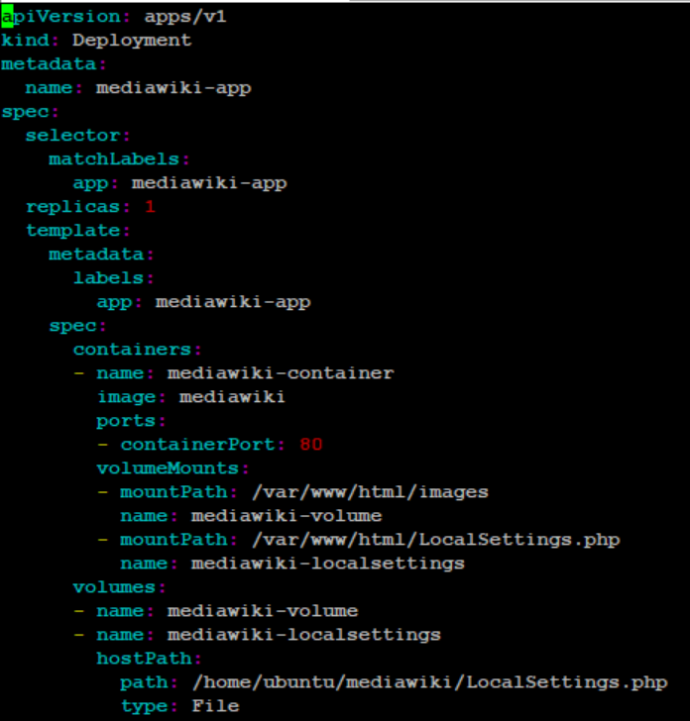
FrontEnd - mediawiki-dep.yaml

Slide 4
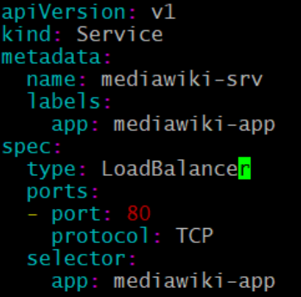
Frontend exposed through Loadbalancer

Slide 5
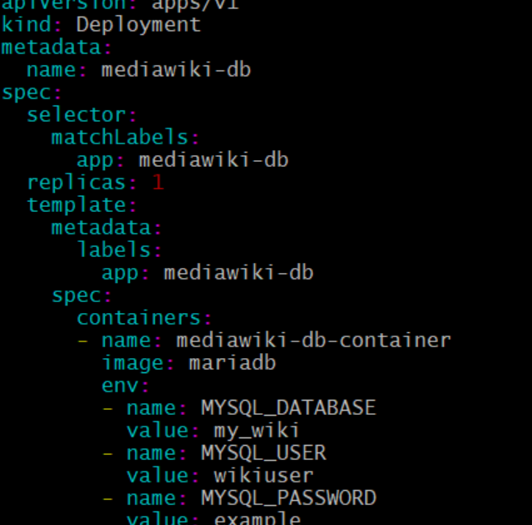
Backend - mediawiki-mariadb.yaml:

Slide 6
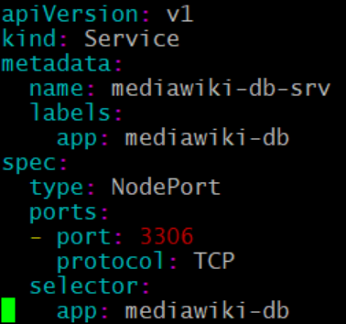
Backend exposed through NodePort svc:

Slide 7
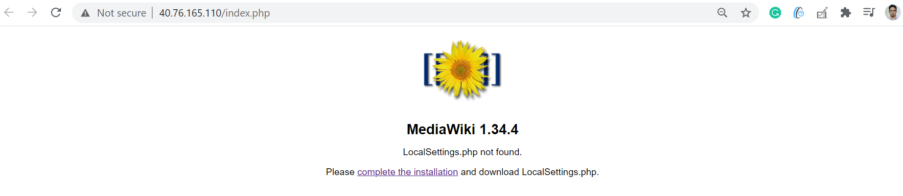
MediaWiki started successfully

Slide 8
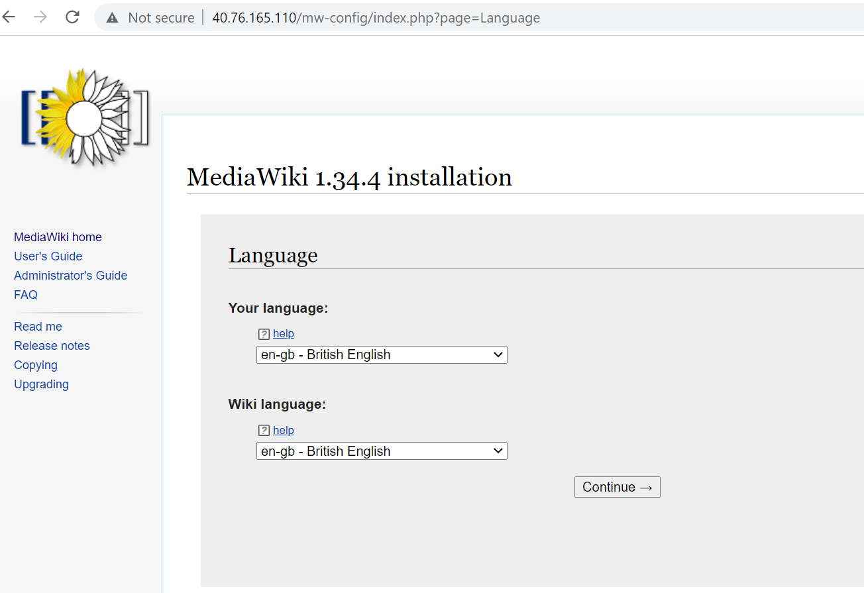
Setting up MediaWiki

Slide 9
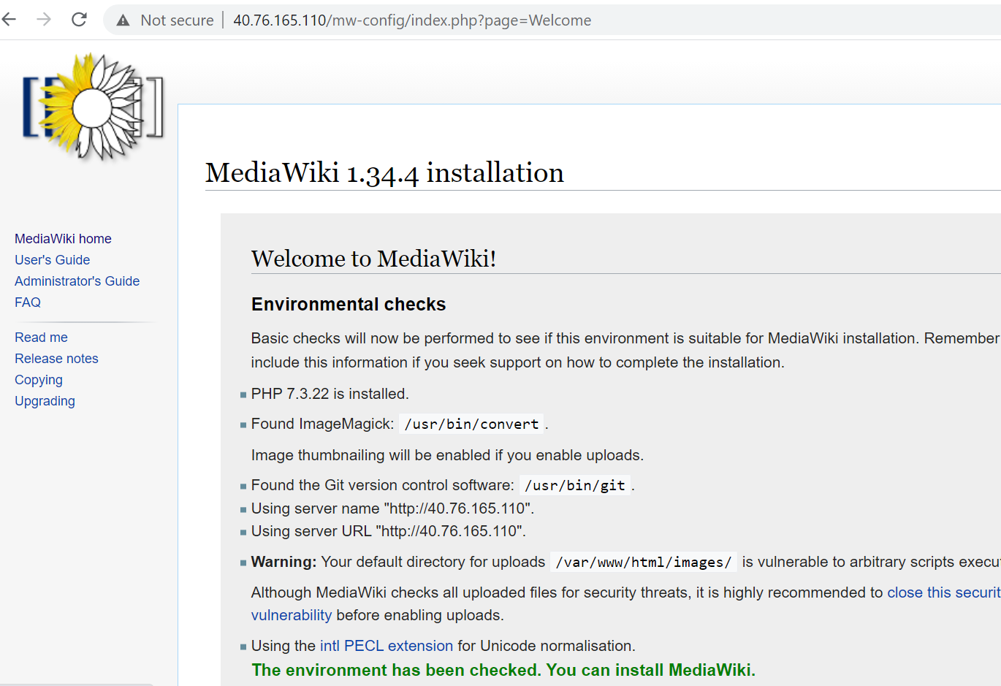
Setup

Slide 10
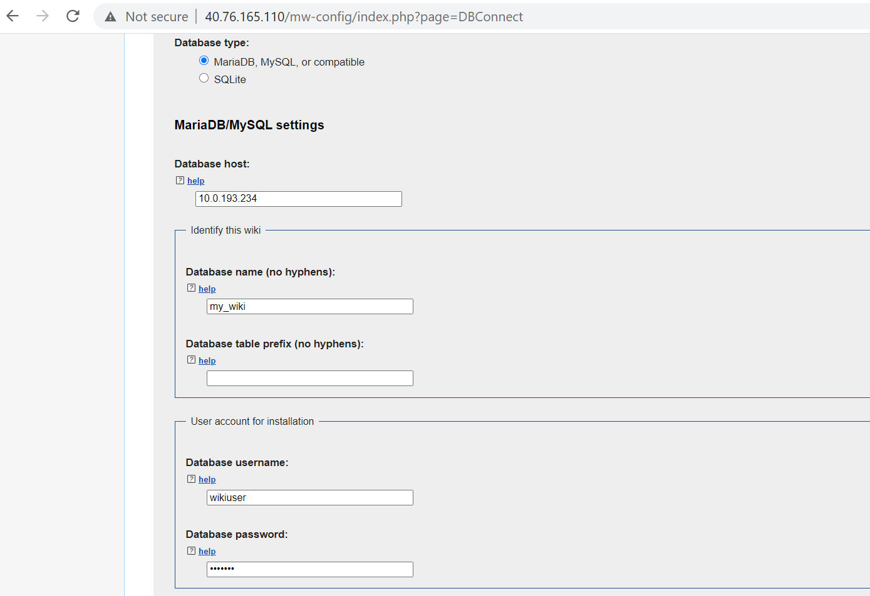
Setup

Slide 11
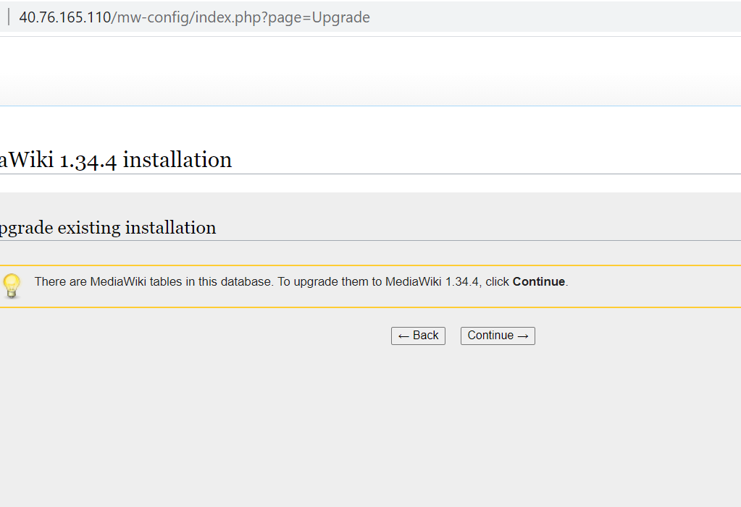
Setup

Slide 12
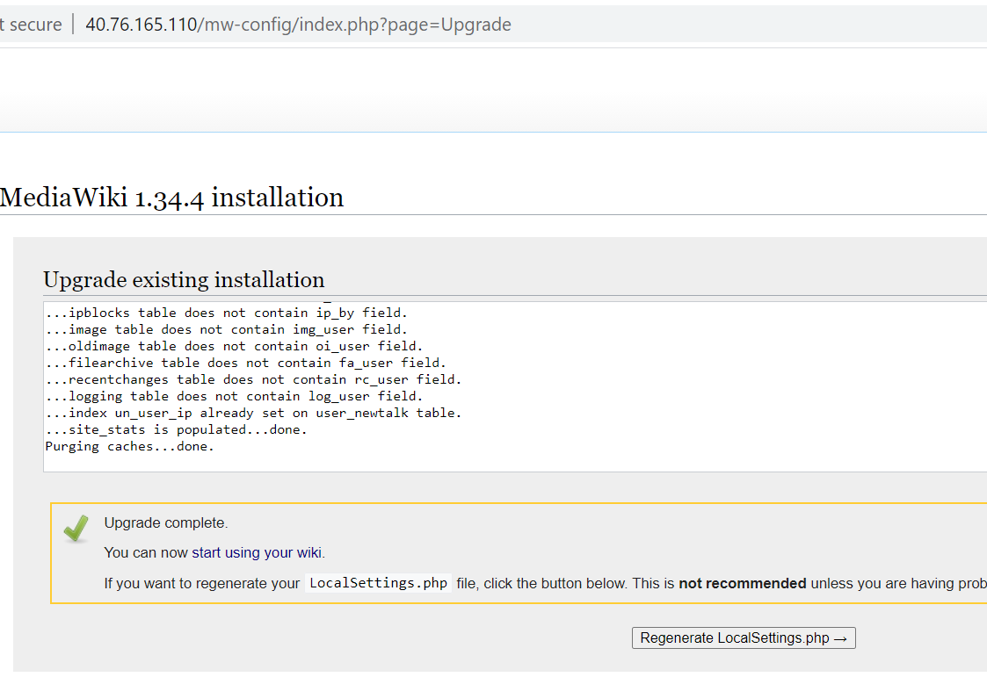
Setup

Slide 13
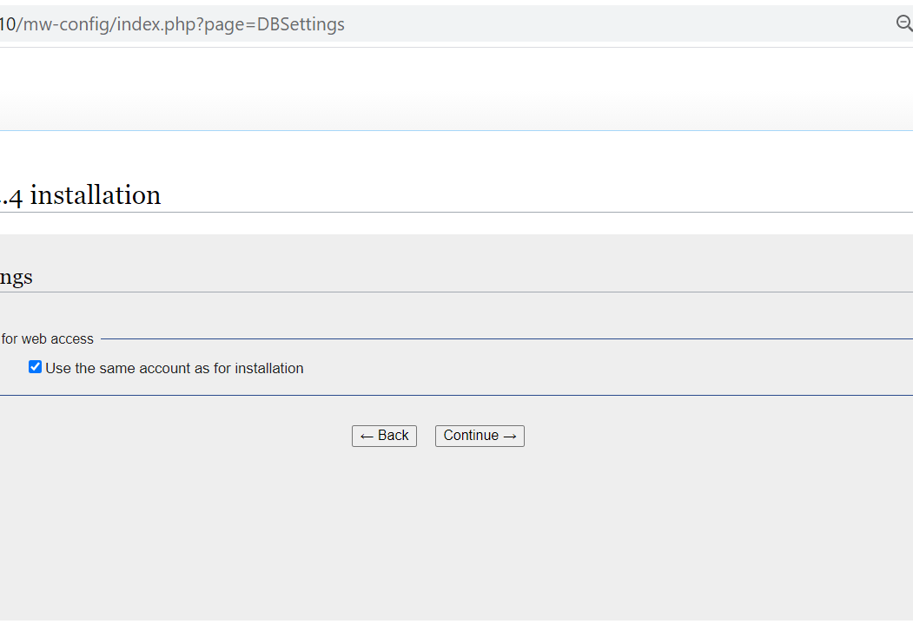
Setup

Slide 14
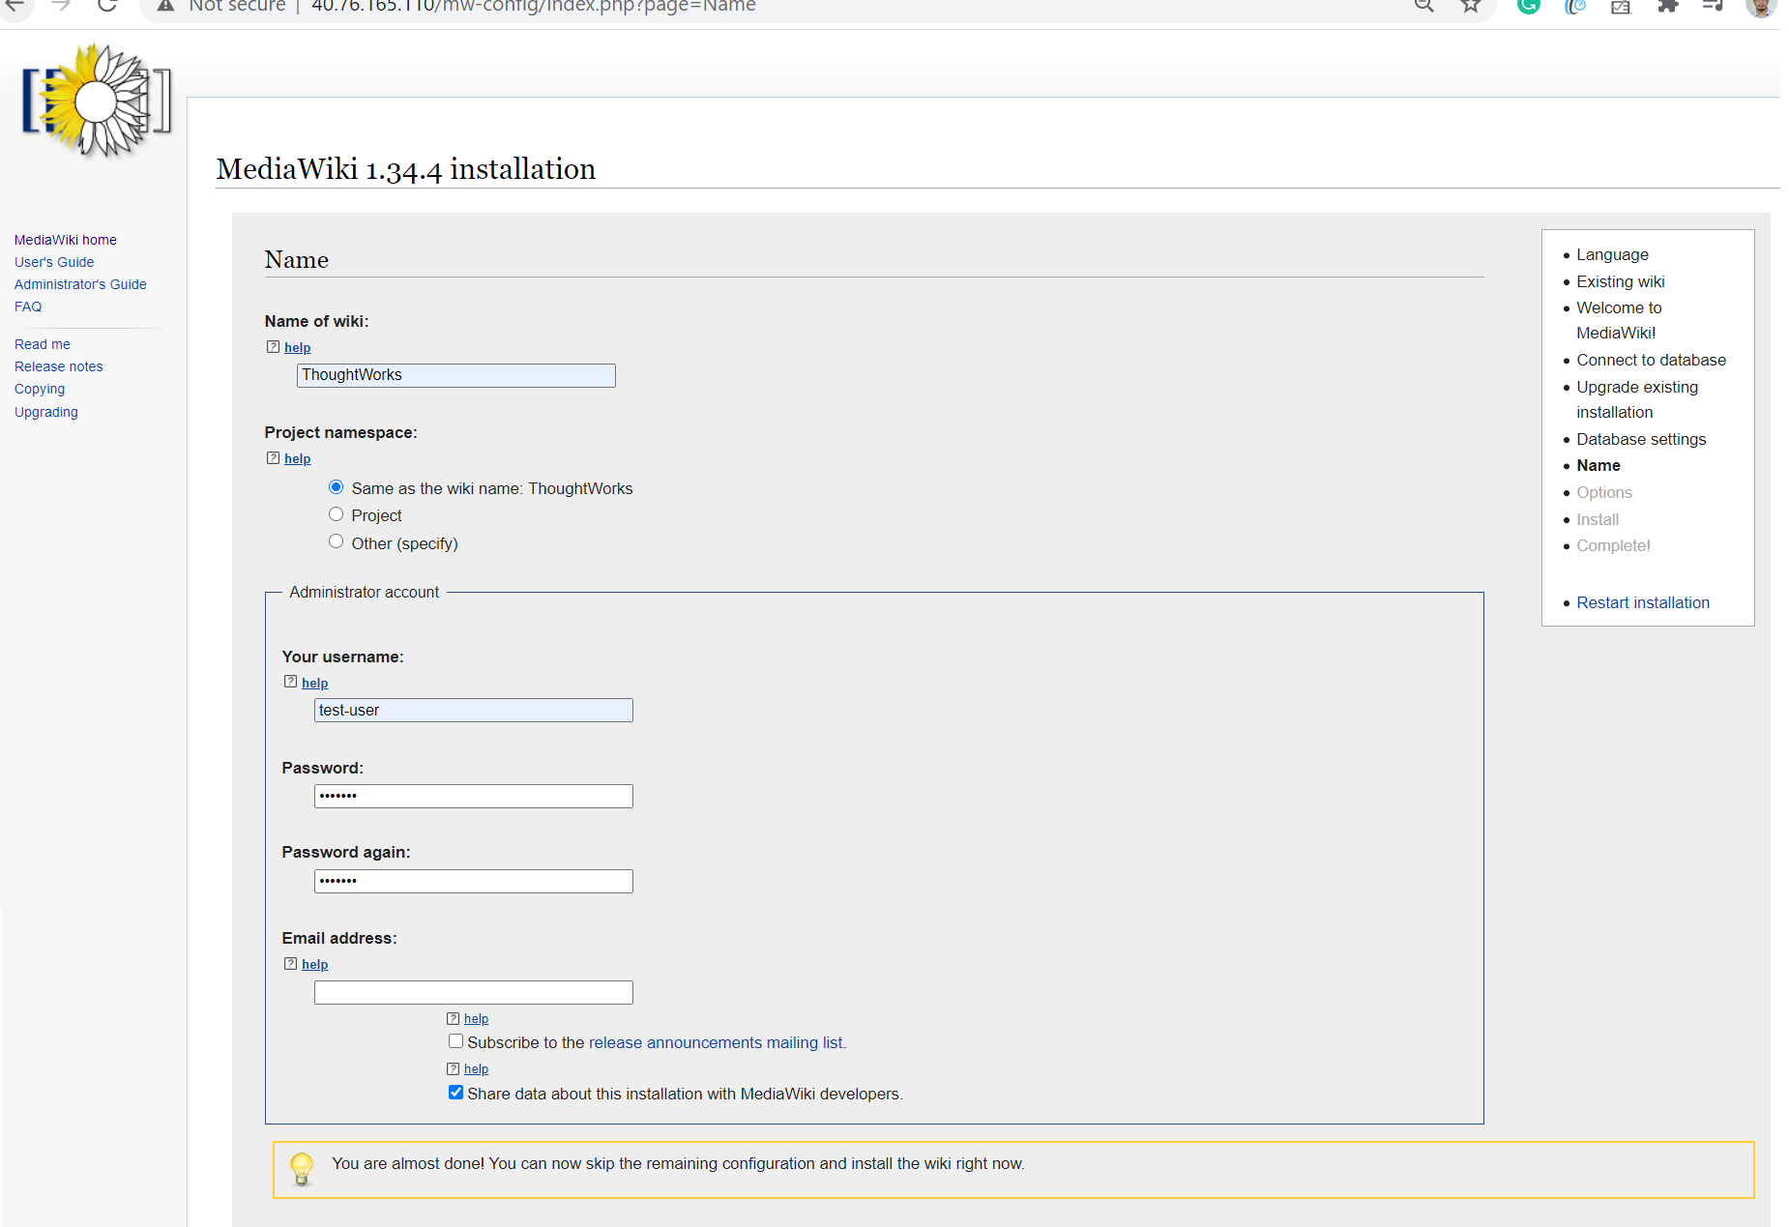
Setup

Slide 15
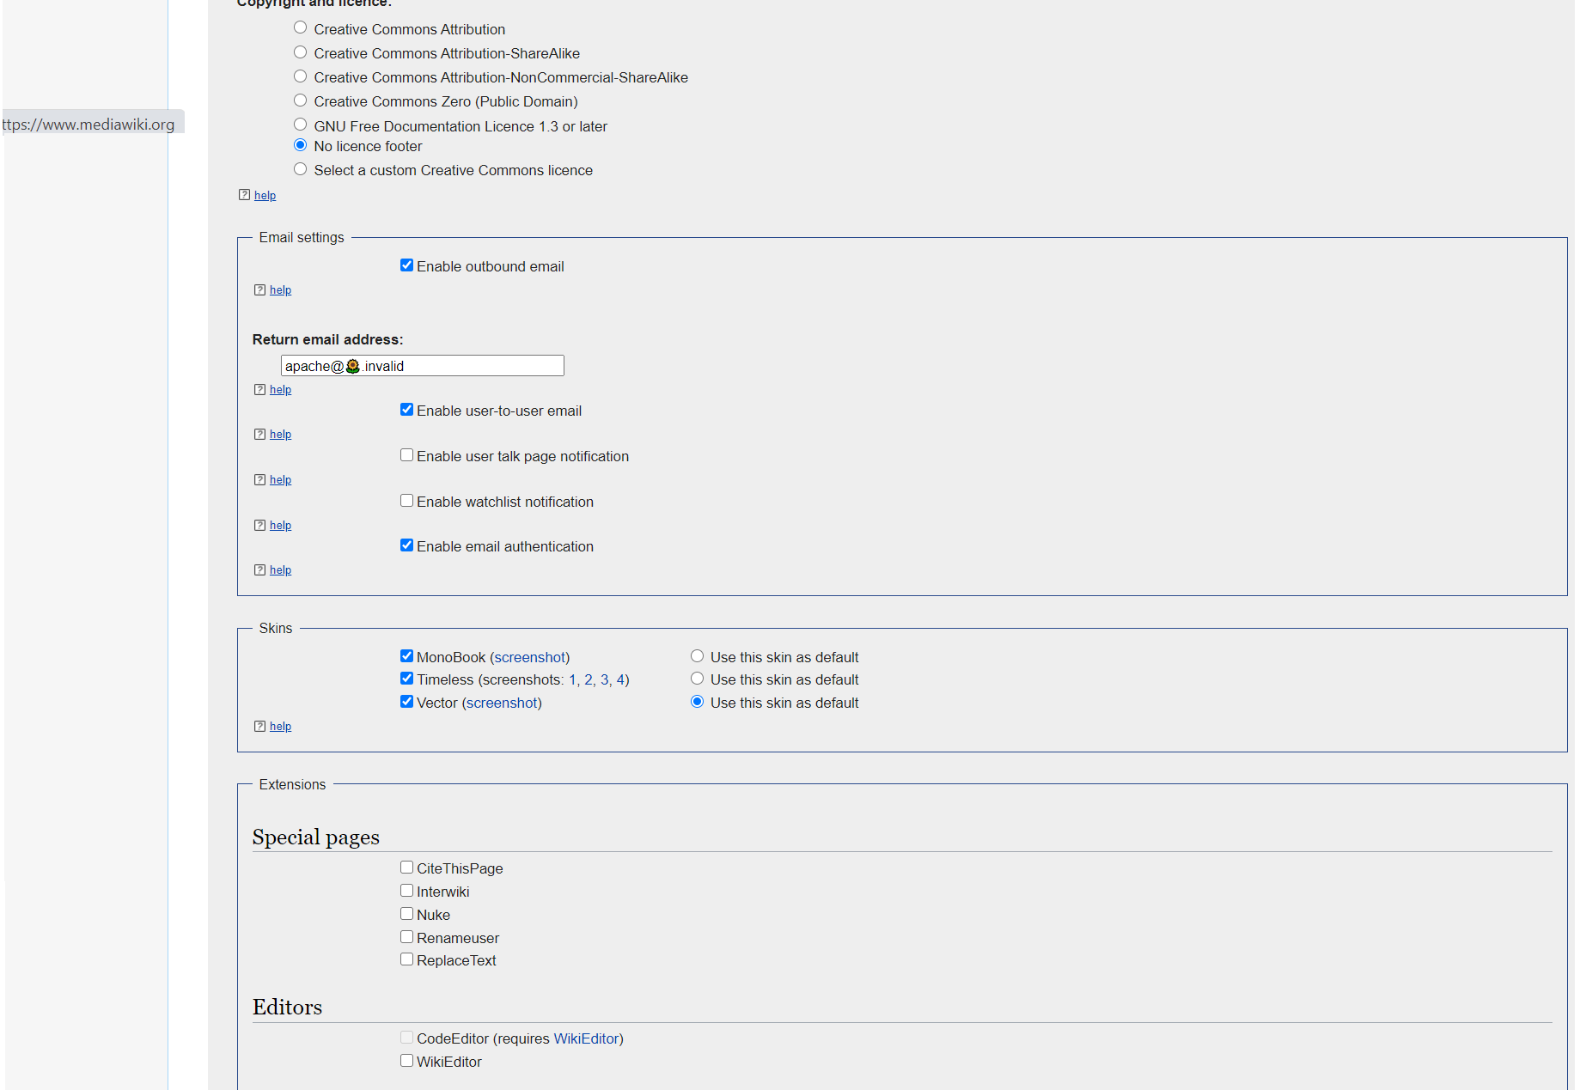
Setup

Slide 16
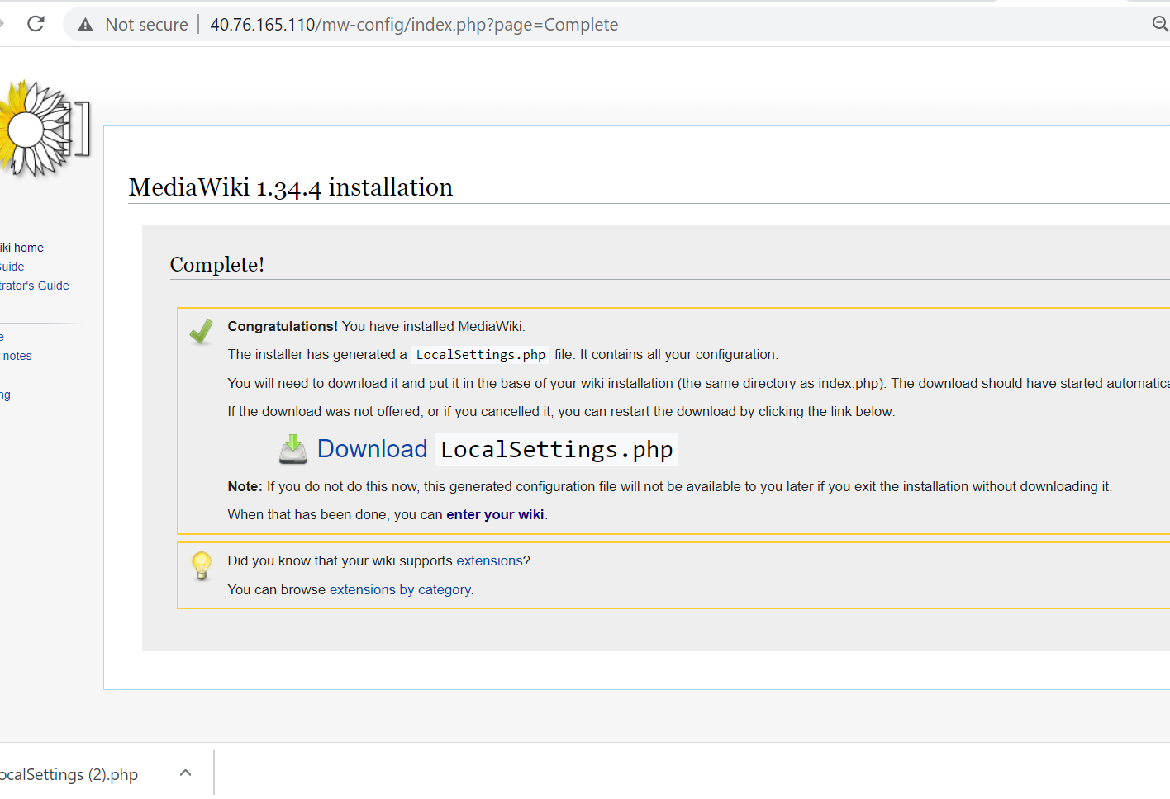
Setup

