Slide 1
Problem statement
Running a MediaWiki page with fully functional frontend and backend.
First instance consists of MediaWiki, which is a PHP based frontend solution.
Second instance consists of MariaDB, which stores the content submitted by MediaWiki
Creating it in a way so that it supports CI/CD pipeline.

Slide 2
Application Solution
Using Kubernetes to deploy the Mediawiki application. Kubernetes will ensure that things work reliably.
Application dependencies:
Kuberenetes Cluster
official mediawiki Docker image
official mariadb Docker image

Slide 3
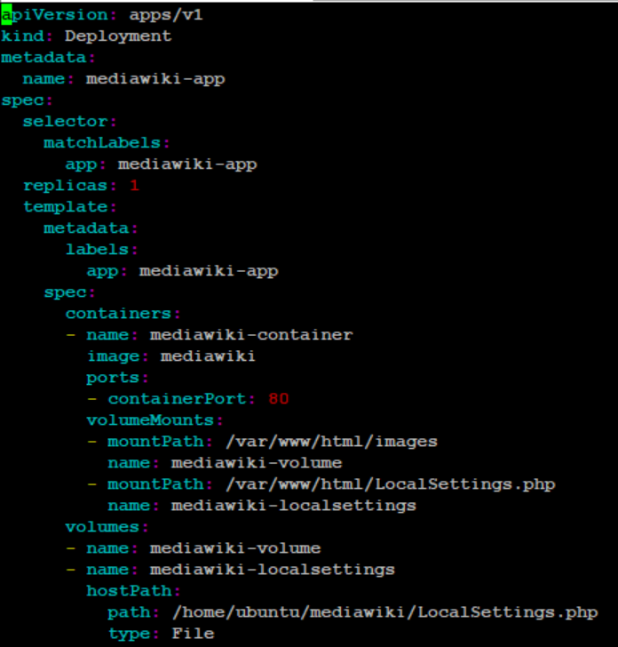
FrontEnd - mediawiki-dep.yaml

Slide 4
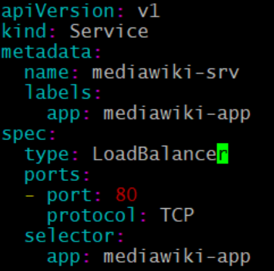
Frontend exposed through Loadbalancer

Slide 5
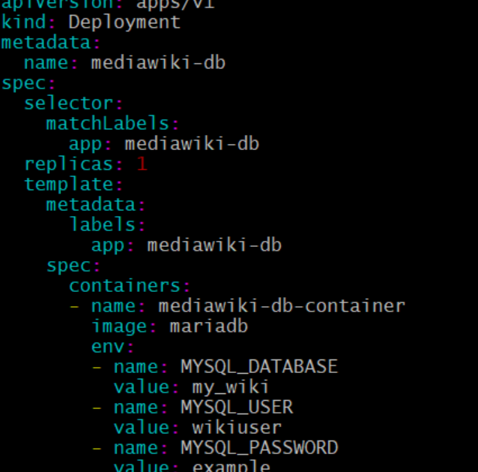
Backend - mediawiki-mariadb.yaml:

Slide 6
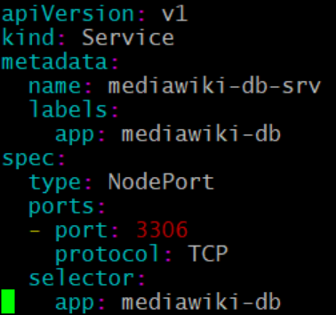
Backend exposed through NodePort svc:

Slide 7
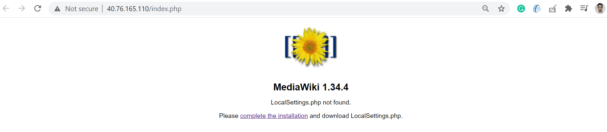
MediaWiki started successfully

Slide 8
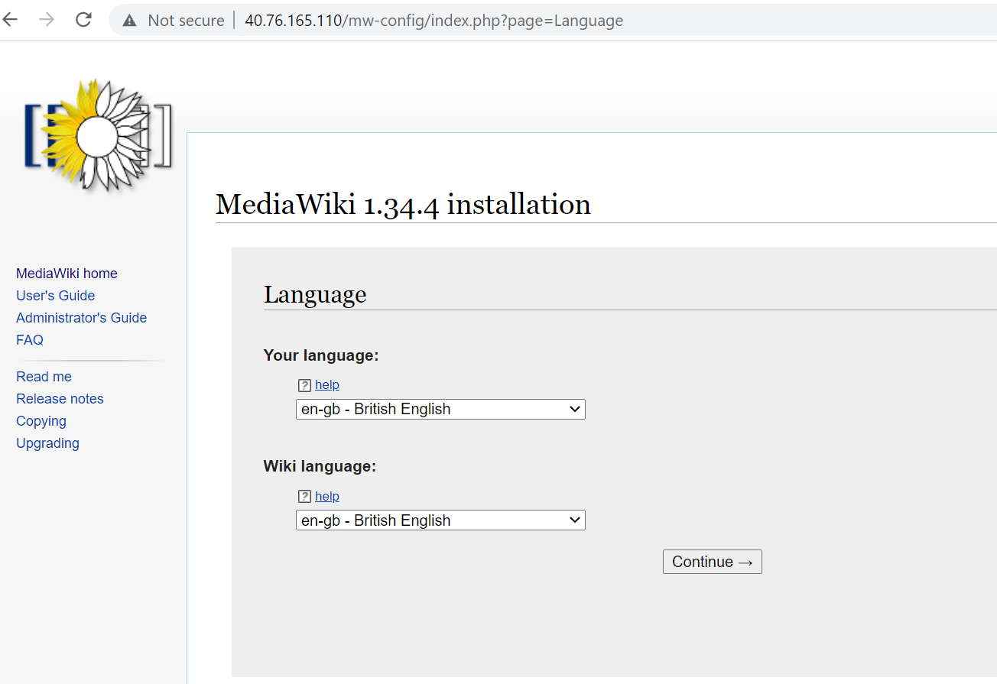
Setting up MediaWiki

Slide 9
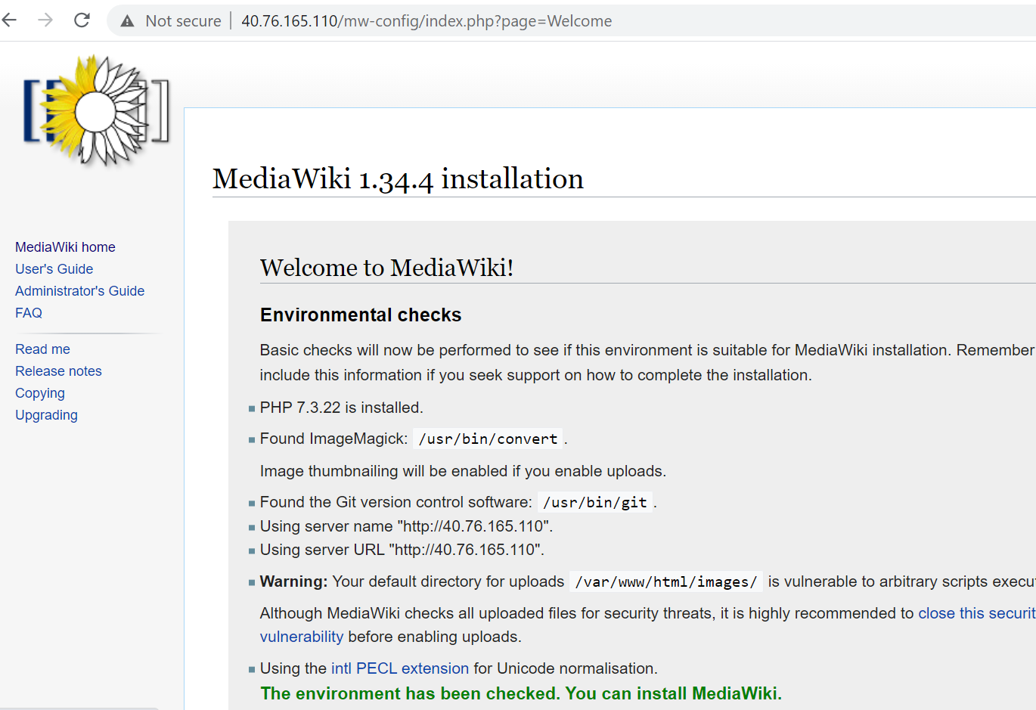
Setup

Slide 10
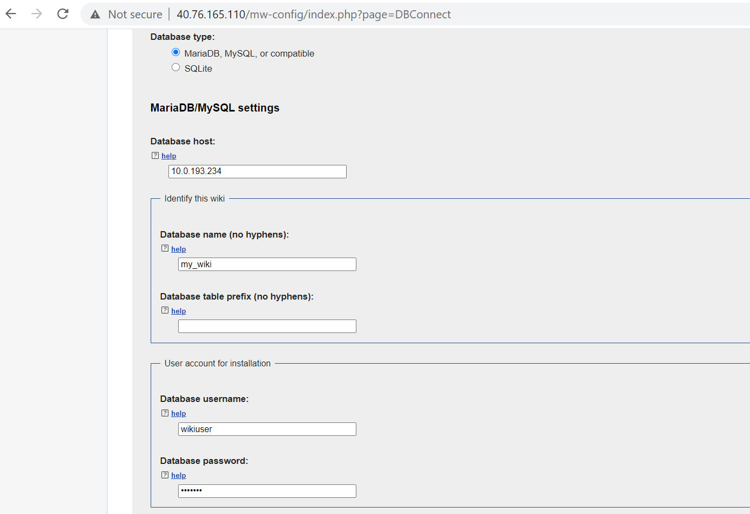
Setup

Slide 11
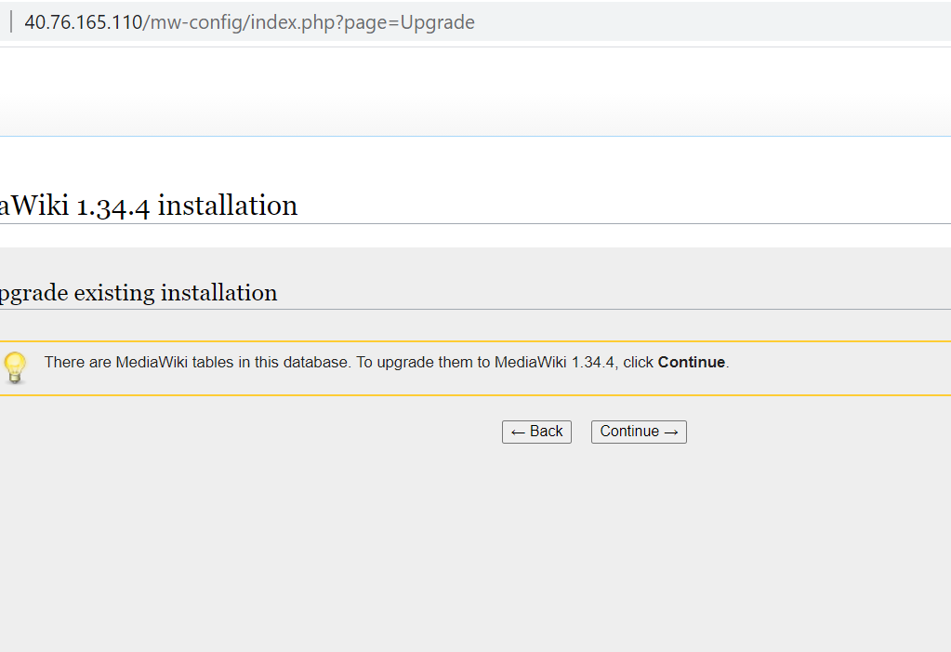
Setup

Slide 12
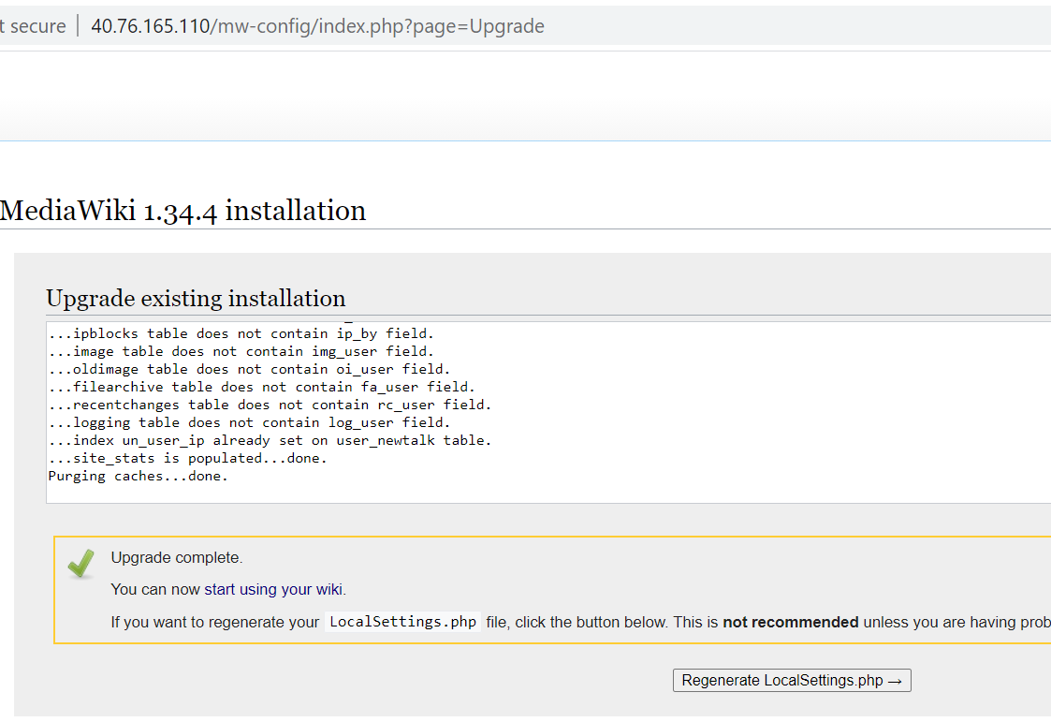
Setup

Slide 13
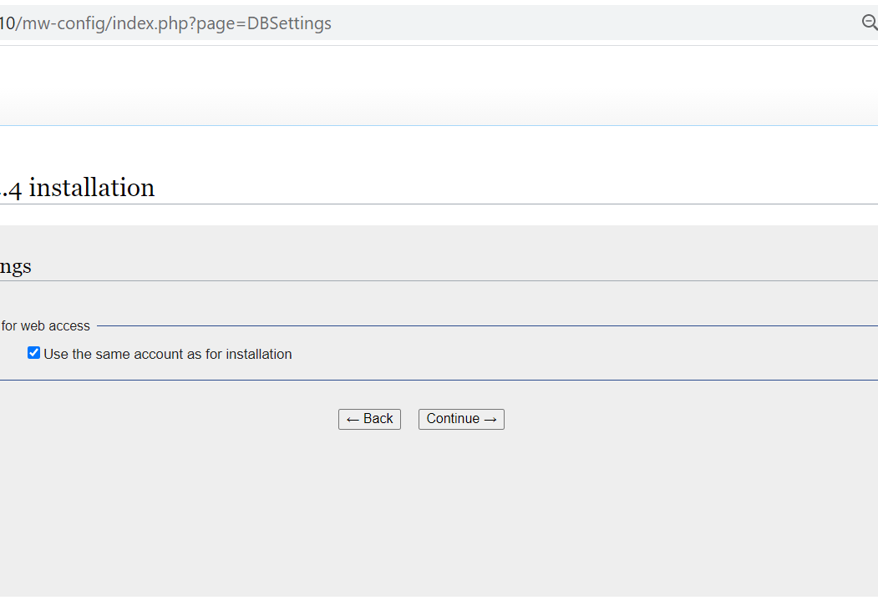
Setup

Slide 14
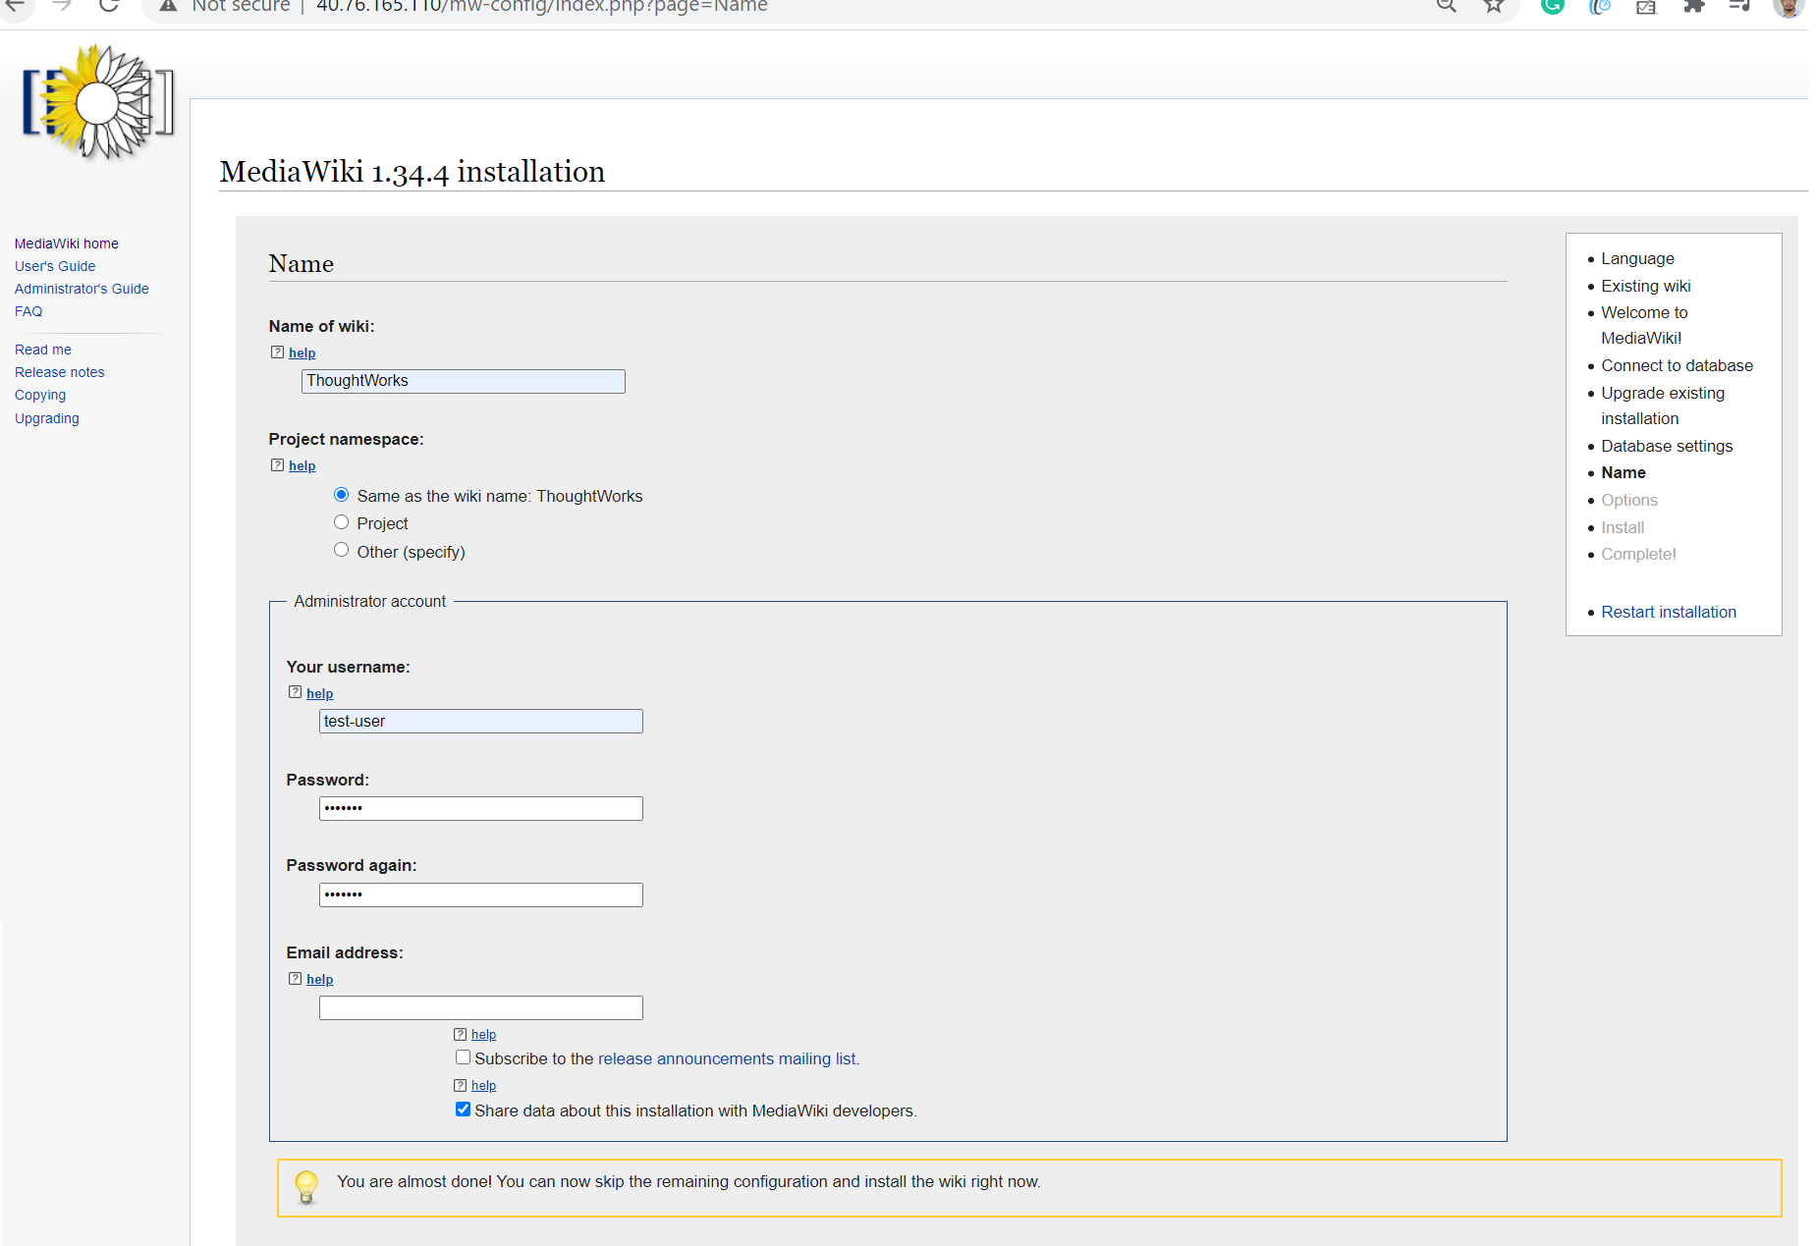
Setup

Slide 15
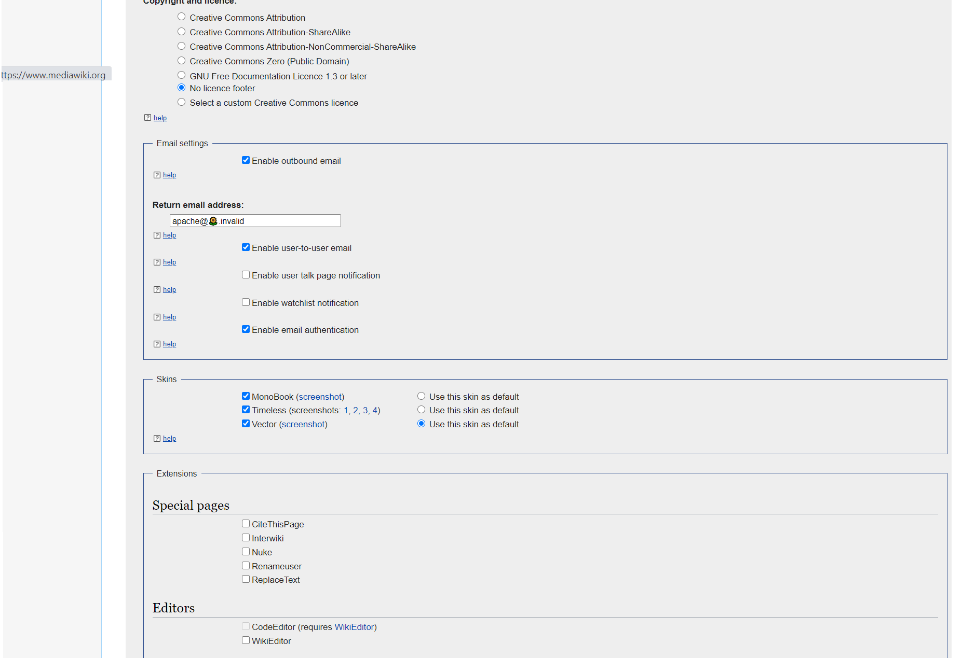
Setup

Slide 16
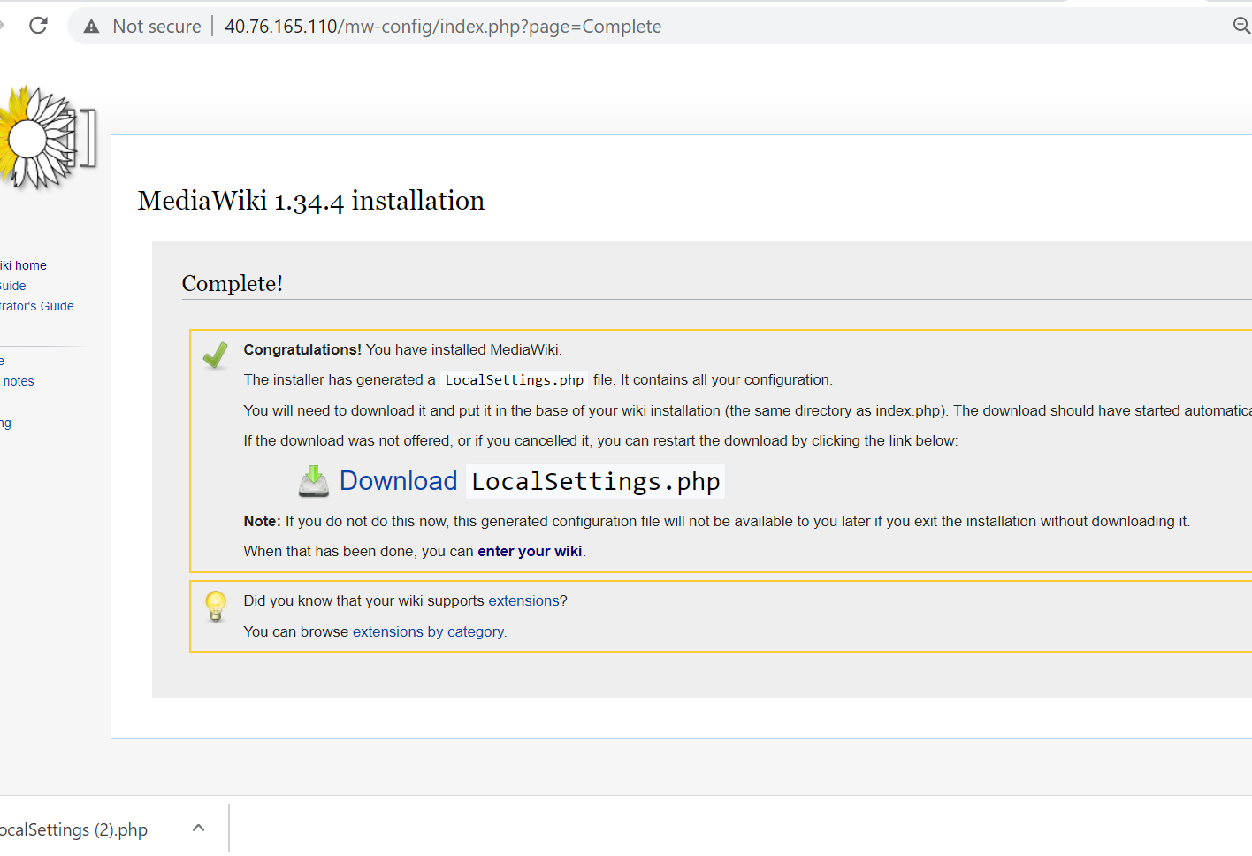
Setup

Slide 17
CI/CD Solution
Using GIT and Azure DevOps to ensure CI/CD.
Application dependencies:
Creating connection token to authentication communication between GIT and Azure DevOps
Making sure CI and CD is enabled in respective Pipelines.

Slide 18
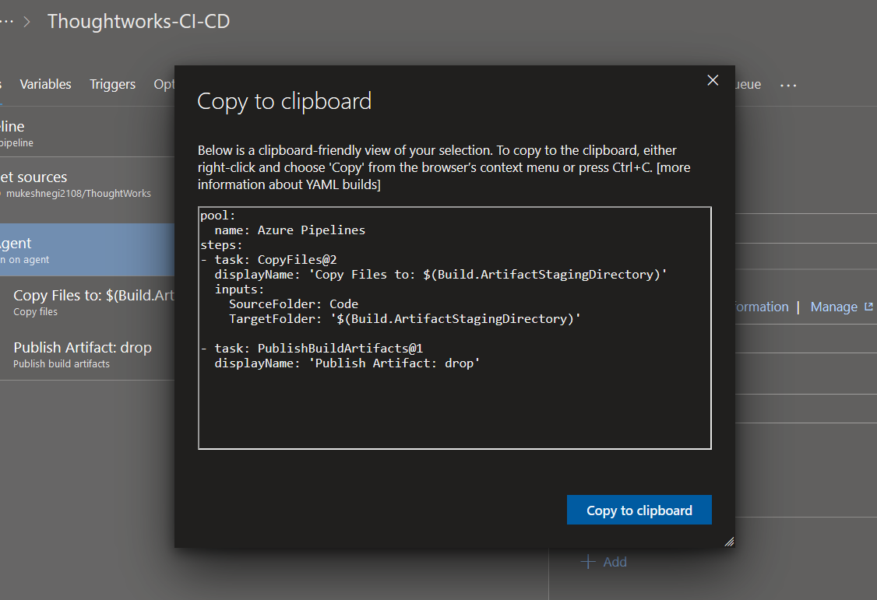
Continuous Integration

Slide 19
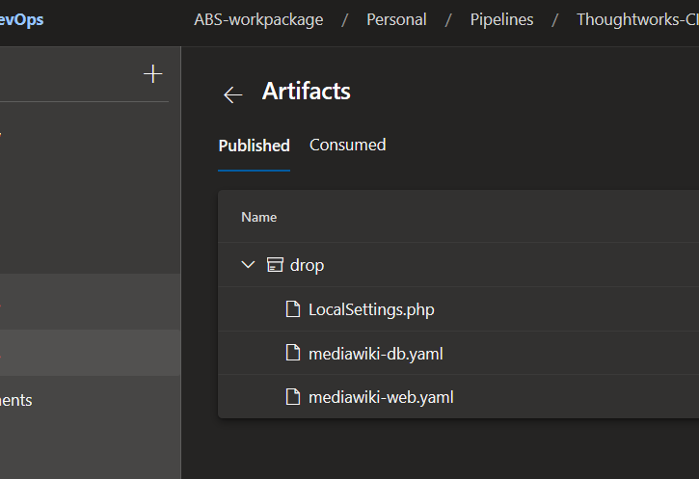
Build Artifacts

Slide 20
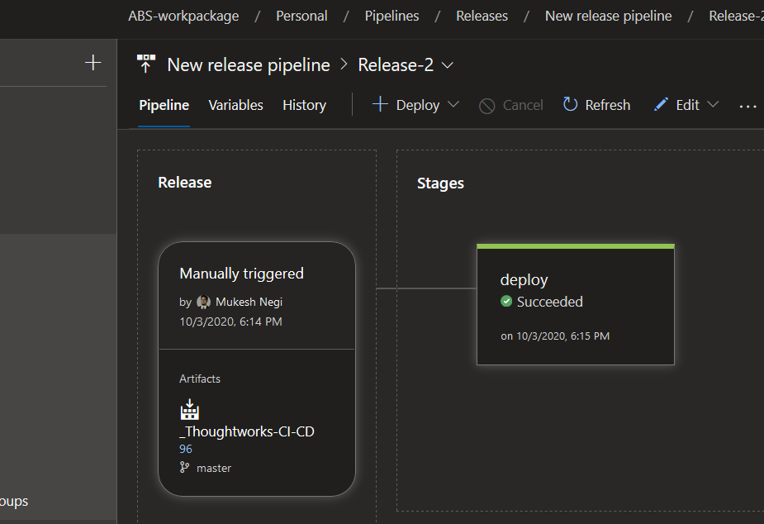
Continuous Deployment

