Slide 1




SpadeX
Ecommerce Solution
Major Industrial Problems of Our Organization
Slow Reporting
No Customer 360
Team Struggles
Security Risk

Slide 2
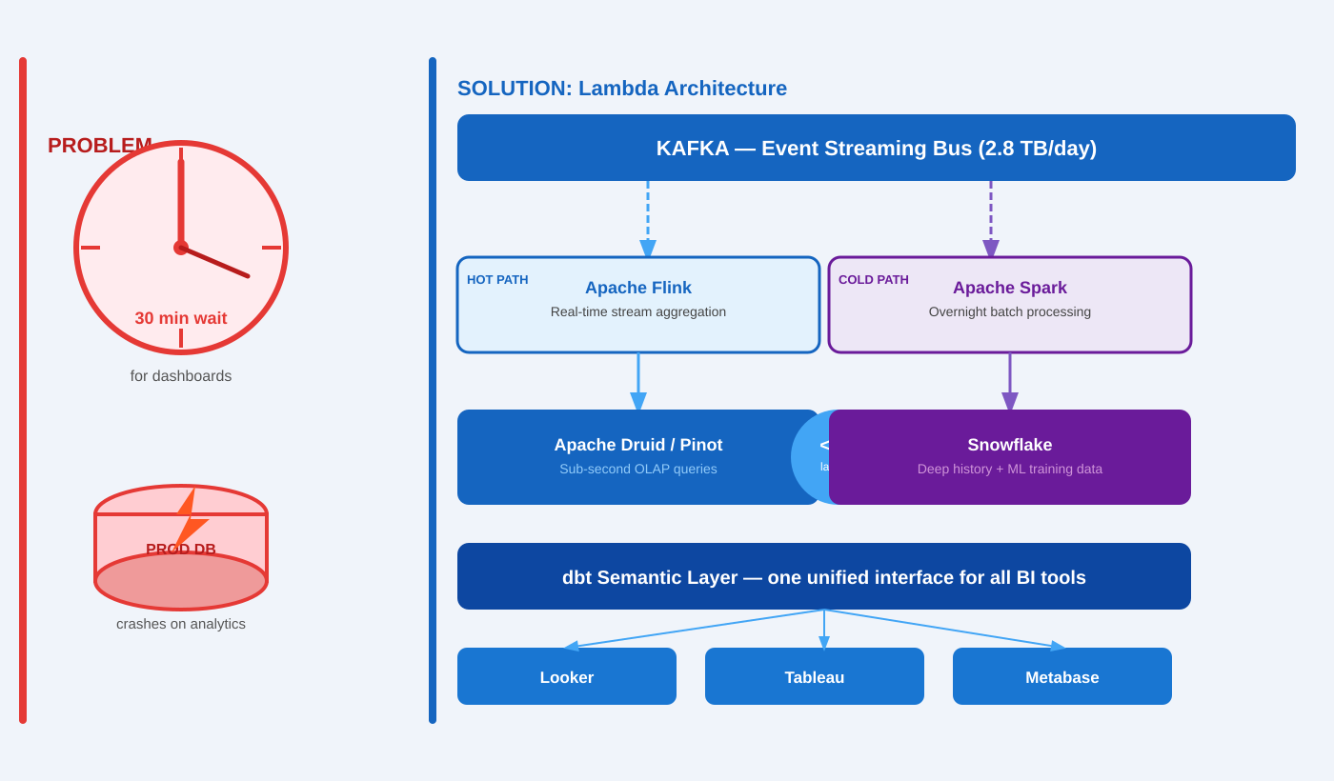
01 Slow Reporting — Lambda + Kappa Architecture

Slide 3
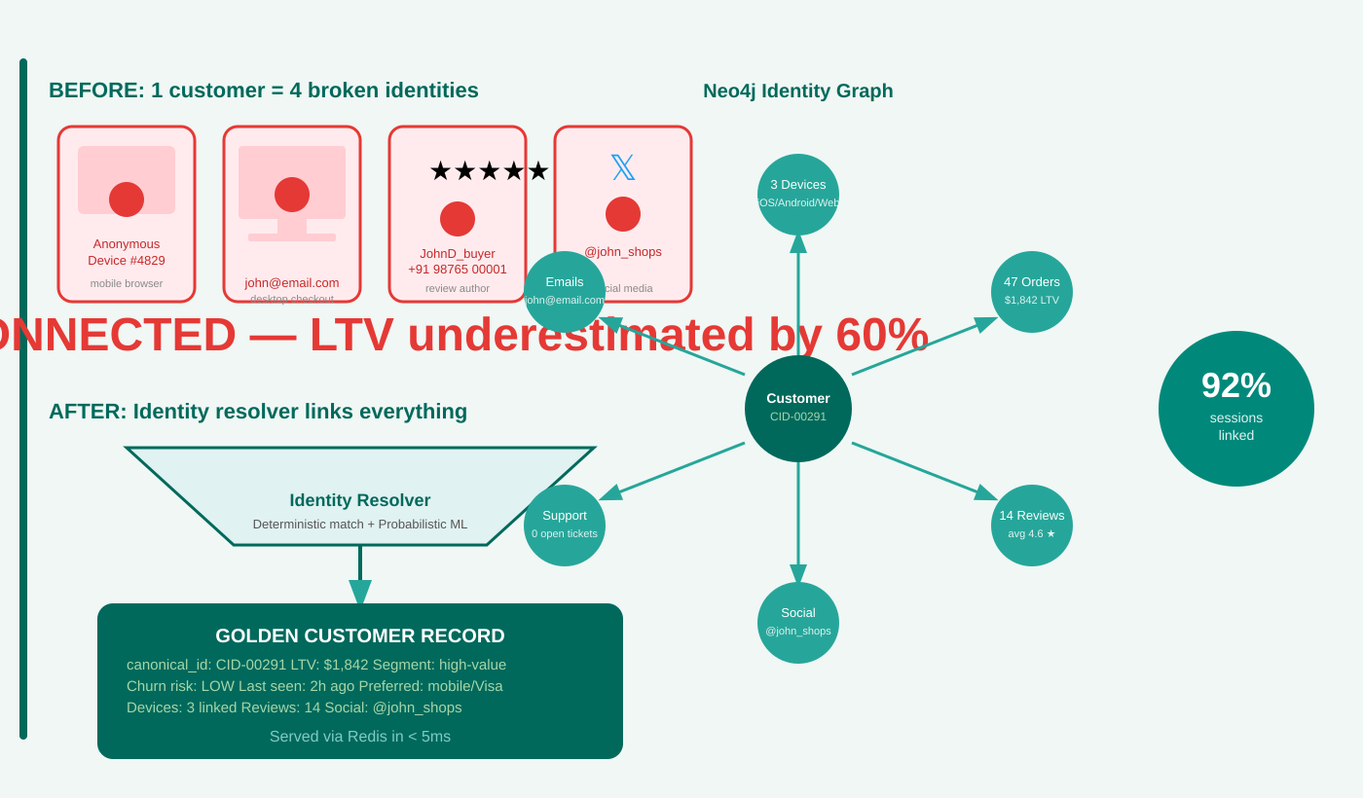
02 No Customer 360 — Graph Identity Resolution

Slide 4
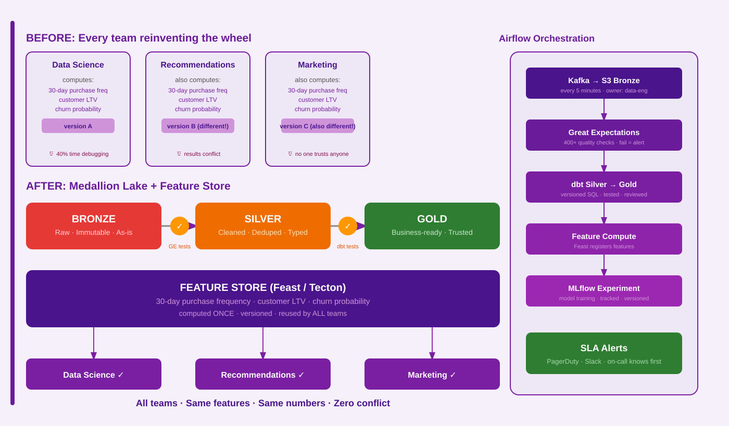
03 Data Team Struggles — Modern Data Stack

Slide 5
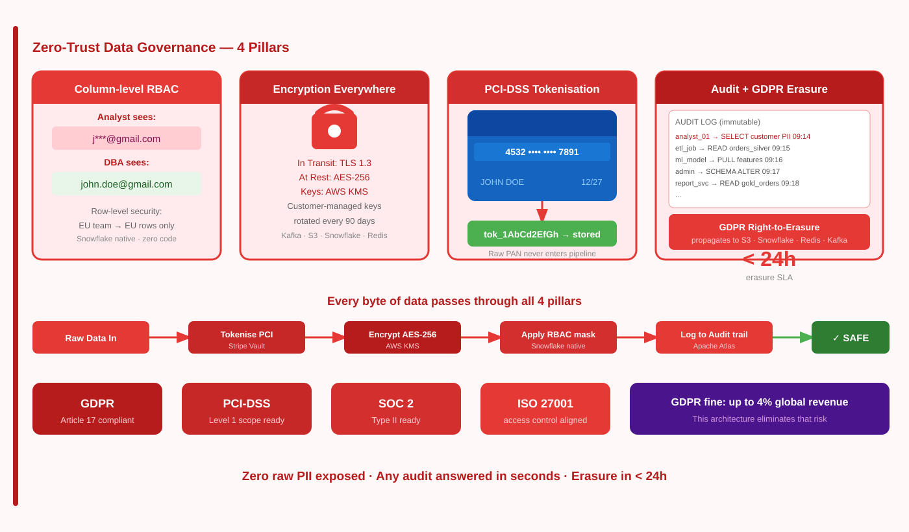
04 Security Concerns — Zero-Trust Governance

Slide 6
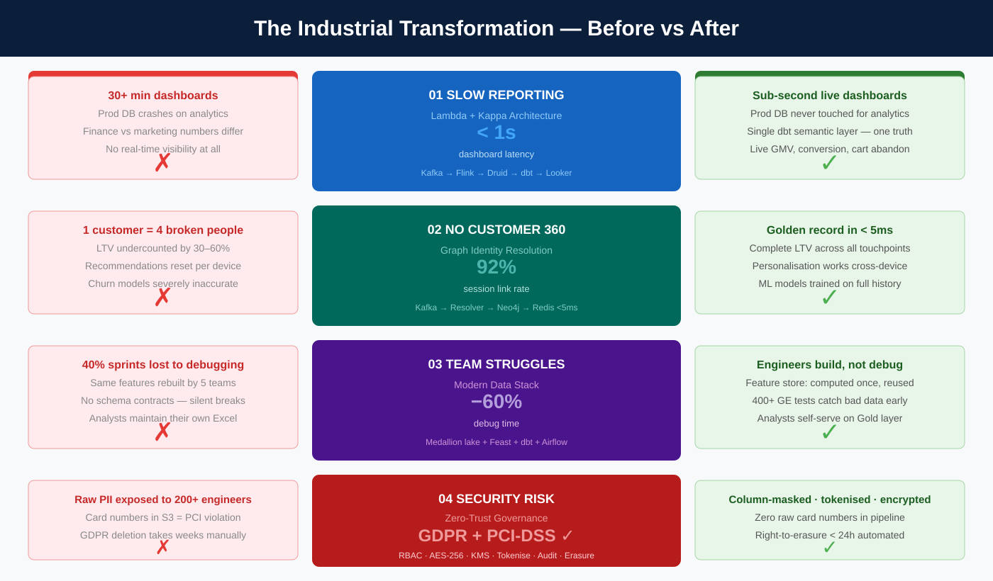

Slide 7



The Full Stack — how all 4 solutions connect
INGEST
Kafka
Debezium
Airbyte
Kinesis
STORE
S3 Lake
Snowflake
Redis
Neo4j
PROCESS
Flink
Spark+dbt
Feast
MLflow
GOVERN
RBAC
AWS KMS
Atlas
Gr.Expect
SERVE
360 API
Looker
ML Infer
AuditAPI
Every layer solves one problem — and they reinforce each other.

