Slide 1
React & Integration of React with Drupal8
By Mukesh Kumar Sah
29-May-2019

Slide 2
Topics
About React
Installation of React App
Basics of React
CRUD functionalities in React using API
Integration of Drupal8 module with React
Shared Codebase

Slide 3
About React
React is a JavaScript library used for building user interface.
React allows developers to create large web applications that use data which can change over time, without reloading the page.
Why React ?
It is used for building fast, lightweight and scalable single page web-applications.
We can create reusable components in React for building a complex applications.

Slide 4
About React
Who are using React?
Facebook
Instagram
Netflix
New York Times
Yahoo! Mail

Slide 5
Features of React
JSX :
JSX stands for JavaScript XML.
JSX is a XML syntax extension to JavaScript that also comes with the full power of ES6 (ECMAScript 2015). It is used for building simple and secure templates in JavaScript.
React uses JSX instead of using regular JavaScript for templating. But it’s not compulsory. We can also use regular JavaScript instead of JSX.
Example : const element = <h1>Hello World!</h1>
React Native:
React has native libraries which were announced by Facebook in 2015, which provides the react architecture to native applications like IOS and Android.
Single Way Data Flow:
In React, a set of immutable values are passed to the components renderer as properties in its HTML tags. Component cannot directly modify any properties but can pass a call back function with help of which we can do modifications. This complete process is known as “properties flow down; actions flow up”.

Slide 6
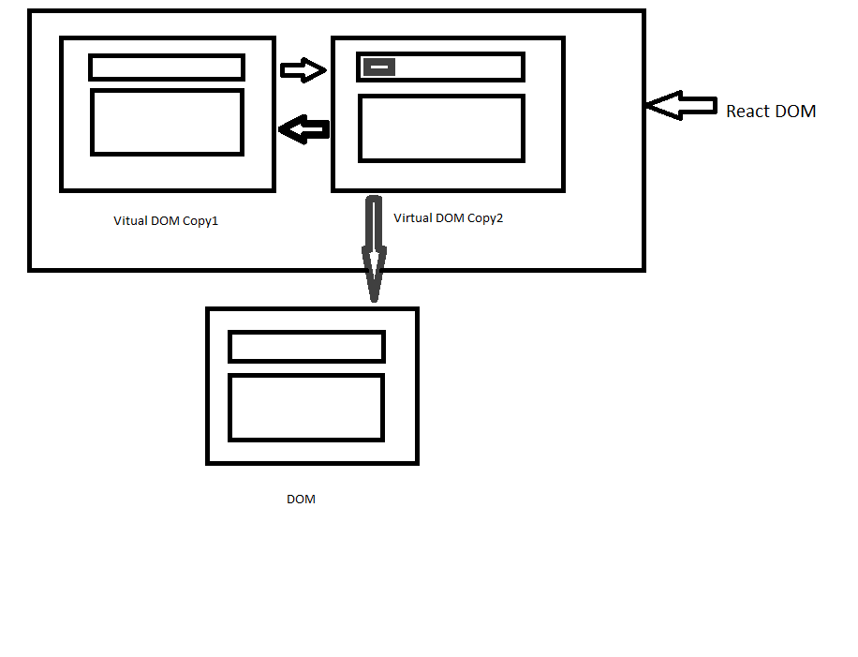
Features of React
Virtual React DOM:
React creates an in-memory data structure cache which computes the changes made and then updates the browser.
It improves the performance of application.

Slide 7
Installation of React
Add React to a Website
We can add react in html page by including CDN js library files.
<script src="https://unpkg.com/react@16/umd/react.development.js" crossorigin></script>
<script src="https://unpkg.com/react-dom@16/umd/react-dom.development.js" crossorigin></script>
<script src="like_button.js"></script>
Create a New React App
We can create a rich and single page application independently by using React App.
To build React App, we need following things.
Node.js,
React and React DOM libraries,
Webpack,
Babel loader etc.

Slide 8
Basics of React
Components
Components let you split the UI into independent, reusable pieces, and think about each piece in isolation.
There are two types of components in React.
Function Component:
function Welcome(props) {
return <h1>Hello, {props.name}</h1>;
}
Class Component:
class Welcome extends React.Component {
render() {
return <h1>Hello, {this.props.name}</h1>;
}
}

Slide 9
Basics of React
Props
React allows us to pass information to a Component using something called props(stands for properties). These are Read-Only. We cannot change the value.
function Welcome(props) {
return <h1>Hello, {props.name}</h1>;
}
const element = <Welcome name="Hello World!" />;
ReactDOM.render( element, document.getElementById('root'));
State
State allows React components to change their output over time in response to user actions, network responses, and anything else, without violating this rule.
This is a private property which cannot be accessible outside of the class. It is used to store data and can be modified within the class.

Slide 10
Basics of React
class Clock extends React.Component {
constructor(props) {
super(props);
this.state = {date: new Date()};
}
componentDidMount() {
this.timerID = setInterval(
() => this.tick(),
1000
);
}
componentWillUnmount() {
clearInterval(this.timerID);
}
tick() {
this.setState({
date: new Date()
});
}
render() {
return (
<div>
<h1>Hello, world!</h1>
<h2>It is {this.state.date.toLocaleTimeString()}.</h2>
</div>
);
}
} ReactDOM.render( <Clock />, document.getElementById('root'));

Slide 11
Basics of React
LifeCycle:
constructor: The constructor(props) method is used to initialize state.
If you don’t initialize state and you don’t bind methods, you don’t need to implement a constructor for your React component.
componentDidMount: The componentDidMount() method runs after the component output has been rendered to the DOM.
componentWillUnmount: The componentWillUnmount() is invoked immediately before a component is unmounted and destroyed.
componentDidUpdate: The componentDidUpdate() is invoked immediately after updating occurs. This method is not called for the initial render.
Use this as an opportunity to operate on the DOM when the component has been updated. This is also a good place to do network requests as long as you compare the current props to previous props (e.g. a network request may not be necessary if the props have not changed).

Slide 12
Basics of React
When <Clock /> is passed to ReactDOM.render(), React calls the constructor of the Clock component. Since Clock needs to display the current time, it initializes this.state with an object including the current time. We will later update this state.
React then calls the Clock component’s render() method. This is how React learns what should be displayed on the screen. React then updates the DOM to match the Clock’s render output.
When the Clock output is inserted in the DOM, React calls the componentDidMount() lifecycle method. Inside it, the Clock component asks the browser to set up a timer to call the component’s tick() method once a second.
Every second the browser calls the tick() method. Inside it, the Clock component schedules a UI update by calling setState() with an object containing the current time. Thanks to the setState() call, React knows the state has changed, and calls the render() method again to learn what should be on the screen. This time, this.state.date in the render() method will be different, and so the render output will include the updated time. React updates the DOM accordingly.
If the Clock component is ever removed from the DOM, React calls the componentWillUnmount() lifecycle method so the timer is stopped.

Slide 13
Basics of React
Handling Events:
React events are named using camelCase, rather than lowercase.
With JSX you pass a function as the event handler, rather than a string.
For example, the HTML:
<button onclick="addData()">
Add
</button>
is slightly different in React:
<button onClick={ addData }>
Add
</button>

Slide 14
Basics of React
List and Keys
class App extends React.Component {
render() {
const numbers = [1,2,3,4,5];
const listItems = numbers.map((number)=> <li key={number.toString()}> {number} </li>);
return (<ul>{listItems}</ul>);
}
}
List
Usually you would render lists inside a component.
Keys
Keys help React identify which items have changed, are added, or are removed. Keys should be given to the elements inside the array to give the elements a stable identity:

Slide 15
Installation of D8 Module
Download simple_react_crud Module of Drupal8 from GitHub:
https://github.com/mukeshsah08/drupal8-simple-react-crud/tree/master
Steps of Installation & Configuration:
Module installation
1. Install and enable drupal module
Run React App
2. Got to react_code
Install all dependency libraries from npm
3. npm install
Set Api path for React
4. Go to react_code\src and change the apiUrl inside config.js as per your current url of Drupal
To start the app server it will display live changes (optional)
5. npm start
To create a new build inside dist directory
6. npm run build
Run the Drupal Page having React
7. http://yourdomain.com/react/product-list

Slide 16
Reference
Get References from following sites
For React:
https://reactjs.org
For Drupal8:
https://www.drupal.org/

Slide 17
Thank You

