Slide 1
Mukesh Sundar P
Final Project
3/21/2024 Annual Review

Slide 2
Predict winners in CS:GO with Keras [80%]
3/21/2024 Annual Review

Slide 3


AGENDA
To predict the winners in CS:GO matches using Keras with an accuracy of at least 80%.
3/21/2024 Annual Review

Slide 4

PROBLEM STATEMENT
Predicting the outcome of CS:GO matches is a challenging task due to the game's complexity and the influence of various factors such as team composition, player skills, and map selection. However, accurate predictions can be valuable for betting enthusiasts and esports analysts.
3/21/2024 Annual Review

Slide 5

PROJECT OVERVIEW
The goal is to build a model that can predict the winning team (CT or T) in a CS:GO match based on historical match data. The model will be trained on features such as team composition, player statistics, and map characteristics.
3/21/2024 Annual Review

Slide 6

WHO ARE THE END USERS?
The end users of this solution could include betting enthusiasts, esports analysts, and CS:GO fans interested in match predictions.
3/21/2024 Annual Review

Slide 7

YOUR SOLUTION AND ITS VALUE PROPOSITION
The solution involves collecting and preprocessing historical CS:GO match data, including information about teams, players, maps, and match outcomes. This data will be used to train a neural network model using Keras. The model will be trained to predict the winning team based on the input features.
3/21/2024 Annual Review

Slide 8

THE WOW IN YOUR SOLUTION
One key aspect of this solution is its ability to leverage historical match data to make accurate predictions about future matches. By analyzing patterns in team performance, player statistics, and map outcomes, the model can learn to make informed predictions about match outcomes.
3/21/2024 Annual Review
8

Slide 9
MODELING
The model will be implemented using a neural network architecture in Keras. The input to the model will be features such as team composition, player statistics, and map characteristics. The output will be a binary prediction indicating the winning team (CT or T).
3/21/2024 Annual Review
9

Slide 10
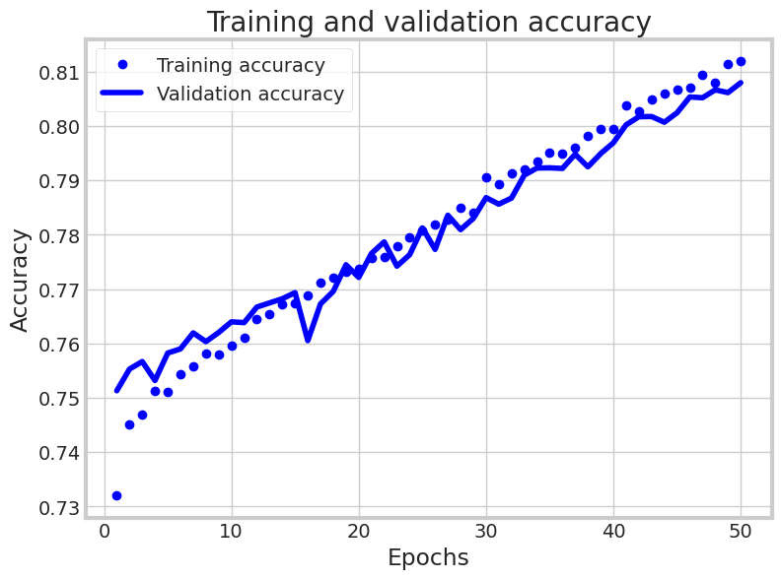
RESULTS
Notebook Link
3/21/2024 Annual Review
10

Slide 11
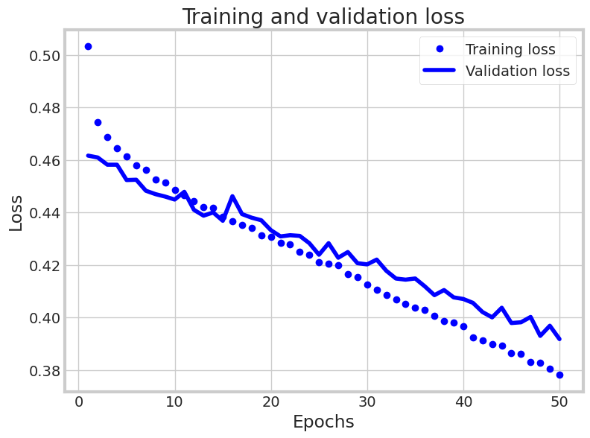
RESULTS
Notebook Link
3/21/2024 Annual Review
11

Slide 12
SUMMARY
The model will be evaluated using a test set of CS:GO matches that were not seen during training. The accuracy of the model will be calculated based on its ability to correctly predict the winning team in these matches. The goal is to achieve an accuracy of at least 80% to demonstrate the effectiveness of the model.
Notebook Link
3/21/2024 Annual Review
12

