Slide 1
Capstone Project
Battle of Neighbourhoods
Best possible location to open a new retail store in Toronto for selling Indian culinary items

Slide 2
Problem & Background
BACKGROUND
Business - selling Indian culinary items which ranges from groceries - rice, pulses to spices
Indian neighbourhood store concept but store centred around shopping places
Distance from any import hub for items or their warehouse is not a part of their analysis
This whole exercise will be like their test run. As they have a significant budget to expand store rentals/buy prices are not considered as part of the analysis
Primary business goal of the chain in this year is to enter Toronto with a small size retail outlet
Suggest the best possible location to open a new retail store in Toronto for selling Indian culinary items

Slide 3
Data Required
Data
Geography and location information – Neighbourhood Lat/Long, Postal Code and Geospatial Data
Neighbourhood Demographics - Toronto Open Data
Four Square venues data - Shops and Services, Indian Restaurant, Travel and Transport

Slide 4
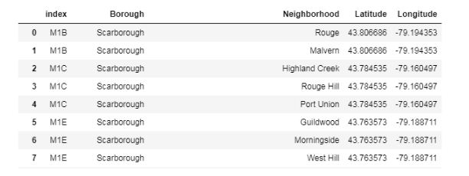
Data Required - Snapshots
Geography and location information of the neighbourhoods. E.g. latitude, longitude, postal codes. We will use https://en.wikipedia.org/wiki/List_of_postal_codes_of_Canada:_M, for the postal codes and either Geocoder or the following csv file for the postal codes http://cocl.us/Geospatial_data . Read/Queried data would look as below

Slide 5
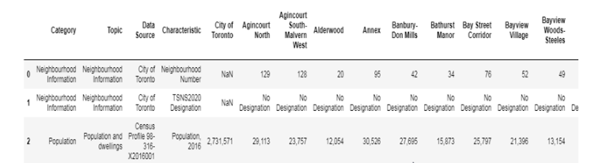
Data Required - Snapshots
Demographics of the neighbourhoods - for this analysis we will use the data available in the following Toronto Open Data site https://www.toronto.ca/city-government/data-research-maps/open-data/open-data-catalogue/#8c732154-5012-9afe-d0cd-ba3ffc813d5a CSV file - https://www.toronto.ca/ext/open_data/catalog/data_set_files/2016_neighbourhood_profiles.csv . Note that here we will limit our analysis to the neighbourhoods of the postal codes available. Queried demographic data from the csv file will look as below

Slide 6
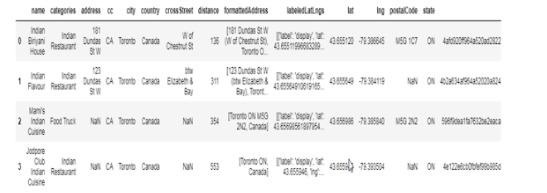
Data Required - Snapshots
We would need venue information in that neighbourhood which could provide us details like restaurants nearby, shopping areas, distances and popularity. For this we will leverage Foursquare data. The type of venue categories we would look at are Indian/Asian restaurants, Food, Shops and service, Travel and transport. Examples from Foursquare resource categories are Indian Restaurant - 4bf58dd8d48988d10f941735, Shop & Service - 4d4b7105d754a06378d81259. For examples Indian restaurants near Scarborough Village queries for, will look as below

Slide 7
Methodology
Content based recommendation - We use a content (venue) based recommendation model as the problem asks us to recommend a particular location.
To build the same we will use a reference priority rating of neighbourhoods using the population parameter. As customer wants to open the store in a neighbourhood location with higher Asian population, this reference provides us the priority of neighbourhoods based on South Asian population percentage. We consider South Asian population (esp Indian population) assign a preference priority of neighbourhoods for those with higher South Asian population.
Additionally the Foursquare venue categories i.e. Bus Stop, Shops and services, Metro stations and Indian Restaurants will be used to provide a weighted order of importance of the "venues" metric i.e. which type of venues do we consider as most important - presence of Bus stops or Metro or Shops and service or Indian restaurant - which ones are most co-related.
And based on number of such nearby venues available for each of the neighbourhood locations (output of Foursquare API search) and weighted venue metric, we will determine the top preferred location among the available neighborhoods using a weighted average of priorities for the neighborhoods.

Slide 8
Methodology - Recommendation Model
Reference priority for preferred neighborhoods
- based on South Asian population % (Customers main consideration)
Recommendation output –weighted average per neighbourhood – highest amongst them is our recommendation
Normalized Venue Counts per neighbourhood – MinMax scaler
Venue matrix – weight of each venue category
Feature list -
Four Square Venues data Indian Restaurants
Shops and Services
Bus Stop
Metro Stations
Snapshot in the next few slides will show data in each of the following steps

Slide 9
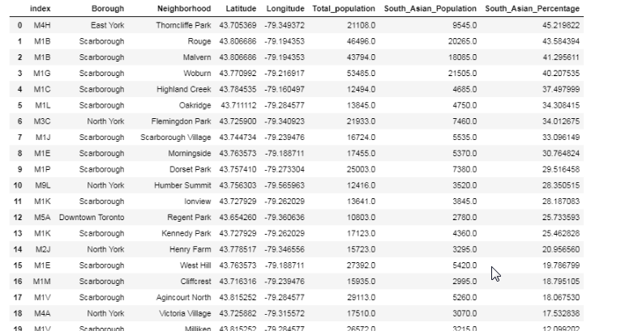
Analysis - Snapshots
Neighbourhood South Asian Population Percentages

Slide 10
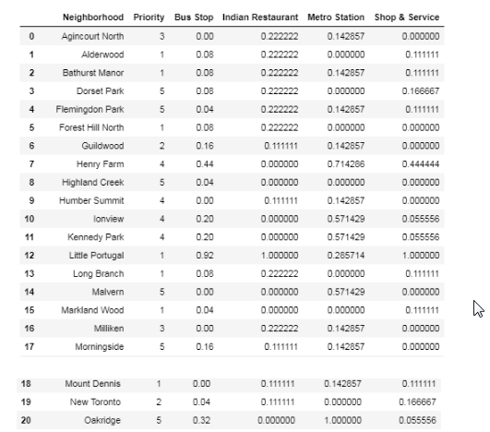
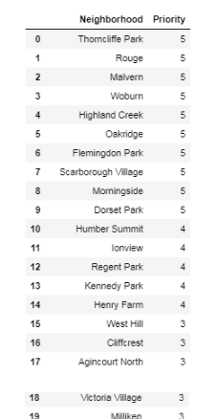
Analysis - Snapshots
Neighbourhood customer preference priority/rating based on population percentages
Normalized venue counts of data fetched from Four Square

Slide 11
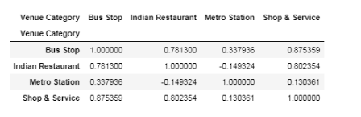
Analysis - Snapshots
Pearson correlation - As we can see Bus stop, Indian Restaurant, Shops and service have a high Pearson coefficient > 75% and a p-value < 0.001.
By standards, p-value < 0.001 shows that the co-relation among these is highly significant. We can see that Metro station has a very low Pearson correlation (0.33, -0.14, 0.13)
The p-values also show that Bus stops, Indian Restaurants and Shop & Services are also statistically significant

Slide 12
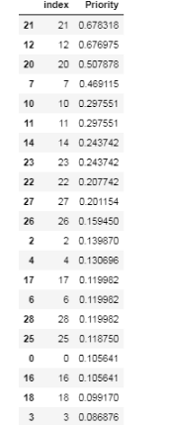
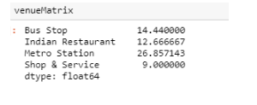
Analysis - Snapshots
Weighted venue matrix dot product to get weight each venue type category per the reference priorities
Using the above priority matrix and weights the final recommendation is calculated by calculating the weighted average priority/rating for every neighbourhood.

Slide 13
Conclusion
The customer should open the culinary items store in "Regent Park" neighbourhood in Toronto.
This has been suggested based on the analysis of the key data points of South Asian population concentration and vicinity of various venues like Indian Restaurants, Shops and Bus stops.
Because of proximity to Indian Restaurants, the customer can explore tie-ups or partnerships for the restaurants culinary requirements in bulk. Also availability of Bus stops and Shops and Services provides the customer's store with relevant eyeballs and the customer can look at easier access to delivery.
As expected by the customer on the test run, I suggest a six-month test run with a shop on rental basis to start with and the existing store items catalogue, to gauge the sales and returns on investment

Slide 14
For Further Discussion
Few more important parameters for consideration and better analysis will be -
In this analysis we have restricted venue data within a 500m radius and 30 venues. We could increase or tweak this limit
Considering Real estate/store rental or buy prices of the neighbourhoods
Considering proximity or distance from warehouse
Supply chain strategy for delivery from any import unit or warehouse
While we have excluded these assuming a no-restriction on budget, the above will definitely be significant criterions for the store location prediction

Slide 15
Thank You

