Slide 1


Sistem Interaksi Qubit dan Osilator Harmonik
Review dari Artikel: Qubit-oscillator systems in the ultrastrong-coupling regime and their potential for preparing nonclassical states, oleh S. Ashhab dan Franco Nori
Muhammad Oktavyan Hardiyono¹, Mukhamad Azis Tholib¹, Reta Lola Oftaviana¹, Ahmad Ridwan Tresna Nugraha²
Universitas Negeri Malang¹
Lembaga Ilmu Pengetahuan Indonesia²
September 2021
1/15
KPL BRIN 2021

Slide 2
KERANGKA PRESENTASI
Motivasi: menuju komputer kuantum
Model sistem:
Atom / molekul / zat padat → sistem dua level
Cahaya → osilator harmonik
Interaksi qubit-osilator:
Hamiltonian sistem
Pendekatan analitik, numerik (qutip)
Hasil dan pembahasan:
Variasi energi qubit-osilator
Variasi gap dan bias
Kesimpulan
2/15
KPL BRIN 2021

Slide 3
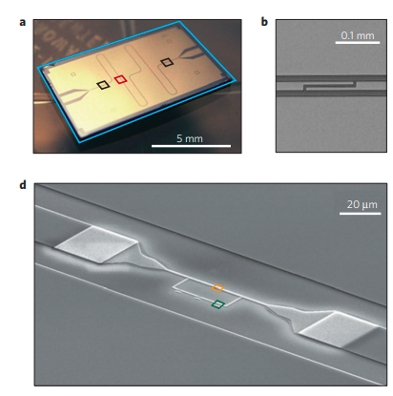
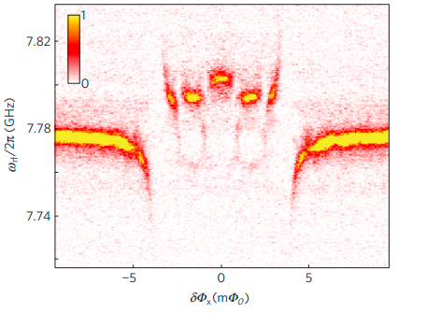
MOTIVASI
Niemczyk, et al., Nature Physics (2010)
3/15
KPL BRIN 2021

Slide 4
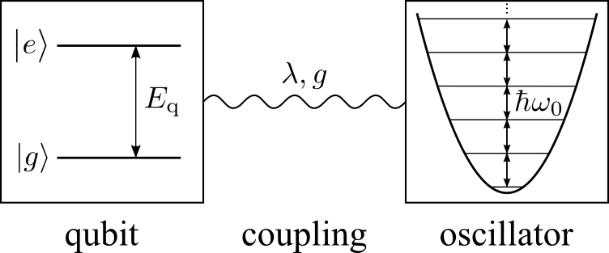
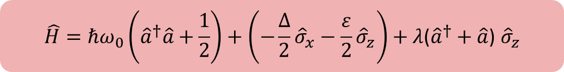

MODEL SISTEM
qubit
osilator
interaksi
$λ =$ parameter interaksi
$$\hat{H}=ℏω_{0}\left({\hat{a}}^{†}\hat{a}+\frac{1}{2}\right)+\left(−\frac{∆}{2}{\hat{σ}}_{x}−\frac{ε}{2}{\hat{σ}}_{z}\right)+λ\text{(}{\hat{a}}^{†}+\hat{a}\text{)} {\hat{σ}}_{z}$$
4/15
KPL BRIN 2021

Slide 5
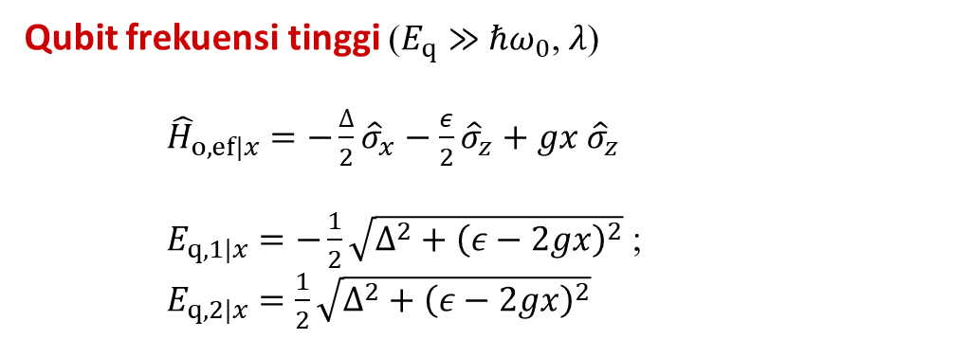
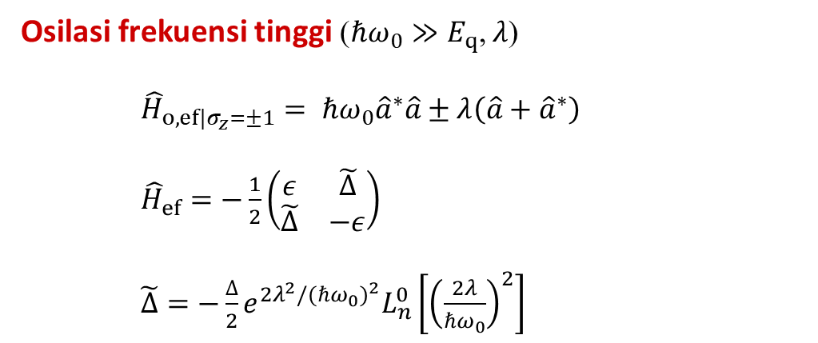
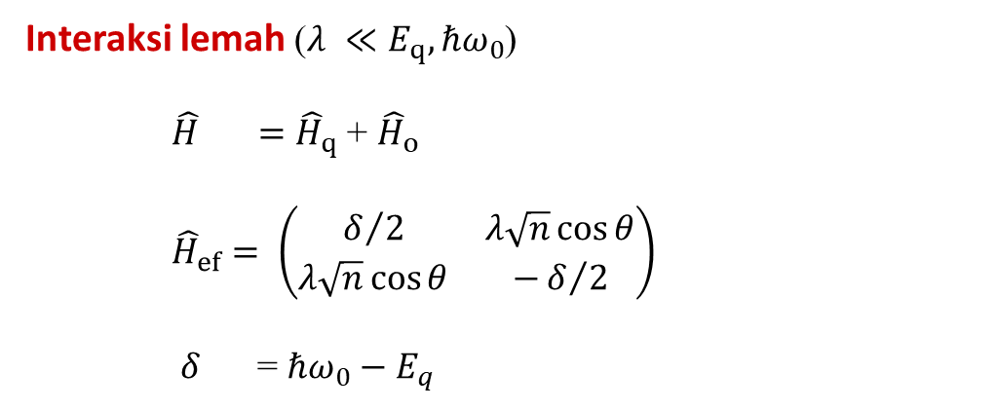
SEKILAS METODE ANALITIK
Interaksi lemah ($λ ≪E_{q}, ℏω_{0}$)
$\hat{H} ={\hat{H}}_{q}$ + ${\hat{H}}_{o}$
${\hat{H}}_{ef}= \left(\begin{matrix}δ/2 & λ\sqrt{n}\cos{θ} \\ λ\sqrt{n}\cos{θ} & −δ/2\end{matrix}\right)$
$δ$ = $ℏω_{0}−$ $E_{q}$
Qubit frekuensi tinggi ($E_{q}≫$ $ℏω_{0}$, $λ$)
${\hat{H}}_{o,ef|x}=−\frac{∆}{2}{\hat{σ}}_{x}−\frac{ε}{2}{\hat{σ}}_{z}+gx {\hat{σ}}_{z}$
$E_{q,1|x}=−\frac{1}{2}\sqrt{Δ^{2}+{\left(ε−2gx\right)}^{2}}$ ;
$E_{q,2|x}=\frac{1}{2}\sqrt{Δ^{2}+{\left(ε−2gx\right)}^{2}}$
Osilasi frekuensi tinggi ($ℏω_{0}≫E_{q}$, $λ$)
${\hat{H}}_{o,ef|σ_{z}=±1}= ℏω_{0}{\hat{a}}^{∗}\hat{a}±λ\left(\hat{a}+{\hat{a}}^{∗}\right)$
${\hat{H}}_{ef}=−\frac{1}{2}\left(\begin{matrix}ε & \tilde{∆} \\ \tilde{∆} & −ε\end{matrix}\right)$
$\tilde{Δ}=−\frac{∆}{2}e^{2λ^{2}/{(ℏω_{0})}^{2}}L_{n}^{0}\left[{\left(\frac{2λ}{ℏω_{0}}\right)}^{2}\right]$
5/15
S. Ashhab, F. Nori (2010)
KPL BRIN 2021

Slide 6
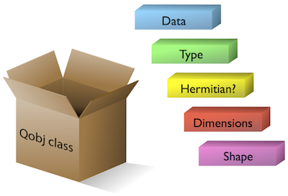
TENTANG PACKAGE QUTIP
State
Operator
6/15
KPL BRIN 2021

Slide 7
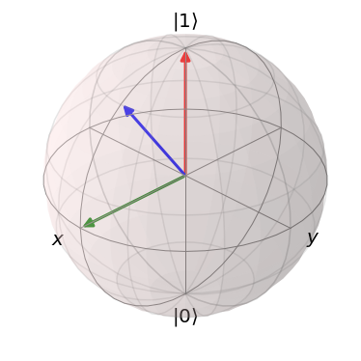
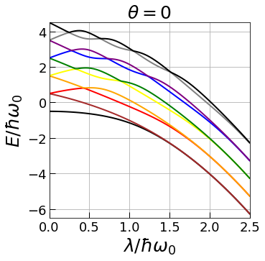
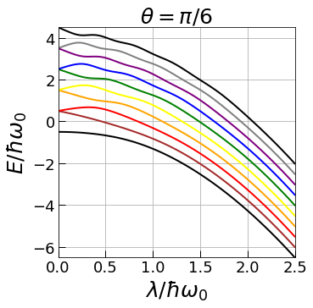
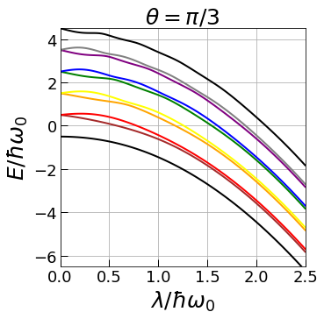

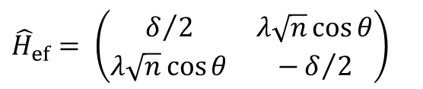



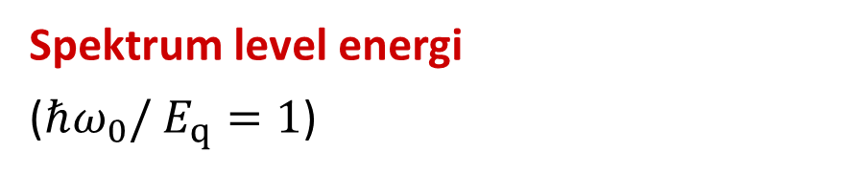
HASIL NUMERIK
Spektrum level energi
($ℏω_{0}/$ $E_{q}=1$)
$${\hat{H}}_{ef}= \left(\begin{matrix}δ/2 & λ\sqrt{n}\cos{θ} \\ λ\sqrt{n}\cos{θ} & −δ/2\end{matrix}\right)$$
$$ε$$
$δ$ = $ℏω_{0}−$ $E_{q}$
$$θ$$
$$∆$$
7/15
KPL BRIN 2021

Slide 8
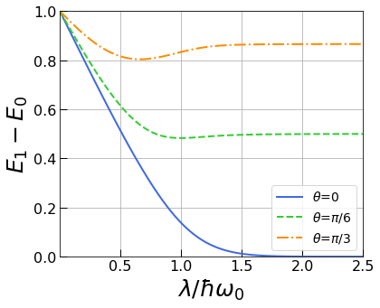
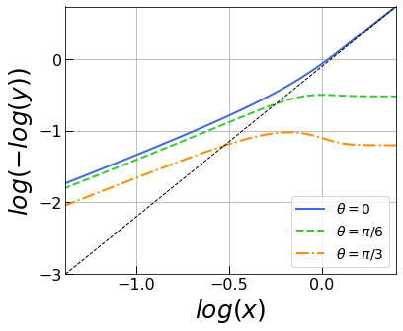


HASIL NUMERIK
Spektrum level energi
($ℏω_{0}/$ $E_{q}=1$)
$$\tilde{Δ}=−\frac{∆}{2}e^{2λ^{2}/{(ℏω_{0})}^{2}}L_{n}^{0}\left[{\left(\frac{2λ}{ℏω_{0}}\right)}^{2}\right]$$
8/15
KPL BRIN 2021

Slide 9
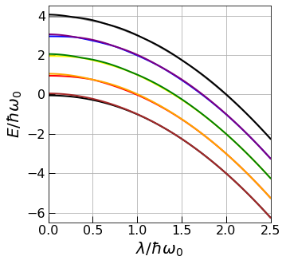
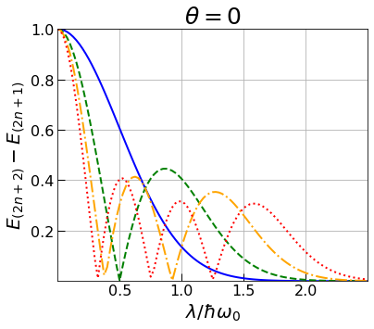
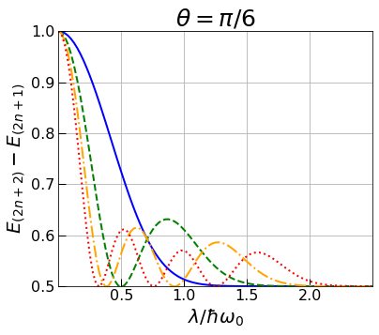
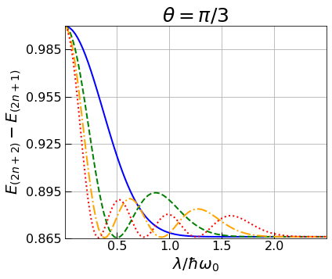


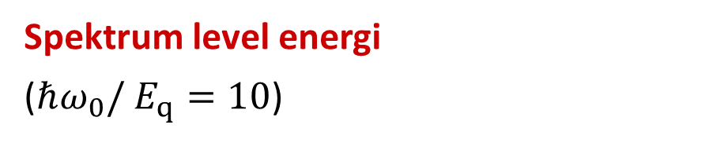

HASIL NUMERIK
Spektrum level energi
($ℏω_{0}/$ $E_{q}=10$)
$$ε$$
$$θ$$
$$∆$$
$δ$ = $ℏω_{0}−$ $E_{q}$
9/15
KPL BRIN 2021

Slide 10
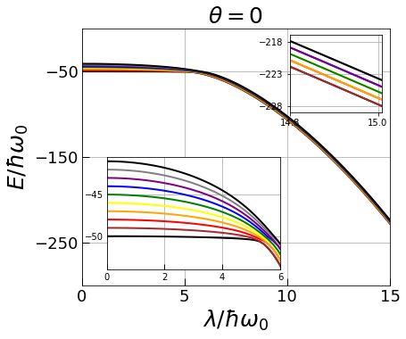
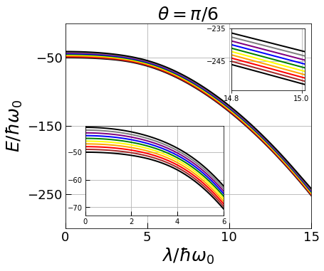
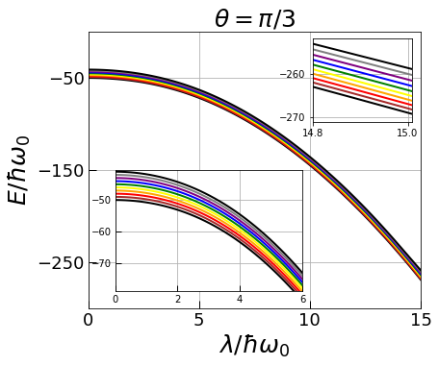



HASIL NUMERIK
Spektrum level energi
($ℏω_{0}/$ $E_{q}=100$)
$$ε$$
$$θ$$
$$∆$$
10/15
KPL BRIN 2021

Slide 11
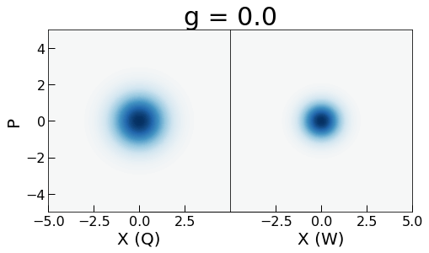
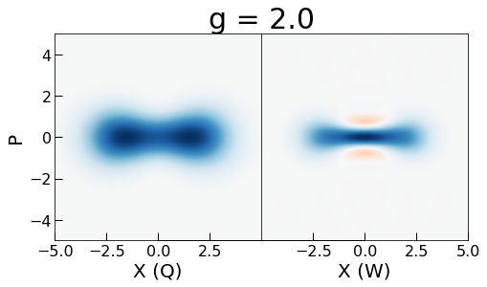
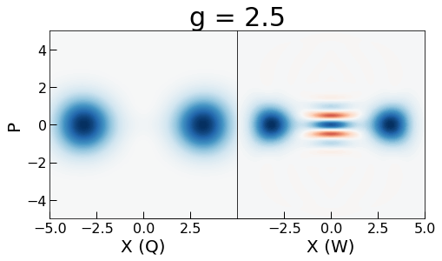
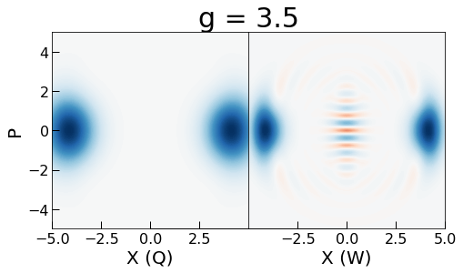
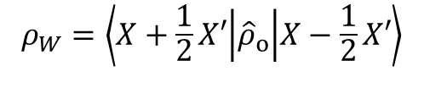
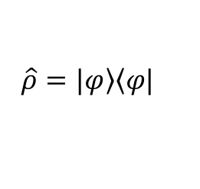
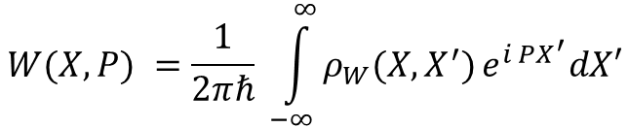

HASIL NUMERIK
Fungsi Q
$$\hat{ρ}=|\left.φ\right\rangle \left\langle φ|\right.$$
Kerapatan
$$Q = \frac{1}{π}\left\langle X+i P | {\hat{ρ}}_{o} | X+i P\right\rangle$$
Fungsi Wigner
$$W(X,P) =\frac{1}{2πℏ} \int_{−∞}^{∞}{ρ_{W}(X, X^{′})}e^{i PX^{′}}dX′$$
$$ρ_{W}=\left\langle X+\frac{1}{2}X′ | {\hat{ρ}}_{o} | X−\frac{1}{2}X′\right\rangle$$
11/15
KPL BRIN 2021

Slide 12
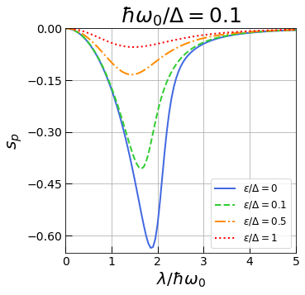
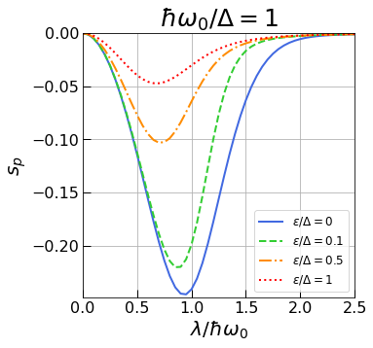
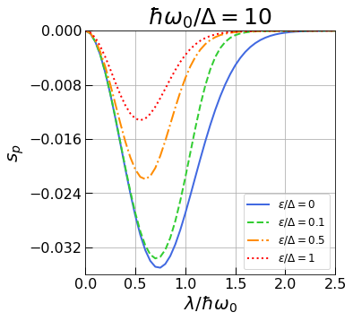
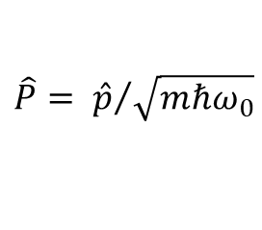

HASIL NUMERIK
Pemampatan (squeezing)
$$s_{p}=4\left\langle {\left(\hat{P} − \left\langle \hat{P}\right\rangle \right)}^{2}\right\rangle −1$$
S. Ashhab, F. Nori (2010)
$$\hat{P}= {\hat{p}}/{\sqrt{mℏω_{0}}}$$
A. I. Lvovsky (2018)
12/15
KPL BRIN 2021

Slide 13
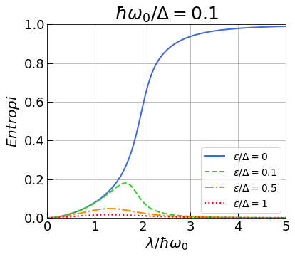
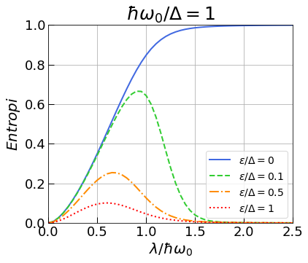
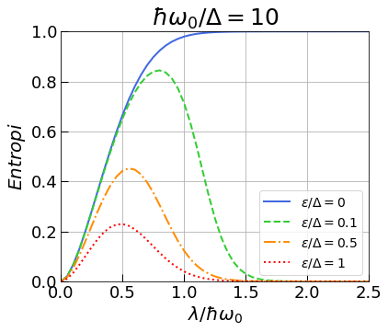

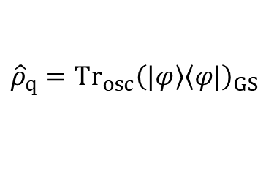
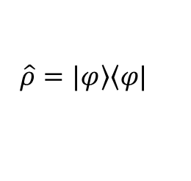
HASIL NUMERIK
Entropi
$$\hat{ρ}=|\left.φ\right\rangle \left\langle φ|\right.$$
Kerapatan
$${\hat{ρ}}_{q}={Tr}_{osc}{\left(|\left.φ\right\rangle \left\langle φ|\right.\right)}_{GS}$$
$$S=Tr\left({\hat{ρ}}_{q}\log_{2}{{\hat{ρ}}_{q}}\right)$$
Von Neumann
13/15
KPL BRIN 2021

Slide 14
KESIMPULAN
Sirkuit superkonduktor memungkinkan kita untuk memasuki rezim baru rongga QED: rezim kopling ultra kuat, dan baru-baru ini dinamai rezim kopling kuat dalam.
Keadaan dasar dari sistem osilator qubit menunjukkan sifat yang menarik saat kekuatan kopling meningkat: tekanan muncul untuk kekuatan kopling menengah, dan belitan kuat muncul untuk kopling yang sangat kuat
Rezim qubit frekuensi tinggi menunjukkan perubahan mendadak, yang akan menarik untuk diamati secara eksperimental.
14/15
KPL BRIN 2021

Slide 15
15/15
KPL BRIN 2021

Slide 16
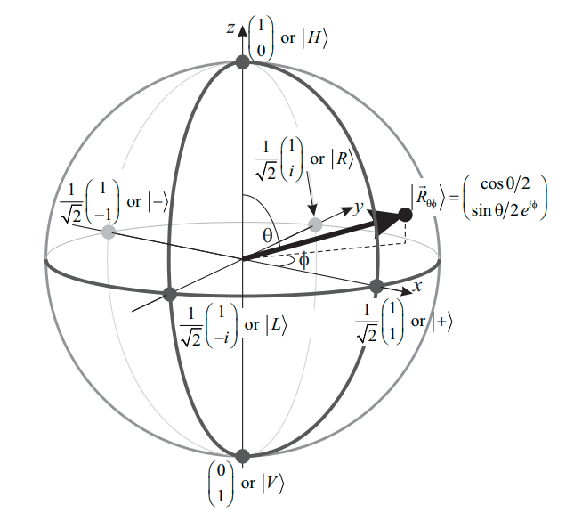


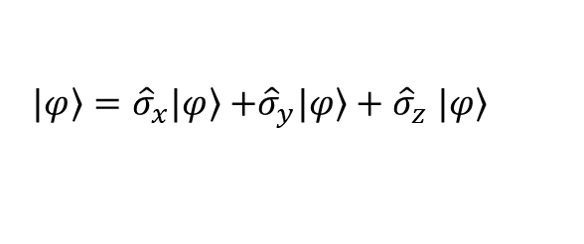
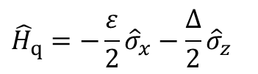

APENDIKS
Bola Bloch
Matriks Pauli
$${\hat{σ}}_{x}≡\left[\begin{matrix}0 & 1 \\ 1 & 0\end{matrix}\right];$$
$${\hat{σ}}_{y}≡\left[\begin{matrix}0 & −i \\ i & 0\end{matrix}\right];$$
$${\hat{σ}}_{z}≡\left[\begin{matrix}1 & 0 \\ 0 & −1\end{matrix}\right]$$
$|\left.φ\right\rangle ={\hat{σ}}_{x}|\left.φ\right\rangle$ $+{\hat{σ}}_{y}|\left.φ\right\rangle +{\hat{σ}}_{z} |\left.φ\right\rangle$
$${\hat{H}}_{q}=−\frac{ε}{2}{\hat{σ}}_{x}−\frac{∆}{2}{\hat{σ}}_{z}$$
-/15
A. I. Lvovsky (2018)
KPL BRIN 2021

Slide 17
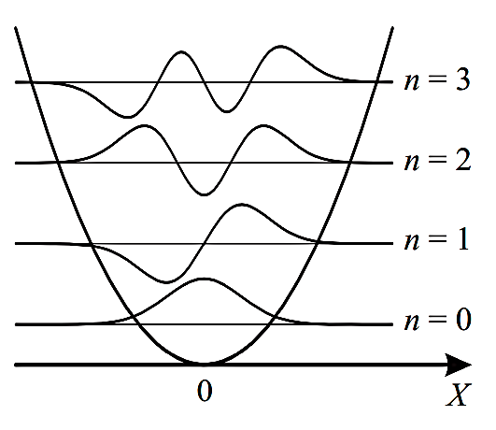
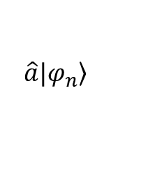

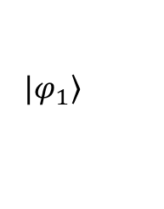
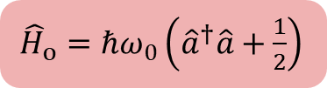
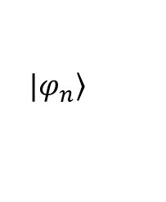

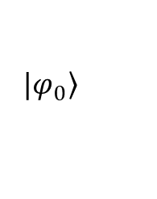
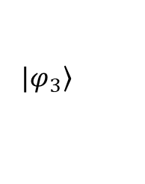










APENDIKS
Medan Osilasi Kuantum
$${\hat{a}}^{†}{\hat{a}}^{†}|\left.φ_{n}\right\rangle$$
$$E_{n}+2ℏω_{0}$$
$E_{M}= \frac{1}{2}\frac{p^{2}}{m}+\frac{1}{2}mω_{0}^{2}x^{2}$
${\hat{H}}_{o}=\frac{{\hat{p}}^{2}}{2m}+\frac{1}{2}mω_{0}^{2}{\hat{x}}^{2}$
$${\hat{a}}^{†}|\left.φ_{n}\right\rangle$$
$$E_{n}+ℏω_{0}$$
$${\hat{a}}^{†}≡\frac{−i\hat{p}+mω_{0}\hat{x}}{\sqrt{2mℏω_{0}}}$$
$$\hat{a}≡\frac{i\hat{p}+mω_{0}\hat{x}}{\sqrt{2mℏω_{0}}}$$
$$|\left.φ_{n}\right\rangle$$
$$E_{n}$$
$$\hat{a}|\left.φ_{n}\right\rangle$$
$E_{n}−$ $ℏω_{0}$
${\hat{H}}_{o}=ℏω_{0}\left({\hat{a}}^{†}\hat{a}+\frac{1}{2}\right)$
$$\hat{a}\hat{a}|\left.φ_{n}\right\rangle$$
$$E_{n}−2ℏω_{0}$$
$$|\left.φ_{3}\right\rangle$$
$E_{o}=\left(n+\frac{1}{2}\right)ℏω_{0}$
$$|\left.φ_{2}\right\rangle$$
$$|\left.φ_{1}\right\rangle$$
$$|\left.φ_{0}\right\rangle$$
-/15
A. I. Lvovsky (2018)
C. C. Gerry, P. L. Knight (2004)
KPL BRIN 2021

Slide 18

APENDIKS
Source:
https://nbviewer.ipython.org/github/jrjohansson/qutip-lectures/blob/master/Lecture-1-Jaynes-Cumming-model.ipynb
-/15
KPL BRIN 2021

