Slide 1
TRANSFORMERS | VARIATIONAL AUTOENCODERS | AGENTIC AI
Deep Learning Triad
Theory, implementation, baselines, and measured evaluation
Deep Learning | Dr. Anup Kumar Maurya | Academic Year 2026-27
TEAM: [NAME + ROLL] x 6 - human input required before submission
Seed 42 | disjoint evaluation | results generated 9 Nov 2026
01
Notes:
Member A: introduce the three distinct concepts and state that every number shown comes from an executed run.

Slide 2
VERIFIED DEEP LEARNING EXPERIMENTS
Assignment objectives and contribution
Questions
Contribution
• How does attention support sentiment classification?
• How does a variational latent space trade reconstruction for regularization?
• How much QA error comes from retrieval versus answer extraction?
• Three modalities: text classification, image reconstruction, grounded QA.
• Disjoint splits, fixed seed, baselines, runtime provenance, and saved predictions.
• Fast smoke runs plus full experiments on one reproducible GPU environment.
Seed 42 | disjoint evaluation | results generated 9 Nov 2026
02

Slide 3
VERIFIED DEEP LEARNING EXPERIMENTS
Reproducibility and compute evidence
Item | Verified configuration
Python | 3.11.15
PyTorch / CUDA | 2.11.0+cu128 / 12.8
GPU | NVIDIA GeForce GTX 1660 Ti (6 GiB)
Seed | 42 for all three experiments
Validation | 4 unit tests + compileall + result schema checks
Integrity gates
• No test examples used for fitting or tuning.
• No answer text enters the QA retrieval index.
• Fast and full outputs archived separately.
• Metrics and plots written only after successful execution.
Seed 42 | disjoint evaluation | results generated 9 Nov 2026
03

Slide 4
VERIFIED DEEP LEARNING EXPERIMENTS
One workflow, three different evaluation lenses
CLASSIFICATION
GENERATION
TOOL WORKFLOW
IMDb text -> DistilBERT -> accuracy / F1
Fashion image -> ConvVAE -> BCE / KL / MSE
Question -> retrieve -> extract -> EM / token F1
Scores are interpreted within each task; raw values are not compared across incompatible metrics.
Seed 42 | disjoint evaluation | results generated 9 Nov 2026
04

Slide 5
VERIFIED DEEP LEARNING EXPERIMENTS
Transformer foundation: scaled dot-product attention
Why pretrained?
Attention(Q, K, V) = softmax(QK^T / sqrt(d_k)) V
• IMDb fast mode has only 800 training reviews.
• Transfer learning supplies broad language representations.
• Fine-tuning adapts those representations to positive/negative sentiment.
• Q asks what each token seeks; K identifies what tokens contain; V carries content.
• Multi-head attention learns several token relationships in parallel.
• DistilBERT is a compact pretrained encoder fine-tuned with a binary head.
Seed 42 | disjoint evaluation | results generated 9 Nov 2026
05

Slide 6
VERIFIED DEEP LEARNING EXPERIMENTS
Transformer experiment architecture
Review
Tokenizer
192 tokens
DistilBERT
Classifier
Sentiment
->
->
->
->
->
AdamW | lr 2e-5 | dynamic padding | 2 full epochs | seed 42
Seed 42 | disjoint evaluation | results generated 9 Nov 2026
06

Slide 7
VERIFIED DEEP LEARNING EXPERIMENTS
IMDb protocol: disjoint train, validation, and test
Mode | Train | Validation | Test | Epochs
Fast | 800 | 200 | 200 | 1
Full | 20,000 | 5,000 | 5,000 | 2
Leakage control
• Train/validation: non-overlapping ranges after seeded shuffle of original train.
• Test: sampled only from IMDb original test split.
• Model and threshold choices never use test labels.
Dataset: stanfordnlp/imdb (25k original train + 25k original test)
Seed 42 | disjoint evaluation | results generated 9 Nov 2026
07

Slide 8
VERIFIED DEEP LEARNING EXPERIMENTS
Transformer implementation: actual training path
args = TrainingArguments(
num_train_epochs=2, learning_rate=2e-5,
seed=42, data_seed=42, full_determinism=True
)
trainer = Trainer(
model=model, processing_class=tokenizer,
data_collator=DataCollatorWithPadding(tokenizer),
compute_metrics=metric_fn
)
trainer.train()
test_prediction = trainer.predict(test_ds)
Quality additions
• Binary F1 plus macro F1.
• Majority-label baseline on the same test set.
• Confusion matrix and classification report.
• Python, library, GPU, elapsed time stored in JSON.
Seed 42 | disjoint evaluation | results generated 9 Nov 2026
08

Slide 9
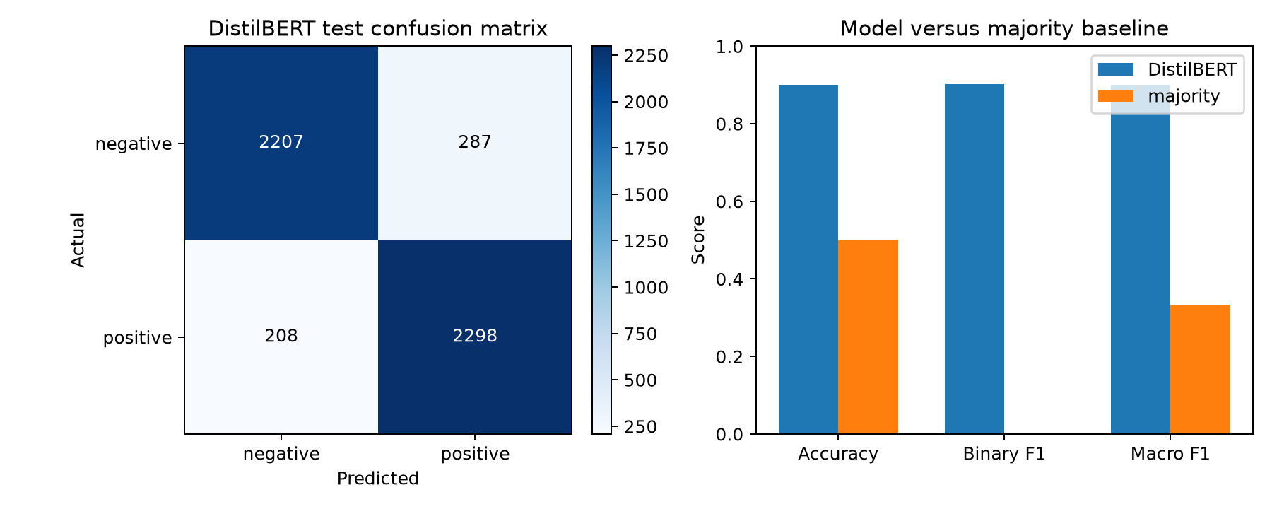
VERIFIED DEEP LEARNING EXPERIMENTS
Transformer full results: 5,000 held-out reviews
Measured results
• Accuracy: 90.10%
• Binary F1: 90.28%
• Macro F1: 90.10%
• Majority accuracy: 49.88%
• Confusion matrix: [[2207, 287], [208, 2298]]
• Train + evaluation: 1064.6s
Seed 42 | disjoint evaluation | results generated 9 Nov 2026
09

Slide 10
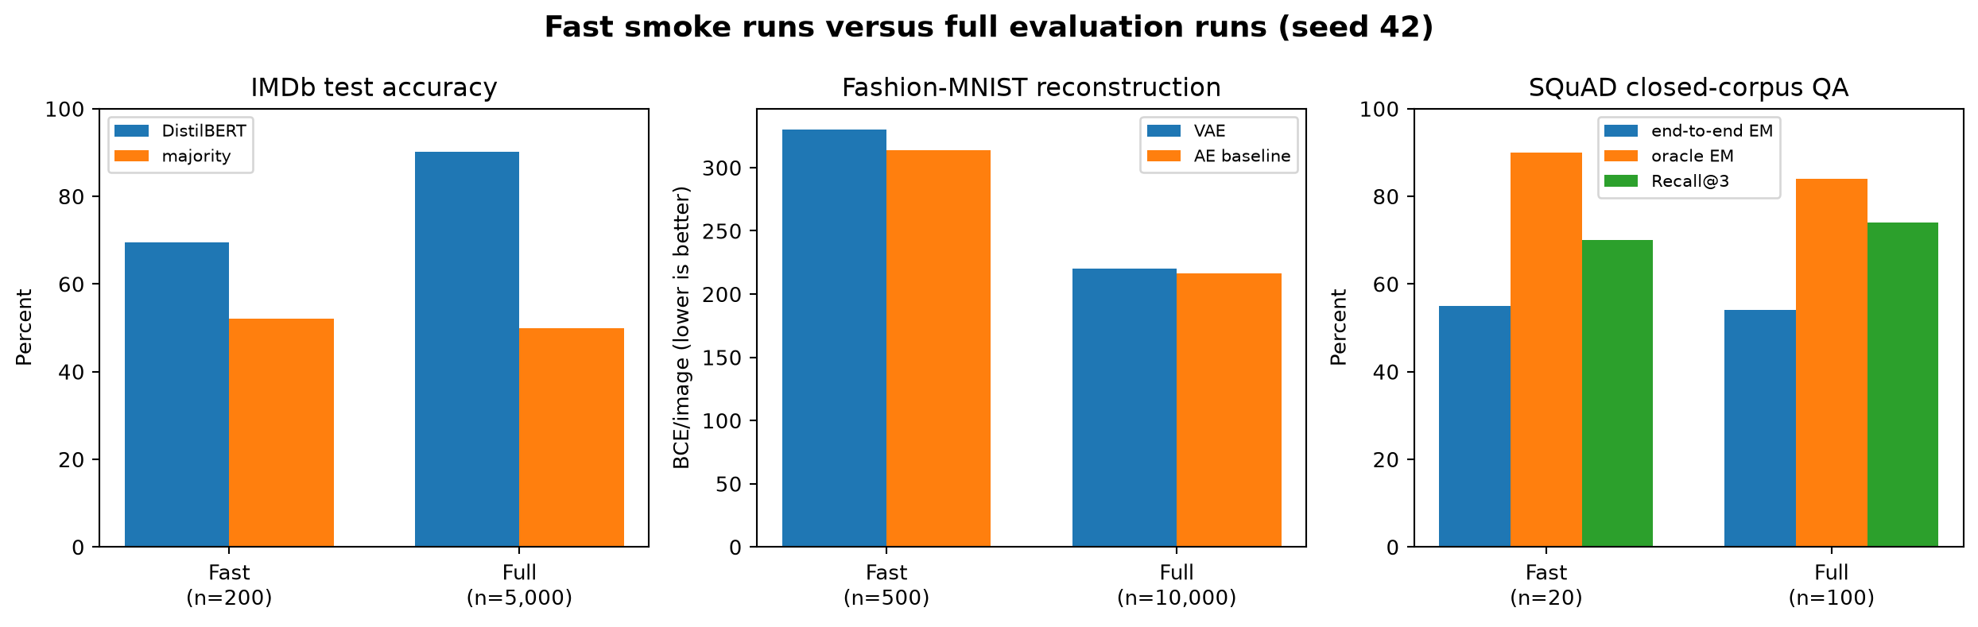
VERIFIED DEEP LEARNING EXPERIMENTS
Fast versus full runs: scale changes the evidence
Interpretation
• IMDb accuracy rose from 69.5% to 90.1%.
• Full VAE training greatly reduced reconstruction error.
• QA fast/full differences show why n=20 is only a smoke test.
• Baselines contextualize each task; metrics remain task-specific.
Seed 42 | disjoint evaluation | results generated 9 Nov 2026
10

Slide 11
VERIFIED DEEP LEARNING EXPERIMENTS
VAE foundation: probabilistic latent representation
Encoder and reparameterization
Objective (negative ELBO)
q_phi(z|x) -> mu, log(sigma^2)
Loss = BCE(x, x_hat) + beta * KL(q || N(0,I))
z = mu + sigma * epsilon, epsilon ~ N(0, I)
• BCE rewards pixel reconstruction.
• KL regularizes the latent distribution.
• beta = 1 in both fast and full runs.
• Sampling remains differentiable through mu and sigma.
• The decoder reconstructs x from the latent z.
Seed 42 | disjoint evaluation | results generated 9 Nov 2026
11

Slide 12
VERIFIED DEEP LEARNING EXPERIMENTS
Convolutional VAE architecture
28x28 image
Conv 32
14x14
Conv 64
7x7
mu + logvar
16-D
Sample z
Transpose conv
28x28
->
->
->
->
->
Deterministic baseline: same convolutional encoder/decoder shape, one 16-D bottleneck, no KL term.
Seed 42 | disjoint evaluation | results generated 9 Nov 2026
12

Slide 13
VERIFIED DEEP LEARNING EXPERIMENTS
Fashion-MNIST protocol and split integrity
Mode | Train | Validation | Test | Epochs
Fast | 2,000 | 400 | 500 | 2
Full | 50,000 | 10,000 | 10,000 | 12
Protocol
• Seeded permutation of original 60k train.
• Adjacent non-overlapping train/validation subsets.
• Original 10k test remains untouched.
• Pixels scaled to [0,1]; batch 128; Adam lr 1e-3.
Both VAE and AE baseline see exactly the same examples and epoch count.
Seed 42 | disjoint evaluation | results generated 9 Nov 2026
13

Slide 14
VERIFIED DEEP LEARNING EXPERIMENTS
VAE implementation: actual loss and baseline
h = self.enc(x)
mu, logvar = self.mu(h), self.logvar(h)
z = mu + torch.randn_like(mu) * torch.exp(0.5 * logvar)
recon = self.dec(self.fc(z))
rec = BCE(recon, x, reduction='sum') / batch
kl = -0.5 * sum(1 + logvar - mu**2 - exp(logvar)) / batch
loss = rec + beta * kl
loss.backward()
Fair comparison
• VAE evaluation uses latent mean mu for deterministic reconstruction.
• AE baseline optimizes reconstruction BCE only.
• Compare reconstruction BCE/MSE, not AE loss with VAE ELBO.
• Full weights saved outside Git under outputs/.
Seed 42 | disjoint evaluation | results generated 9 Nov 2026
14

Slide 15
VERIFIED DEEP LEARNING EXPERIMENTS
VAE full results and deterministic baseline
Metric (test n=10,000) | ConvVAE | ConvAE baseline
Reconstruction BCE / image | 220.06 | 216.22
MSE / pixel | 0.01261 | 0.01093
KL / image | 17.47 | not applicable
ELBO loss / image | 237.53 | not comparable
Finding
• AE wins pure reconstruction, as expected.
• VAE pays a KL cost to organize a sampleable latent distribution.
• Both models completed 12 epochs; total script time 396.3s.
Seed 42 | disjoint evaluation | results generated 9 Nov 2026
15

Slide 16
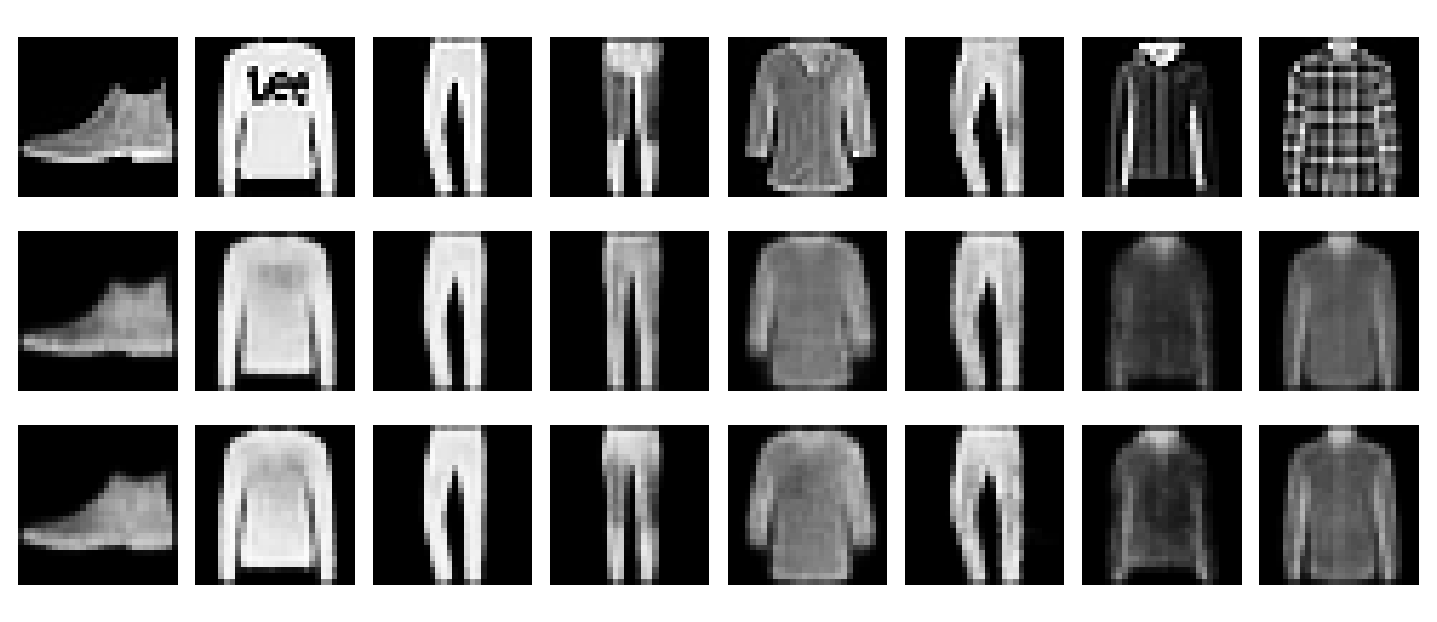
VERIFIED DEEP LEARNING EXPERIMENTS
VAE qualitative evaluation: originals and reconstructions
What to inspect
• Garment silhouette is retained.
• Fine texture and sharp edges are smoothed.
• AE baseline is slightly sharper, consistent with lower BCE/MSE.
• Visuals complement, not replace, test metrics.
Seed 42 | disjoint evaluation | results generated 9 Nov 2026
16

Slide 17
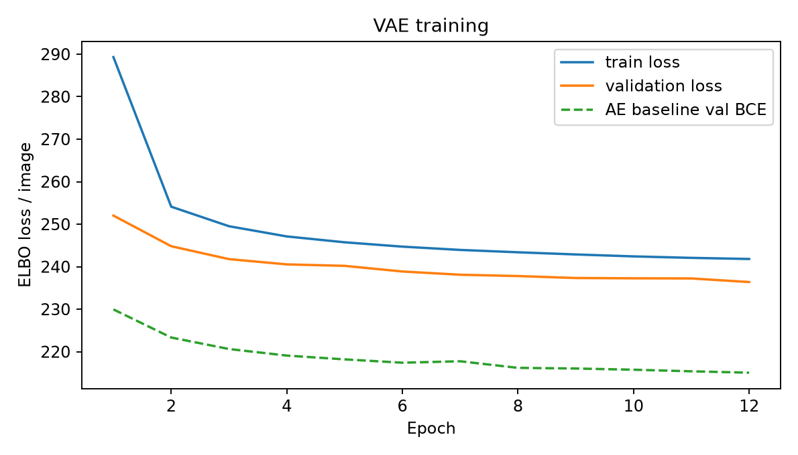
VERIFIED DEEP LEARNING EXPERIMENTS
VAE learning curves: convergence and diminishing returns
Reading the curves
• Largest improvement occurs in early epochs.
• Validation VAE ELBO falls from 252.02 to 236.39.
• Train and validation trends remain close: no strong overfitting signal.
• AE curve is reconstruction BCE, not ELBO.
Seed 42 | disjoint evaluation | results generated 9 Nov 2026
17

Slide 18
VERIFIED DEEP LEARNING EXPERIMENTS
Agentic AI: a transparent tool-use workflow
Implemented agent
Claim boundary
• Deterministic router recognizes bounded arithmetic.
• TF-IDF retrieves top-3 passages from a closed corpus.
• Extractive QA proposes spans; score combines relevance and QA confidence.
• Returns source ID, scores, excerpt, or abstention.
• Not an autonomous LLM planner.
• Not web search or open-domain research.
• A lightweight, auditable orchestration pipeline.
• Calculator uses restricted AST operations - never eval().
Seed 42 | disjoint evaluation | results generated 9 Nov 2026
18

Slide 19
VERIFIED DEEP LEARNING EXPERIMENTS
Agentic QA pipeline and provenance
Question
Route
TF-IDF
top 3
QA each
passage
Rerank
Answer +
source
->
->
->
->
->
candidate score = QA confidence x max(TF-IDF relevance, epsilon)
Threshold 0.05 controls abstention before extraction.
Seed 42 | disjoint evaluation | results generated 9 Nov 2026
19

Slide 20
VERIFIED DEEP LEARNING EXPERIMENTS
SQuAD closed-corpus evaluation and leakage control
Mode | Questions | Unique contexts | Evidence corpus
Fast | 20 | 2067 | all validation contexts
Full | 100 | 2067 | all validation contexts
Fairness
• Documents are visible because retrieval requires a corpus.
• Answer strings are never indexed or used for routing.
• Gold context is supplied only to the explicitly labelled oracle baseline.
• EM and normalized token F1 score accepted answers.
Oracle baseline isolates extraction quality from retrieval quality.
Seed 42 | disjoint evaluation | results generated 9 Nov 2026
20

Slide 21
VERIFIED DEEP LEARNING EXPERIMENTS
Agent implementation: retrieval, extraction, and evidence
hits = self.retrieve(question, k=3)
for h in hits:
out = self.qa(question=question, context=h['context'])
score = float(out['score']) * max(h['score'], 1e-9)
candidates.append((score, out, h))
_, answer, winner = max(candidates, key=lambda x: x[0])
return {
'answer': answer['answer'],
'source_id': winner['id'],
'retrieval_score': winner['score'],
'qa_score': float(answer['score'])
}
Saved per question
• Prediction and accepted answers.
• Exact match and token F1.
• Top-1/top-3 gold-context indicators.
• Selected-context correctness.
• Retrieval score, QA score, source excerpt, oracle prediction.
Seed 42 | disjoint evaluation | results generated 9 Nov 2026
21

Slide 22
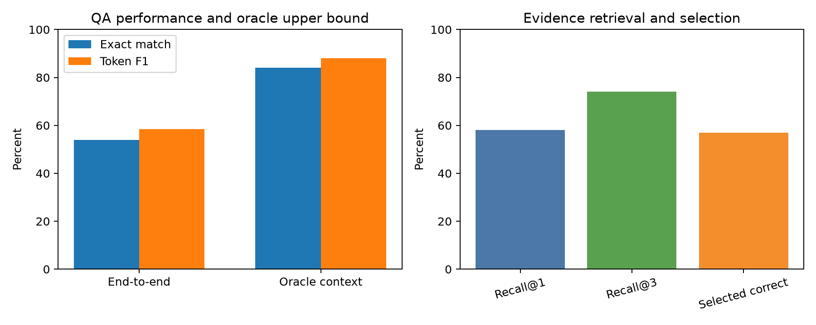
VERIFIED DEEP LEARNING EXPERIMENTS
Agent full results: retrieval is the main bottleneck
100-question evaluation
• End-to-end EM: 54.0%
• End-to-end token F1: 58.54%
• Gold-context Recall@3: 74.0%
• Selected-context accuracy: 57.0%
• Oracle-context EM: 84.0%
• Oracle-context token F1: 87.93%
• Abstention: 0.0%
Seed 42 | disjoint evaluation | results generated 9 Nov 2026
22

Slide 23
VERIFIED DEEP LEARNING EXPERIMENTS
Cross-experiment conclusions, limits, and next steps
What worked
Limitations
Next steps
• Pretrained attention clearly beat the majority baseline.
• VAE learned useful reconstructions and a regularized latent space.
• Explicit evidence tracking exposed retrieval failure separately from QA failure.
• Single seed and one GPU environment.
• IMDb truncation can miss long-range evidence.
• Pixel BCE encourages smooth reconstructions.
• TF-IDF lexical matching and uncalibrated abstention.
• Multi-seed confidence intervals.
• Transformer length/learning-rate ablations.
• beta and latent-dimension sweeps.
• Dense retrieval and threshold calibration.
Seed 42 | disjoint evaluation | results generated 9 Nov 2026
23

Slide 24
VERIFIED DEEP LEARNING EXPERIMENTS
References, recording link, and final human inputs
Core references
Complete before submission
• Vaswani et al. (2017), Attention Is All You Need.
• Sanh et al. (2019), DistilBERT.
• Kingma & Welling (2014), Auto-Encoding Variational Bayes.
• Maas et al. (2011), Learning Word Vectors for Sentiment Analysis.
• Xiao et al. (2017), Fashion-MNIST.
• Rajpurkar et al. (2016), SQuAD.
• Replace six team name/roll placeholders.
• Insert verified video URL.
• Grant viewing access to required faculty emails.
• Attach PPT/PDF and code; CC all members.
• Submit by 15 November 2026.
VIDEO LINK: [INSERT VERIFIED GOOGLE DRIVE / ONEDRIVE URL]
Seed 42 | disjoint evaluation | results generated 9 Nov 2026
24

