Slide 1
A STUDY ON FOLDABLE ELECTRIC

Slide 2
CONTENTS
Abstract
Introduction
Literature Review
3D-View
Individual Components
Mechanism of Folding
Stress Analysis
Applications

Slide 3
ABSTRACT
With growing focus on environmental issues like global warming, Electric vehicles are currently given more importance over petroleum vehicles. concentrating on old and handicapped people, this reasearch highlights about foldable electric vehicle.
This is a light weight vehicle with mechanisms to fold into compact size according to requirement and situation which makes it easily carriable by a person and in a car's boot space. It will have a detachable battery, so that it can be easily chargeable. By means of this vehicle, User can travel in any compact areas such as Hospitals, Parks, Work space etc. when designing this vehicle parking issues are solved and also a portable suitcase mechanism added which makes it simple to carry.

Slide 4
INTRODUCTION
As fossil fuels are going to extinct in near future, Electric power will be a better alternative.
Electric vehicles are future of automobile industry as they have ZERO carbon emissions.
This vehicle will have low weight and occupies less space.
It makes travel more convinient for old and handicapped people within compact spaces.
This will be fitted in a suitcase which makes it easy to carry.

Slide 5
LITERATURE REVIEW
Shlok Desai, Kavan Mehta, Zinal Kheni, Naitik Bhatt, Rahul Patel [1] After designing and modelling analysis of presented foldable electric bike they found that it will help manufacturers of foldable electrical bike to reach their goal with low cost, lighter in weight and an electric bike that can operated rough roads.
Jayesh S. Renge, Ronak P. Rathore, Shubham V. Bakade, Suprit P. Bardekar (2017) [2] They considered aesthetic parameters in their design. By using of foldable mechanism, it can be used in college campuses and industrial areas to minimize the walking distance and resolve parking problems. As it is electric motor powered, it is easy to operate and due to its compact, lightweight has simple and easily portable.
Naimeesh C H M [3] In this project, we knew that it is an eco-friendly foldable vehicle with the top speed of 25km/h and its range up to 40km/h. It includes the twist-grip acceleration with a 240W hub motor, and a lithium ion battery. It is a best vehicle, which emits 0% pollution. As it used foldable mechanism, anyone can carry it anywhere and can be used in places like mall, hospital, airport, etc. In addition, it can be placed in a luggage car.

Slide 6
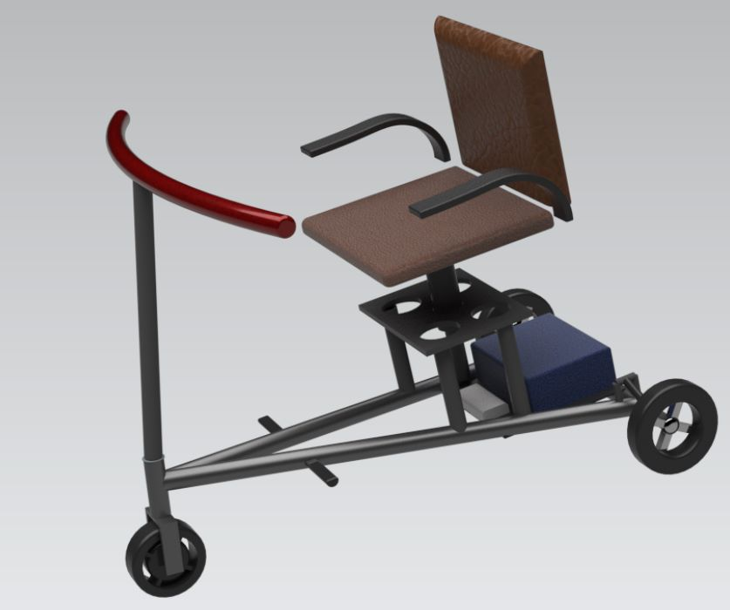
3D-VIEW

Slide 7
INDIVIDUAL COMPONENTS
Motor(Brushless DC)
Battery
Controller
Charger
Wheels
Suspensions
Rotatable Chair
Chassis
Break lever
Break wires

Slide 8
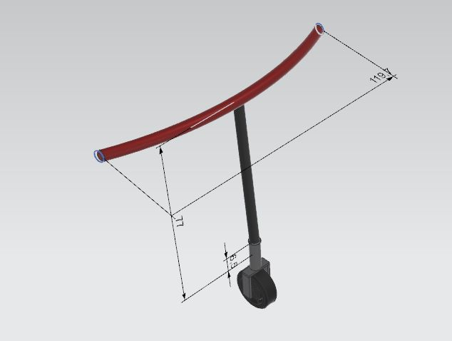
Folding Mechanism and Handle
Foldable mechanism

Slide 9
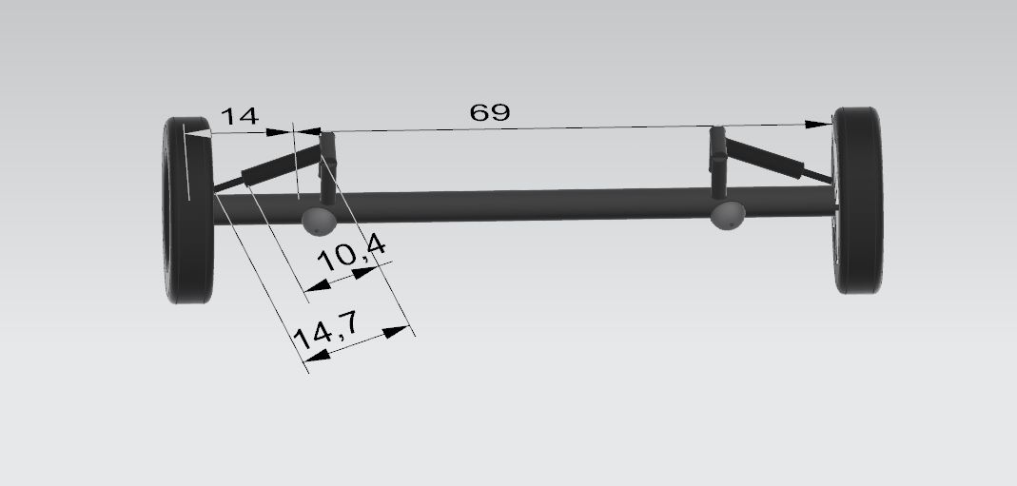
SUSPENSION

Slide 10
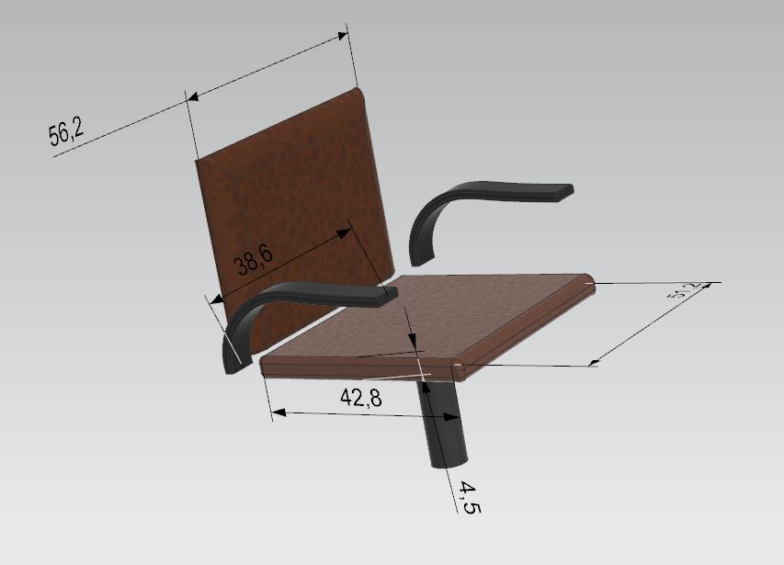
Foldable Chair

Slide 11
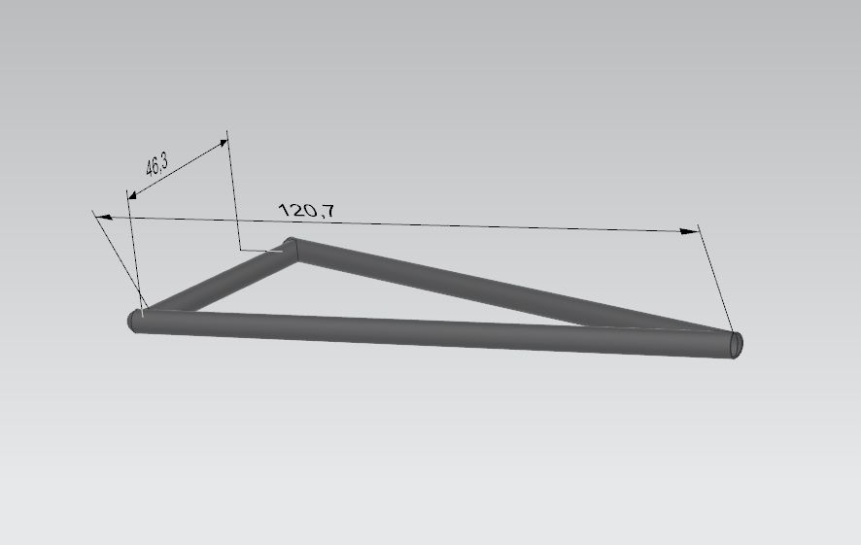
CHASSIS

Slide 12
Low Weight and portable
Force Analysis
Material
Cross section
Luggage carrier
Stick Holder
Suit case

