Slide 1

Customer Shopping Behavior Analysis
3,900 transactions · Python · SQL · Power BI · June 2026

Slide 2

Project Overview
Revenue Patterns
Identify high-value segments
Discount Impact
Analyze discount vs. purchase behavior
Product Performance
Evaluate satisfaction & ratings
Subscription Value
Compare subscriber vs. non-subscriber revenue

Slide 3


Dataset Summary
3,900 Records
Demographics
18 columns across 4 feature groups
Age, Gender, Location, Subscription
Purchase Details
Behavior
Item, Category, Amount, Season
Discount, Reviews, Shipping Type
37 missing values in Review Rating — imputed by category median

Slide 4
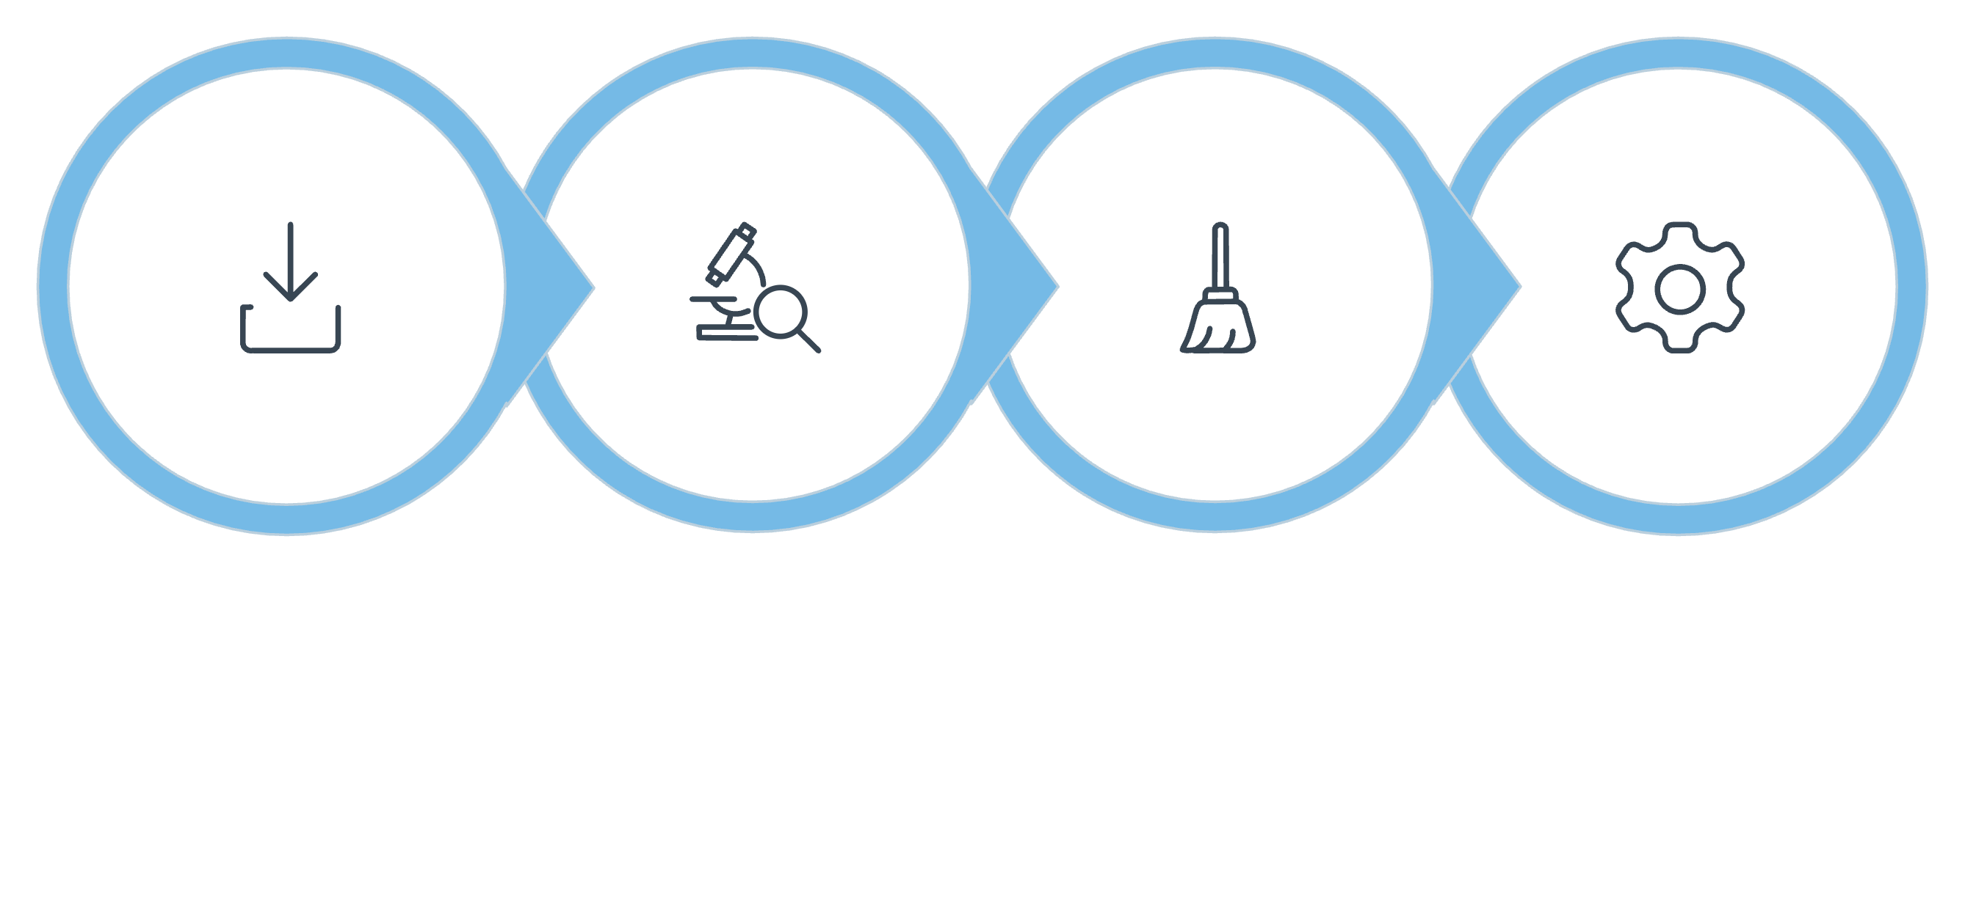
Data Preparation Process
Load Data
Explore
Clean
Engineer
Python and pandas used for full data pipeline — connected to MS SQL Server 20 for SQL analysis.

Slide 5
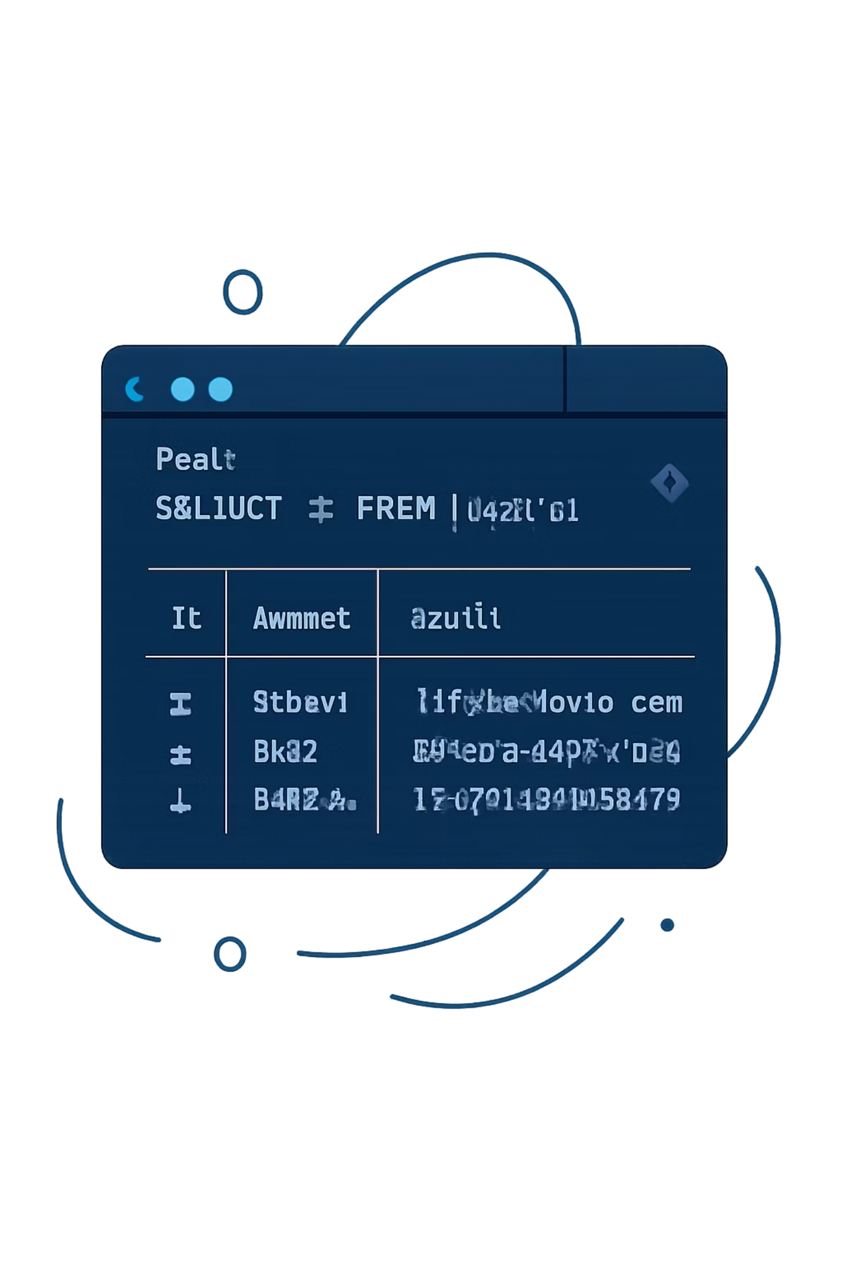
SQL Analysis Highlights
$157,890
Male Revenue
2.1× higher than female
27%
Subscribers
Despite similar avg. spend
3.86
Top Rating
Gloves — highest rated product
3.4%
Express Premium
Higher avg. spend vs. standard

Slide 6


Power BI Dashboard
Dashboard Components
Key metrics: customers, avg. purchase, rating
Subscription distribution: 27% vs. 73%
Revenue by category & age group
Interactive filters: gender, category, shipping
Clothing leads revenue (~$100K). Young Adults dominate sales volume.

Slide 7
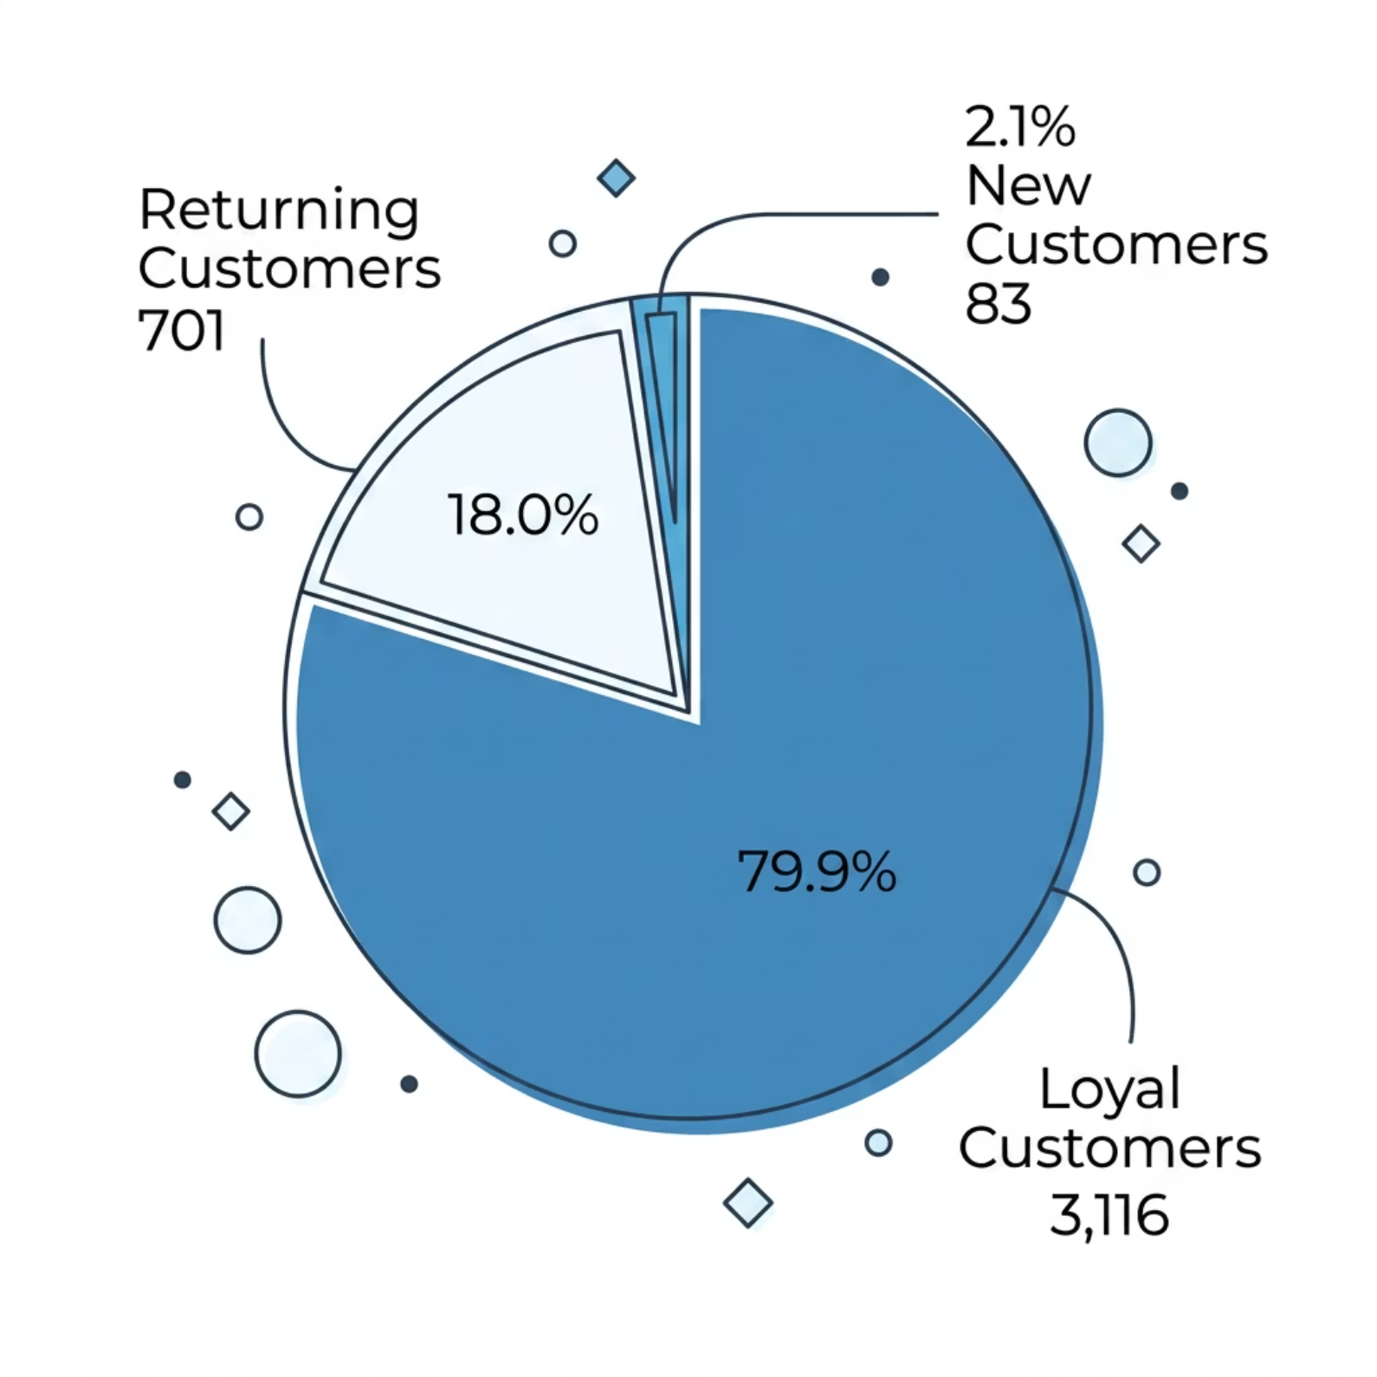
Key Insights
Customer Base
80% loyal — strong retention
Gender Revenue Gap
Male revenue 2.1× female ($157,890 vs. $75,191)
Top Discount Products
Hats 50%, Sneakers 49.7%, Coats 49.1%
Revenue by Age
Young Adults lead at $62,143

Slide 8
Business Recommendations
Boost Subscriptions
1
Target +10% conversion → +$17K recurring
Loyalty Tiers
2
Move 18% Returning → Loyal
Reduce Discounts
3
−5 pts on Hats/Sneakers → +10% margin
Female Engagement
4
Match male spend → +$40K potential
Premium Shipping
5
+20% Express adoption → 2–3% revenue lift

Slide 9
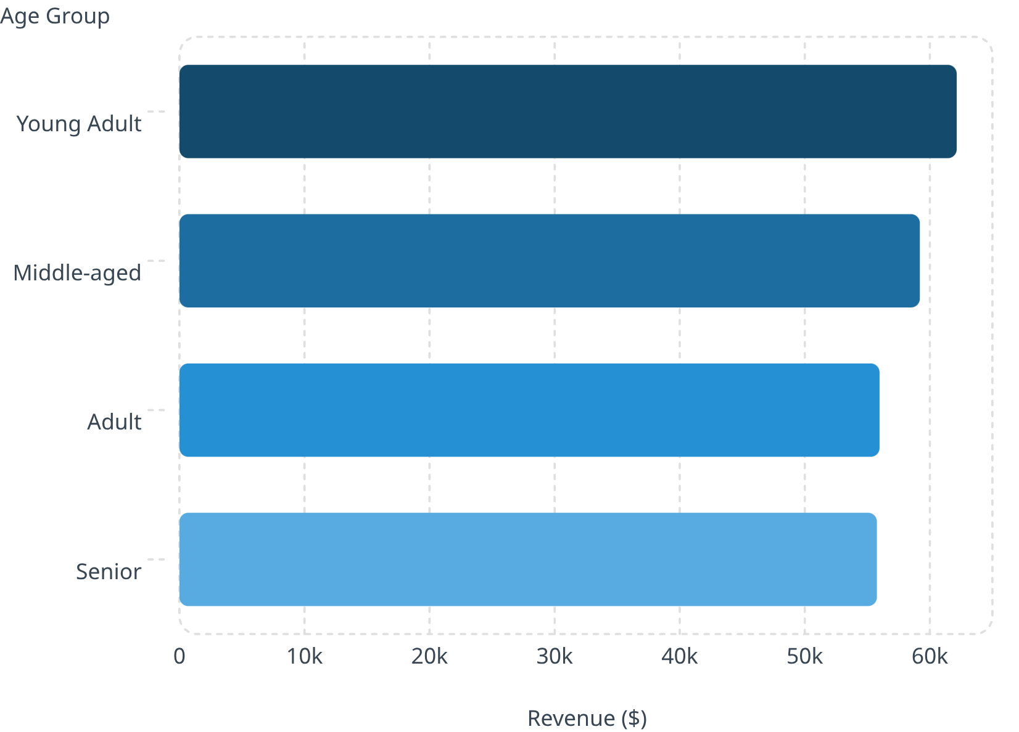
Revenue by Age Group
Consistent Spending
Young Adults lead at $62,143. Revenue declines modestly with age — all groups remain valuable segments.
Focus marketing on Young Adults & Middle-aged for highest ROI

Slide 10

Conclusion
🔁 Strong Retention
📈 Growth Potential
80% loyal base — healthy core
15–20% revenue growth achievable
🎯 Key Levers
Subscriptions, female engagement, discount optimization, premium shipping
Power BI dashboard enables ongoing data-driven decision making.

