Slide 1
PharmacologY
- Dib

Slide 2
Basic Understanding : Definitions
Sources of Drugs
Administration
Notes:
Pharmacology is the study to know about drugs

Slide 3
Pharmacology
Study of drugs , their properties, actions & uses
Notes:
Here, the properties, actions & uses of drugs are being discussed.

Slide 4
Pharmacokinetics & Pharmacodynamics

Slide 5
Pharmacokinetics : What body does to drug
Pharmacodynamics : What drug does to body
Notes:
The basic 2 things about pharmacology is Pharmacokinetics and Pharmacodynamics. Pharmacokinetics discuss about what body does to the drug and Pharmacodynamics discuss what drug does to the body.

Slide 6
Drug : A substance used in the prevention , diagnosis or treatment of a disease.
Notes:
Lets discuss about the Drug , its dosage , source and different routes of administration.

Slide 7
Dosage Form : The form in which the drug is presented for use. In other words, this is
the active substance + excipients
Eg. – Capsules , Tablets , Injections , Eye/Ear
Drops

Slide 8
Sources of Drugs
Natural
Plants | Taxol ( Paclitaxel ) from Yew Tree
Animals | Cod Liver Oil
Minerals | Calcium Carbonate
Microbes | Penicillin , Recombinant Insulin
Synthetic | Sulpha Dugs

Slide 9
Routes of Administration
Enteral | Oral , Sublingua;
Parentral | Injections ( IM , IV Infusion , IV Injection , SC )
Others | Inhalation , Topical , Anal , Vaginal

Slide 10
Pharmacokinetics
Study of movement of drug in body
Encompasses 4 main stages :
Absorption
Distribution
Drug Metabolism
Excretion

Slide 11
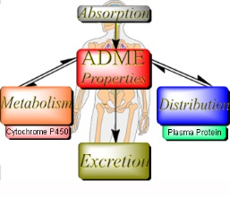
Pharmacokinetics
Notes:
Pharmacokinetics comprise of 4 steps mentioned here.

Slide 12
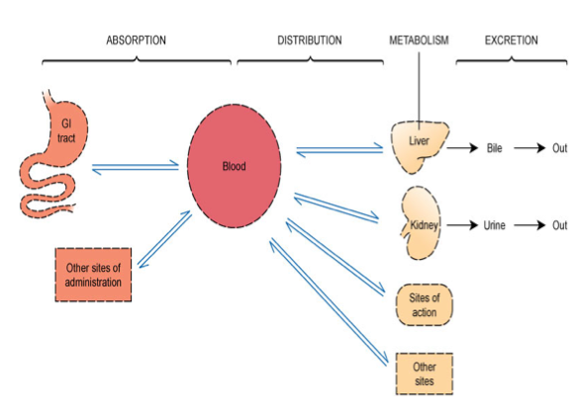
Pharmacokinetics

Slide 13
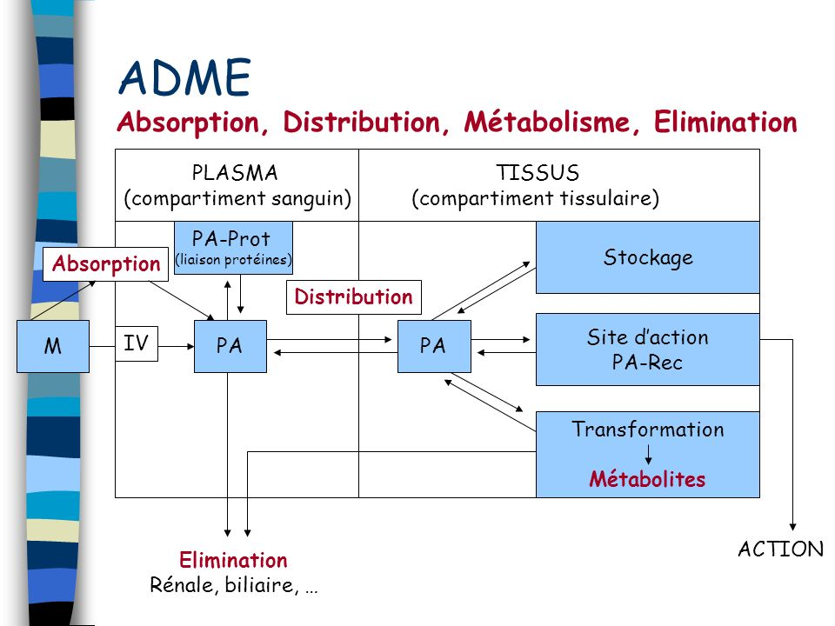
Pharmacokinetics

Slide 14
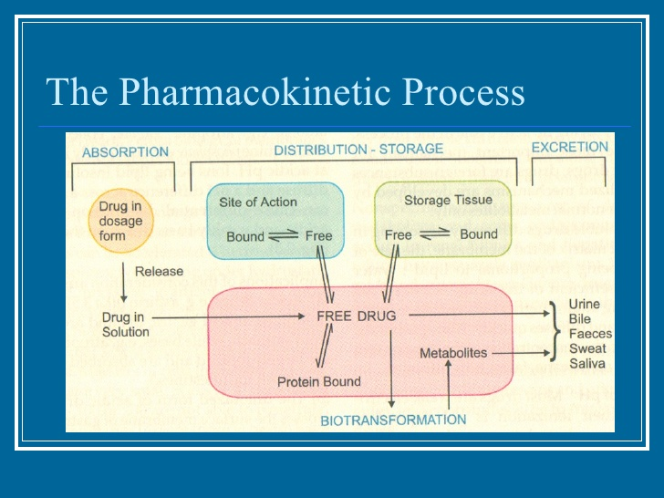
Pharmacokinetics

Slide 15
Absorption

Slide 16
Absorption
The process by which drug appears into the systemic circulation after administration
Notes:
Absorption is the process by which drug appears into the systemic circulation after administration.

Slide 17
Drug Passage Across Membranes
Passive Diffusion : Simple diffusion of drug owing to (a) Concentration Gradient and (b) Lipid Solubility
Active Transportation : Drug carried across membrane by ‘carrier molecules ‘ regardless of conc. gradient. Energy is involved
Filtration : Passage across membranes owing to membrane pore size and mol. Size, Eg. Glomerular Filtration
Notes:
Now absorption also happens through different modes.

Slide 18
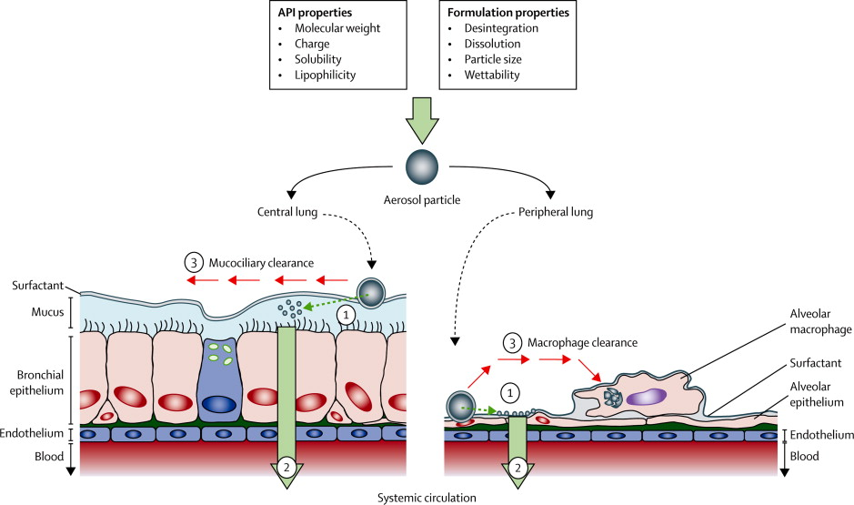
Drug Passage

Slide 19
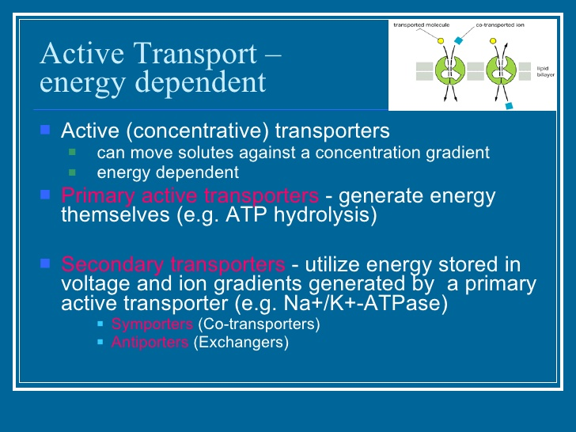
Drug Passage
Notes:
Now this drug passage also happens ijn 2 ways – Active Transport & Passive Transport.

Slide 20
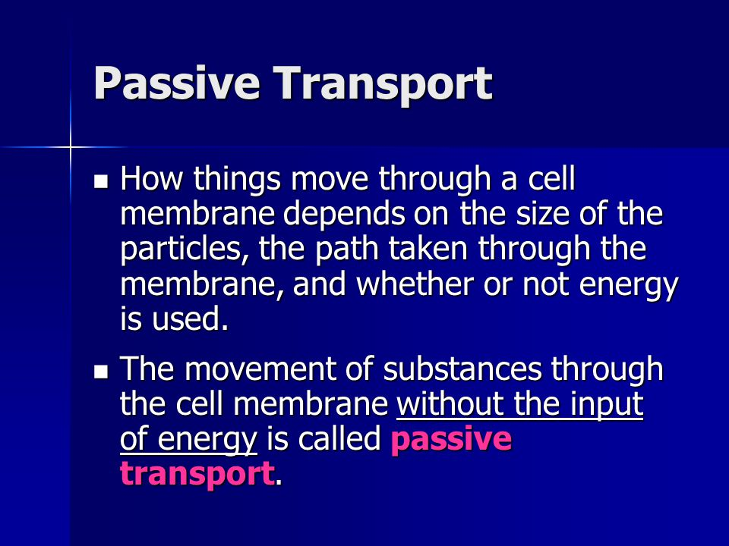
Drug Passage

Slide 21
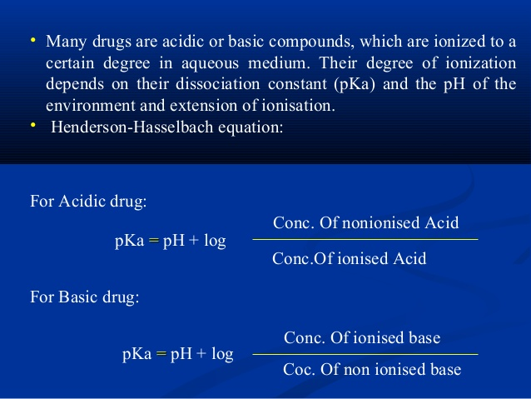
Drug Passage
Notes:
Now drug passage also depends on the pH of the drug as well which is mentioned in this slide.

Slide 22
Bioavailability
A measure of the fraction of the administered dose of a drug that reaches the systemic circulation in the unchanged form
Bioavailability of a drug administered through the IV route is 100%
Notes:
Now, the most important factor is Bioavailability in studying any drug.

Slide 23
Distribution

Slide 24
Distribution
When the drug reaches the blood , it gets carried ( distributed ) to the various tissues which is influenced by :
Protein Binding
Drug Metabloism
Hepatic First Pass Effect
Notes:
Drug distribution helps to reach the target tissues of body and that is influenced by 3 things – Protein Binding , Drug Metabolism & Hepatic First Pass Effect.

Slide 25
Distribution
Protein Binding :
Drugs are carried in the blood in 2 forms . They are –
1) Free Form – Here the drug in the blood in the solution form and is pharmacologically active, diffusive and available for metabolism and excretion
2) Bound Form – The drug is bound to the proteins in the blood ( mainly albumin ) and this form of the drug is pharmacologically inactive

Slide 26
Distribution
Drug Metabloism :
WHAT ? – Process of bio-chemical alteration of drug in body
WHY ? – To facilitate elimination from the body
WHERE ? – Primarily occurs in the liver
WHAT HAPPENS TO DRUG ?
In this process, the drug can be converted from an
(a) Remain unchanged Eg. Streptomycin or
(b) Active to inactive form Eg. Morphine or
(c) Active to another active form Eg. Phenacetin or
(d) Inactive to active form Eg. Cefuroxime Axetil

Slide 27
Distribution
Hepatic First Pass Effect (HFPE) :
When a drug is absorbed from the gut all of it must pass the liver before entering systemic circulation. During this “ first pass “ through the liver, drugs might
Be metabolized or
Pass unaffected
What is the significance of HFPE ?
Drugs which are highly metabolized during the first pass have to be administered
In high doses through oral route or
Through parenteral route

Slide 28
Elimination
Drugs are removed from the body via a number of routes. Some of the important routes of elimination are :
1. Kidneys
2. Bile
3. Feaces
4. Breast Milk
Notes:
Elimination of the drug happens through 4 routes ,- Kidneys , Bile, Feaces & Breast Milk.

Slide 29
Elimination
Creatinine Clearance :
Creatinine is a natural waste product of the body’s functions
What is the significance of Creatinine :
Its rate of elimination via the kidney provides a good indication of renal function
For drugs which are dependent on Renal Elimination, drug clearance fails as Creatinine Clearance falls

Slide 30
Blood Levels
Usually expressed in units of micrograms of drugs per ml of blood ( mcg/ml )

Slide 31
Plasma Half-life
Time in which the peak-plasma concentration falls by one half
Plasma half life is for a drug, not for a dosage form
It is denoted as T1/2
Notes:
Plasma half-life for a drug regulates the bioavalability of the drug and its duration.

Slide 32
Application of Pharmacokinetics
Determining dosage forms :
Enteric coated tablets for drugs which are destroyed in the stomach
Sustained release dosage forms for drugs which are too rapidly absorbed and eliminated
Notes:
Lets understand that Pharmacokinetics of the drug regulates dosage forms, route of administration etc.

Slide 33
Application of Pharmacokinetics
Suitability of drug for particular indication
Prediction Dosage schedule
Selecting route of administration

Slide 34
Pharmacodynamics
Study of what drug does to the body

Slide 35
Drug : Mechanism of Action (MOA)
Physical action
Chemical action
Through enzymes
Through receptors
Notes:
Pharmacodynamics discuss about Mode of Action, drug safety etc which is discussed now.

Slide 36
Pharmacodynamics
MIC Value : Minimum inhibitory concentration (MIC) is the lowest concentration of an antimicrobial (like an antifungal, antibiotic or bacteriostatic) drug that will inhibit the visible growth of a microorganism after overnight incubation
Therapeutic Index : Therapeutic index (TI) (also referred to as therapeutic window or safety window or sometimes as therapeutic ratio) is a comparison of the amount of a therapeutic agent that causes the therapeutic effect to the amount that causes toxicity.

Slide 37
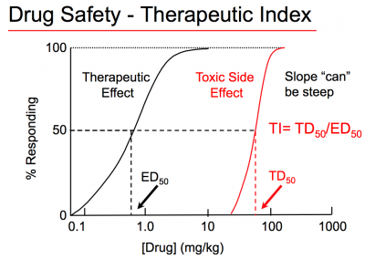

Slide 38
HOW DRUGS WORK
Most work by interacting with endogenous proteins
Some antagonize, block or inhibit endogenous proteins
Some activate endogenous proteins
A few have unconventional mechanisms of action
Notes:
When drug works on protein , it works through different modes.

Slide 39
HOW DRUGS WORK
FDA Approved - On Lebel Uses
Interactions with Other Drugs
Adverse Effects and Contraindications

Slide 40
HOW DRUGS WORK
Better assessment of new modalities for using drugs
Better assessment of new indications for drugs
Better assessment of new concerns regarding risk-benefit

Slide 41
DRUGS : MODE OF ACTIONS
Antagonists of Cell Surface Receptors
Antagonists of Nuclear Receptors
Enzyme Inhibitors
Ion Channel Blockers
Transport Inhibitors
Inhibitors of Signal Transduction Proteins
Notes:
Now, based on Mode of Actions , drugs are classified into different groups as mentioned in this slide.

Slide 42
RECEPTOR
A macromolecular component of the organism that
binds the drug and initiates its effect.
Most receptors are proteins that have undergone various
post-translational modifications such as covalent
attachments of carbohydrate, lipid and phosphate.
Notes:
Also, lets understand how drug works on Receptors.

Slide 43
CELL SURFACE RECEPTOR
A receptor that is embedded in the cell membrane and
functions
to receive chemical information from the extracellular
compartment and to transmit that information to
the intracellular compartment.

Slide 44
CELL SURFACE RECEPTOR
Cell surface receptors exist to transmit chemical signals from
the outside to the inside of the cell.
Some compounds bind to cell surface receptors, yet do not
activate the receptors to trigger a response.
When cell surface receptors bind the molecule,
the endogenous chemical cannot bind to the
receptor and cannot trigger a response.
The compound is said to “antagonize” or “block” the receptor
and is referred to as a receptor antagonist.

Slide 45
DRUGS WORK BY ANTAGONIZING
CELL SURFACE RECEPTORS
Extracellular
Compartment
Unbound Endogenous Activator (Agonist) of Receptor
Cell Membrane
Inactive Cell Surface Receptor
Intracellular
Compartment

Slide 46
DRUGS WORK BY ANTAGONIZING
CELL SURFACE RECEPTORS
Extracellular
Compartment
Bound Endogenous Activator (Agonist) of Receptor
Cell Membrane
Active Cell Surface Receptor
Intracellular
Compartment
Cellular Response

Slide 47
DRUGS WORK BY ANTAGONIZING
CELL SURFACE RECEPTORS
Displaced Endogenous Activator (Agonist) of Receptor
Extracellular
Compartment
Bound Antagonist of Receptor (Drug)
Cell Membrane
Intracellular
Compartment
Inactive Cell Surface Receptor Upon being Bound

Slide 48
DRUGS WORK BY ANTAGONIZING
CELL SURFACE RECEPTORS
Displaced Endogenous Activator (Agonist) of Receptor
Extracellular
Compartment
Bound Antagonist of Receptor
Cell Membrane
Intracellular
Compartment
Active Receptor
Inactive Receptor
Allosteric Inhibitor

Slide 49
DRUGS WORK BY ANTAGONIZING
NUCLEAR RECEPTORS
Unbound Endogenous Activator
(Agonist) of Nuclear Receptor
Inactive Nuclear Receptor
in cytosolic compartment
DNA
Nucleus
Intracellular
Compartment
Inactive Nuclear Receptor
in nuclear compartment

Slide 50
DRUGS WORK BY ANTAGONIZING
NUCLEAR RECEPTORS
Active Nuclear Receptor
Bound Endogenous Activator
(Agonist) of Nuclear Receptor
DNA
Modulation of
Transcription
Intracellular
Compartment

Slide 51
HOW DO DRUGS WORK BY INHIBITING ENZYMES?
Active Enzyme
Substrate
Product
Cellular Function
Inactive Enzyme
Substrate
Bound Enzyme
Inhibitor (Drug)

Slide 52
DRUGS WORK BY
INHIBITING ENZYMES
Enzymes catalyze the biosynthesis of products from substrates.
Some drugs bind to enzymes and inhibit enzymatic activity.
Loss of product due to enzyme inhibition mediates the
effects of enzyme inhibitors.

Slide 53
DRUGS WORK BY ACTIVATING
ENDOGENOUS PROTEINS
Agonists of Cell Surface Receptors
(e.g. alpha-agonists, morphine agonists)
Agonists of Nuclear Receptors
(e.g. HRT for menopause, steroids for inflammation)
Enzyme Activators
(e.g. nitroglycerine (guanylyl cyclase), pralidoxime)
Ion Channel Openers
(e.g. minoxidil (K) and alprazolam (Cl))

Slide 54
CHEMICALS WORK BY ACTIVATING
CELL SURFACE RECEPTORS
Cell surface receptors exist to transmit chemical signals from
the outside to the inside of the cell.
Some chemicals bind to cell surface receptors and
trigger a response.
Chemicals in this group are called receptor agonists.
Some agonists are actually the endogenous chemical signal,
whereas other agonists mimic endogenous chemical signals.

Slide 55
CHEMICALS WORK BY
UNCONVENTIONAL MOA
Disrupting of Structural Proteins
e.g. vinca alkaloids for cancer, colchicine for gout
Being Enzymes
e.g. streptokinase for thrombolysis
Covalently Linking to Macromolecules
e.g. cyclophosphamide for cancer
Reacting Chemically with Small Molecules
e.g. antacids for increased acidity
Binding Free Molecules or Atoms
e.g. drugs for heavy metal poisoning, infliximab (anti-TNF)

Slide 56
CHEMICALS WORK BY
UNCONVENTIONAL MOA
Being Nutrients
e.g. vitamins, minerals
Exerting Actions Due to Physical Properties
e.g. mannitol (osmotic diuretic), laxatives
Working Via an Antisense Action
e.g. fomivirsen for CMV retininitis in AIDS
Being Antigens
e.g. vaccines
Having Unknown Mechanisms of Action
e.g. general anesthetics

Slide 57
Characteristics of Drug-Receptor Interactions
Chemical Bond: ionic, hydrogen, hydrophobic, Van der Waals, and covalent.
Saturable
Competitive
Specific and Selective
Structure-activity relationships
Transduction mechanisms

Slide 58
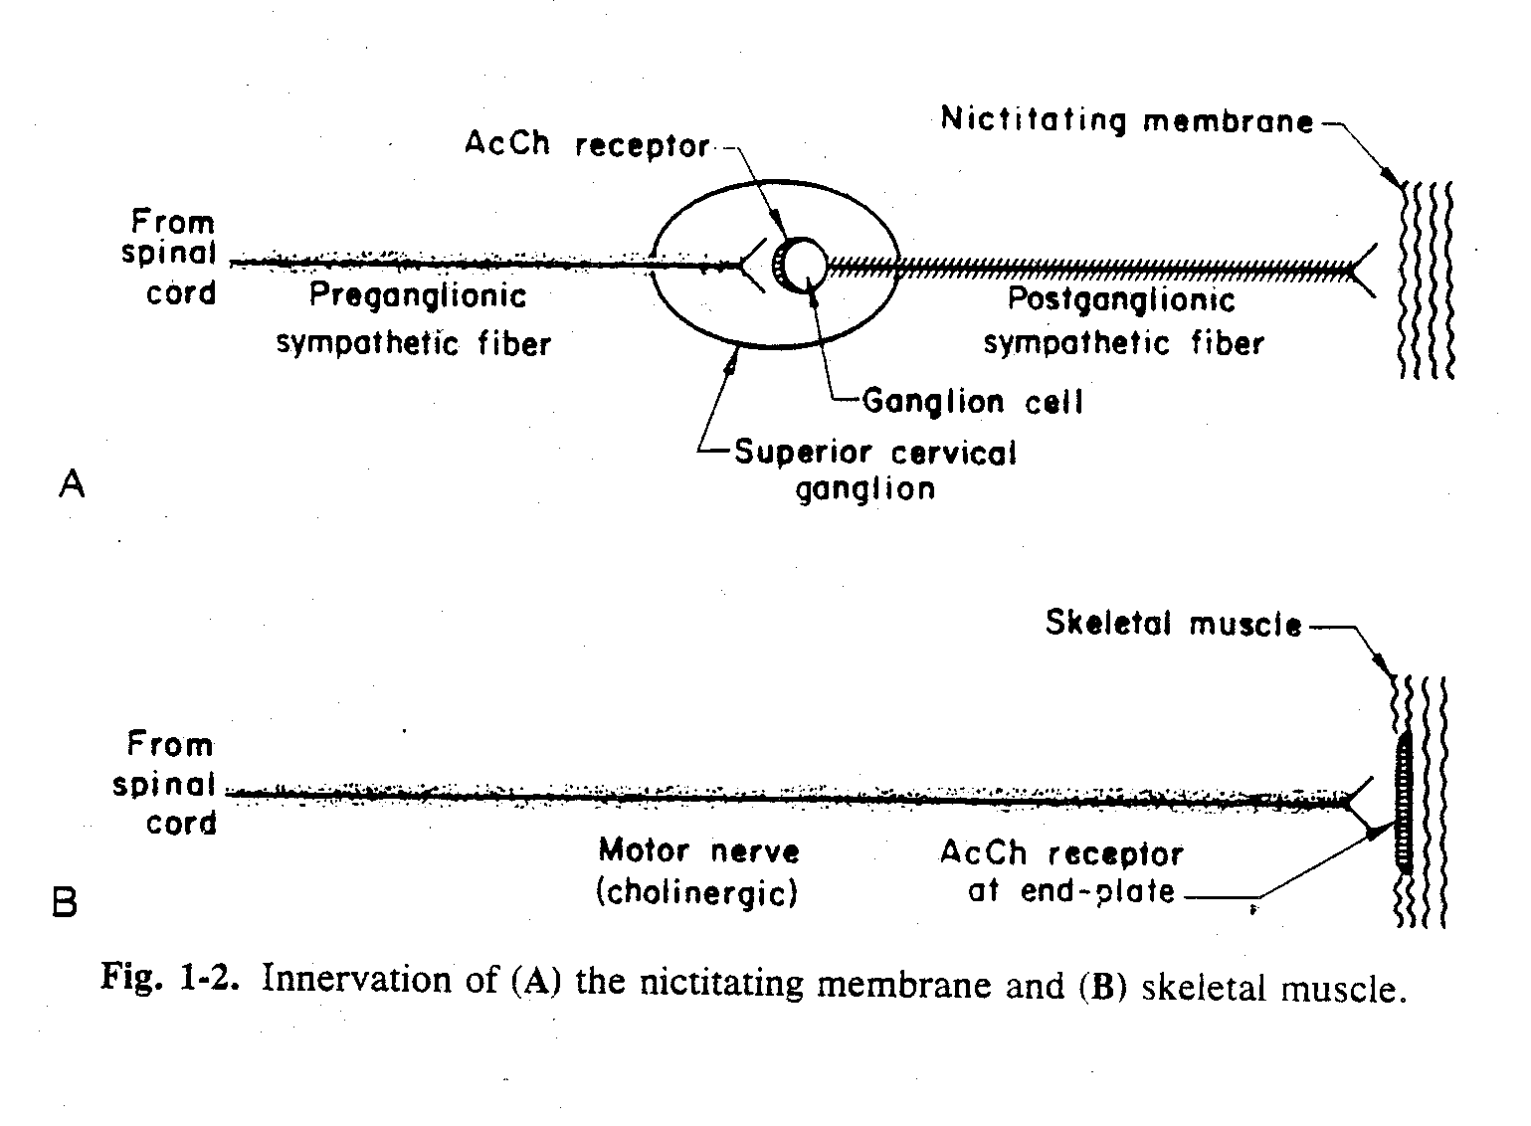

Slide 59
Receptor Transduction Mechanisms
Ion channel linked receptors e.g. Ach nicotinic (Na⁺) and GABA (Cl⁻)
Second messenger generation,
adenylate cyclase stimulation or inhibition - cAMP,
guanylate cyclase - cGMP,
phospholipase C - IP3, DAG
Some receptors are themselves protein kinases
Intracellular receptors (e.g. corticosteroids, thyroid hormone)

Slide 60
EFFICACY
Drug (D)
The relative affinity
of the drug to either conformation will determine the effect of the drug
Ri
Ra
DRi
DRa
CONFORMATIONAL SELECTION

Slide 61
Receptor Regulation
Sensitization or Up-regulation
1. Prolonged/continuous use of receptor blocker
2. Inhibition of synthesis or release of hormone/neurotransmitter - Denervation
Desensitization or Down-regulation
1. Prolonged/continuous use of agonist
2. Inhibition of degradation or uptake of agonist
Homologous vs. Heterologous
Uncoupling vs. Decreased Numbers

Slide 62
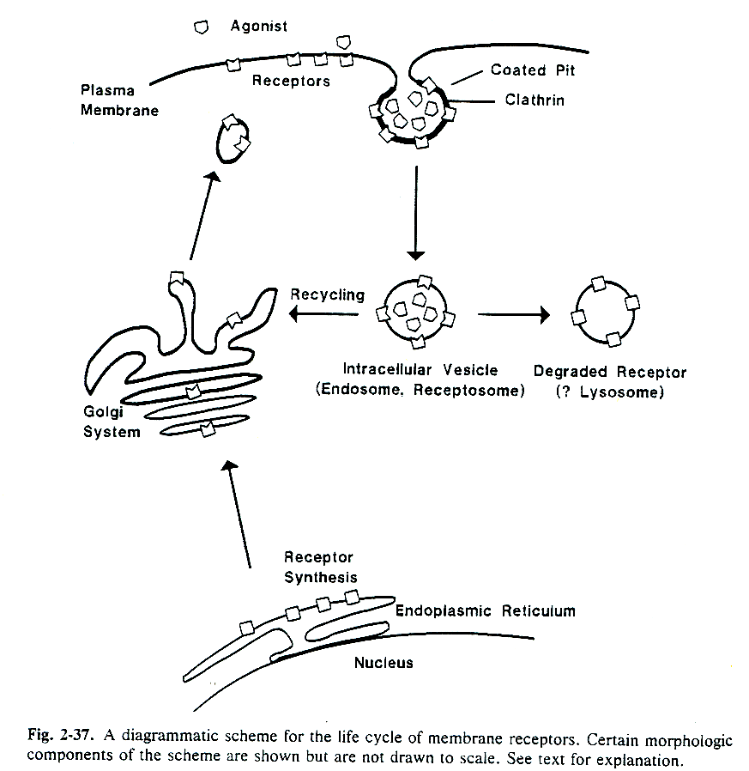

Slide 63
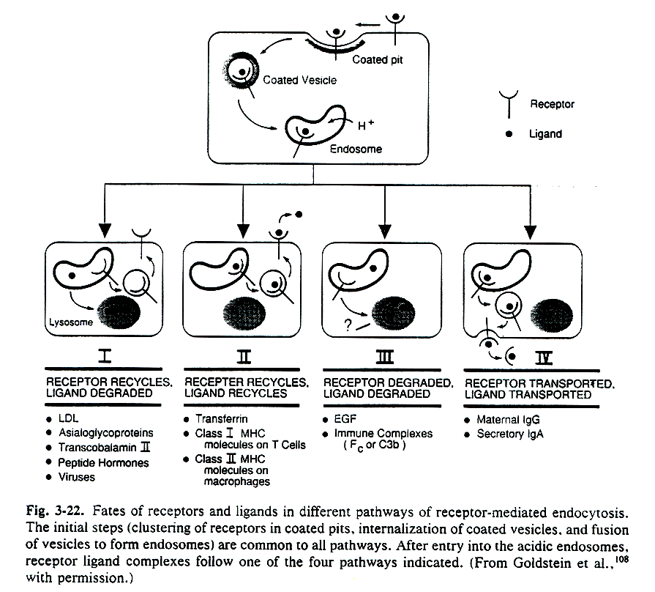

Slide 64
Causes of Variability in Drug Response
Those related to the biological system
1. Body weight and size
2. Age and Sex
3. Genetics - pharmacogenetics
4. Condition of health
5. Placebo effect
Notes:
After this , there are few reasons to be remembered which cause variability in drug response. Those are mentioned here.

Slide 65
Causes of Variability in Drug Response
Related to the conditions of administration
1. Dose, formulation, route of administration.
2. Resulting from repeated administration of drug:
drug resistance; drug tolerance-tachyphylaxis; drug allergy
3. Drug interactions:
chemical or physical;
GI absorption;
protein binding/distribution;
metabolism (stimulation/inhibition);
excretion (pH/transport processes);
receptor (potentiation/antagonism);
changes in pH or electrolytes.

Slide 66
Applications of Pharmacodynamics
To know the MIC Value
To predict the Therapeutic Effect
To predict the Side Effects & contraindications
Notes:
Lastly , just to understand how Pharmacodynamics of a drug help to decide few key important factors of a drug during usage.

Slide 67
THANK YOU

