Slide 1
CelL BIOLOGY PHYSIOLOGY ANATOMY
Notes:
Lets start with the very basic unit of Cell Biology and then gradually will move to understand the entire physiology and anatomy of human body.

Slide 2
Cell
Tissue
Organ
System
Notes:
In context of human body, lets first understand Cell , then Tissue and followed by Organ and System.

Slide 3
Cell
Cell : Structural & Functional Unit of Body
Cytology : Study concerning Cell
Cell Function :
Ingestion & Assimilation
Metabolism
Respiration,Excretion,Irritability & Conductivity
Reproduction
Metabolism :
Catabolism – Complex substances breaking into simpler substances through series of chemical reactions in living body
Anabolism – Simpler substances changing into complex substances through series of chemical reactions in living body
Notes:
Cell is the basic Structural & Functional Unit of Body. And the study of that is called as cytology. Now cell is the basic integral unit of human body and it does the basic required functions of body which are ,mentioned in the slide.
One of these functions , is the Metabolism which is the most important function of body which is again of 2 types. One, is breaking down and the other is forming up complex things from simpler things. These 2 process always go on to maintain the equilibrium in human body.

Slide 4
Cell Structure
Nucleus
Cytoplasm
Nucleus – It is bounded by Nuclear Membrane
Cytoplasm – Protoplasm ( viscid liquid ) of a cell exclusive of that of the nucleus
Notes:
Cell is comprised of 2 parts : 1. Nucleus which is the brain of cell 2. Cytoplasm which is a viscous part of the cell which contains different organelles including Nucleus

Slide 5
Cell Structure
Nucleus – Control Center or head of the cell ; it contains a large amount of DNA that determine the characteristics of the protein enzymes of the cytoplasm and thus control cytoplasmic activities
DNA is stored in structures called chromosomes
Notes:
A nucleus is basically the head of cells which is comprised of DNA that determine the characteristics of the protein enzymes.

Slide 6
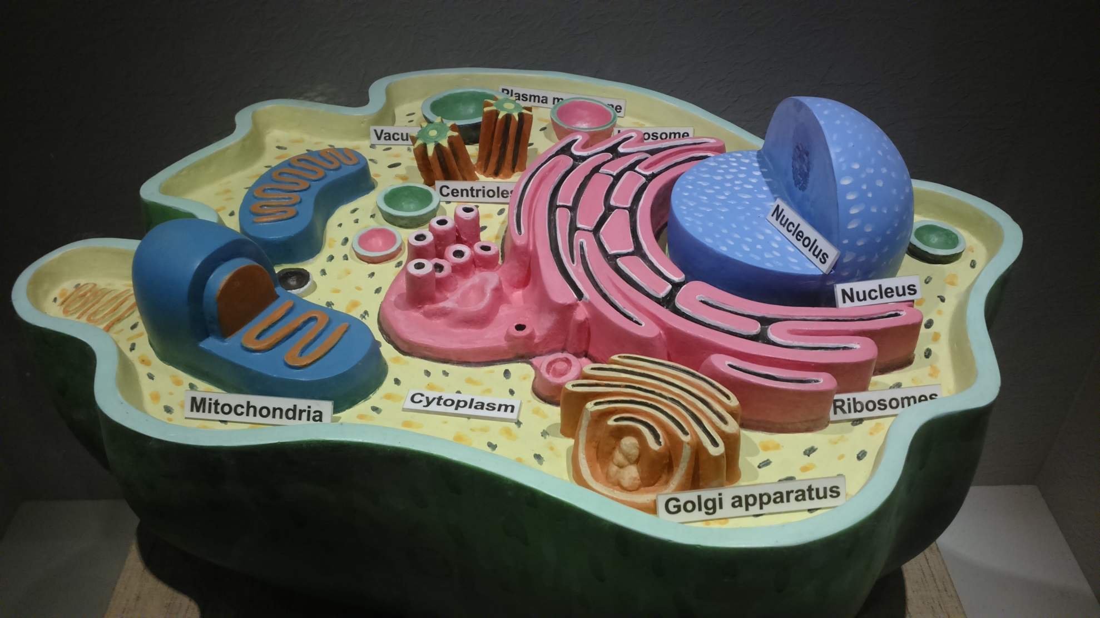
Cell Diagram
Notes:
This is a 3D model of human cell.

Slide 7
Organelles
Endoplasmic Reticulum ( ER )–
Transport of substances from one part of the cell to another
Provide surface area for many enzymes aided reactions in the cell
ER of 2 types – Rough ER & Smooth ER
Notes:
Endoplasmic Reticulum is an important organelle which works as a transporter and helps to happen different enzymes’ reactions.

Slide 8
Organelles
Golgi Aparatus – Substances produced in ER gets transported in the form of vesicles,fuse with the golgi apparatus and gets processed there.
Processed material gets formed into lysosomes or secretory vesicles
Notes:
Golgi aparatus are the substances produced in ER gets transported in the form of vesicles,fuse with the golgi apparatus and gets processed there.

Slide 9
Organelles
Lysosome – Membrane bound vesicle, with granules containing digestive enzymes
Provide an intracellular digestive system that helps in removing unwanted substances or foreign particles.
Suicidal Bag of cells : If lysosomes break , leaking the digestive enzymes , parts of the cell might get killed, killing the whole cell itself
Notes:
Lysosomes are called as suicidal bag which contains digestive enzymes ; it helps in removing unwanted substances or foreign particles.

Slide 10
Organelles
Mitochondria – Power house of cell ; contains 2 membranes.
Outer membrane & Inner membrane
Inner membrane is convoluted to increase surface area. Convolutions are called Cristae.
Generates power for the various activities of the cell breaking down nutrients
Notes:
Mitochondria is the Power House of cell which generates power for the various activities of cell.

Slide 11
Organelles
Centrosome – Comprises of 2 centrioles
Forms Spindle Fibres ( fibrous outgrowth ) and centriloles move to the opposite pole of the cell to conduct cell division
Notes:
Centrosome is a organelle which is mainly responsible for cell division.

Slide 12
Tissue
Assemblage of cells and fibrous elements commonly assigned for particular functions
Histology : Study of tissues
Tissue types :
Epithelial
Mascular
Connective
Nervous
Notes:
Then comes the tissue which is basically made up of cells. Tissues are different based on specific structure and function; which are broadly of 4 types.

Slide 13
Epithelial Tissue
Tissue covering body and body parts ; single or multi-layered ; cells here are held by basement membranes with silia occasionally
Skin , airway passages , GIT , blood vessels , lungs etc
Function : Protects body parts, secretes mucus in the inside hollow, balances body temperature, siliary movements help to move out the foreign particles
Notes:
Outer layer of body is mainly made up of Epithelial Tissue which is responsible for protection.

Slide 14
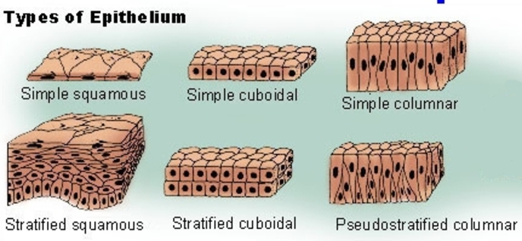
Epithelial Tissue Diagram
Notes:
These are the different Epithelial Tissues …..

Slide 15
Mascular Tissue
Typec | Location | Function
Voluntary | Attached to skeletal muscle | Voluntary movements
Involuntary | Present in GIT & RT | Involuntary reflex actions
Cardiac | Present in Heart | Rhythmic beating of heart
Notes:
Muscular tissue are of 3 types : these classification is based on function of the muscle -

Slide 16
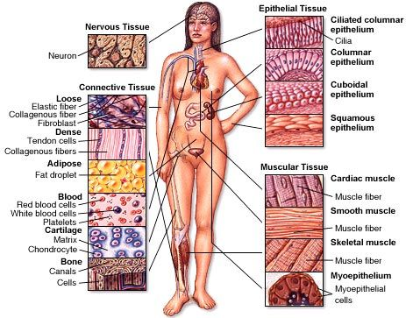
Muscular Tissue Diagram
Notes:
These are different tissues in the body with the structure -

Slide 17
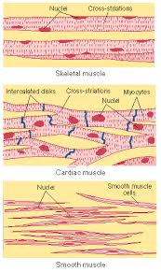
Different Muscle Diagram
Notes:
Coming to muscle tissue , different types of tissues with different structures and presence of nucleus differently.

Slide 18
Connective Tissue
Characterized by a large amount of inter-cellular substances produced by the cells
Types - Blood , Adipose Tissue , Bone , Cartilage
Function : Connects and provides support to various parts of the body
Notes:
Connective tissue is mainly responsible for connecting one part of the body to the other.

Slide 19
Nervous Tissue
Unique as it does not get divided ( as there is no centrosome in Neuron )
Made up of Neurons ( Nerve Cells ) & Neuroglia ( Supporting Cells )
Function : Helps to transmit impulses from one part of the body to the other
Notes:
Brain and nerves are made up of this tissue ; the structural and functional unit of Nervous tissue is Nerve Cells which are called as Neurons.

Slide 20
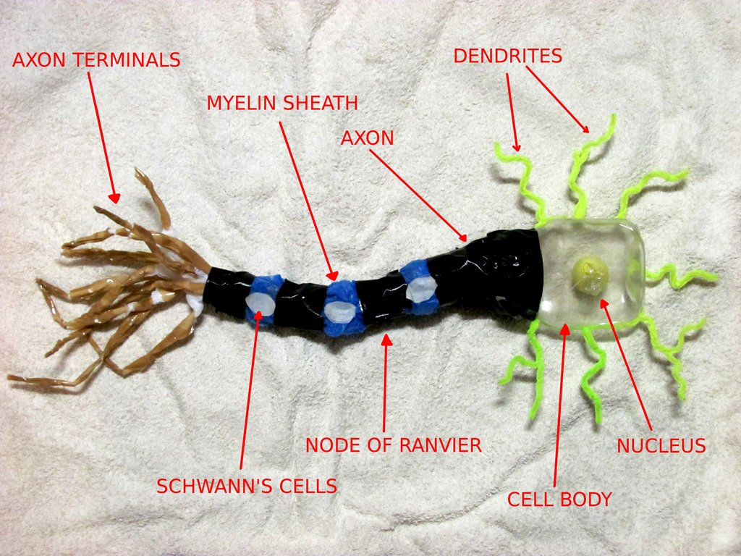
Neuron Diagram
Notes:
This is a Neuron picture.

Slide 21
Organs
Same kind of tissues situated in one part of the body altogether performing common function is an organ
Different organs altogether performing a set of common actions form a system
5 Systems available in human body
Notes:
Organs are made up of tissues and different organs perform different functions.

Slide 22
System
Digestive System
Respiratory System
Circulatory System
Excretory System
Nervous System
Musculo-skeletal System
Reproductive System
Integumentary System
Endocrine System
Immune System

Slide 23
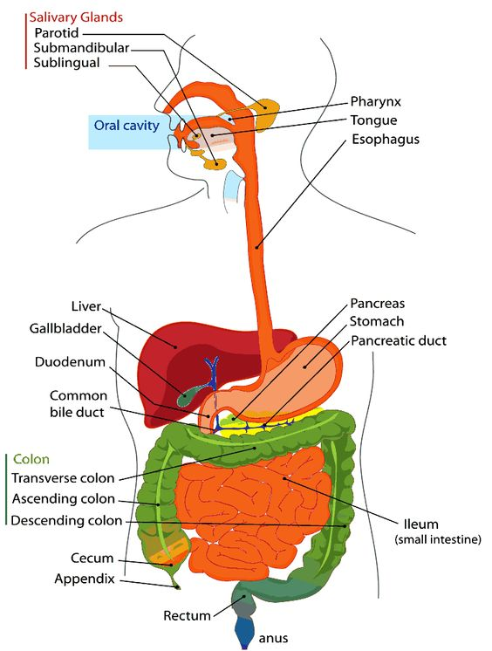
Digestive System Diagram
Notes:
This is a diagram of digetive system with different parts.

Slide 24
Digestive System
Structure & Parts :
Digestive Tube - Mouth , Pharynx , Oesophagus , Stomach , Small Intestine , Large Intestine, Rectum & Anus
Digestive Glands - Salivary Glands , Liver & Pancreas
Notes:
Now, Digestive System is consisting of different parts , as discussed here.

Slide 25
Digestive System
Function :
Ingestion
Digestion
Absorption
Assimilation
Elimation
Notes:
Broadly, Digestive system is for Digestion through 5 steps -

Slide 26
Respiratory System
Structure & Parts :
Upper Respiratory Tract
Nose / Pharynx / Larynx / Trachea
Lower Respiatory Tract
Bronchi / Bronchioles / Lungs / Muscles for Respiration ( Intercostal & Diaphragm )
Notes:
Respiratory System is comprised of different parts with Upper and Lower Tract.

Slide 27
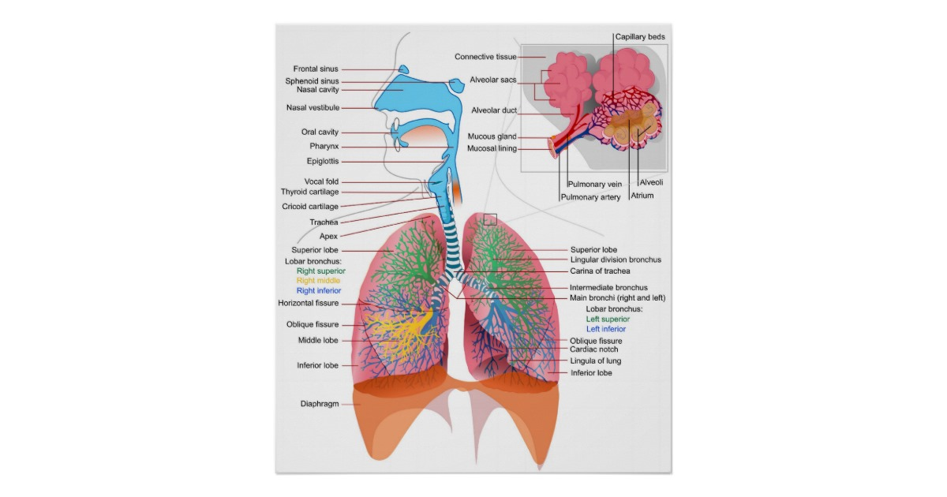
Respiratory System Diagram

Slide 28
Respiratory System
Function :
Inspiration
Expiration
Pause
Respiration Cycle per minute 15 times
Notes:
Broadly, this system is to control Inspiration & Expiration

Slide 29
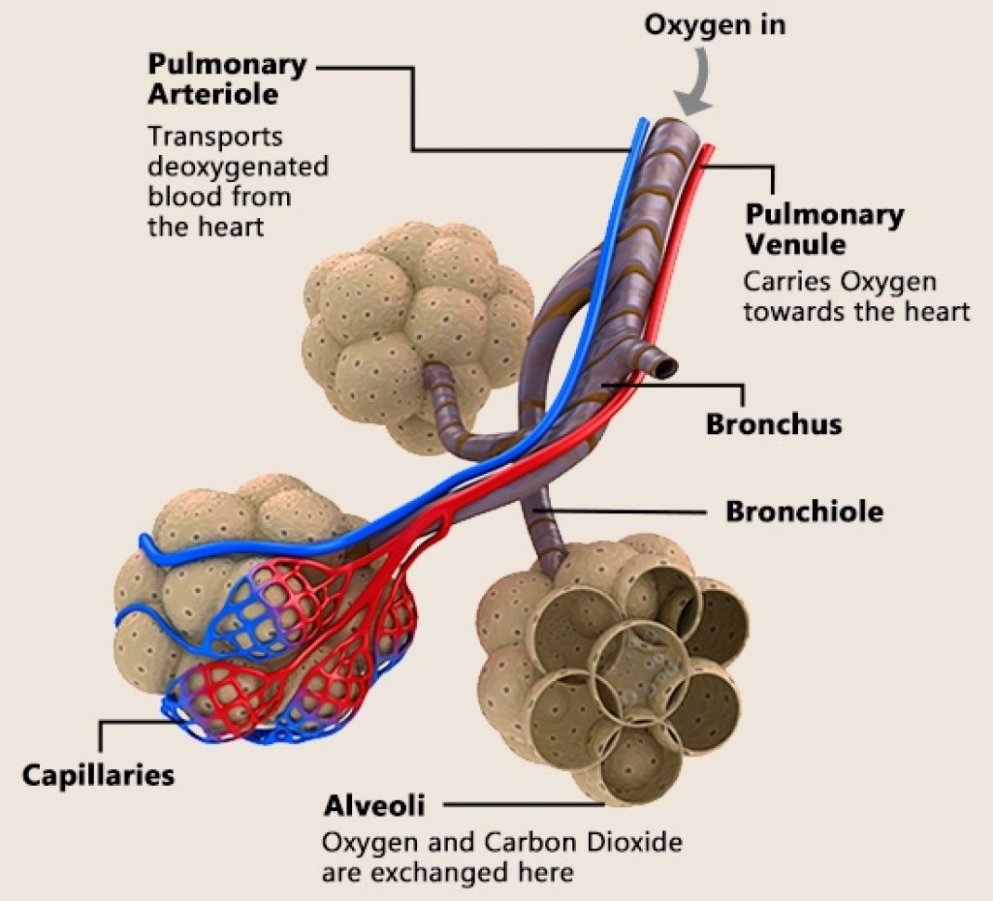
Alveoli Diagram

Slide 30
Respiratory System
Function :
External Respiration ( O2-CO2 exchange ) – Between Lungs & Blood
Internal Respiration ( O2-CO2 exchange ) –
Between Blood & Cells

Slide 31
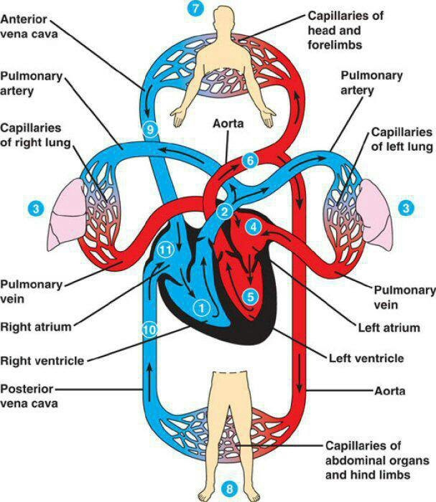
Circulatory System Diagram
Notes:
This is the diagramatic presentation to make understand how this system collaborates with Circulatory System to purify the blood.

Slide 32
Circulatory System
Structure & Parts :
Heart / Blood / Blood Vessels
Blood Vessels – Artery / Vein / Capillary
Blood–Serum/Blood Cells( RBC/WBC/Platelets )
Notes:
Circulatory is comprised of different parts.

Slide 33
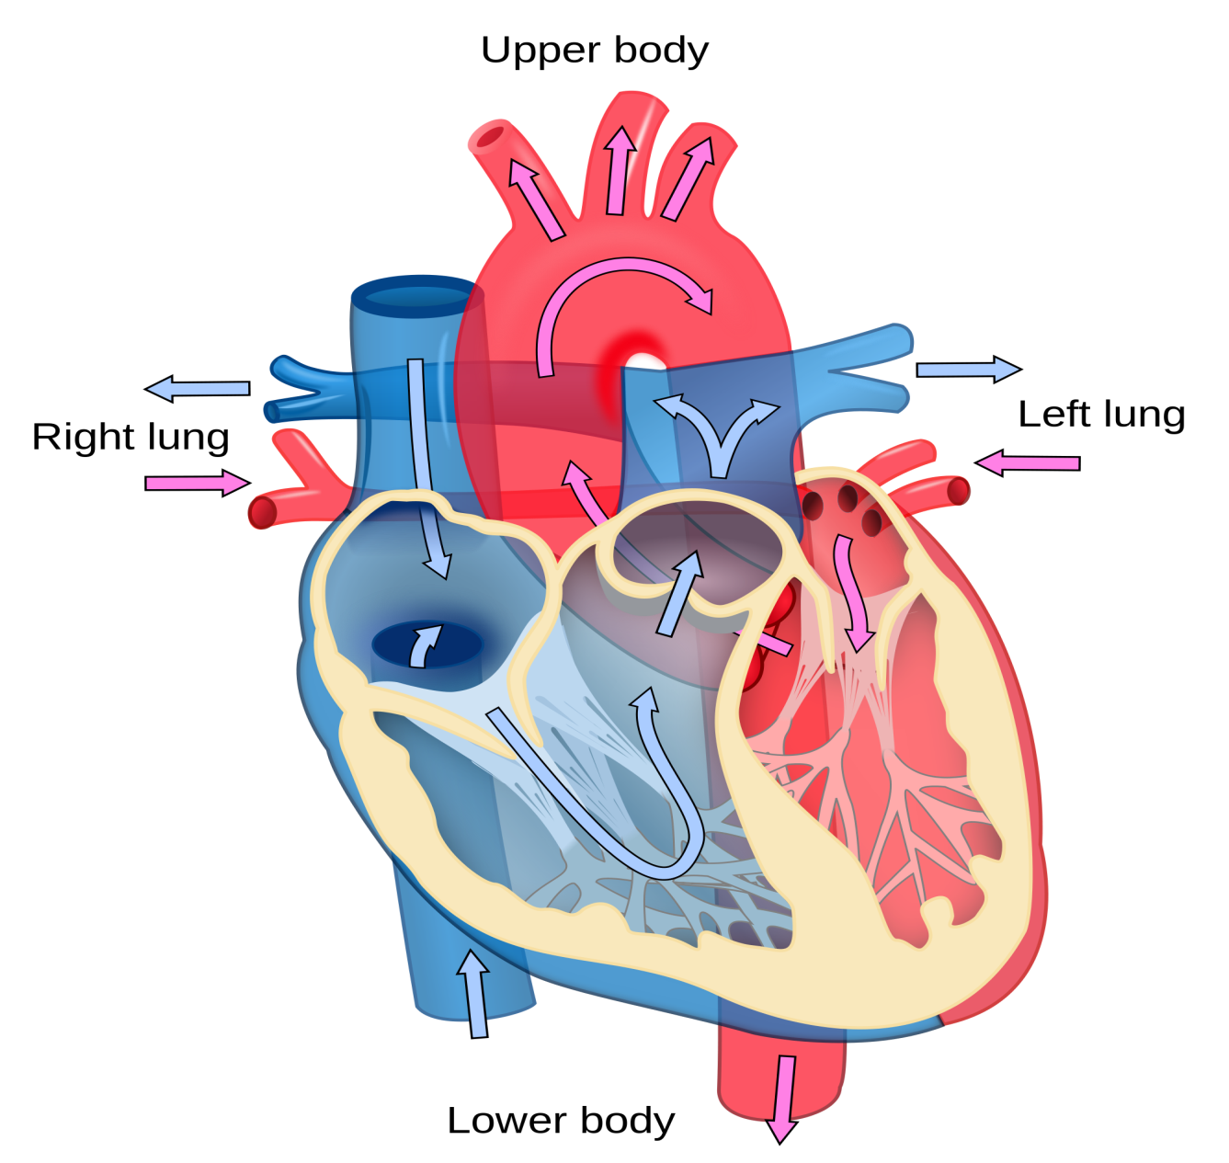
Heart Diagram

Slide 34
Circulatory System
Function :
Supplies O₂ and nutrients to various parts of body
Transports wastes & CO₂ from different parts of body to excretory organs
Body temperature regulation
Blood pressure maintain
Responsible for Immunity and protects body from infection
Helps in coagulation after injury
Maintains body pH
Notes:
Blood is the main component of this system which helps to happen different important functions of human body.

Slide 35
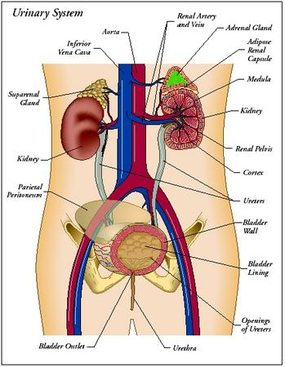
Excretory System Diagram
Notes:
Urinary System is to remove the urine etc excretory materials of body.

Slide 36
Excretory System
Structure & Parts :
1)Kidneys
Ureters
Urinary Bladder
Urethra ------------ Urine
Nephron – Structural & Functional unit of Kidney
2) Intestine ------------ Bile
3) Ear ------------ Ear Wax
4) Skin ------------- Sweat & Sebum
5) Lungs ------------- CO2
Notes:
This system is for other Excretory Materials which are classified in accordance with details mentioned in this slide.

Slide 37
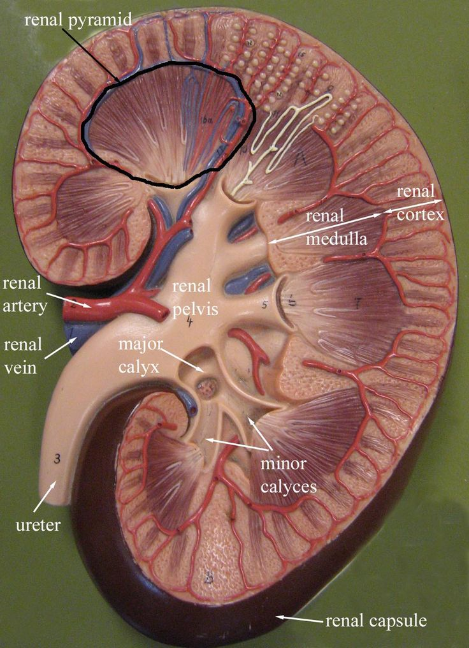
Kidney Diagram
Notes:
This is how about cross-sectional diagram of human kidney.

Slide 38
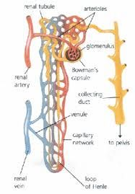
Nephron Diagram
Notes:
And this all about Nephron connected with Collecting Tubule in yellow mark at right.

Slide 39
Excretory System
Function :
Filtration of waste materials from body and eliminate through different excretory pathway as different excretory material ( Eg. Urine,Bile,Ear Wax,CO₂,Sweat& Sebum )
Notes:
SO the function of Excretory System is to purify body from waste materials.

Slide 40
Nervous System
Structure & Parts :
3 Types –
A) Central Nervous System B) Autonomic Nervous System
Notes:
Nervous System : the basic structural and functional unit is Neuron. This system is of 2 types based on Functional aspects.

Slide 41
Nervous System
Structure & Parts :
Central Nervous System – Brain / Nerves / Spinal Cord
Autonomic Nervous System – Sympathetic / Parasympathetic
Neuron – Structural & Functional unit of brain
Notes:
Lets discuss on the structure of Nervous System.

Slide 42
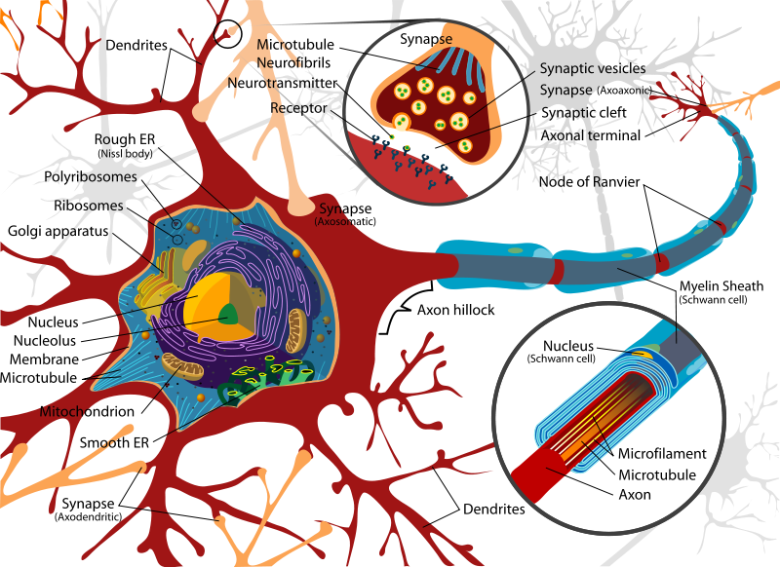
Neuron Diagram
Notes:
Here the structure of Neuron can be referred.

Slide 43
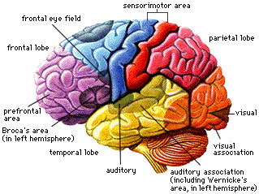
Brain Diagram
Notes:
Brain is the main part of Central Nervous System and the structure is as in the slide.

Slide 44
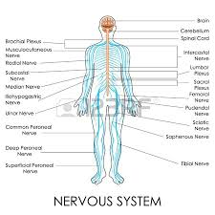
Nervous System Diagram
Notes:
This picture depicts the nerve distribution in the body.

Slide 45
Nervous System
Function :
Maintain an equilibrium between internal and external environment of the human body through conducting impulses.
Notes:
Function of this system is - Maintain an equilibrium between internal and external environment of the human body through conducting impulses

Slide 46
Musculo-skeletal System
Structure & Parts :
640 Voluntary muscles and in total around 850 muscles . 3 types of muscles A) Voluntary B) Involuntary C) Cardiac
206 Bones form the skeletal system of human body.
Notes:
Function of this system is to provide the basic structure of human body.

Slide 47
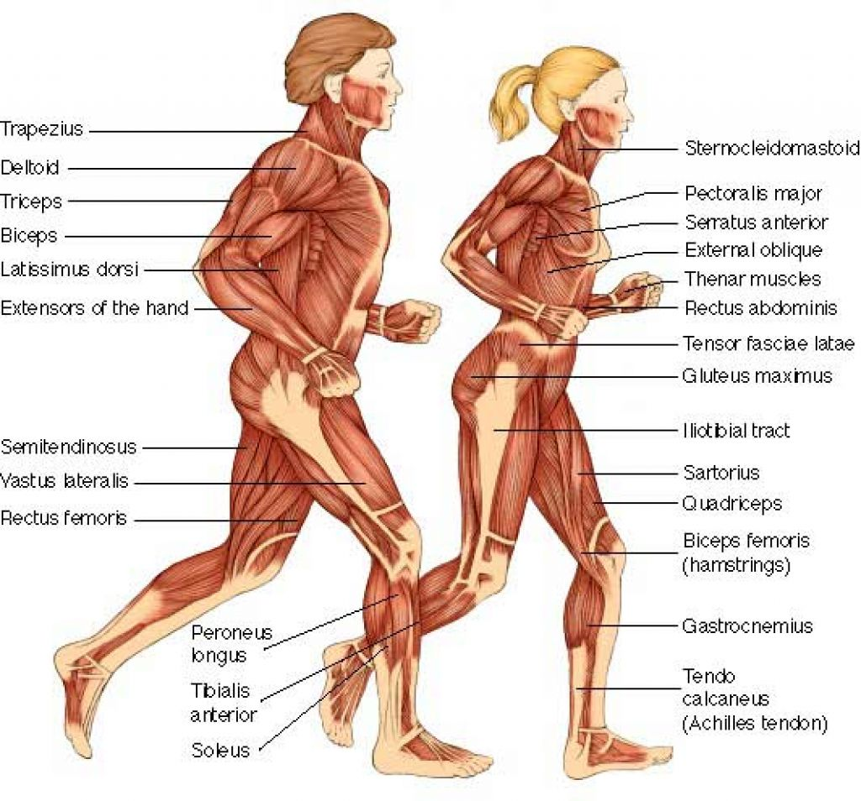
Muscular System Diagram
Notes:
This slide refers the muscles of human body in detail.

Slide 48
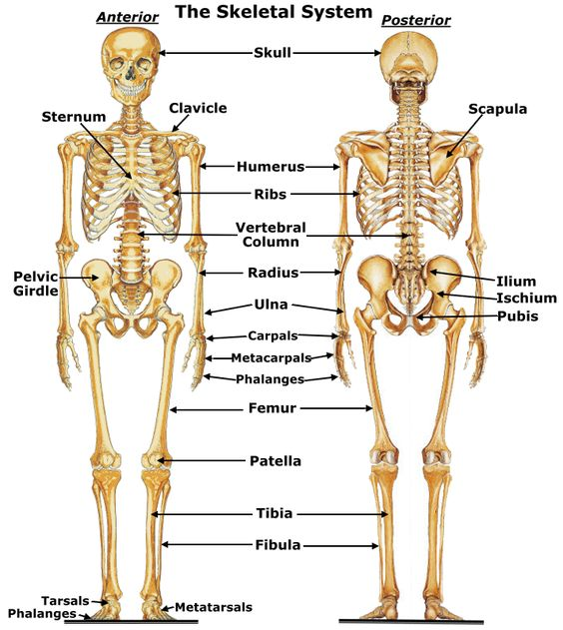
Skeletal System Diagram
Notes:
And this is all about the bones i.e the parts of human skeletal system.

Slide 49
Musculo-skeletal System
Function :
To form and support the body and body parts
To connect different parts of the body
To conduct movement
To conduct Cardiac rhythm
To happen reflex and involuntary movement of different body parts
Notes:
Now, Musculo-skeletal System offers 5 functions mentioned in this slide.

Slide 50
Reproductive System
Structure & Parts :
Male Reproductive System –
Seminal Vescicle/Cowper’s Gland/Vas Deferens/Epididymis/Testis/Ejaculatory Duct/Penis
Female Reproductive System –
Fallopian Tube/Ovary/Uterus/Cervix/Vagina
Notes:
Reproductive System helps to maintain the genration and are of 2 types. Male & Female. Now these are of different parts.

Slide 51
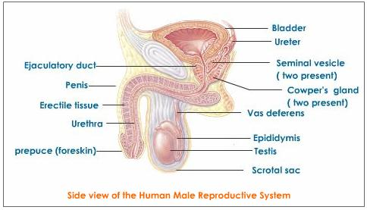
Male Reproductive System Diagram
Notes:
This is Male-Reproductive System.

Slide 52
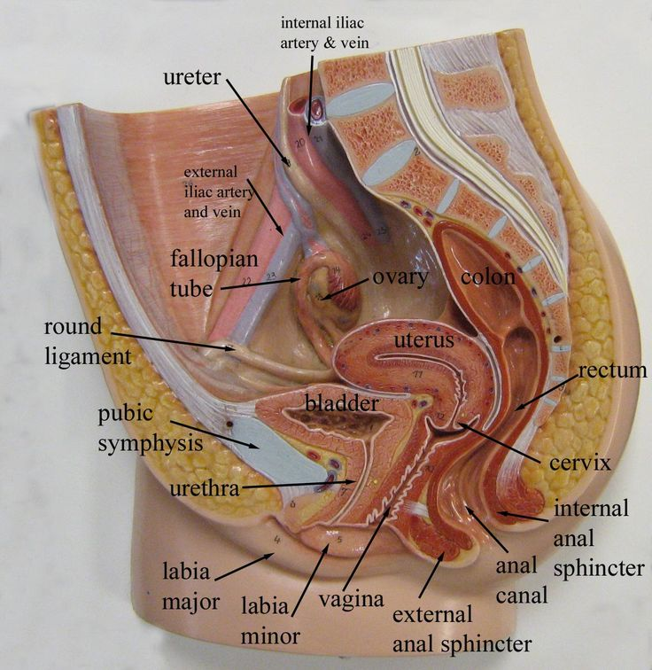
Female Reproductive System Diagram
Notes:
Whereas, this is Female Reproductive System.

Slide 53
Reproductive System
Function :
To reproduce and maintain the progeny of the species
Notes:
Role of Reproductive System is to Reproduce and maintain the progeny of the species.

Slide 54
Integumentary System
Structure & Parts :
Skin ( Integument ) is the largest organ comprises of –
Epidermis (Outer most layer )
Dermis ( Papillary & Reticular layers )
It contains connective tissue,glands,folicles,blood vessels, hair roots & nerve endings etc
Notes:
Integumentary System basically consists of skin-the largest organ of body.

Slide 55
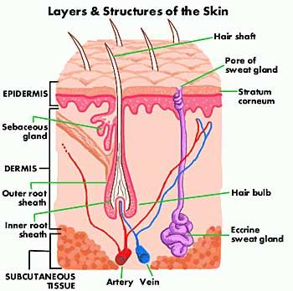
Integumentary System Diagram
Notes:
Here you can find the structure of skin.

Slide 56
Integumentary System
Function :
Epidermis - Protection , Absorption of nutrients & Haemostasis
Dermis - Provide elasticity to the integument, allowing stretching and conferring flexibility, resisting distortions, wrinkling and sagging
Notes:
Different layers of skin performs separately.

Slide 57
Endocrine System
Structure & Parts :
Comprises of glands from which secretory materials directly mixes in the blood through diffusion as there is no duct with these glands
Hormone gets secreted from endocrine glands
Notes:
Endocrine system is basically to secrete hormone. And hormone has different roles in human body.

Slide 58
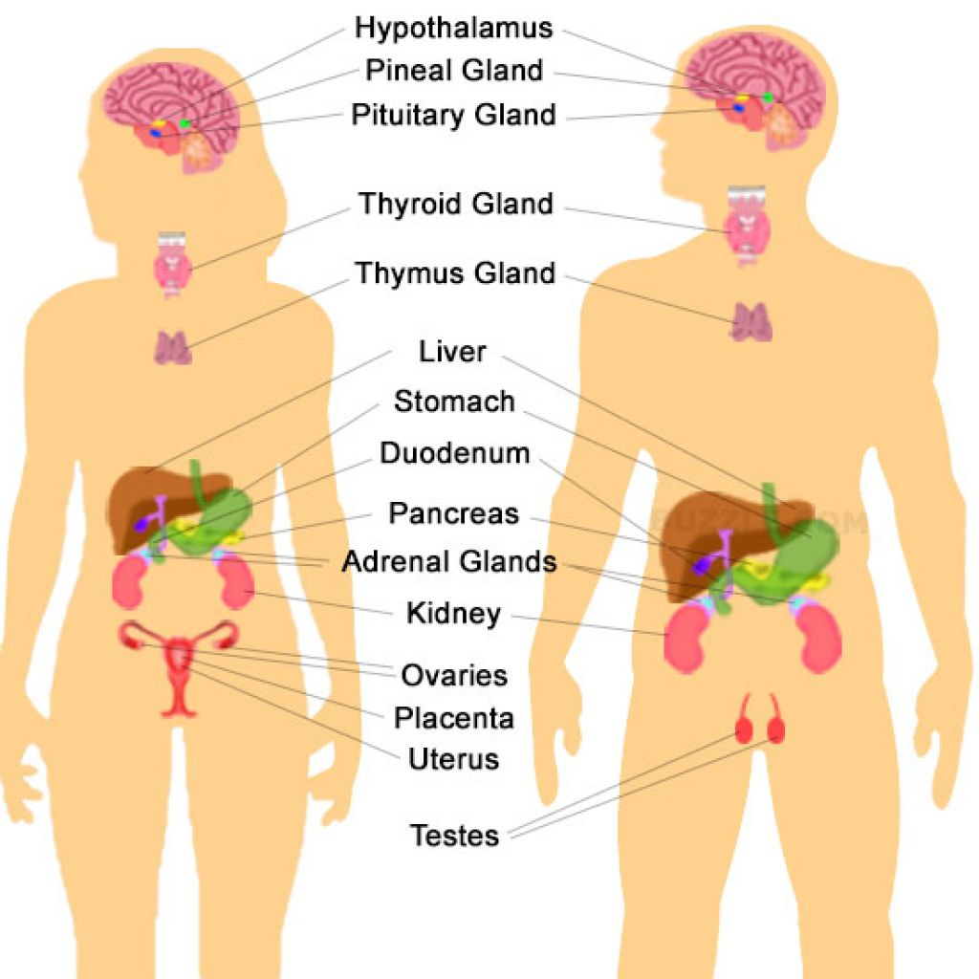
Endocrine System Diagram
Notes:
Find the different endocrine glands,

Slide 59
Endocrine System
Function :
Hormone secreted from endocrine system helps in body cell growth , metabolism, sexual development and function

Slide 60
Immune System
Structure & Parts :
Innate Immune System –
Surface Barrier / Inflammation / Complement System / Cellular Barriers / Natural Killer (NK) Cells
Adaptive Immune System –
Lymphocytes / Killer T cells / Helper T Cells / Gamma Delta T Cells / B Lymphocytes & Antibodies / Alternative Adaptive Immune System / Immunological Memory
Notes:
Immune System is the last system but plays a major role in taking care of human body immunity. The different system runs in the body which has been captured in this silde.

Slide 61
Immune System
Function :
To protect human body from external attacks of microbes etc or internal aberrations
Thereby prevents from microbial infections and system aberrations ( Cancer etc )

Slide 62
THANK YOU

