Slide 1
Cell BIOLOGY PHYSIOLOGY ANATOMY
Dib

Slide 2
Cell
Tissue
Organ
System

Slide 3
Cell
Cell : Structural & Functional Unit of Body
Cytology : Study concerning Cell
Cell Function :
Ingestion & Assimilation
Metabolism
Respiration,Excretion,Irritability & Conductivity
Reproduction
Metabolism :
Catabolism – Complex substances breaking into simpler substances through series of chemical reactions in living body
Anabolism – Simpler substances changing into complex substances through series of chemical reactions in living body

Slide 4
Cell Structure
Nucleus
Cytoplasm
Nucleus – It is bounded by Nuclear Membrane
Cytoplasm – Protoplasm ( viscid liquid ) of a cell exclusive of that of the nucleus

Slide 5
Cell Structure
Nucleus – Control Center or head of the cell ; it contains a large amount of DNA that determine the characteristics of the protein enzymes of the cytoplasm and thus control cytoplasmic activities
DNA is stored in structures called chromosomes

Slide 6
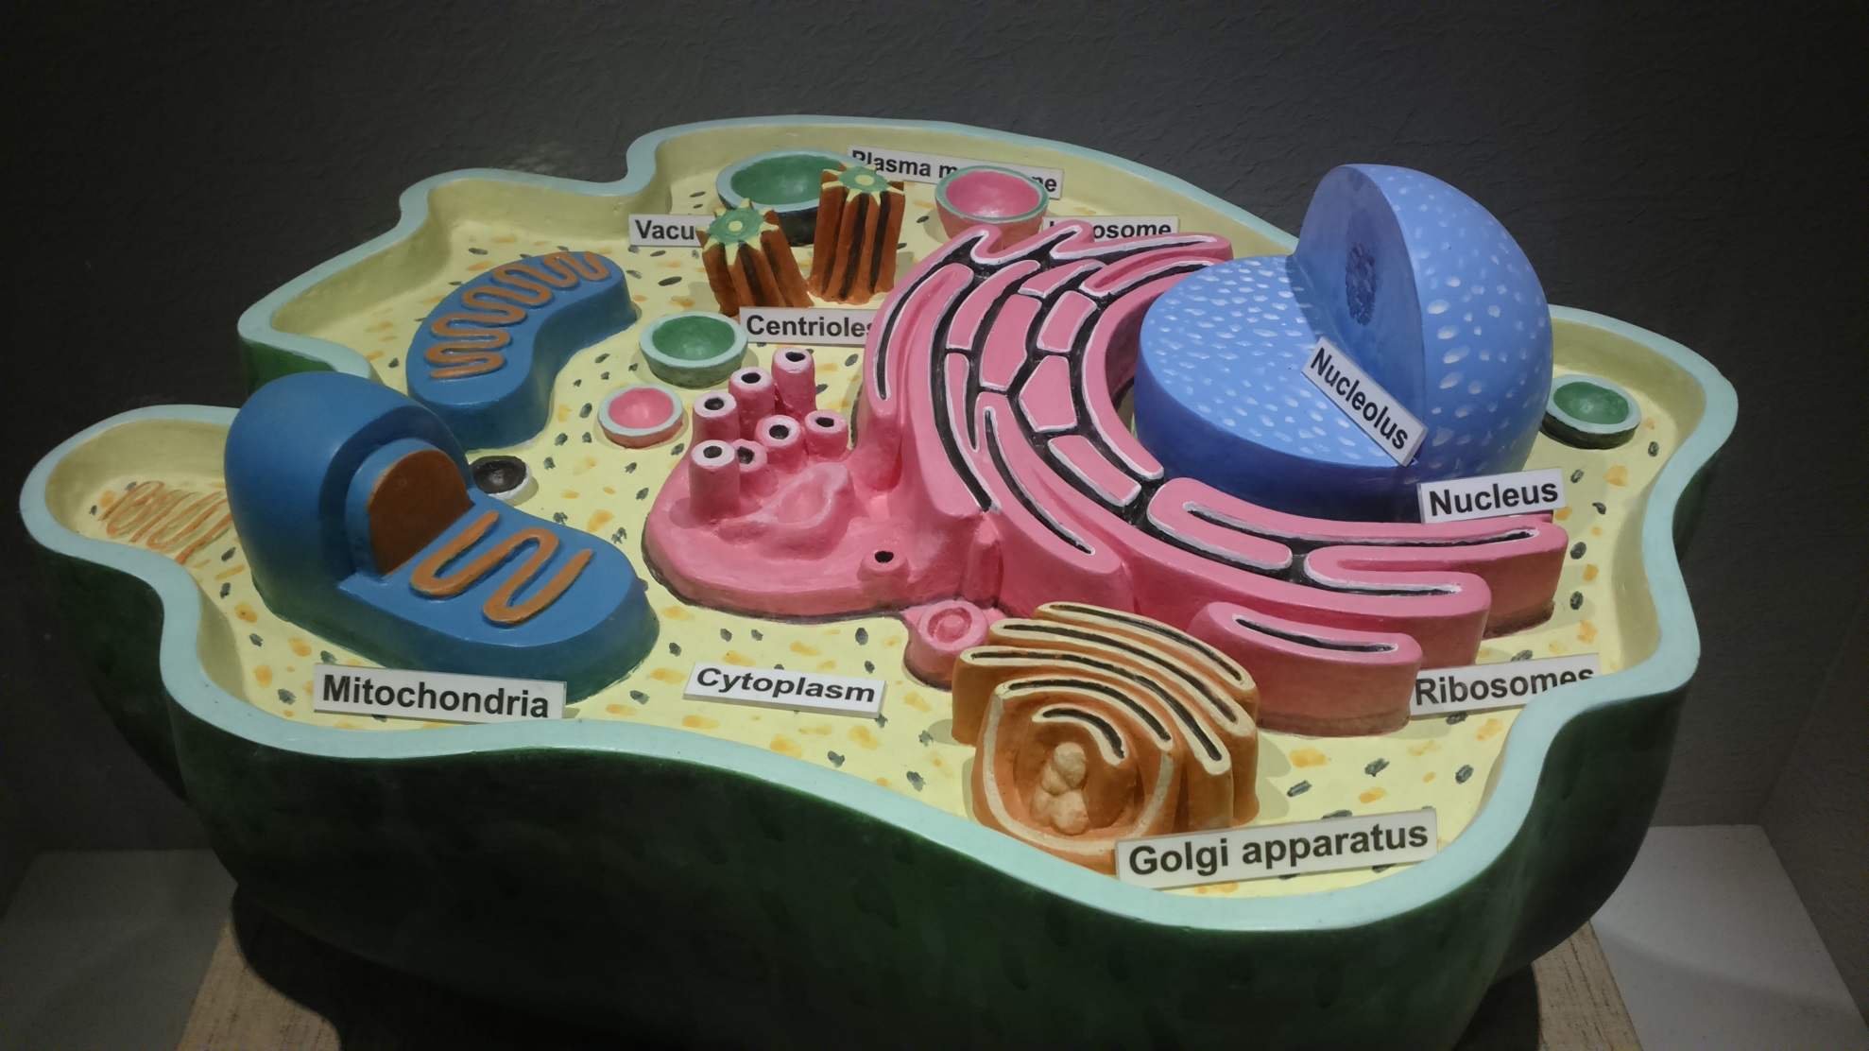
Cell Diagram

Slide 7
Organelles
Endoplasmic Reticulum ( ER )–
Transport of substances from one part of the cell to another
Provide surface area for many enzymes aided reactions in the cell
ER of 2 types – Rough ER & Smooth ER

Slide 8
Organelles
Golgi Aparatus – Substances produced in ER gets transported in the form of vesicles,fuse with the golgi apparatus and gets processed there.
Processed material gets formed into lysosomes or secretory vesicles

Slide 9
Organelles
Lysosome – Membrane bound vesicle, with granules containing digestive enzymes
Provide an intracellular digestive system that helps in removing unwanted substances or foreign particles.
Suicidal Bag of cells : If lysosomes break , leaking the digestive enzymes , parts of the cell might get killed, killing the whole cell itself

Slide 10
Organelles
Mitochondria – Power house of cell ; contains 2 membranes.
Outer membrane & Inner membrane
Inner membrane is convoluted to increase surface area. Convolutions are called Cristae.
Generates power for the various activities of the cell breaking down nutrients

Slide 11
Organelles
Centrosome – Comprises of 2 centrioles
Forms Spindle Fibres ( fibrous outgrowth ) and centriloles move to the opposite pole of the cell to conduct cell division

Slide 12
Tissue
Assemblage of cells and fibrous elements commonly assigned for particular functions
Histology : Study of tissues
Tissue types :
Epithelial
Mascular
Connective
Nervous

Slide 13
Epithelial Tissue
Tissue covering body and body parts ; single or multi-layered ; cells here are held by basement membranes with silia occationally
Skin , airway passages , GIT , blood vessels , lungs etc
Function : Protects body parts, secretes mucus in the inside hollow, balances body temperature, siliary movements help to move out the foreign particles

Slide 14
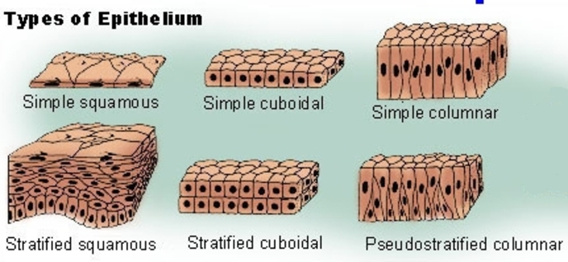
Epithelial Tissue Diagram

Slide 15
Mascular Tissue
Typec | Location | Function
Voluntary | Attached to skeletal muscle | Voluntary movements
Involuntary | Present in GIT & RT | Involuntary reflex actions
Cardiac | Present in Heart | Rhythmic beating of heart

Slide 16
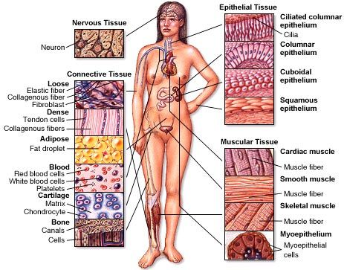
Muscular Tissue Diagram

Slide 17
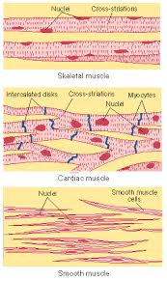
Different Muscle Diagram

Slide 18
Connective Tissue
Characterized by a large amount of inter-cellular substances produced by the cells
Types - Blood , Adipose Tissue , Bone , Cartilage
Function : Connects and provides support to various parts of the body

Slide 19
Nervous Tissue
Unique as it does not get divided ( as there is no centrosome in Neuron )
Made up of Neurons ( Nerve Cells ) & Neuroglia ( Supporting Cells )
Function : Helps to transmit impulses from one part of the body to the other

Slide 20
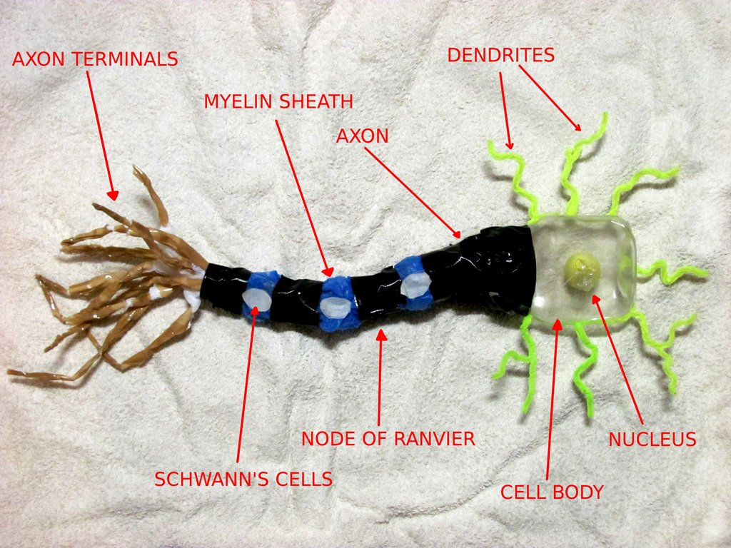
Neuron Diagram

Slide 21
Organs
Same kind of tissues situated in one prt of the body altogether performing common function is an organ
Different organs altogether performing a set of common actions form a system
5 Systems available in human body

Slide 22
System
Digestive System
Respiratory System
Circulatory System
Excretory System
Nervous System
Musculo-skeletal System
Reproductive System
Integumentary System
Endocrine System
Immune System

Slide 23
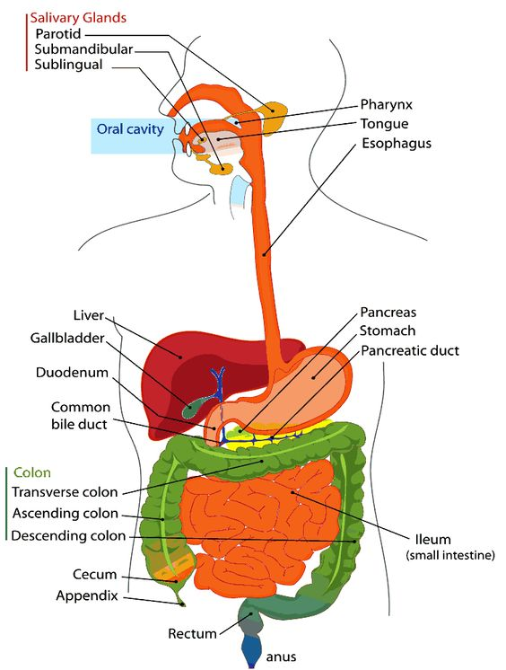
Digestive System Diagram

Slide 24
Digestive System
Structure & Parts :
Digestive Tube - Mouth , Pharynx , Oesophagus , Stomach , Small Intestine , Large Intestine, Rectum & Anus
Digestive Glands - Salivary Glands , Liver & Pancreas

Slide 25
Digestive System
Function :
Ingestion
Digestion
Absorption
Assimilation
Elimation

Slide 26
Respiratory System
Structure & Parts :
Upper Respiratory Tract
Nose / Pharynx / Larynx / Trachea
Lower Respiatory Tract
Bronchi / Bronchioles / Lungs / Muscles for Respiration ( Intercostal & Diaphragm )

Slide 27
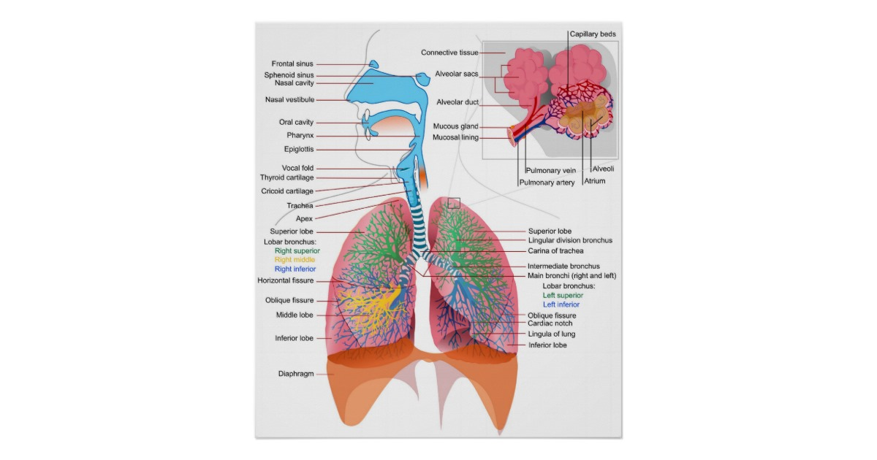
Respiratory System Diagram

Slide 28
Respiratory System
Function :
Inspiration
Expiration
Pause
Respiration Cycle per minute 15 times

Slide 29
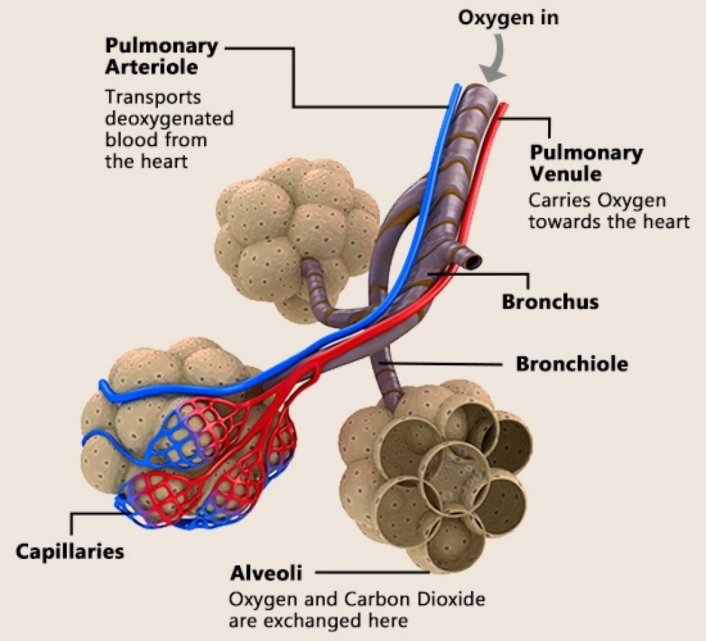
Alveoli Diagram

Slide 30
Respiratory System
Function :
External Respiration ( O2-CO2 exchange ) – Between Lungs & Blood
Internal Respiration ( O2-CO2 exchange ) –
Between Blood & Cells

Slide 31
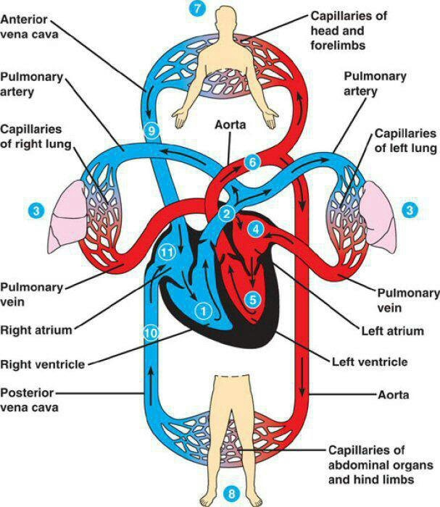
Circulatory System Diagram

Slide 32
Circulatory System
Structure & Parts :
Heart / Blood / Blood Vessels
Blood Vessels – Artery / Vein / Capillary
Blood–Serum/Blood Cells( RBC/WBC/Platelets )

Slide 33
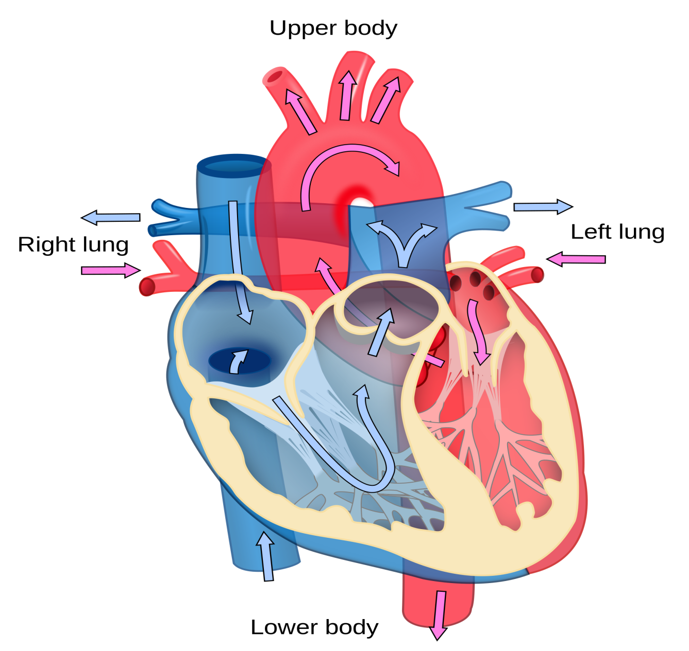
Heart Diagram

Slide 34
Circulatory System
Function :
Supplies O₂ and nutrients to various parts of body
Transports wastes & CO₂ from different parts of body to excretory organs
Body temperature regulation
Blood pressure maintain
Responsible for Immunity and protects body from infection
Helps in coagulation after injury
Maintains body pH

Slide 35
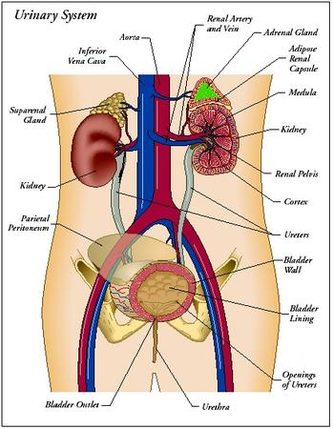
Excretory System Diagram

Slide 36
Excretory System
Structure & Parts :
1)Kidneys
Ureters
Urinary Bladder
Urethra ------------ Urine
Nephron – Structural & Functional unit of Kidney
2) Intestine ------------ Bile
3) Ear ------------ Ear Wax
4) Skin ------------- Sweat & Sebum
5) Lungs ------------- CO2

Slide 37
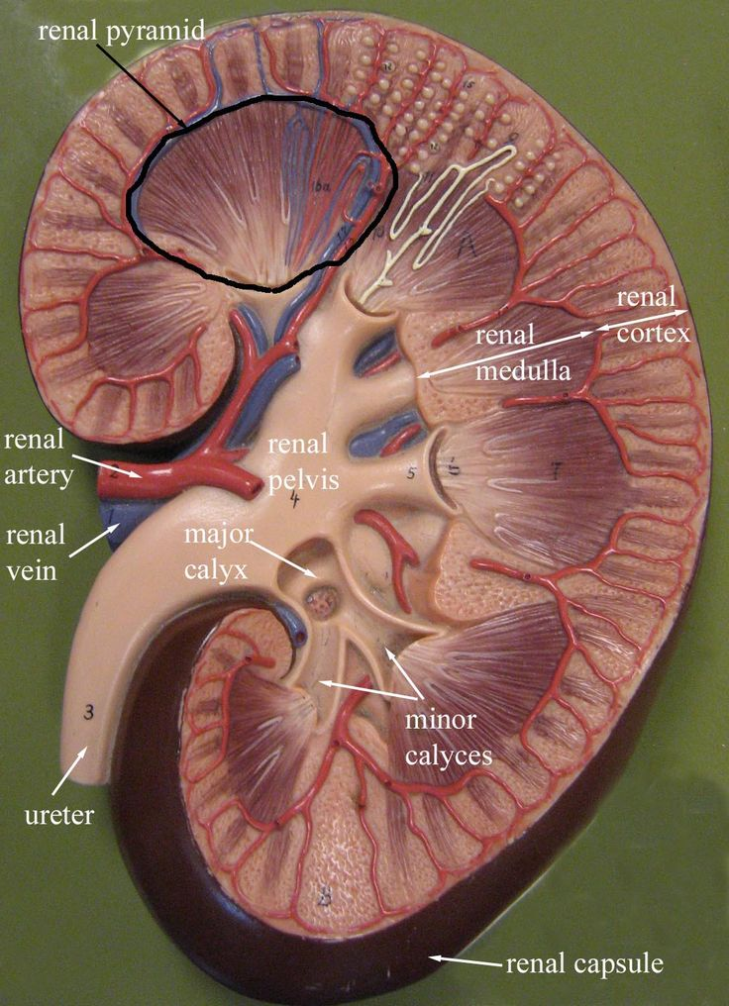
Kidney Diagram

Slide 38
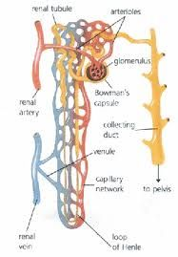
Nephron Diagram

Slide 39
Excretory System
Function :
Filtration of waste materials from body and eliminate through different excretory pathway as different excretory material ( Eg. Urine,Bile,Ear Wax,CO₂,Sweat& Sebum )

Slide 40
Nervous System
Structure & Parts :
3 Types –
A) Central Nervous System B) Autonomic Nervous System

Slide 41
Nervous System
Structure & Parts :
Central Nervous System – Brain / Nerves / Spinal Cord
Autonomic Nervous System – Sympathetic / Parasympathetic
Neuron – Structural & Functional unit of brain

Slide 42
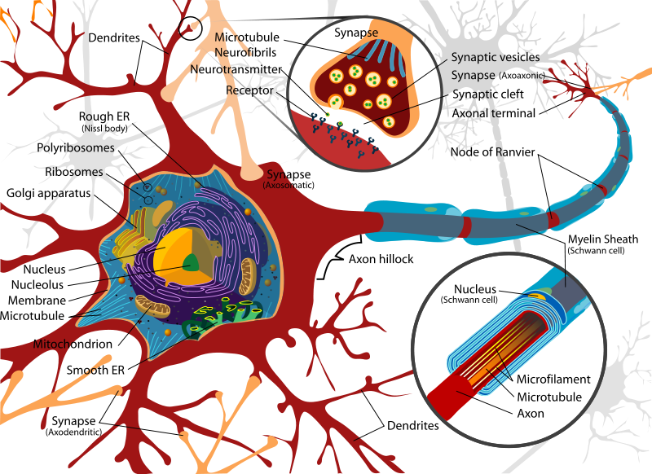
Neuron Diagram

Slide 43
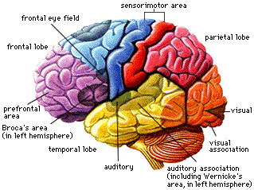
Brain Diagram

Slide 44
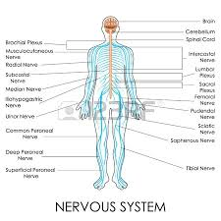
Nervous System Diagram

Slide 45
Nervous System
Function :
Maintain an equilibrium between internal and external environment of the human body through conducting impulses.

Slide 46
Musculo-skeletal System
Structure & Parts :
640 Voluntary muscles and in total around 850 muscles . 3 types of muscles A) Voluntary B) Involuntary C) Cardiac
206 Bones form the skeletal system of human body.

Slide 47
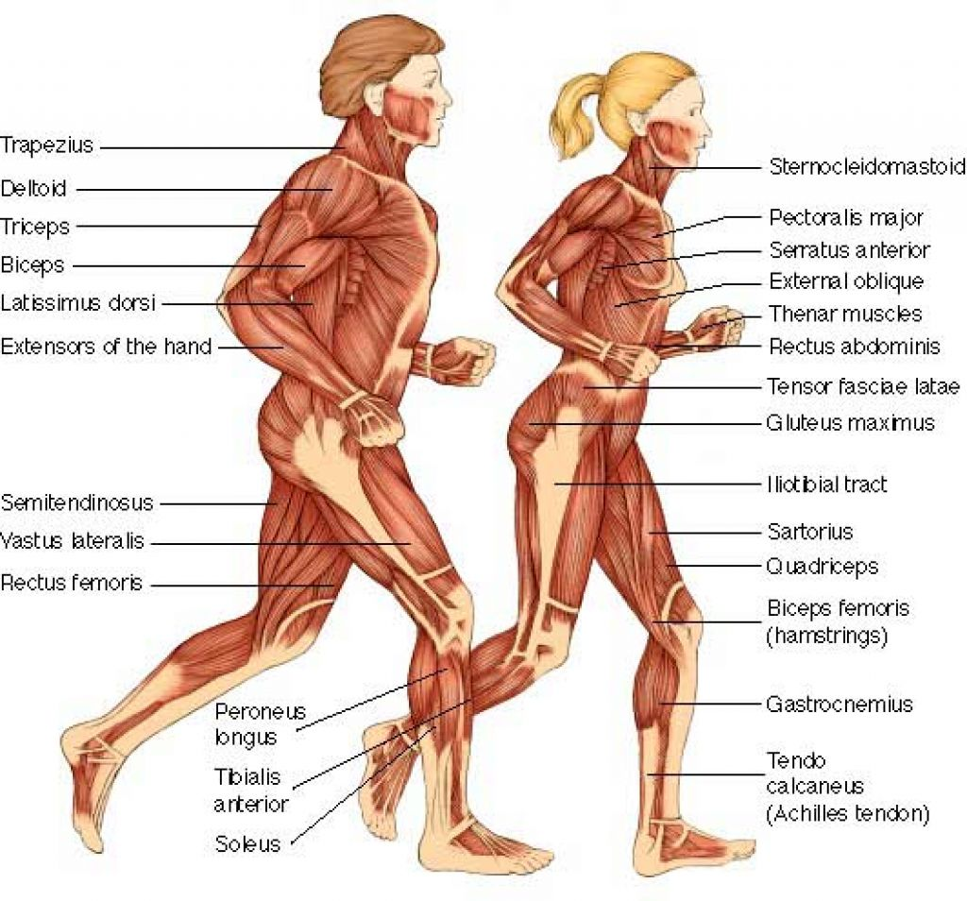
Muscular System Diagram

Slide 48
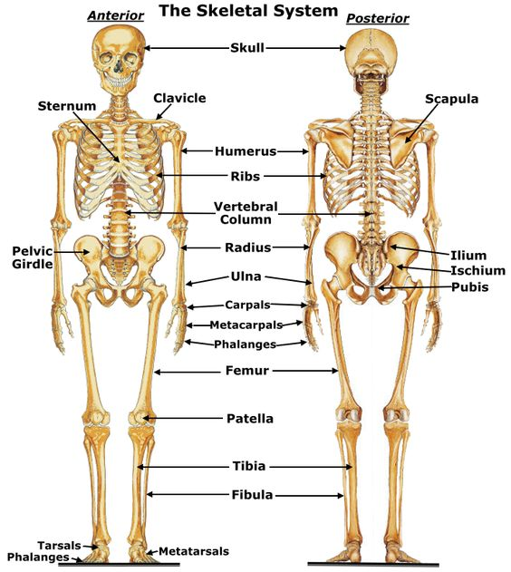
Skeletal System Diagram

Slide 49
Musculo-skeletal System
Function :
To form and support the body and body parts
To connect different parts of the body
To conduct movement
To conduct Cardiac rhythm
To happen reflex and involuntary movement of different body parts

Slide 50
Reproductive System
Structure & Parts :
Male Reproductive System –
Seminal Vescicle/Cowper’s Gland/Vas Deferens/Epididymis/Testis/Ejaculatory Duct/Penis
Female Reproductive System –
Fallopian Tube/Ovary/Uterus/Cervix/Vagina

Slide 51
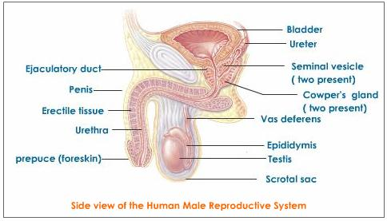
Male Reproductive System Diagram

Slide 52
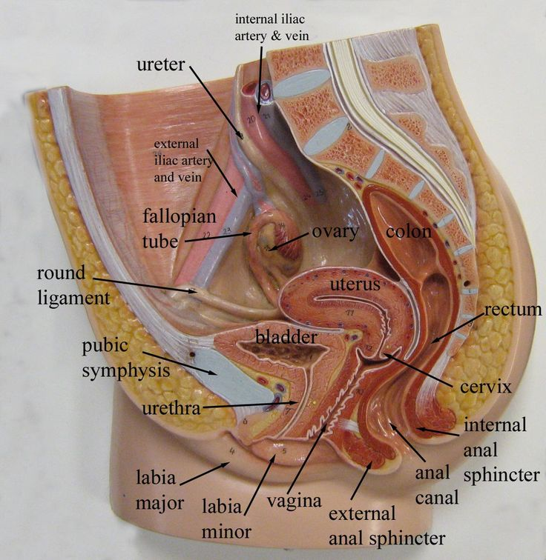
Female Reproductive System Diagram

Slide 53
Reproductive System
Function :
To reproduce and maintain the progeny of the species

Slide 54
Integumentary System
Structure & Parts :
Skin ( Integument ) is the largest organ comprises of –
Epidermis (Outer most layer )
Dermis ( Papillary & Reticular layers )
It contains connective tissue,glands,folicles,blood vessels, hair roots & nerve endings etc

Slide 55
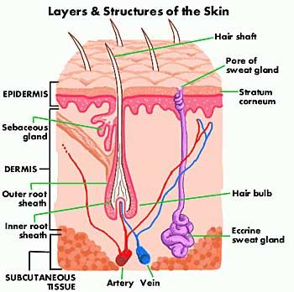
Integumentary System Diagram

Slide 56
Integumentary System
Function :
Epidermis - Protection , Absorption of nutrients & Haemostasis
Dermis - Provide elasticity to the integument, allowing stretching and conferring flexibility, resisting distortions, wrinkling and sagging

Slide 57
Endocrine System
Structure & Parts :
Comprises of glands from which secretory materials directly mixes in the blood through diffusion as there is no duct with these glands
Hormone gets secreted from endocrine glands

Slide 58
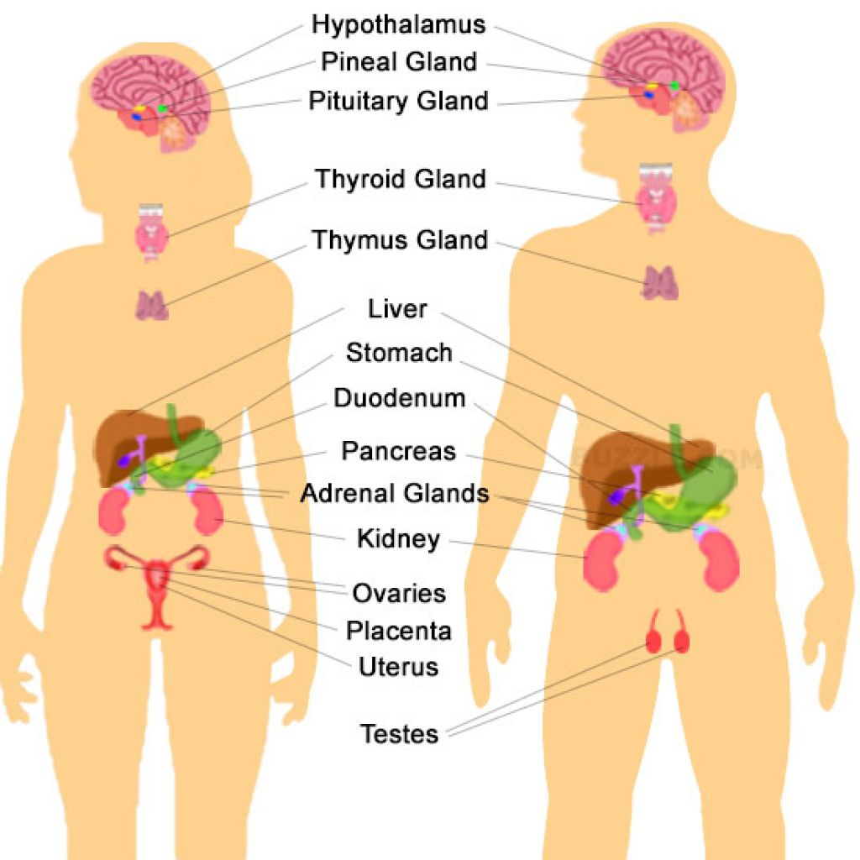
Endocrine System Diagram

Slide 59
Endocrine System
Function :
Hormone secreted from endocrine system helps in body cell growth , metabolism, sexual development and function

Slide 60
Immune System
Structure & Parts :
Innate Immune System –
Surface Barrier / Inflammation / Complement System / Cellular Barriers / Natural Killer (NK) Cells
Adaptive Immune System –
Lymphocytes / Killer T cells / Helper T Cells / Gamma Delta T Cells / B Lymphocytes & Antibodies / Alternative Adaptive Immune System / Immunological Memory

Slide 61
Immune System
Function :
To protect human body from external attacks of microbes etc or internal aberrations
Thereby prevents from microbial infections and system aberrations ( Cancer etc )

Slide 62
THANK YOU

