Slide 1

A Study of the Difference in the Productivity in Software Development Before and After the Initial COVID-19 Lockdowns
CS7CS5-202122: DISSERTATION
By: Tapabrata Tapanlal Mukhopadhyay
Supervisor: Prof. Stephen Barrett

Slide 2

Topic Breakdown
Based on reasonable proxies
A Study of the Difference in the Productivity in Software Development Before and After the Initial COVID-19 Lockdowns
Scope: top 20 GitHub repositories based on star count.
In the top 10 countries based on number of GitHub users. This averages out to March 2020.

Slide 3
Elevator Pitch
The COVID-19 pandemic led to radical global changes
Reasonable to assume multivariate impact on work-life
Productivity -> industrial interest
Aim to provide simple, efficient analysis
Terms familiar to industry
Analysis cannot be gamed because working with past data

Slide 4
Research Question
Had there been a measurable change in the productivity in software development after the initial COVID-19 lockdowns were imposed?
Hypothesis 0: There will be a change in the productivity of the software developers after the initial COVID-19 lockdowns.

Slide 5
Methodology
Selecting Productivity Markers
Commit Count
Additions
Deletions
Lines of Code (LOC)
Cyclomatic Complexity
Token Count
Gathering Data
GitHub API ☹
PyDriller^{[1]} Module ☺
[1] PyDriller: Python framework for mining software repositories (https://dl.acm.org/doi/10.1145/3236024.3264598)

Slide 6
Methodology (Contd.)
Grouping Data
By Month
By Author
By Repository and month
By Repository and author
Analysis Library
Trend in Mean (pre and post-lockdown)
Month/Author Eq (Equilibrium Number)
Month/Author 80 (Pareto Number)

Slide 7
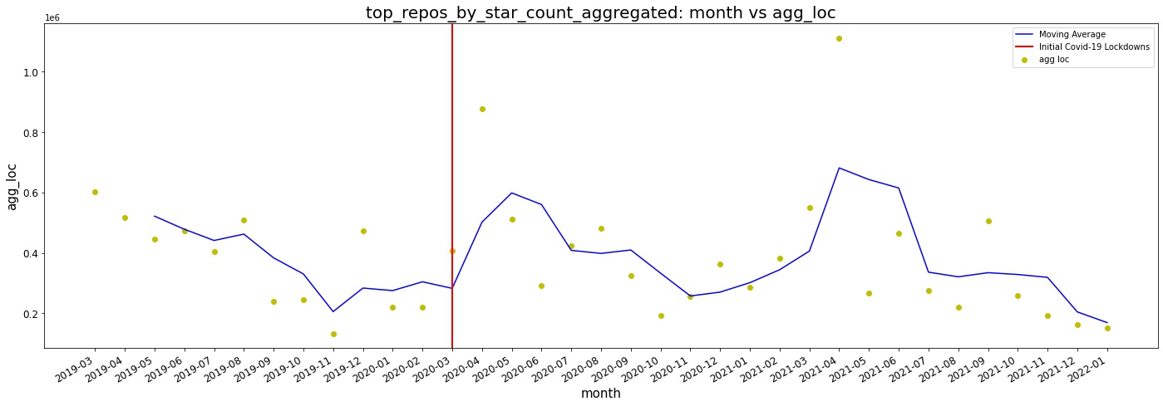
Results
Fig. 1: Month vs Aggregate LOC graph with a quarterly rolling average trendline

Slide 8
Results (Contd.)
Repository Rank | Repository Name | Marker | Trend in Mean | Author Eq (pre) | Author Eq (post) | Change Direction (Author Eq) | Author 80 (pre) | Author 80 (post) | Change Direction (Author 80)
18 | flutter | Commit Count | Down (34.6%) | 1.8 | 0.8 | Down | 6.8 | 5.2 | Down
18 | flutter | Additions | Down (40.0%) | 1.3 | 1.5 | Up | 4.5 | 4.5 | No Change
18 | flutter | Deletions | Down (41.6%) | 1.0 | 1.0 | No Change | 2.9 | 2.8 | Down
18 | flutter | Aggregate LOC | Down (28.3%) | 0.6 | 0.4 | Down | 1.6 | 1.1 | Down
18 | flutter | Aggregate Complexity | Down (16.7%) | 0.6 | 0.4 | Down | 1.9 | 1.0 | Down
18 | flutter | Aggregrate Token Count | Down (28.2%) | 0.6 | 0.4 | Down | 1.6 | 1.1 | Down
Fig. 2: Trend, equilibrium number, and pareto number comparisons for the flutter repository

Slide 9
Findings
Hypothesis 0 is TRUE
Overall productivity has reduced
Productivity distribution got slightly more even over time
Productivity distribution did not change significantly among authors, but there was notable change in the percentage of highly productive authors
Code is likely getting more verbose
Commit count among authors only marker to come close to following the Pareto principle
Hypothesis 0 is TRUE
Overall productivity has reduced
Productivity distribution got slightly more even over time
Productivity distribution did not change significantly among authors, but there was notable change in the percentage of highly productive authors
Code is likely getting more verbose
Commit count among authors only marker to come close to following the Pareto principle

Slide 10
Limitations
Possible Selection Bias
Limited Sample Size
Incompleteness
Previous works more academically inclined rather than industrially inclined
Losing time in working with GitHub API
Inheritance of limitations of module used for data gathering
Potential holes in analysis of observations due to lack of expertise
Possible Selection Bias
Limited Sample Size
Incompleteness
Previous works more academically inclined rather than industrially inclined
Losing time in working with GitHub API
Inheritance of limitations of module used for data gathering
Potential holes in analysis of observations due to lack of expertise

Slide 11
Future Work
Potential to add subjective markers like self-reported productivity
Working with larger dataset that spans across a longer time period (with more nuance)
Granularity
PyDriller offers more potential markers like Delta Maintainability ^{[2]}
Adding non-commit-centric data to the mix (For e.g. issues and pull requests)
[2] The Delta Maintainability Model: Measuring Maintainability of Fine-Grained Code Changes (https://doi.org/10.1109/TechDebt.2019.00030)

Slide 12

THANK YOU!

