Slide 1
Make A Copy Of This Deck And Update The Red Ink Based On Your Notebook Results

Slide 2

Instructor Kick-off
Analyze A/B Test Results
© 2019 Udacity. All rights reserved.

Slide 3
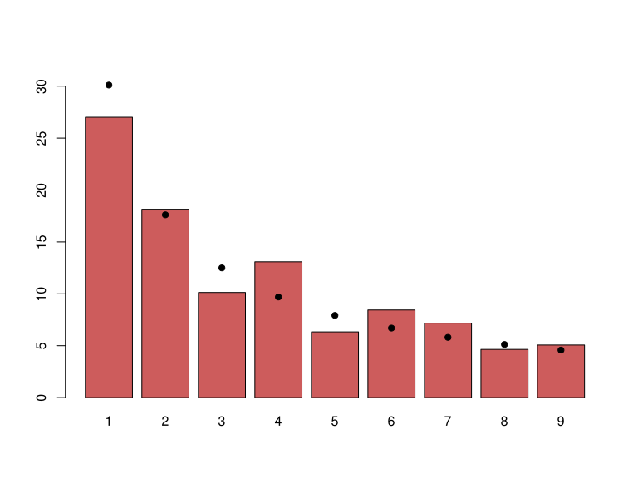
How Was The Experiment Implemented?​
Total Variant Visitors: 147,239
Total Control Participants:​ 147,239
​
Country Distribution: United States (70%), United Kingdom (17%), Canada (13%). The experiment was evenly split between control (old page) and treatment (new page) groups across all three countries.

Slide 4
Conversion Rates
 | U.S. | U.K. | CA
Control | 11.8% | 12.3% | 12.0%
Treatment | 12.0% | 11.7% | 12.0%
Executive Summary: Conversion rates are nearly identical across all three countries and both groups, ranging from 11.7% to 12.3%. Neither the treatment page nor the country of origin shows a meaningful association with conversion. The differences are too small to suggest a practical effect.

Slide 5
Experiment Results
Treatment Conversion Rate: 11.92%
Control Conversion Rate:​ 11.88%
Delta in Treatment vs. Control Conversion Rate:​ +0.04% (Treatment slightly higher)
p-value:​ 0.394
Conclusion:​ We fail to reject the null hypothesis. The p-value of 0.394 is well above the 0.05 significance threshold, meaning there is no statistically significant evidence that the new page leads to higher conversion rates. Practically speaking, the company should not switch to the new page based on this data alone. Running the experiment longer or gathering more data may be warranted before making a final decision.

Slide 6
Country Results
Conclusion:​ The logistic regression model with country dummy variables shows no statistically significant country effect. US users had a p-value of 0.509 and UK users had a p-value of 0.940, both far above 0.05. Adding country to the model does not improve predictive power. We conclude that country of origin does not meaningfully influence conversion, and the decision on whether to adopt the new page should be based on the A/B test results, which also show no significant difference.

