Slide 1

Gene List Analysis Report
Hint: Each slide has notes that explain the analysis!
http://metascape.org
Please cite Zhou et al. Nature Commun. 2019 10(1):1523
Oct 9, 2024
Notes:
This analysis report is automatically generated by Metascape (https://metascape.org).

Slide 2
Gene List Summary
Name | Total | Unique | _Color_
DEGs | 419 | 419 | #E41A1C
DMRs | 307 | 307 | #377EB8
Please check online Metascape User Manual for explanation of each annotation field.
Notes:
Metascape first automatically converts you input identifiers (Entrez Gene ID, RefSeq, Ensembl ID, UnProt ID or Symbol) into Human Entrez Gene ID. For example, input identifiers can be from human, mouse or rat orthologs, which can be mapped into human (or “analysis as” species) based on both EggNOG and Homologene databases.
The background of each row is the color code used in the various plots within this report, where each color is consistently used to code a corresponding gene list.

Slide 3
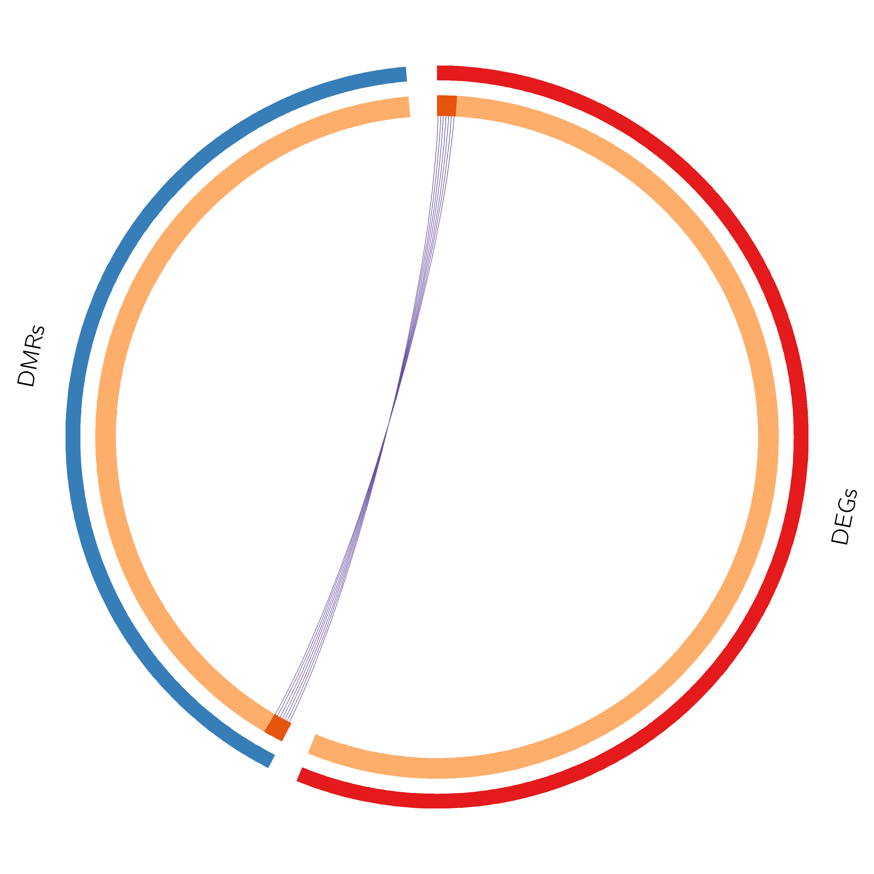
Gene Overlap Analysis
Notes:
The Circos plot shows how genes from the input gene lists overlap.
On the outside, each arc represents the identity of each gene list, using the same color code as the color used for table rows in slide #2.
On the inside, each arc represents a gene list, where each gene member of that list is assigned a spot on the arc. Dark orange color represents the genes that are shared by multiple lists and light orange color represents genes that are unique to that gene list.
Purple lines link the same gene that are shared by multiple gene lists (notice a gene that appears in two gene lists will be mapped once onto each gene list, therefore, the two positions are purple linked).
The greater the number of purple links and the longer the dark orange arcs implies greater overlap among the input gene lists.

Slide 4
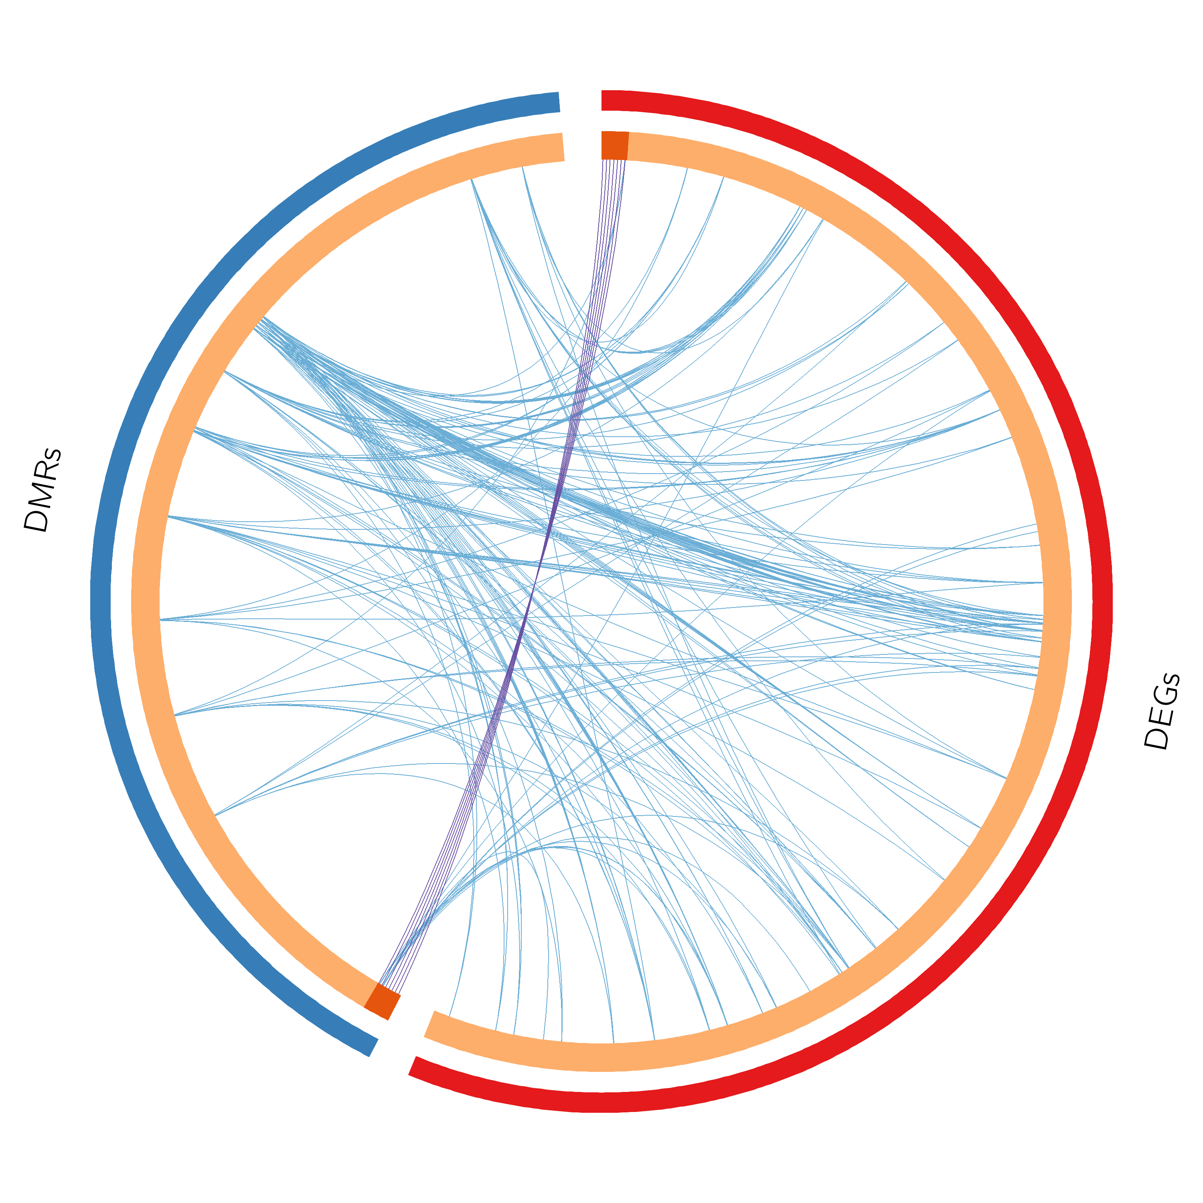
Gene Overlap Analysis Expanded via Shared Enriched Ontologies
Notes:
The Circos plot shows how genes from the input gene lists overlap.
On the outside, each arc represents the identity of each gene list, using the same color code as the color used for table rows in slide #2.
On the inside, each arc represents a gene list, where each gene member of that list is assigned a spot on the arc. Dark orange color represents the genes that are shared by multiple lists and light orange color represents genes that are unique to that gene list.
Purple lines link the same gene that are shared by multiple gene lists (notice a gene that appears in two gene lists will be mapped once onto each gene list, therefore, the two positions are purple linked). Blue lines link the genes, although different, fall under the same ontology term (the term has to statistically significantly enriched and with size no larger than 100).
The greater the number of purple links and the longer the dark orange arcs implies greater overlap among the input gene lists. Blue links indicate the amount of functional overlap among the input gene lists. It is common in meta-analysis that we observe little directly overlap among studies, due to the variations in the biological assays used. However, we tend to see a lot more functional overlap, as these studies probably pick up different subset of gene members of the same biological processes.

Slide 5
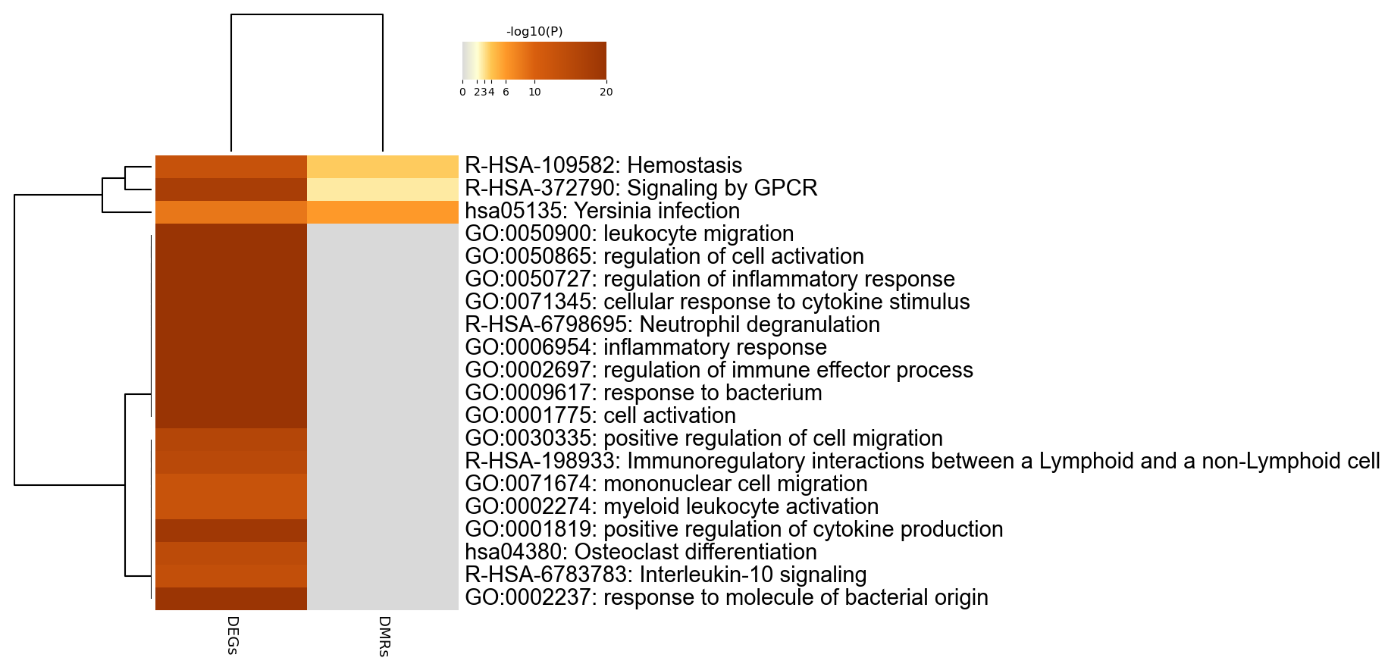
Enriched Ontology Clusters Across Studies
Notes:
We first identified all statistically enriched terms (can be GO/KEGG terms, canonical pathways, hall mark gene sets, etc., based on the default choices under Express Analysis or your choice during Custom Analysis), accumulative hypergeometric p-values and enrichment factors were calculated and used for filtering. Remaining significant terms were then hierarchically clustered into a tree based on Kappa-statistical similarities among their gene memberships (similar to what is used in NCI DAVID site). Then 0.3 kappa score was applied as the threshold to cast the tree into term clusters. The terms within each cluster are exported in the Excel spreadsheet named “Enrichment Analysis”.
We selected the term with the best p-value within each cluster as its representative term and display them in a dendrogram. The heatmap cells are colored by their p-values, white cells indicate the lack of enrichment for that term in the corresponding gene list. We also export files behind this heatmap (.cdt, .gtr, .atr, and .jtv files), so that one can visualize it interactively using JTreeView program (http://sourceforge.net/projects/jtreeview/). The PDF version of the graph can be found in the zip package.
If you want to view the complete list of enriched terms, please download the .zip file and check Enrichment_GO/GO_AllLists.csv.
Note: gene lists containing more than 3000 genes are not analyzed. Please use a more stringent hit calling criterion, as you most likely have retained too many genes.

Slide 6
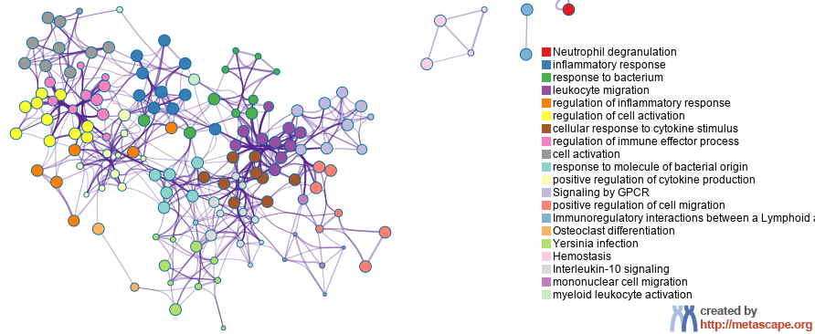
Enriched Ontology Clusters Colored by Cluster ID
Notes:
We selected a subset of representative terms from the full cluster and converted them into a network layout. More specifically, each term is represented by a circle node, where its size is proportional to the number of input genes fall under that term, and its color represent its cluster identity (i.e., nodes of the same color belong to the same cluster). Terms with a similarity score > 0.3 are linked by an edge (the thickness of the edge represents the similarity score). The network is visualized with Cytoscape with “force-directed” layout and with edge bundled for clarity. One term from each cluster is selected to have its term description shown as label.

Slide 7
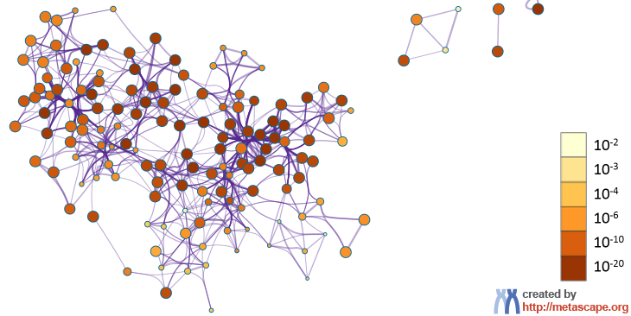
Enriched Ontology Clusters Colored by p-Value
Notes:
The same enrichment network has its nodes colored by p-value, as shown in the legend. The dark the color, the more statistically significant the node is (see legend for p-value ranges).

Slide 8
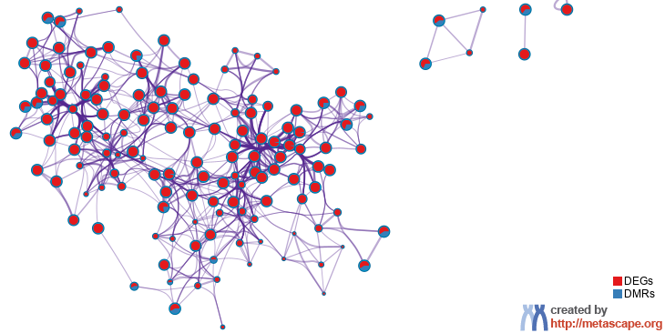
Enriched Ontology Clusters Pied by Gene Counts Across Studies
Notes:
The same enrichment network has its nodes displayed as pies. Each pie sector is proportional to the number of hits originated from a gene list.
Color code for pie sector represents a gene list and is consistent with the colors used for table rows in slide #2.

Slide 9
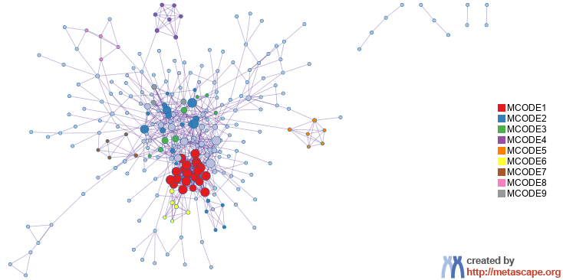
Protein-protein Interaction Network
Gene List: DEGs
Notes:
All protein-protein interactions among input genes were extracted from PPI data source and formed a PPI network.
GO enrichment analysis was applied to the network to extract “biological meanings”.

Slide 10
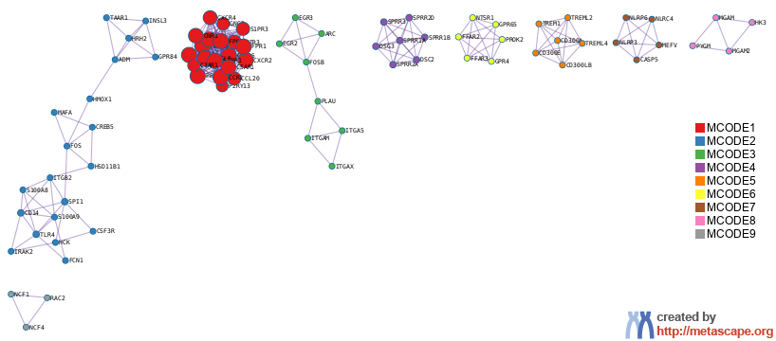
PPI MCODE Components
Gene List: DEGs
Notes:
MCODE algorithm was then applied to this network to identify neighborhoods where proteins are densely connected. Each MCODE network is assigned a unique color.

Slide 11
Biological Interpretation PPI Network & MCODE Components
Gene List: DEGs
Network | Annotation
DEGs | R-HSA-6798695|Neutrophil degranulation|-54.5;GO:0006954|inflammatory response|-48.1;GO:0032103|positive regulation of response to external stimulus|-37.5
DEGs_MCODE_ALL | R-HSA-373076|Class A/1 (Rhodopsin-like receptors)|-34.3;R-HSA-500792|GPCR ligand binding|-33.3;R-HSA-388396|GPCR downstream signalling|-30.9
DEGs_SUB1_MCODE_1 | R-HSA-418594|G alpha (i) signalling events|-36.6;R-HSA-500792|GPCR ligand binding|-36.4;R-HSA-373076|Class A/1 (Rhodopsin-like receptors)|-36.1
DEGs_SUB1_MCODE_2 | GO:0006954|inflammatory response|-12.0;M264|PID TOLL ENDOGENOUS PATHWAY|-11.5;R-HSA-166016|Toll Like Receptor 4 (TLR4) Cascade|-11.4
DEGs_SUB1_MCODE_3 | R-HSA-9031628|NGF-stimulated transcription|-9.8;R-HSA-198725|Nuclear Events (kinase and transcription factor activation)|-9.0;R-HSA-187037|Signaling by NTRK1 (TRKA)|-7.9
DEGs_SUB1_MCODE_4 | R-HSA-6809371|Formation of the cornified envelope|-16.7;R-HSA-6805567|Keratinization|-15.1;GO:0031424|keratinization|-8.8
DEGs_SUB1_MCODE_5 | R-HSA-198933|Immunoregulatory interactions between a Lymphoid and a non-Lymphoid cell|-14.2;R-HSA-1280218|Adaptive Immune System|-9.6;R-HSA-2172127|DAP12 interactions|-7.2
DEGs_SUB1_MCODE_6 | R-HSA-416476|G alpha (q) signalling events|-12.9;R-HSA-373076|Class A/1 (Rhodopsin-like receptors)|-11.8;R-HSA-500792|GPCR ligand binding|-10.9
DEGs_SUB1_MCODE_7 | GO:0050729|positive regulation of inflammatory response|-11.4;GO:0070269|pyroptotic inflammatory response|-11.3;hsa04621|NOD-like receptor signaling pathway|-11.1
DEGs_SUB1_MCODE_8 | hsa00500|Starch and sucrose metabolism|-11.6;hsa00052|Galactose metabolism|-8.4;hsa04973|Carbohydrate digestion and absorption|-7.7
DEGs_SUB1_MCODE_9 | GO:0045730|respiratory burst|-9.4;R-HSA-5668599|RHO GTPases Activate NADPH Oxidases|-9.4;R-HSA-1222556|ROS and RNS production in phagocytes|-8.8
Notes:
GO enrichment analysis was applied to each MCODE network to extract “biological meanings” from the network component, where top three best p-value terms were retained.

Slide 12
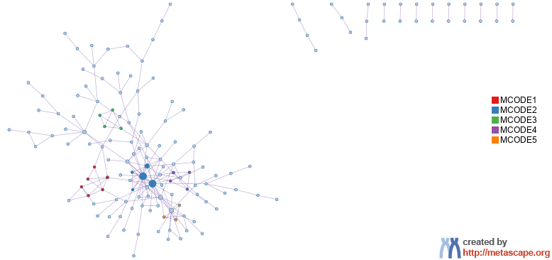
Protein-protein Interaction Network
Gene List: DMRs

Slide 13
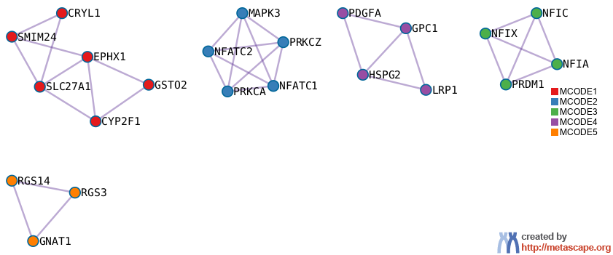
PPI MCODE Components
Gene List: DMRs

Slide 14
Biological Interpretation PPI Network & MCODE Components
Gene List: DMRs
Network | Annotation
DMRs | hsa04360|Axon guidance|-12.2;hsa04144|Endocytosis|-9.2;R-HSA-9675108|Nervous system development|-9.1
DMRs_MCODE_ALL | M113|PID NFAT 3PATHWAY|-9.5;R-HSA-2187338|Visual phototransduction|-8.0;WP4666|Hepatitis B infection|-7.2
DMRs_SUB1_MCODE_1 | GO:0019752|carboxylic acid metabolic process|-7.2;GO:0006631|fatty acid metabolic process|-6.7;hsa00980|Metabolism of xenobiotics by cytochrome P450|-6.5
DMRs_SUB1_MCODE_2 | M113|PID NFAT 3PATHWAY|-13.9;M272|PID CD8 TCR DOWNSTREAM PATHWAY|-10.0;WP3888|VEGFA VEGFR2 signaling|-9.2
DMRs_SUB1_MCODE_3 | R-HSA-73980|RNA Polymerase III Transcription Termination|-8.8;R-HSA-74158|RNA Polymerase III Transcription|-8.0;R-HSA-749476|RNA Polymerase III Abortive And Retractive Initiation|-8.0
DMRs_SUB1_MCODE_4 | R-HSA-975634|Retinoid metabolism and transport|-7.9;R-HSA-6806667|Metabolism of fat-soluble vitamins|-7.8;R-HSA-2187338|Visual phototransduction|-6.8
DMRs_SUB1_MCODE_5 | GO:0008277|regulation of G protein-coupled receptor signaling pathway|-6.8;R-HSA-418594|G alpha (i) signalling events|-5.9;R-HSA-388396|GPCR downstream signalling|-5.0

Slide 15
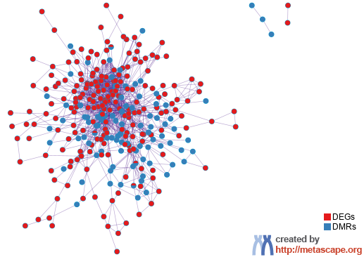
PPI Network for Lists Merged Pied by Gene Origin in Studies
Notes:
All input gene lists were also merged into one list and resulted in a PPI network.
Network nodes are displayed as pies. Color code for pie sector represents a gene list and is consistent with the colors used for table rows in slide #2.

Slide 16
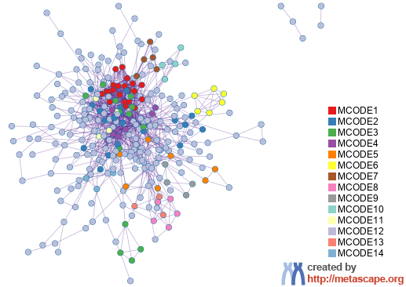
PPI Network for Lists Merged Colored by MCODE ID
Notes:
All input gene lists were also merged. Each MCODE network is assigned a unique color.

Slide 17
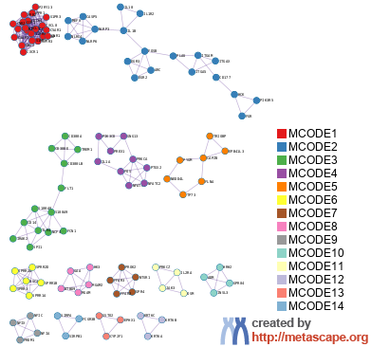
Protein-protein Interaction Network
Notes:
MCODE components were identified from the merged network. Each MCODE network is assigned a unique color.

Slide 18
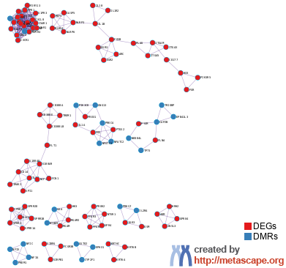
MCODE for Lists Merged Pied by Gene Origin in Studies
Notes:
MCODE algorithm was then applied to this network to identify neighborhoods where proteins are densely connected.
Network nodes are displayed as pies. Color code for pie sector represents a gene list and is consistent with the colors used for table rows in slide #2.

Slide 19
Biological Interpretation MCODE Components for Lists Merged
Network | Annotation
_FINAL | GO:0006954|inflammatory response|-50.5;R-HSA-6798695|Neutrophil degranulation|-45.8;GO:0032103|positive regulation of response to external stimulus|-33.5
_FINAL_MCODE_ALL | GO:0006954|inflammatory response|-34.3;R-HSA-388396|GPCR downstream signalling|-30.1;R-HSA-372790|Signaling by GPCR|-29.9
_FINAL_SUB1_MCODE_1 | R-HSA-418594|G alpha (i) signalling events|-38.5;R-HSA-500792|GPCR ligand binding|-38.2;R-HSA-373076|Class A/1 (Rhodopsin-like receptors)|-38.1
_FINAL_SUB1_MCODE_2 | GO:0050727|regulation of inflammatory response|-11.5;GO:0050778|positive regulation of immune response|-11.4;WP1433|Nucleotide binding oligomerization domain NOD pathway|-10.3
_FINAL_SUB1_MCODE_3 | M264|PID TOLL ENDOGENOUS PATHWAY|-12.6;R-HSA-1280218|Adaptive Immune System|-11.6;GO:0045088|regulation of innate immune response|-11.5
_FINAL_SUB1_MCODE_4 | hsa05167|Kaposi sarcoma-associated herpesvirus infection|-13.8;hsa05170|Human immunodeficiency virus 1 infection|-11.0;hsa05163|Human cytomegalovirus infection|-10.9
_FINAL_SUB1_MCODE_5 | GO:0030029|actin filament-based process|-7.1;R-HSA-9662360|Sensory processing of sound by inner hair cells of the cochlea|-6.4;R-HSA-9659379|Sensory processing of sound|-6.3
_FINAL_SUB1_MCODE_6 | R-HSA-6809371|Formation of the cornified envelope|-14.3;R-HSA-6805567|Keratinization|-12.9;GO:0031424|keratinization|-9.1
_FINAL_SUB1_MCODE_7 | R-HSA-416476|G alpha (q) signalling events|-10.8;R-HSA-373076|Class A/1 (Rhodopsin-like receptors)|-9.8;R-HSA-500792|GPCR ligand binding|-9.1
_FINAL_SUB1_MCODE_8 | hsa00052|Galactose metabolism|-11.3;hsa00500|Starch and sucrose metabolism|-10.9;hsa04973|Carbohydrate digestion and absorption|-7.3
_FINAL_SUB1_MCODE_9 | R-HSA-73980|RNA Polymerase III Transcription Termination|-8.8;R-HSA-74158|RNA Polymerase III Transcription|-8.0;R-HSA-749476|RNA Polymerase III Abortive And Retractive Initiation|-8.0
_FINAL_SUB1_MCODE_10 | R-HSA-418555|G alpha (s) signalling events|-9.1;R-HSA-388396|GPCR downstream signalling|-6.7;R-HSA-372790|Signaling by GPCR|-6.5
_FINAL_SUB1_MCODE_11 | M143|PID IL2 PI3K PATHWAY|-8.3;GO:2000514|regulation of CD4-positive, alpha-beta T cell activation|-7.2;GO:0046634|regulation of alpha-beta T cell activation|-6.7
_FINAL_SUB1_MCODE_12 | GO:0045109|intermediate filament organization|-7.9;GO:0031424|keratinization|-7.7;GO:0045104|intermediate filament cytoskeleton organization|-7.6
_FINAL_SUB1_MCODE_13 | hsa00980|Metabolism of xenobiotics by cytochrome P450|-7.8;GO:0006805|xenobiotic metabolic process|-7.2;WP702|Metapathway biotransformation Phase I and II|-6.7
_FINAL_SUB1_MCODE_14 | hsa04380|Osteoclast differentiation|-7.0;R-HSA-6798695|Neutrophil degranulation|-5.4
Notes:
GO enrichment analysis was applied to the original PPI network and its MCODE network components to extract their “biological meanings”, where top three best p-value terms were retained.

Slide 20


metascape.org
bioinformatics for biologists
Hint: If you have multiple related gene lists, upload them in one Excel file will trigger meta analyses.
Easy, Fresh & Free
Submit gene identifiers, one click on Expression Analysis. Done!
Interpretable results: visualizations, methods, pptx, xslx, zip
Best Practices for Gene List Analyses
Rich annotations for thousands of genes at once
Pathway & process enrichment analysis
Protein-protein interaction network analysis
Overlap analysis across multiple gene lists
Common and unique pathways across multiple studies
Support key model organisms
Scalable
Docker containers available for bioinformaticians
Notes:
Thank you for using Metascape, you are welcome to past question to our public forum: https://metascape.freeforums.net, or email us with your private questions at “metascape.team at gmail.com”.

