Slide 1
Capstone Project
EDA On Global Terrorism-Data by-Mukhtar ul Islam

Slide 2
Approach
Defining problem statement
Data Summary and variables understating
EDA
Graphical representation of finding
Conclusion

Slide 3
Problem Statement
I am using the Global Terrorism dataset from (1970-2017) for this project.
The aim is to identify the parameters that influence the terror activities
I will find the region and countries which are more prone to terror attacks, groups that are most targeted and terrorist groups which are most active.

Slide 4
Data Summary The dataset has a shape of (181691,135) which means that it contains approximately 181691 rows and 135 Variables. List of variables that used for further analysis:
Year
Month
Day
Country
state
Region
fatalities
Target
injuries
success
Group
weapon

Slide 5
EDA(Exploratory Data Analysis)
Exploratory Data Analysis (EDA) is an approach to analyzing the data sets to summarize their main characteristics, often using statistical graphics and other Data Visualization Methods

Slide 6
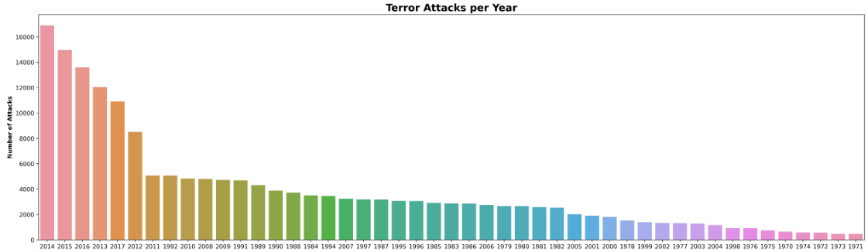
Graphical Representation of Findings
I have drawn the count plot to draw year vs number of attacks.
According to the graph, most number of attacks happen in year 2014

Slide 7
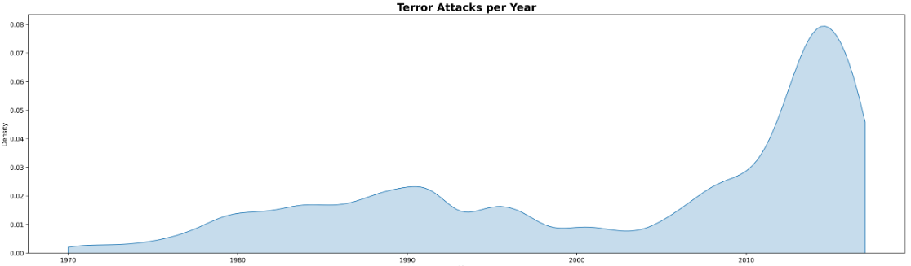
KDE plot to show relation between year vs number of attacks

Slide 8
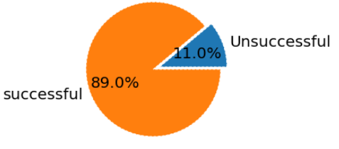
Success rate of attacks?

Slide 9
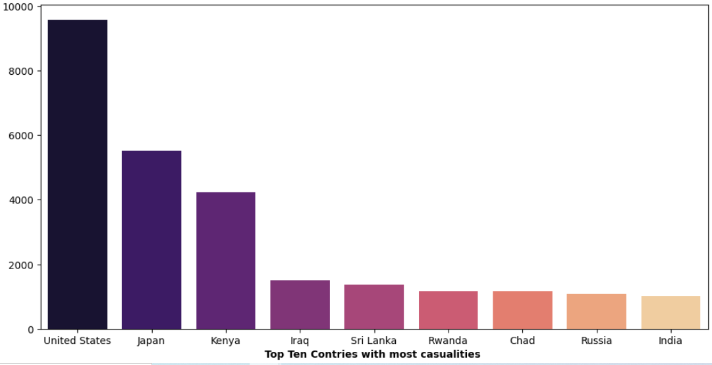
Which country has most number of causalities ?

Slide 10
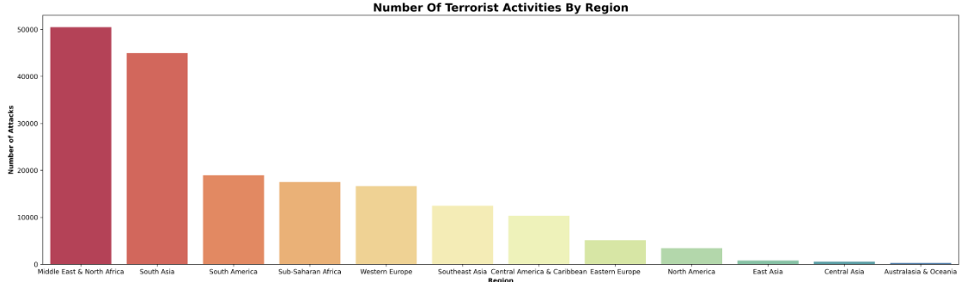
Terror activities per region:

Slide 11
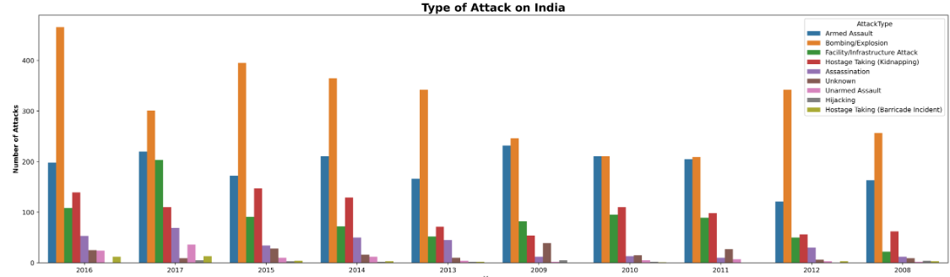
Types of Attacks on India from 2008-2016

Slide 12
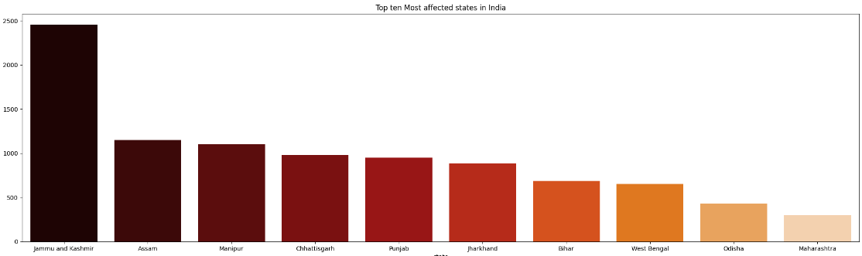
Which State in India is most prone to attacks?

Slide 13
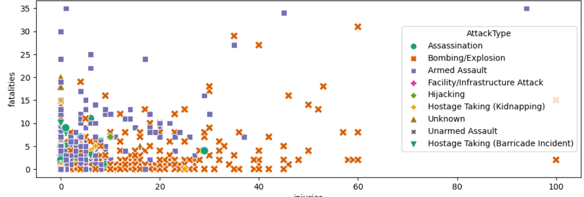
Trend of attacks in J&K:

Slide 14
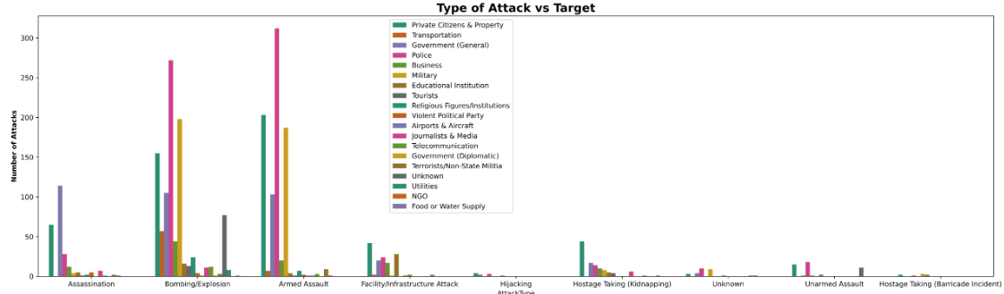
Attack Type Vs Target in J&K

Slide 15
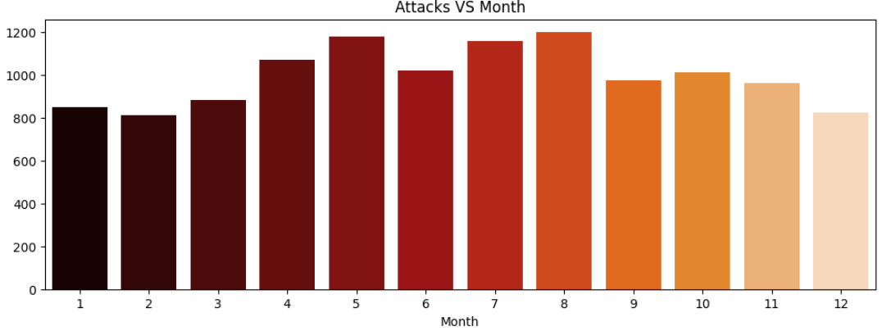
Which month is most targeted in J&K?

Slide 16
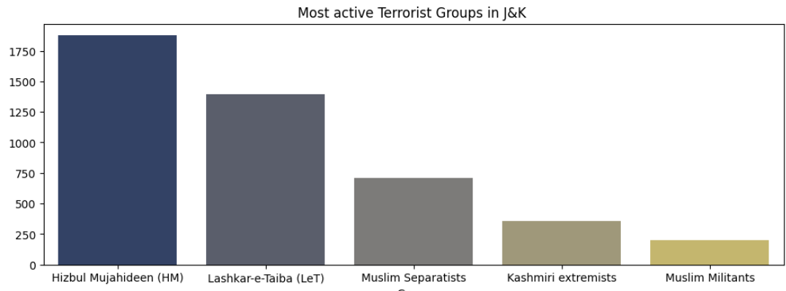
What are the most active terrorist group in J&K?

Slide 17
Conclusions
After the Year 2003-04 there is sharp increase in the terror attacks throughout the globe..
Year 2014 is where most attack happen considered the most violent year for the world in terms of terror attacks.
89% of attacks are successful as per data.
United States faced most number of Causalities(Killed+ Bounded) in the world.
Iraq is a country where most number of terrorist attack happen
Middle East and North Africa is a region where most number of terrorist attack happen, followed by South Asia where second most number of terrorist attack happen
Australia & Oceania is the least prone to terrorist Attacks.

Slide 18
Conclusions (continued)
After the year 2008, India sees a sharp increase of terrorist attacks
Majority of terror attacks in India are of the kind Bombing/Explosion
J&K is a state where most number of terrorist attack happen in india followed by Assam and Manipur.
Most number of fatalities happen in armed assault and most number of injuries happen in Bombing/Explosion in J&K
Police is most targeted when terrorist do Bombing/Explosion and Armed Assault
Most Active Terrorist group is Hizbul Mujahideen.

Slide 19
THANK YOU

