Slide 1
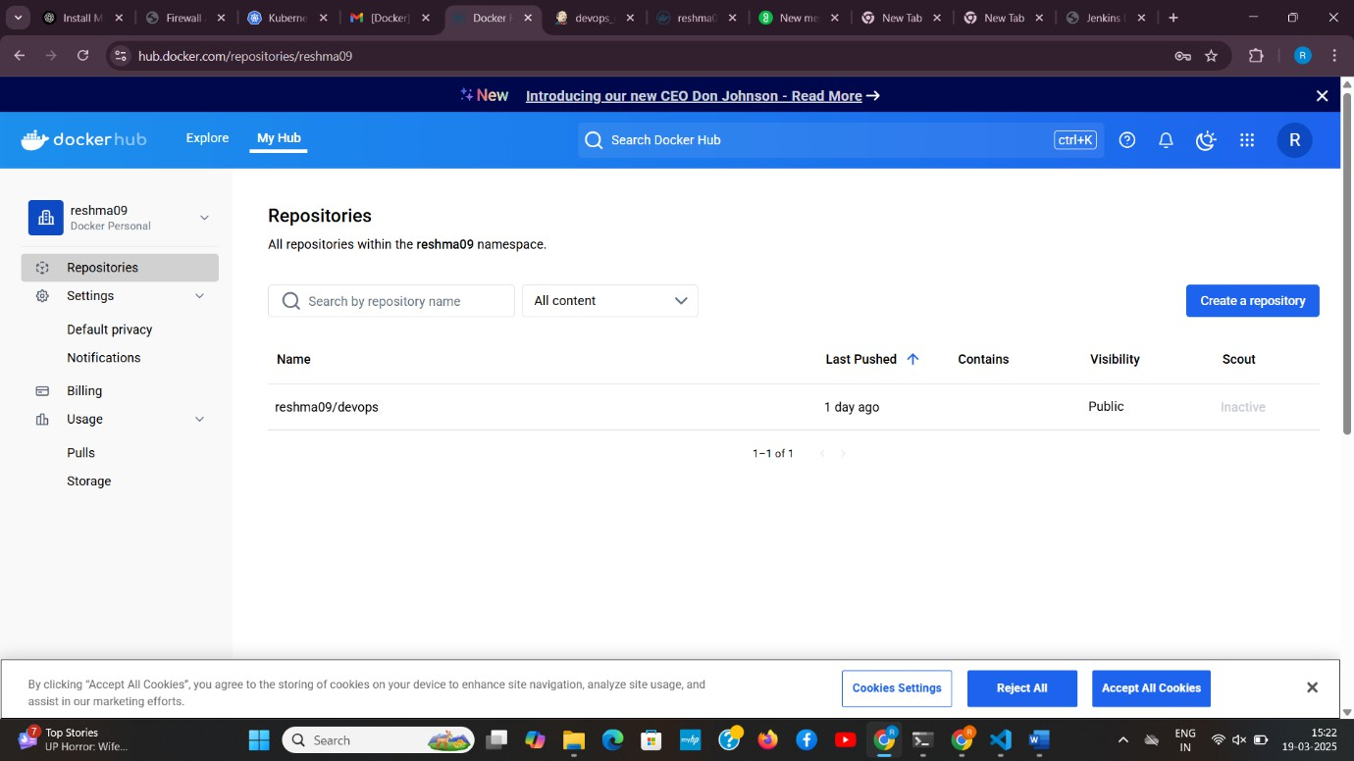
DAY-2 DOCKER
Create docker credentials :
Pipeline Script:
pipeline {
agent any
environment {
IMAGE_NAME = "reshma09/devops" // Replace with your Docker Hub username and image name TAG = "latest"
CONTAINER_NAME = "my-container"
PORT = "3001"
}
stages {
stage('Clone Repository') { steps {
echo "Cloning GitHub repository..."
git branch:'main', url: 'https://github.com/reshreshu/devops_.git' // Replace with your repo URL
}
}

Slide 2
stage('Build Docker Image') {
steps {
echo "Building Docker image..." sh 'chmod +x build.sh'
sh './build.sh'
}
}
stage('Login to Docker Hub') { steps {
echo "Logging into Docker Hub..."
withCredentials([usernamePassword(credentialsId: 'docker-hub-creds', usernameVariable: 'DOCKER_USER', passwordVariable: 'DOCKER_PASS')]) {
sh 'docker login -u $DOCKER_USER -p $DOCKER_PASS'
}
}
}
stage('Push Docker Image') { steps {
echo "Pushing Docker image to Docker Hub..."
sh "docker tag $IMAGE_NAME:$TAG $IMAGE_NAME:$TAG" sh "docker push $IMAGE_NAME:$TAG"
}
}
stage('Deploy Docker Container') { steps {
echo "Deploying Docker container..." sh 'chmod +x deploy.sh'
sh './deploy.sh'
}
}
}

Slide 3
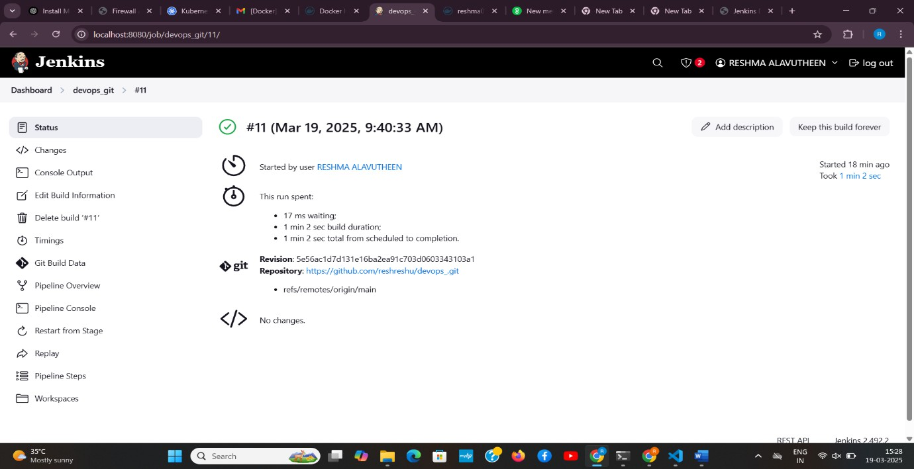
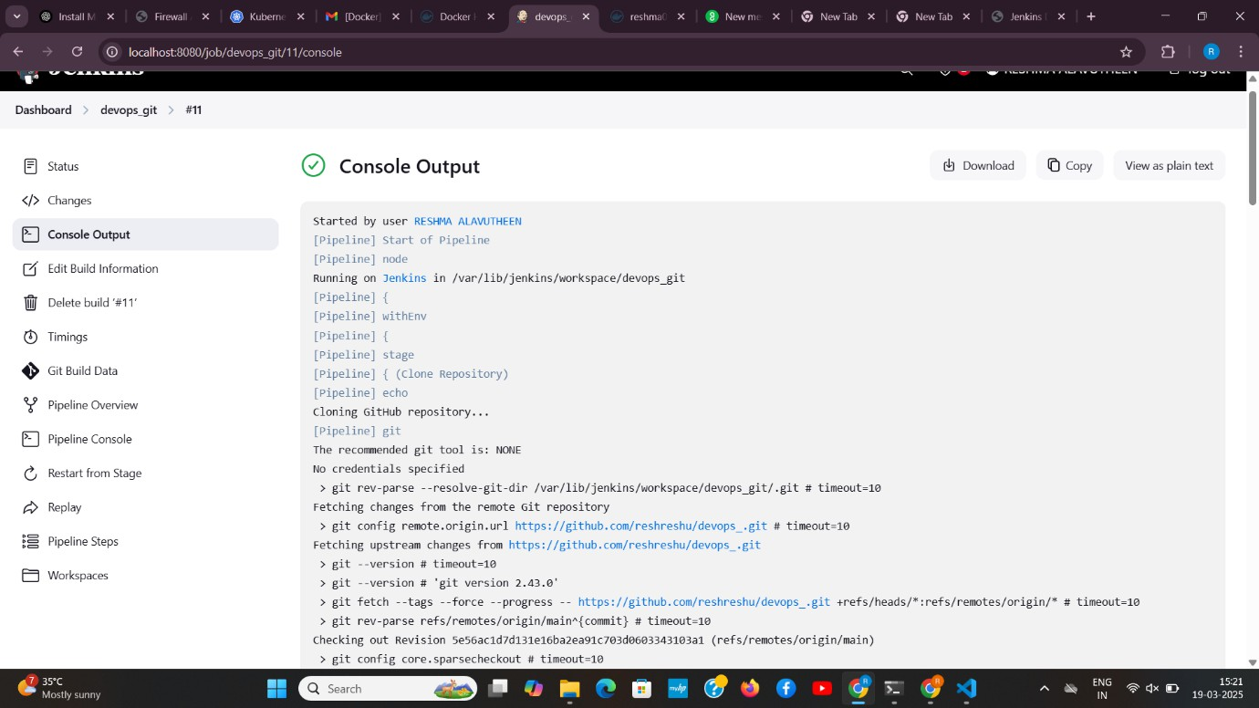
post {
success {
echo "Deployment Successful!"
}
failure {
echo "Deployment Failed!"
}
}
}
Credentials-docker:

Slide 4


Hello from Docker with Jenkins!
@ devops git
6 Add descripâon
Stage View
zs
3s
8s
1s
169ms
2s
Os
169 m s
Permalinks

