Slide 1
Fault Scalable Virtualized Infrastructure Management
Mukil Kesavan, Ada Gavrilovska, Karsten Schwan
VMware Inc., Georgia Tech

Slide 2
Typical Virtualized Datacenter Workloads
Cluster Capacity Allocation
Live Rolling Upgrades
Backup/Restore for Disaster Recovery
Continuous Integration Testing
Generic: AWS CloudFormation, VMWare vRealize, OpenStack Heat
Management Workloads
=> Composed as workflows consisting of basic VM operations

Slide 3
Basic Virtual Machine Operations
Power-on Placement
Live Migration
State Snapshotting Ops
Cloning
Re-configuration (e.g. hot-add CPU, memory)

Slide 4
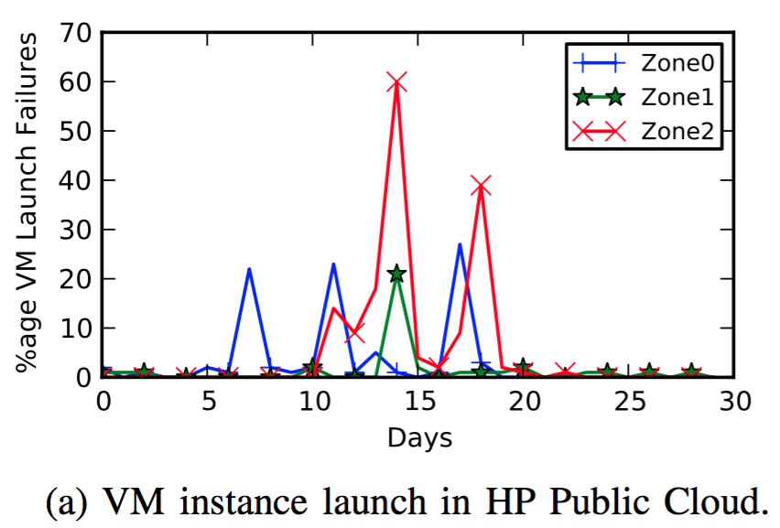
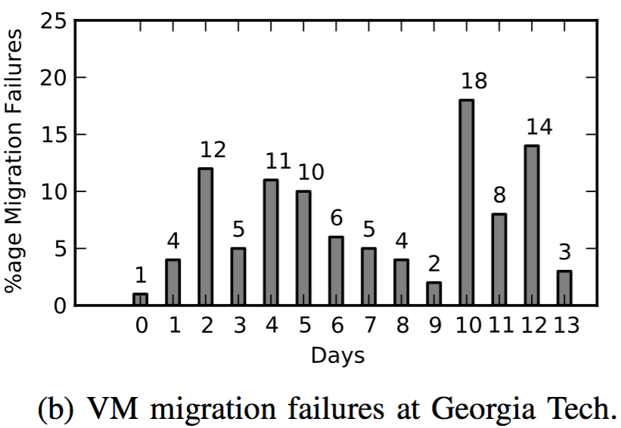
Basic VM Operation Failures
Non-trivial, highly variable basic VM op failures impair workloads!
Problem: How to Improve DC Workload Outcomes despite Failures?

Slide 5
State of the art solutions
Root-cause Diagnosis
  With wide-variety of causes => Extremely complicated to do
  High fix and turnaround times
Tolerate Infrastructure Failures at Application Layer
  Usually just naïve backoff-retry based
  Burdens developers
  Lack of infra info to employ intelligent resiliency techniques

Slide 6
Naïve Retrying
Workload
Server ‘X’
Server ‘Y’

Slide 7
Naïve Retrying
Workload
Server ‘X’
Server ‘Y’
Invocation ‘N’:
Run Algo
Do Op ‘p’ on VM ‘v’ on Server ‘X’

Slide 8
Naïve Retrying
Workload
Server ‘X’
Server ‘Y’
Invocation ‘N’:
Run Algo
Do Op ‘p’ on VM ‘v’ on Server ‘X’

Slide 9
Naïve Retrying
Workload
Server ‘X’
Server ‘Y’
Invocation ‘N’:
Run Algo
Do Op ‘p’ on VM ‘v’ on Server ‘X’

Slide 10
Naïve Retrying
Workload
Server ‘X’
Server ‘Y’
Invocation ‘N’:
Run Algo
Do Op ‘p’ on VM ‘v’ on Server ‘X’

Slide 11
Naïve Retrying
Workload
Server ‘X’
Server ‘Y’
Invocation ‘N’:
Run Algo
Do Op ‘p’ on VM ‘v’ on Server ‘X’
Backoff/Retry

Slide 12
Naïve Retrying
Workload
Server ‘X’
Server ‘Y’
Invocation ‘N’:
Run Algo
Do Op ‘p’ on VM ‘v’ on Server ‘X’
Backoff/Retry

Slide 13
Naïve Retrying
Workload
Server ‘X’
Server ‘Y’
Invocation ‘N’:
Run Algo
Do Op ‘p’ on VM ‘v’ on Server ‘X’
Backoff/Retry

Slide 14
Naïve Retrying
Workload
Server ‘X’
Server ‘Y’
Invocation ‘N’:
Run Algo
Do Op ‘p’ on VM ‘v’ on Server ‘X’
Backoff/Retry

Slide 15
Naïve Retrying
Workload
Server ‘X’
Server ‘Y’
Invocation ‘N’:
Run Algo
Do Op ‘p’ on VM ‘v’ on Server ‘X’
Backoff/Retry
Algo Re-invocation
Timeout

Slide 16
Naïve Retrying
Workload
Server ‘X’
Server ‘Y’
Invocation ‘N’:
Run Algo
Do Op ‘p’ on VM ‘v’ on Server ‘X’
Backoff/Retry
Algo Re-invocation
Timeout
Invocation ‘N+1’:
Run Algo
Do Op ‘p’ on VM ‘v’ on Server ‘Y’

Slide 17
Naïve Retrying
Workload
Server ‘X’
Server ‘Y’
Invocation ‘N’:
Run Algo
Do Op ‘p’ on VM ‘v’ on Server ‘X’
Backoff/Retry
Algo Re-invocation
Timeout
Invocation ‘N+1’:
Run Algo
Do Op ‘p’ on VM ‘v’ on Server ‘Y’

Slide 18
Naïve Retrying
Workload
Server ‘X’
Server ‘Y’
Invocation ‘N’:
Run Algo
Do Op ‘p’ on VM ‘v’ on Server ‘X’
Backoff/Retry
Algo Re-invocation
Timeout
Invocation ‘N+1’:
Run Algo
Do Op ‘p’ on VM ‘v’ on Server ‘Y’

Slide 19
Naïve Retrying
Workload
Server ‘X’
Server ‘Y’
Invocation ‘N’:
Run Algo
Do Op ‘p’ on VM ‘v’ on Server ‘X’
Backoff/Retry
Time to complete Op ‘p’
Algo Re-invocation
Timeout
Invocation ‘N+1’:
Run Algo
Do Op ‘p’ on VM ‘v’ on Server ‘Y’

Slide 20
Speculative Operation Replication in Space
Workload
Server ‘X’
Server ‘Y’
Server ‘Z’

Slide 21
Speculative Operation Replication in Space
Workload
Server ‘X’
Server ‘Y’
Server ‘Z’
Invocation ‘N’:
Run Algo
Do Op ‘p’ on VM ‘v’ on OneOf(‘X, Y, Z’)

Slide 22
Speculative Operation Replication in Space
Workload
Server ‘X’
Server ‘Y’
Server ‘Z’
Invocation ‘N’:
Run Algo
Do Op ‘p’ on VM ‘v’ on OneOf(‘X, Y, Z’)

Slide 23
Speculative Operation Replication in Space
Workload
Server ‘X’
Server ‘Y’
Server ‘Z’
Invocation ‘N’:
Run Algo
Do Op ‘p’ on VM ‘v’ on OneOf(‘X, Y, Z’)

Slide 24
Speculative Operation Replication in Space
Workload
Server ‘X’
Server ‘Y’
Server ‘Z’
Invocation ‘N’:
Run Algo
Do Op ‘p’ on VM ‘v’ on OneOf(‘X, Y, Z’)
Complete

Slide 25
Speculative Operation Replication in Space
Workload
Server ‘X’
Server ‘Y’
Server ‘Z’
Invocation ‘N’:
Run Algo
Do Op ‘p’ on VM ‘v’ on OneOf(‘X, Y, Z’)
Complete
Cancel

Slide 26
Speculative Operation Replication in Space
Workload
Server ‘X’
Server ‘Y’
Server ‘Z’
Invocation ‘N’:
Run Algo
Do Op ‘p’ on VM ‘v’ on OneOf(‘X, Y, Z’)
Complete
Cancel
ACK

Slide 27
Speculative Operation Replication in Space
Workload
Server ‘X’
Server ‘Y’
Server ‘Z’
Invocation ‘N’:
Run Algo
Do Op ‘p’ on VM ‘v’ on OneOf(‘X, Y, Z’)
Complete
Cancel
ACK

Slide 28
Speculative Operation Replication in Space
Workload
Server ‘X’
Server ‘Y’
Server ‘Z’
Invocation ‘N’:
Run Algo
Do Op ‘p’ on VM ‘v’ on OneOf(‘X, Y, Z’)
Complete
Cancel
ACK

Slide 29
Speculative Operation Replication in Space
Workload
Server ‘X’
Server ‘Y’
Server ‘Z’
Invocation ‘N’:
Run Algo
Do Op ‘p’ on VM ‘v’ on OneOf(‘X, Y, Z’)
Complete
Time to complete Op ‘p’
Cancel
ACK
Real-time Failure Masking
Leverages Failure Independence
Leverages Inherent Choice (2nd,3^{rd.}… best)
Fault Agnostic

Slide 30
Solution Design
Speculatively Replicated Operations for IaaS Stacks
  Correctness: Only one replica wins
  SpecOp(IN vm, IN targets[], IN cost)
Separate Policy from Implementation
Workloads control replication and its cost (policy):
  Number of Operation Replicas
  Cost of each Operation Replica
    Timeout based Replica Abort
    Resource consumption based Replica Abort
    Progress Rate based Replica Abort
Workloads
Speculative Replication Policy
Speculative Op Replication API
IaaS Stack
Speculative Op Replication Impl.

Slide 31
Example: Speculative VM Migration Repl. Impl.
Source
Host
Dst Host D1
Dst Host D2 (Slow N/W)
time
Dirty Pages
Pre-copy round durations vary => Dirty pages per target, per round vary
One dirty bitmap per migration thread
Reset shadow PTs at end of any pre-copy migration round

Slide 32
Example: Speculative VM Migration Repl. Impl.
Migration
Start
Source
Host
Dst Host D1
Dst Host D2 (Slow N/W)
time
Dirty Pages
Pre-copy round durations vary => Dirty pages per target, per round vary
One dirty bitmap per migration thread
Reset shadow PTs at end of any pre-copy migration round

Slide 33
Example: Speculative VM Migration Repl. Impl.
Migration
Start
D1-R1
End
Source
Host
Dst Host D1
Dst Host D2 (Slow N/W)
time
Dirty Pages
Pre-copy round durations vary => Dirty pages per target, per round vary
One dirty bitmap per migration thread
Reset shadow PTs at end of any pre-copy migration round

Slide 34
Example: Speculative VM Migration Repl. Impl.
Migration
Start
D1-R1
End
D2-R1
End
Source
Host
Dst Host D1
Dst Host D2 (Slow N/W)
time
Dirty Pages
Pre-copy round durations vary => Dirty pages per target, per round vary
One dirty bitmap per migration thread
Reset shadow PTs at end of any pre-copy migration round

Slide 35
Example: Speculative VM Migration Repl. Impl.
Migration
Start
D1-R1
End
D2-R1
End
D1-R2
End
Source
Host
Dst Host D1
Dst Host D2 (Slow N/W)
time
Dirty Pages
Pre-copy round durations vary => Dirty pages per target, per round vary
One dirty bitmap per migration thread
Reset shadow PTs at end of any pre-copy migration round

Slide 36
Example: Speculative VM Migration Repl. Impl.
Migration
Start
D1-R1
End
D2-R1
End
D1-R2
End
D2-R2
End
Source
Host
Dst Host D1
Dst Host D2 (Slow N/W)
time
Dirty Pages
Pre-copy round durations vary => Dirty pages per target, per round vary
One dirty bitmap per migration thread
Reset shadow PTs at end of any pre-copy migration round

Slide 37
Example: Speculative VM Migration Repl. Impl.
Migration
Start
D1-R1
End
D2-R1
End
D1-R2
End
D2-R2
End
Source
Host
Abort D2
Dst Host D1
Dst Host D2 (Slow N/W)
time
Dirty Pages
Pre-copy round durations vary => Dirty pages per target, per round vary
One dirty bitmap per migration thread
Reset shadow PTs at end of any pre-copy migration round

Slide 38
Example: Speculative VM Migration Repl. Impl.
Migration
Start
D1-R1
End
D2-R1
End
D1-R2
End
D2-R2
End
Source
Host
Abort D2
Dst Host D1
Dst Host D2 (Slow N/W)
time
Dirty Pages
Pre-copy round durations vary => Dirty pages per target, per round vary
One dirty bitmap per migration thread
Reset shadow PTs at end of any pre-copy migration round

Slide 39
Implementation and Evaluation
Speculatively Replicated VM Migration and PowerOn Placement
Implemented in Xen hypervisor and API Exposed via OpenStack Nova
Parametric Failure Simulation
  Maintains configurable %age of servers in “failed” state
  Failure event durations vary uniformly randomly
Results on 12-server Physical Testbed
1024-server Custom Datacenter Discrete Event Simulator Results

Slide 40
Resource Capacity Multiplexing Workload
Periodically Migrate VMs from overloaded to underloaded servers
Traditional Algo: Picks one underloaded destination for each VM
Modified: Pick more than one underloaded server for each VM
(VM + Target Servers) => Composite Speculatively Rep. Migration Op
Goal: Maximize load-shedding from overloaded hosts asap

Slide 41
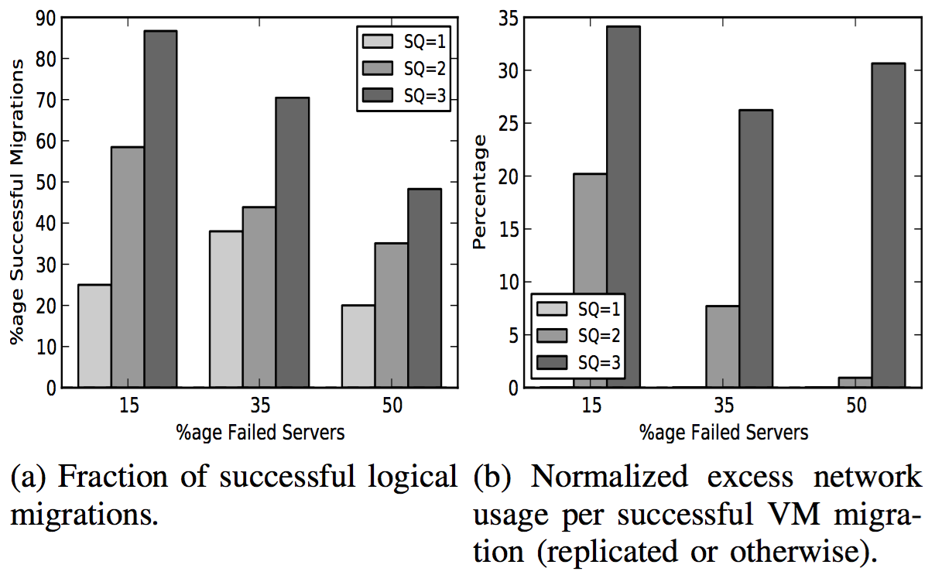
Resource Capacity Multiplexing Results

Slide 42
Resource Capacity Multiplexing Results
> 2x gains, 20% overhead!

Slide 43
Continuous Integration Testing Workload
PowerOn VMs in response to code checkin, build and run tests on it
When a PowerOn fails, the VM goes back in backlog and tried again
Modified: Pick multiple eligible servers per VM at random
Goal: Minimize average delay in launching a testing VM

Slide 44
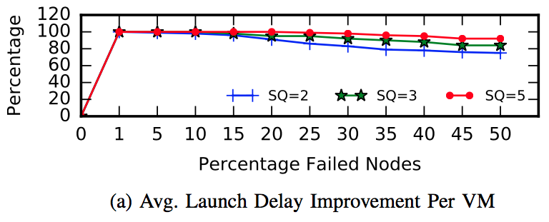
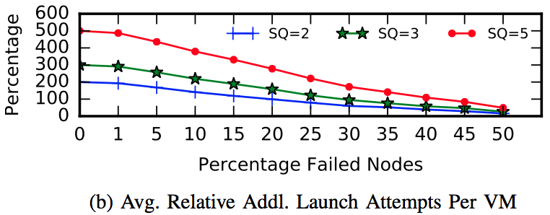
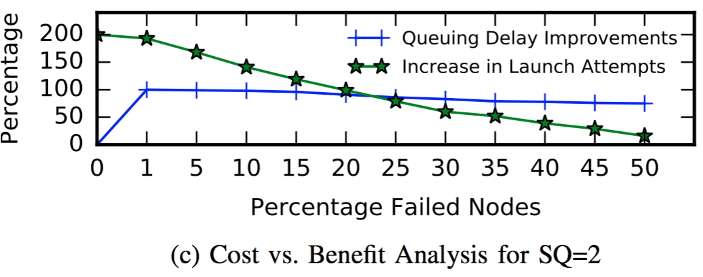
Continuous Integration Testing Results

Slide 45
Continuous Integration Testing Results
Minimal replication still Leads to large benefits!

Slide 46
Continuous Integration Testing Results
Replication cost steadily approaches retry cost as failures increase!

Slide 47
Continuous Integration Testing Results
Workloads can dynamically control replication based on observed failure-rates to lower cost & increase benefit

Slide 48
Conclusion
We propose extensions to VM operations API exposed by IaaS Stacks
IaaS stack implements speculatively replicated version of VM ops
Workloads control cost vs. benefit tradeoff using specific knowledge
System is fault-agnostic, provides fault-scalable performance
Improves outcomes for typical datacenter workloads

Slide 49
Backup

Slide 50
Overall Flow
Background on datacenter automation services
Impairment Problem + Motivation
Approach + Philosophy
Implementation of Speculatively Replicated Migration
Redesigned Auto Services: LB, RollUpgrade, CI/CD
Results

Slide 51
Rolling Cluster Server Software Upgrades
Migrate away all VMs on server to other servers in cluster
  Prefer set of already upgraded servers, then pending servers
Upgrade evacuated server and remove VMs
Repeat for all servers in cluster without taking down application
Modified: Picks multiple available migration targets per VM
(Dst servers + VM) => Composite Speculatively Rep. Migration Op
Goal: Minimize total time to upgrade cluster
Notes:
TODO: Consider moving this to backup

Slide 52
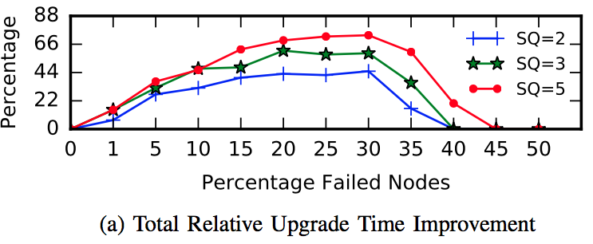
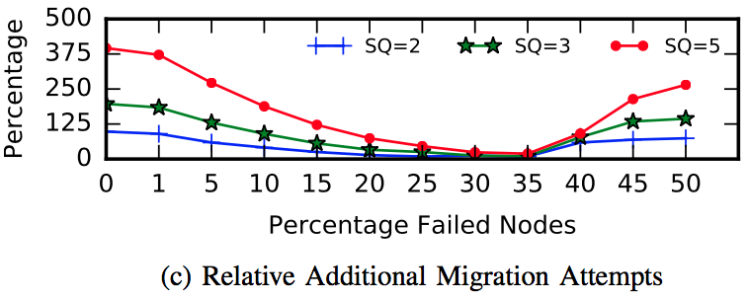
Rolling Software Upgrades Results
Notes:
TODO: Add cost vs. benefit graph
TODO: Consider moving this to backup

