Slide 1
Smart Nkunganire System (SNS)
Anti-Fraud & Soil-Specific Subsidy Allocator
DPR400210 Capstone Project | UNILAK Faculty of Computing and Information Sciences
Academic Year 2025-2026

Slide 2
Introduction
Rwanda's national Smart Nkunganire System (SNS) digitalizes subsidized seed and fertilizer distribution to millions of smallholder farmers via USSD (*774#).
This capstone re-engineers the transaction layer of SNS to close two real gaps: agro-dealer fraud, and soil-blind over-allocation.
RAB + BK TecHouse + RwSIS
power the national subsidy chain

Slide 3
The Problem
Agro-dealer fraud
Dealers key in vulnerable farmers' National IDs to create ghost transactions, hoard fertilizer, and resell it at double price on the black market.
Soil over-allocation
Flat subsidy caps ignore RwSIS soil-health data, risking degradation from over-fertilization across differing sectors (potato vs. maize zones).

Slide 4
Methodology
Problem
analysis
→
Business
process model
→
ERD &
3NF design
→
Oracle schema
& constraints
→
PL/SQL
+ triggers
→
Testing &
demo
Waterfall-style capstone phases I - VIII, tracked continuously on GitHub.

Slide 5
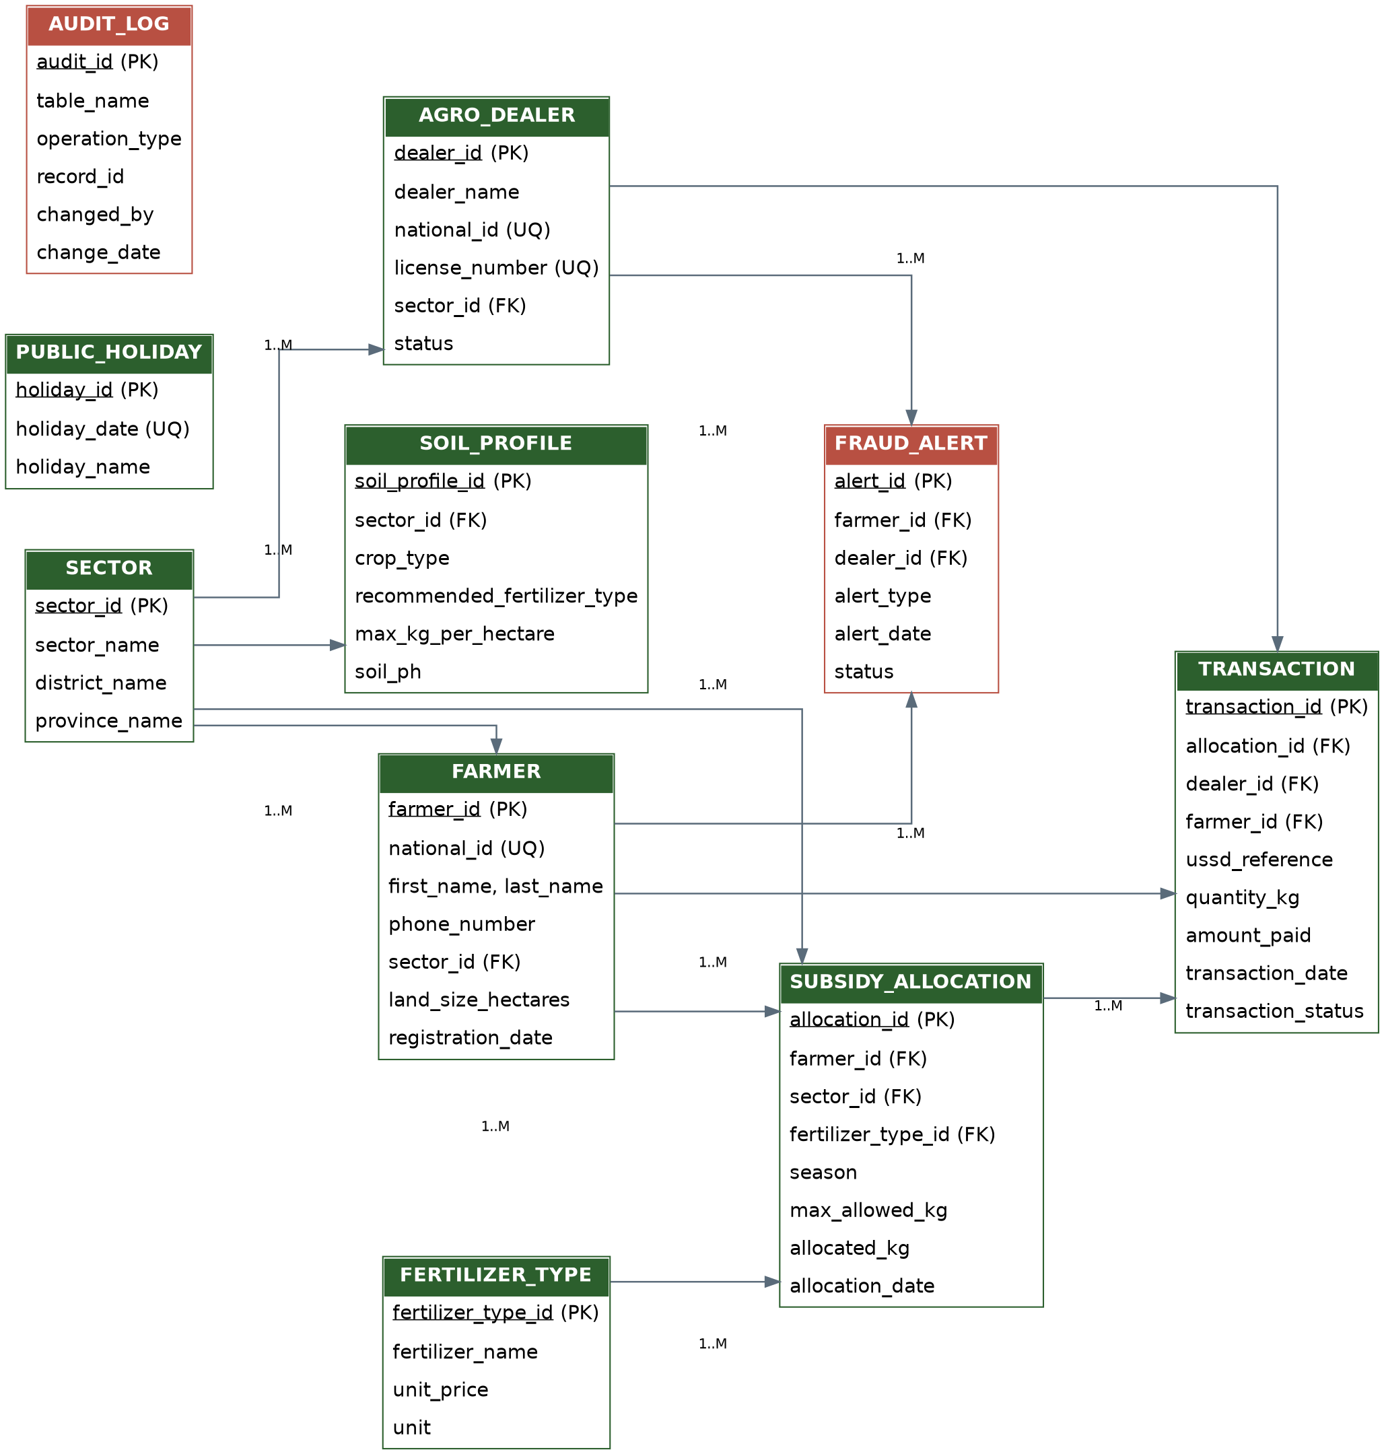
Database Design - ERD (3NF)

Slide 6
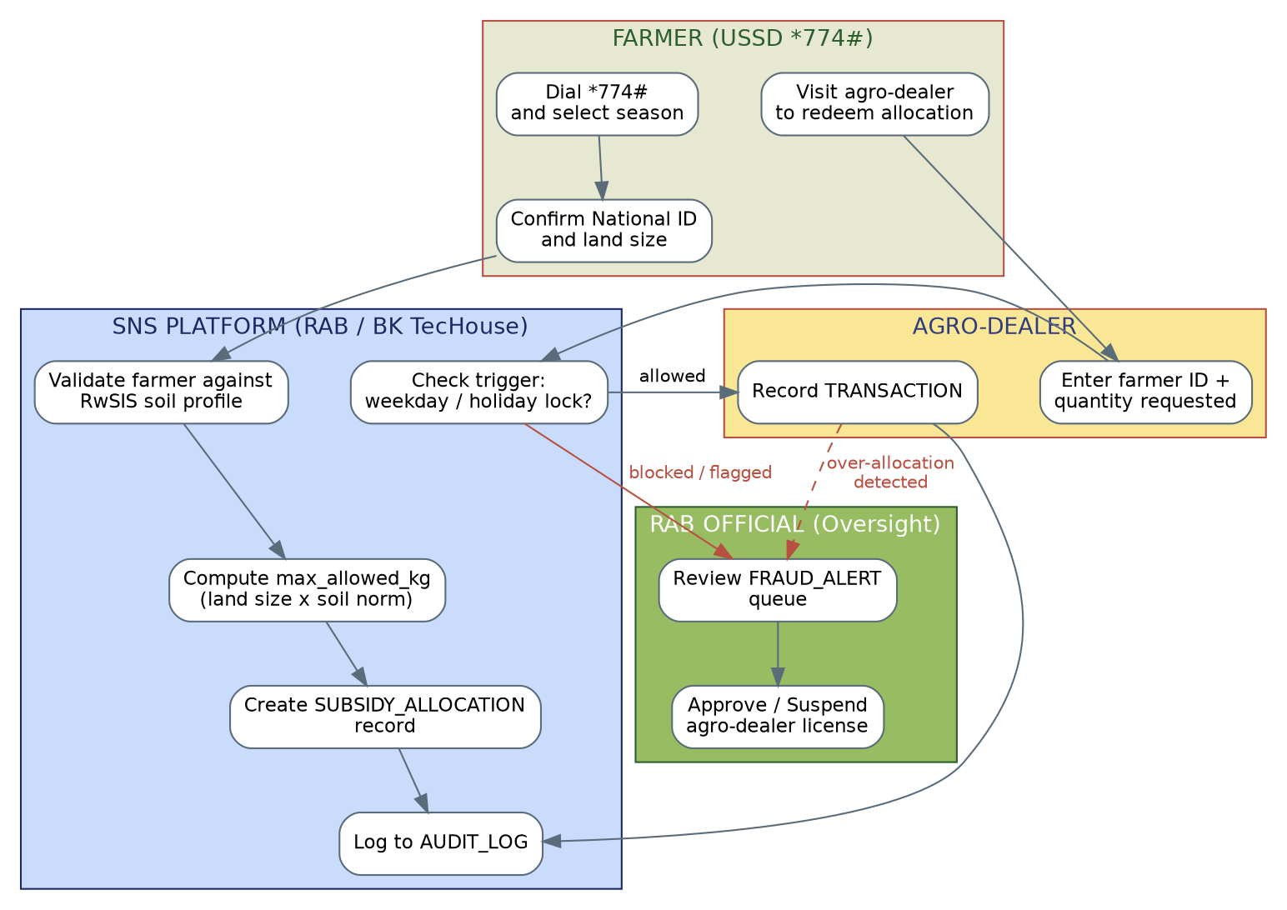
Business Process Model (Swimlane)

Slide 7
Implementation - PL/SQL
fn_calc_max_allocation()
Soil-specific ceiling = land size x RwSIS max kg/hectare
pkg_sns_subsidy.record_transaction()
Validates dealer status + remaining ceiling; rejects & flags fraud
pkg_sns_subsidy.fn_dealer_fraud_score() + detect_ghost_transactions()
Cursor-based scoring of volume concentration per dealer

Slide 8
Triggers, Audit & Security
trg_farmer_audit / trg_transaction_compound
Row + statement level audit of every change
trg_allocation_dml_lock
Blocks INSERT/UPDATE/DELETE on allocations during weekdays and public holidays (PUBLIC_HOLIDAY reference table)
sns_auditor_role
Read-only security role for RAB oversight staff

Slide 9
Results & Innovation
100%
Auto
Power BI
of over-ceiling redemption attempts rejected in testing
fraud flags raised for hoarding dealers via cursor scoring
dashboard on FRAUD_ALERT & AUDIT_LOG for RAB officers

Slide 10
Conclusion
SNS demonstrates that a fraud-resistant, soil-aware subsidy allocator is achievable within Oracle using PL/SQL packages, compound triggers, and reference-table-driven business rules.
Next steps: integrate live RwSIS feeds and extend the Power BI dashboard to district-level anomaly heat maps.
"Whatever you do, work at it with all your heart..." - Colossians 3:23

