Slide 1
C++ Presentation

Slide 2
Presentation 27/10/2022
vector
string
unordered_map
optional
General Description
High level discussion

Slide 3
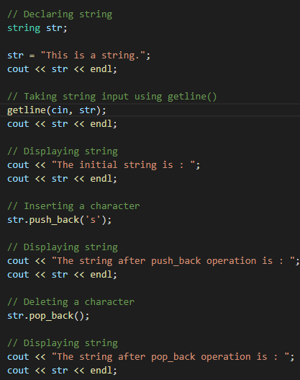
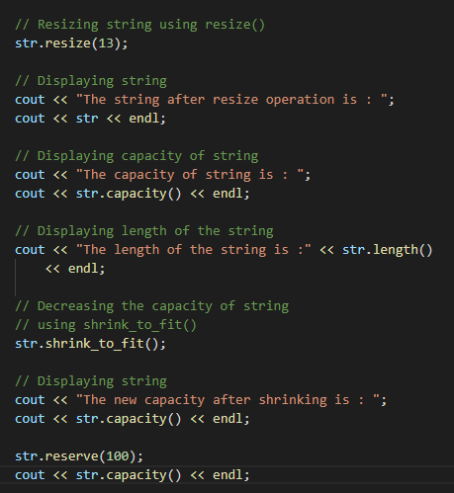
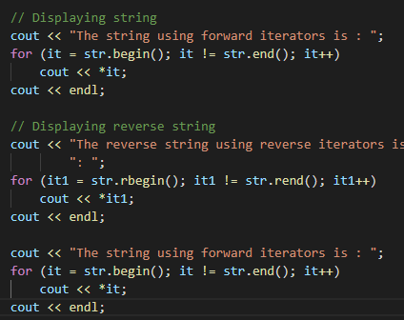
string
Sequence of characters as an object of the class
Input, Capacity, Iterator, Manipulation

Slide 4
string
Interesting concepts:
std:string not a subclass of vector
string vs vector <char>: Easier initialisation and functions for string
string vs const char*: ??

Slide 5
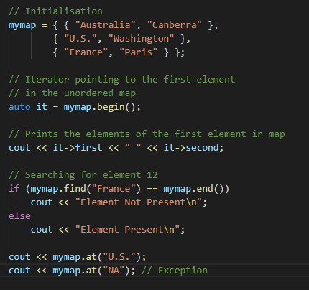
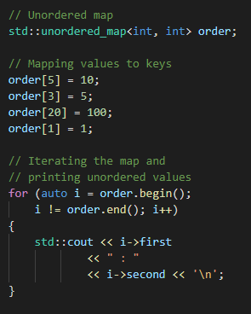


unordered_map
Elements stored as a dictionary without any order.
Search/ Insert/ Delete

Slide 6
unordered_map
Elements stored as a dictionary without any order.
Search/ Insert/ Delete: Θ(1) time.
unordered_map vs map:
Order of keys
Hash table vs BST

Slide 7
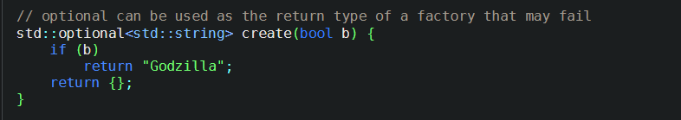
optional
??
Class Template
Manages a value that may or may not be present.

Slide 8
Presentation 21/10/2022
vector
string
unordered_map
optional
- General Description
- Interesting member functions and related topics
- Time Complexity
- Comparison with Python

Slide 9
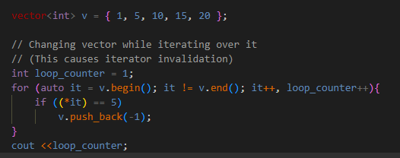
vector
Dynamic arrays with the ability to resize itself.
Element access: Iterators and offset
Iterators, Capacity, Element Access, Modifiers
Interesting concepts:
Iterator Invalidation
Certain operations can invalidate current iterators
(E.g.: Resizing.)

Slide 10
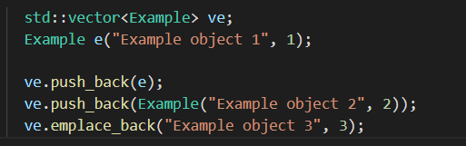
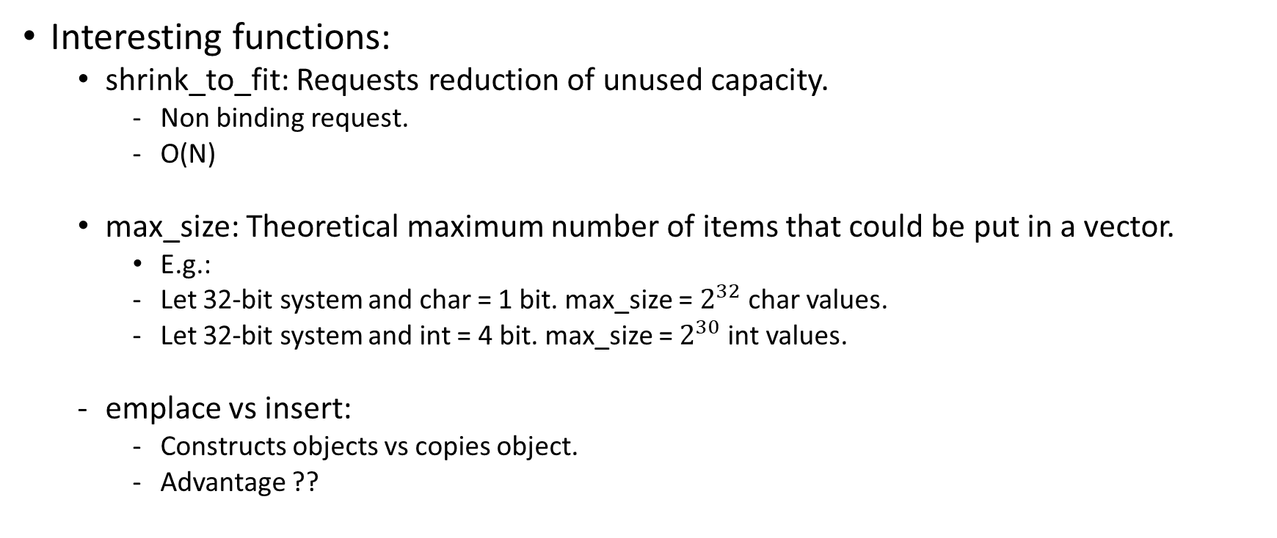
vector
Interesting functions:
shrink_to_fit: Requests reduction of unused capacity.
Non binding request.
O(N)
max_size: Theoretical maximum number of items that could be put in a vector.
E.g.:
Let 32-bit system and char = 1 bit. max_size = $2^{32}$ char values.
Let 32-bit system and int = 4 bit. max_size = $2^{30}$ int values.
emplace vs insert:
Constructs objects vs copies object.
Advantage ??

Slide 11
string
Sequence of characters as an object of the class
Input, Capacity, Iterator, Manipulation
Interesting concepts:
string vs vector <char>
Easier initialisation and functions for string
string vs const char*
??
cpp is std:string not a subclass of vector

Slide 12
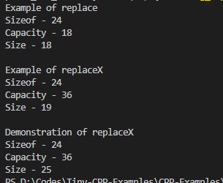
string
Interesting concepts:
Double Quote (”) vs Sigle Quote(‘):
single quotes = single character
double quotes = string literal
"a" = 'a’ + a null terminator
Iterator invalidation –
??
Unable to reproduce in code.
Sizeof (string) ??

Slide 13
unordered_map
Elements stored as a dictionary without any order.
Search/ Insert/ Delete: Θ(1) time.
unordered_map vs map:
Order of keys
Hash table vs BST

Slide 14
optional
??
Class Template
Manages a value that may or may not be present.

