Slide 1
C++ Presentation

Slide 2
Presentation 21/10/2022
vector
string
unordered_map
optional

Slide 3
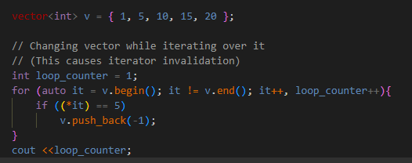
Std::vector
Dynamic arrays with the ability to resize itself.
Element access: Iterators and offset
Iterators, Capacity, Element Access, Modifiers
Interesting concepts:
Iterator Invalidation
Certain operations can invalidate current iterators
(E.g.: Resizing.)

Slide 4
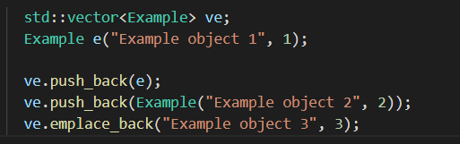
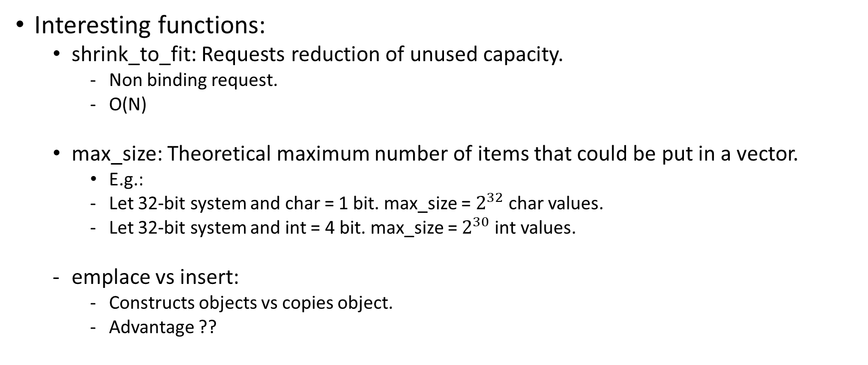
Std::vector
Interesting functions:
shrink_to_fit: Requests reduction of unused capacity.
Non binding request.
O(N)
max_size: Theoretical maximum number of items that could be put in a vector.
E.g.:
Let 32-bit system and char = 1 bit. max_size = $2^{32}$ char values.
Let 32-bit system and int = 4 bit. max_size = $2^{30}$ int values.
emplace vs insert:
Constructs objects vs copies object.
Advantage ??

Slide 5
string
Sequence of characters as an object of the class
Input, Capacity, Iterator, Manipulation
Interesting concepts:
string vs vector <char>
Easier initialisation for string
string vs const char*
cpp is std:stiring not a subclass of vector

Slide 6
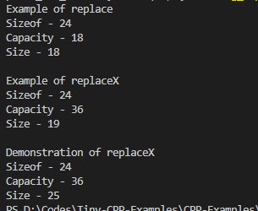
string
Interesting concepts:
Double Quote (”) vs Sigle Quote(‘):
single quotes = single character
double quotes = string literal
"a" = 'a’ + a null terminator
Iterator invalidation ??
Sizeof (string) ??

Slide 7
unordered_map
Elements stored as a dictionary without any order.
Search/ Insert/ Delete: Θ(1) time.
unordered_map vs map:
Order of keys
Hash table vs BST

Slide 8
optional
Elements stored as a dictionary without any order.

Slide 9
Reference
STL https://stackoverflow.com/a/2826347/4168707 | Memory management Python https://bit.ly/3EQHoxH https://stackoverflow.com/a/68637039/4168707
Vector https://www.geeksforgeeks.org/vector-in-cpp-stl/ | Iterator Invalidation https://www.geeksforgeeks.org/iterator-invalidation-cpp/ https://en.cppreference.com/w/cpp/container/vector/reserve https://stackoverflow.com/a/6438087/4168707
Vector – max_size https://qr.ae/pGclP6 https://stackoverflow.com/a/3813203/4168707 https://stackoverflow.com/a/2664094/4168707 | Vector - Reserve https://en.cppreference.com/w/cpp/container/vector/reserve
Vector – shrink_to_fit https://en.cppreference.com/w/cpp/container/vector/shrink_to_fit https://stackoverflow.com/q/16518533/4168707 | Vector – Assign https://www.geeksforgeeks.org/vector-assign-in-c-stl/ https://en.cppreference.com/w/cpp/container/vector/assign
String https://www.geeksforgeeks.org/stdstring-class-in-c/ | String – Single Quote vs Double Quotes https://stackoverflow.com/a/3683613/4168707

