Slide 2
STL
Efficiently separates data structures and algorithms to operate on them.

Slide 3
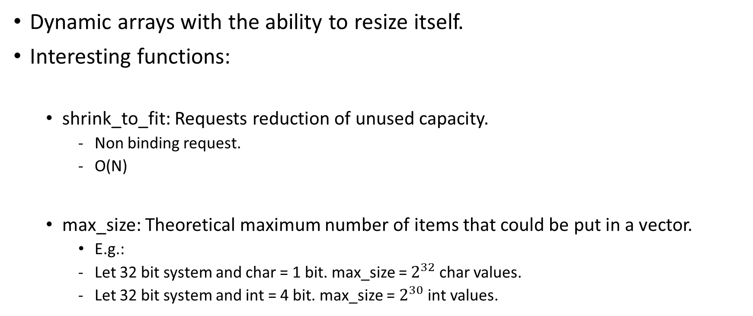
VECTORS
Dynamic arrays with the ability to resize itself.
Interesting functions:
shrink_to_fit: Requests reduction of unused capacity.
Non binding request.
O(N)
max_size: Theoretical maximum number of items that could be put in a vector.
E.g.:
Let 32 bit system and char = 1 bit. max_size = $2^{32}$ char values.
Let 32 bit system and int = 4 bit. max_size = $2^{30}$ int values.

Slide 4
Reference
Source:
https://stackoverflow.com/a/2826347/4168707
https://www.geeksforgeeks.org/vector-in-cpp-stl/
https://qr.ae/pGclP6
https://stackoverflow.com/a/3813203/4168707
https://stackoverflow.com/a/2664094/4168707
https://en.cppreference.com/w/cpp/container/vector/shrink_to_fit
https://stackoverflow.com/q/16518533/4168707
https://stackoverflow.com/a/68637039/4168707
https://www.opensourceforu.com/2021/05/memory-management-in-lists-and-tuples/

