Slide 1
Example Application
Muksitur Rahman

Slide 2
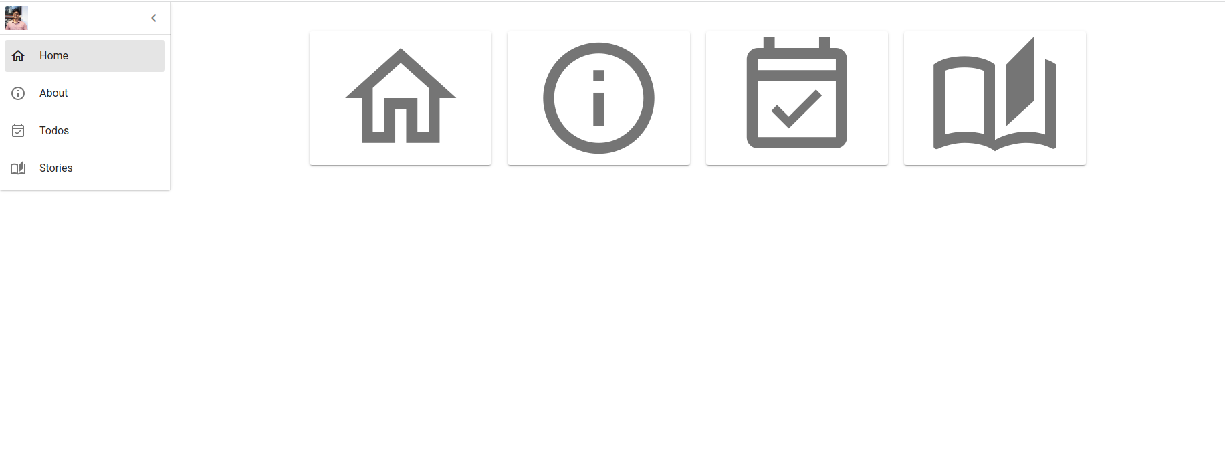
A guide to the User Interface
There are two ways to navigate the application:
One is the Side Navigation Bar.
The other one is the Home page.
Each Icon of the home page includes a tool-tip to guide the user to the destination page.

Slide 3
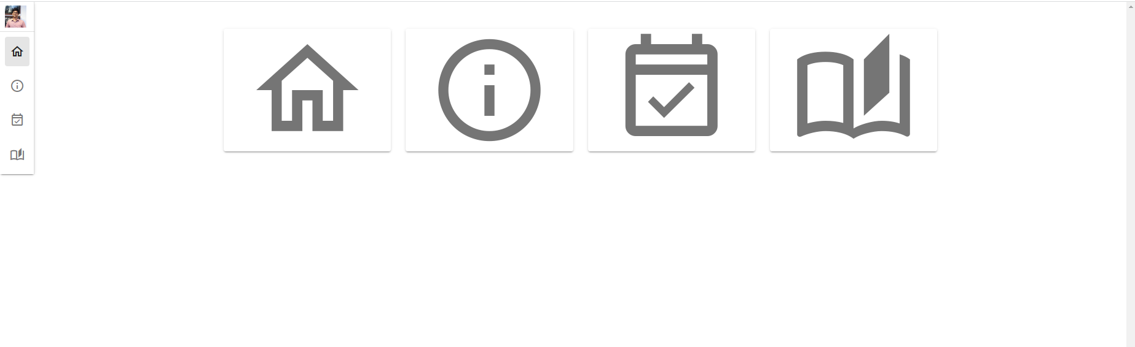
A guide to the User Interface
The Side navigation can slide inside to leave room for the content of a page.

Slide 4
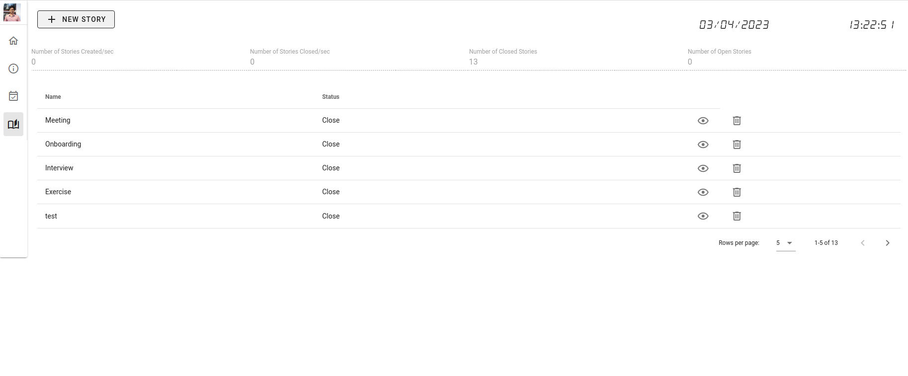
A guide to the User Interface
The “Stories page” contains all the contents related to resources such as “stories” and “tasks”.
One can click on the “Expand button” and see all the associated tasks to that particular story.

Slide 5
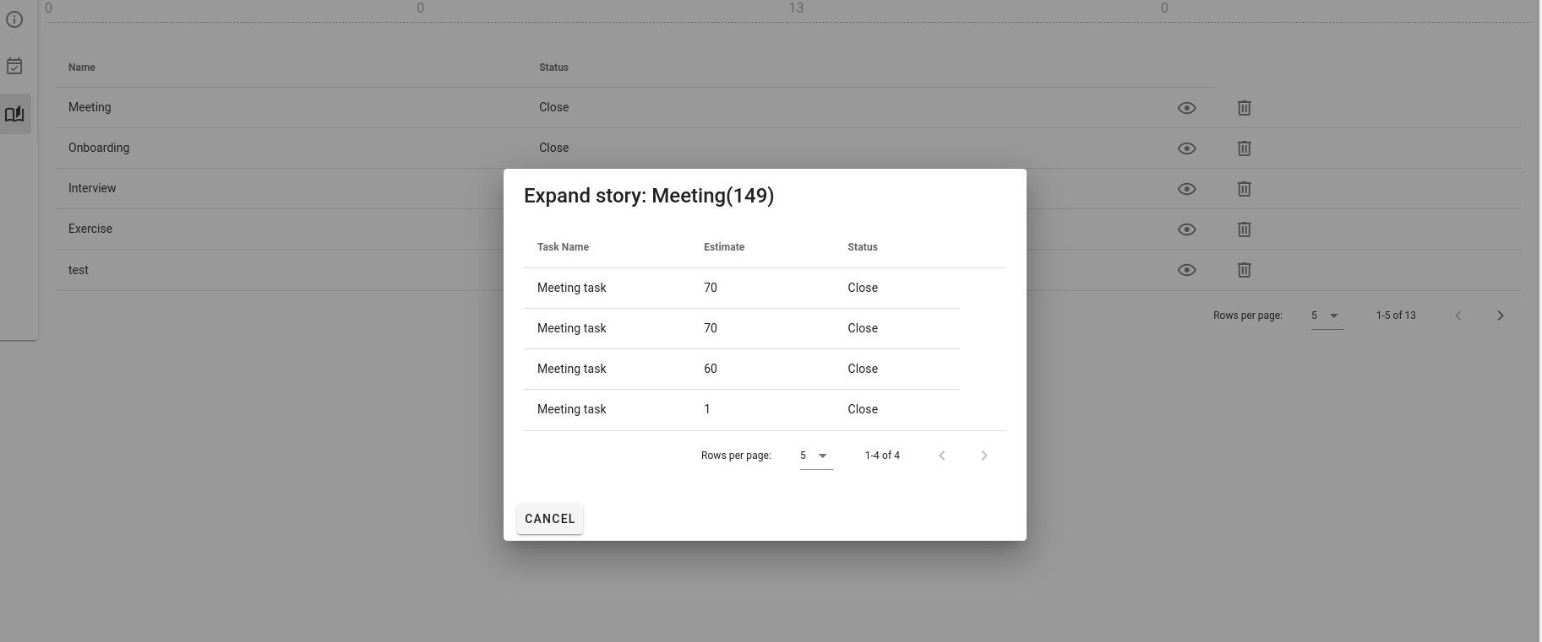
A guide to the User Interface
All tasks associated to one story.

Slide 6
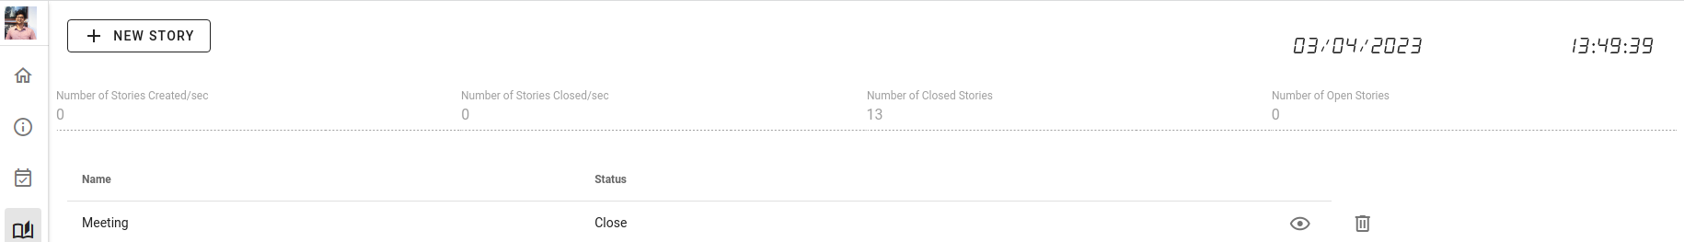
A guide to the User Interface
A digital clock is added to increase user experience in terms of stats per seconds.
Stats are presented in the top row.
One can add “New Story” by clicking the button.
One can remove a story and all it’s associated tasks by clicking the “remove/delete” button.

Slide 7
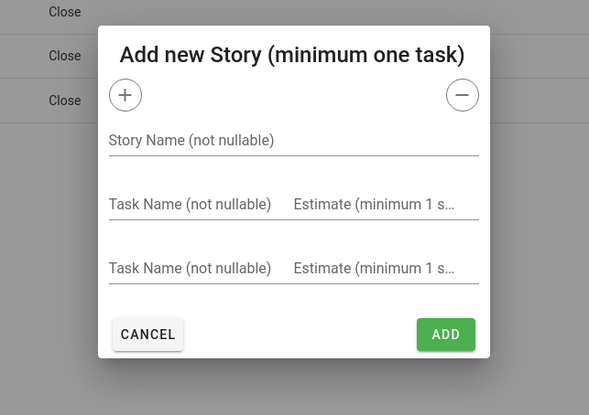
A guide to the User Interface
The story creation workflow involves a dialog box.
The “plus” button adds the number of tasks.
The “minus” button reduces the number of tasks.
The input text fields have the minimum sanitizing and validation rules in place.

Slide 8
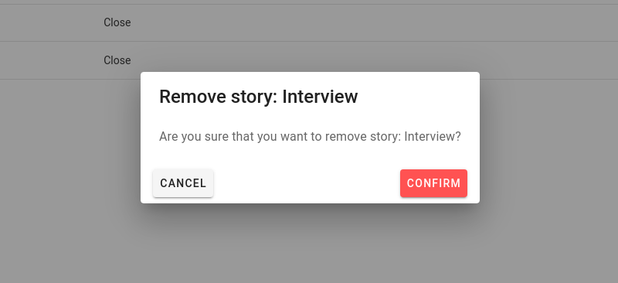
A guide to the User Interface
The “Remove Story” workflow has a confirmation dialog box.

Slide 9
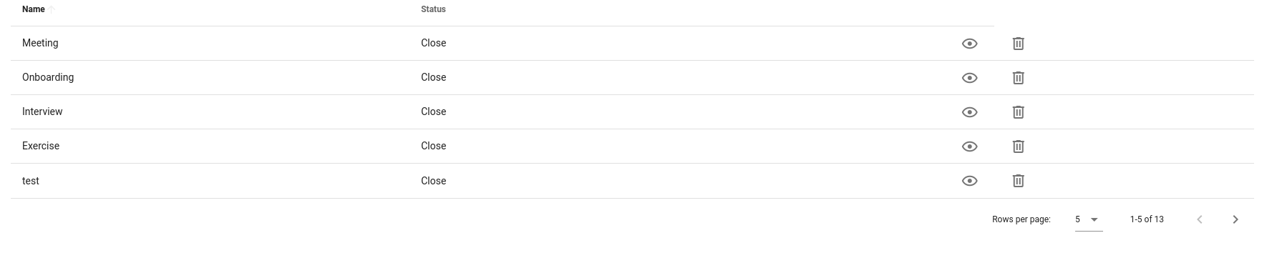
A guide to the User Interface
The data table of stories and sub data table of tasks are both paginated.

Slide 10
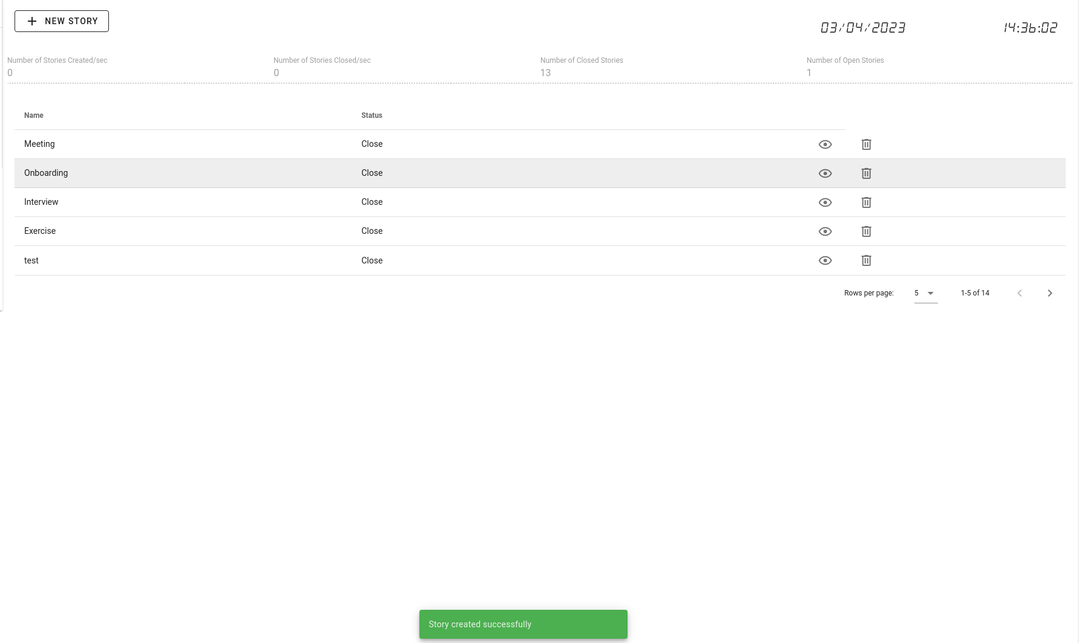
A guide to the User Interface
A snack bar appears for each API call, with a detailed message.
Green snack bar: success
Red snack bar: error
Detail of the error is described in the error message.

Slide 11
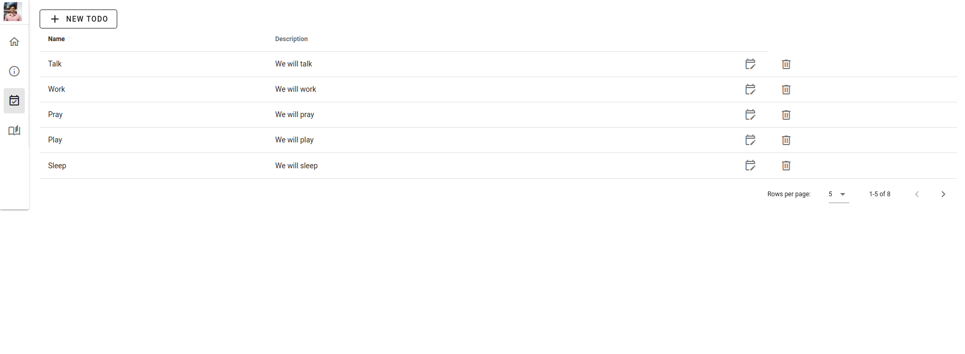
A guide to the User Interface
The “Todos page” contains all the contents related to the resource: “todos”.
One additional workflow is available in “Todos page”, unlike the “Stories page”. That is “Edit todos”.

Slide 12
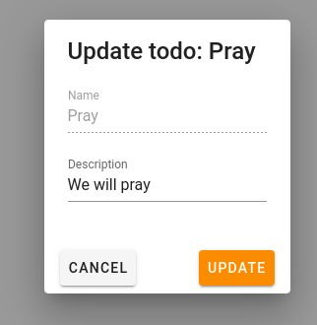
A guide to the User Interface
One can click on the “Edit button” and open the “Edit todo” dialog box.

Slide 13
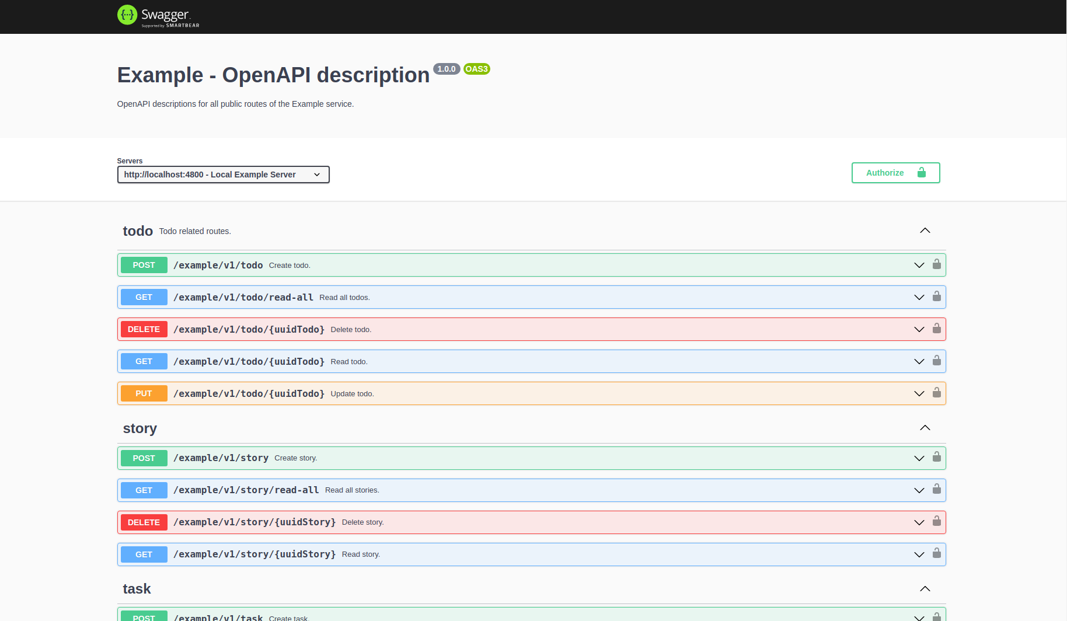
A guide to the Backend API
After starting the backend server, the documentation of the API and data models can be found here: http://localhost:4800/example/v1/swagger/.

Slide 14
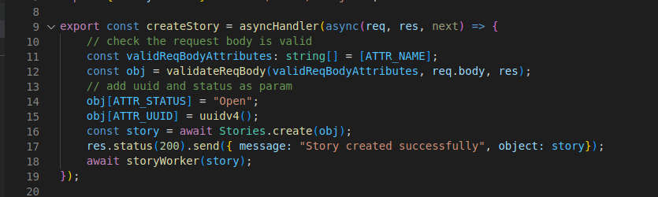
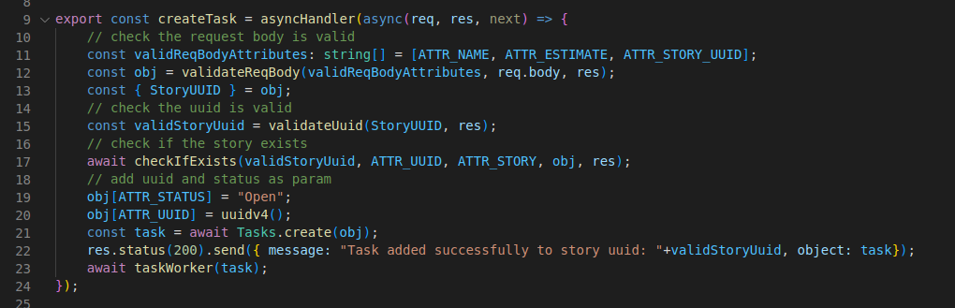
A guide to the Backend API
Since inception of each story and each task, the API deploys a worker for each resource (one for each story, and one for each task).

Slide 15
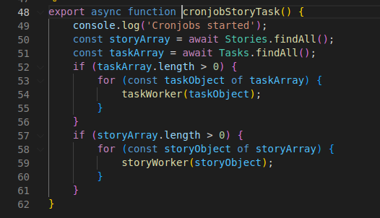
A guide to the Backend API
Each time the backend server starts, the cronjob starts to process each of the open tasks and stories. This ensures data consistency.

Slide 16
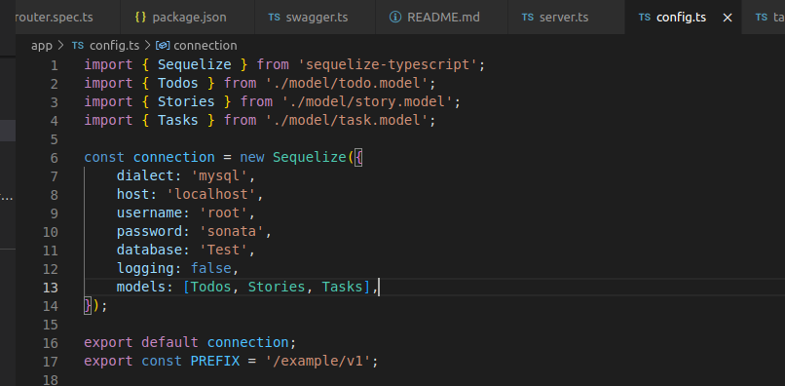
A guide to the Backend API
All the data are stored in a persistent database.

Slide 17
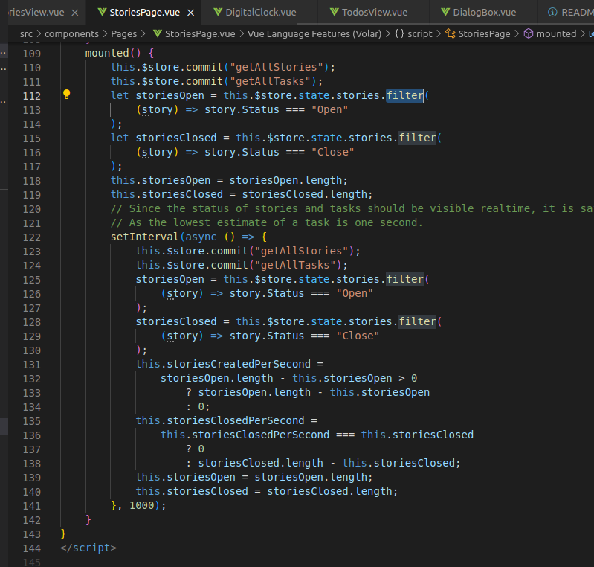
A guide to the Backend API
The UI queries the backend API every second in real-time.

Slide 18
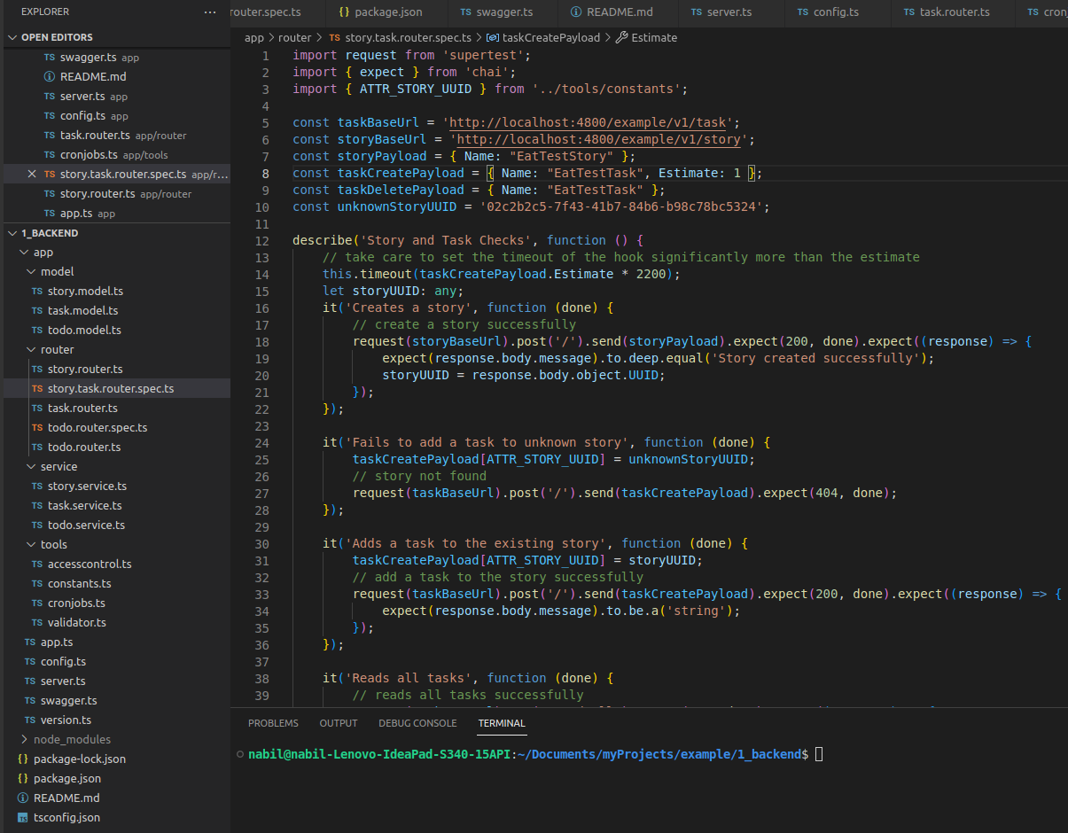
A guide to the Backend API
Each of the route or endpoint’s validation is tested via unit tests.

Slide 19
Ecosystem, Code-base & Technologies
The code is available in github repository: https://github.com/muksitur/ExampleWebApp.
Language: TypeScript.
Backend environment and framework: NodeJS, ExpressJS.
Unit test: Mocha-Chai.
API and Data model documentation: Swagger.
UI framework: VueJS (Vue 2.7 using class-component-style, Options API).

Slide 20
Ecosystem, Code-base & Technologies
UI Component framework: Vuetify.
HTTP client between NodeJS and the browser: Axios.
API platform to test APIs: Postman.
Design pattern: MVVM (Model-View-ViewModel). Model is the data model and business logic. View is the UI. And ViewModel is the state management system (Vuex) in the middle of Model and View.

Slide 21
General Techniques & Ideas
The UI is mainly designed in terms of best user experience.
The code follows the standard programming practices.
The structure of the UI and the backend is designed considering the possibility of scaling up.
Any team comprising a number of developers, UI/UX designers, Product owner, QA engineers, and a fleet of stakeholders should be able to increment an application like this in subsequent sprints.

Slide 22
Questions?

Slide 23
Thank you

