Slide 1
Best Location
Capstone Project

Slide 2
Introduction/Business Problems
Our client, a bottled water brand, has an established role in th market of Toronto. He is the first supplier of bottled water with more than 1500 clients in the neighborhoods of Toronto. His main clients are hotels, coffee shops, restaurants and bars. Currently, the products are stored in a big central warehouse outside Toronto and distributed in the different venues in a daily basis.The main problem of this business plan is that the distribution of the product becomes time consuming, inefficient, and costly. Our client wants to reduces the costs of distribution by building 5 smaller warehouse in Toronto to serve locally his clients. This approach will reduce the time which is required to serve his clients, the fuel costs, and will also transform his business to a green chain.To do so, our client asked from us to find the 5 best locations in Toronto at which the warehouses must be build in order to create smaller distribution clusters. The warehouses locations must be at the centers of these clusters in order to minimize the relative distance from each of the venues.

Slide 3
Data Usage
The data required for this task are the locations of the hotels, coffee shops, bars and restaurants in Toronto. To gather the data we ‘ll use the locations of all neighborhoods in Toronto gathered from Wikipedia. Based on these location we ll gather the locations of all venues in these neighborhoods from Foursquare. We will filter the data to acquire the locations of the targeted venues. In order to inspect the data, we ll use the folium library to extract the map of Toronto and visualize the locations of the venues on the map.A k-means algorithm will be applied on the location features to define the 5 clusters of venues. The locations of the warehouse will be defined as the centroids of the clusters. Again, to visualize the map of Toronto, the 5 clusters and the locations of the warehouses we ll use the folium library.

Slide 4
Methodology contd….
In order to define the location of each warehouse, we choose to use the k-means algorithm. By default, this algorithm minimize the distance of each point in a cluster from the centroid of the cluster. As a result, the output of the k-mean algorithm is a set of clusters whose points are lying at the minimum distance from the determined centroids.As an input, we used the set of locations (lat, long) of the venues of interest. In this example the category of each venue is not required in the algorithm. All venues belonging to hotels, bars, restaurants and coffee shops are included in the list. The locations of hotels, bars, restaurants and coffee shops are shown as the were gathered from the Foursquared database in Figure 1, 2, 3, 4. A total of 258 coffee shops, 909 restaurants, 178 bars and 73 hotels were found and used in the k-means algorithm.

Slide 5
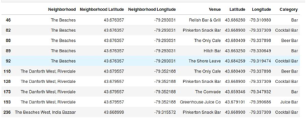
Methodology contd….
Figure 1: Locations of Bars in Toronto (sample).

Slide 6
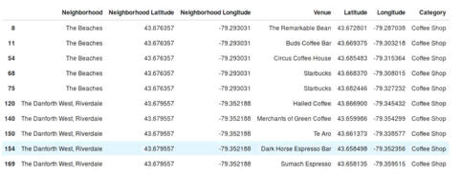
Methodology contd….
Figure 2: Locations of Coffee Shops in Toronto

Slide 7
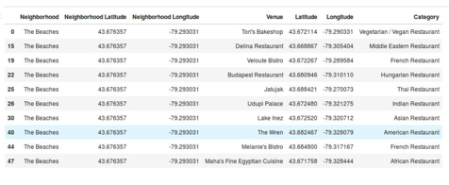
Methodology contd….
Figure 3: Location of Restaurant in Toronto (sample).

Slide 8
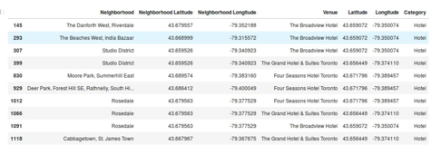
Methodology contd….
Figure 4: Locations of Hotels in Toronto

Slide 9
Methodology contd….
Having extracted the clusters, descriptive statistics were used to determine the radius of each cluster and therefore the area in which the venues of interest will be served by the specific warehouse. Morover, in order to examine the result, the density of venues in each area was calculated. Mean values were used to determine the exact location of each warehouse.

Slide 10
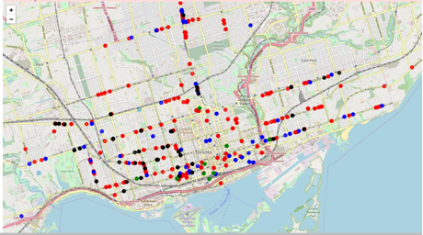
Results contd…
In Figure 5 we present the map of Toronto. The locations of the venues of interest are marked on the map with different colors according to their category.
Figure 5: Hotels (green points), Coffee shops (blue points), Restaurants (red points) and Bars (black points ) in Toronto

Slide 11
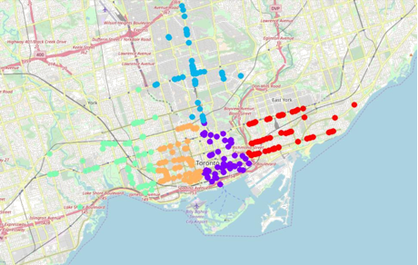
Results contd….
All of the above points were used in the k-mean algorithm. The resulted clusters are shown in Figure 6.
Figure 6: The 5 clusters of the venues indicated by the different colors. The clusters were extracted with the k-means algorithm.

Slide 12
Results contd….
The mean radius was calculated for each cluster. The location of the warehouse was defined by the clusters centroids calculated in the k-means algorithm. Moroever, the number of venues in each cluster was extracted and used to define the density in each area. The results are shown in the next table.
Cluster | Location- | Location- | Mean | Area | Number of | Density
 | Centre | Centre | Radius | (km^2) | Venues | (#/km^2)
 | (latitude) | (longitude) | (km)
Red | 43.66962 | -79.33436 | 5.24 | 86.27 | 182 | 2.1
Magenta | 43.65410 | -79.37749 | 3.49 | 38.42 | 425 | 11.1
Light blue | 43.70438 | -79.39764 | 4.18 | 54.99 | 231 | 4.2
Light green | 43.65665 | -79.44908 | 5.87 | 108.33 | 166 | 1.5
Orange | 43.65278 | -79.40520 | 3.81 | 45.7 | 414 | 9.1

Slide 13
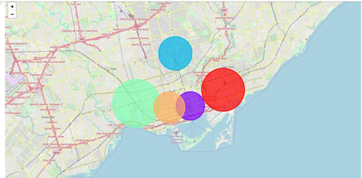
Results contd….
In Figure 7 were present the area of each cluster overlayed on the map of Toronto
Figure 7: Clusters Area. Each warehouse will be responsible for the venues lying at the area indicated by the corresponding circle.

Slide 14
Discussion
From the results we can see the variability in the distribution of venues in the Toronto city. As seen the two central clusters in the middle of the city contain at least a double number of hotels, restaurants, bars and coffee shops than the three other cluster. For this reason, their areas are smaller than those of the other three clusters. Based on this observation we suggest:
The size of the warehouse placed at the orange and purple areas be at least double than the size of the other warehouse.
Similarly, th employees employed in the central warehouses be at leas double than those employed in the other three warehouse,
The number of trucks in each warehouse to chosen regarding the number of venues in each cluster.

Slide 15
Conclusion
The main problem solved in this work is the definition of the locations where 5 warehouses can be build to improve the process of bottled water distribution in the Toronto city. Our approach was to divide the Toronto city in 5 different subregions. The criterion used for this division was the distribution (density) of the venues of interest in the entire city. The center of each subregion was estimated using the k-means algorithm. The standard deviation of each cluster was used to define the area containing the venues to which the warehouse must provide the products. Based on the results, we are able to define the location of the warehouses, their size, the number of employees in each warehouse and the number of trucks required.

