Slide 1
CS436:Introduction to Machine Learning
Toxic Comment Classification
-Sweekrithi Shetty(B00866138)
-Mukta Parab (B00863950)
Notes:
1

Slide 2
Contents
INTRODUCTION
-Problem Statement
-Dataset
-Data Analysis
INTIAL APPROACH
-Results
-Comparison
FINAL APPROACH
-Results
-Flow Chart
-Conclusion
Notes:
2

Slide 3
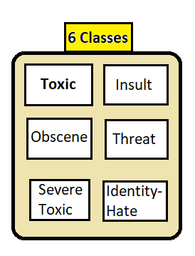
Problem Statement
Background:
Social media has become an integral platform for expressing individual options and thoughts. However, this has also increased risk of harassment and abuse.
Objective:
Build a CNN and SVM classification
model to detect different types of
toxicity for each comment.

Slide 4
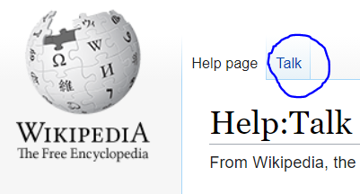
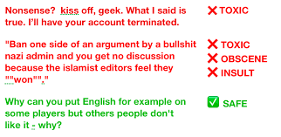
Dataset
Kaggle Competition Dataset: Comments taken from Wikipedia Talk Pages.
6 Classes of Toxicity
• Toxic
• Severe toxic
• Obscene
• Threat
• Insult
• Identity hate

Slide 5
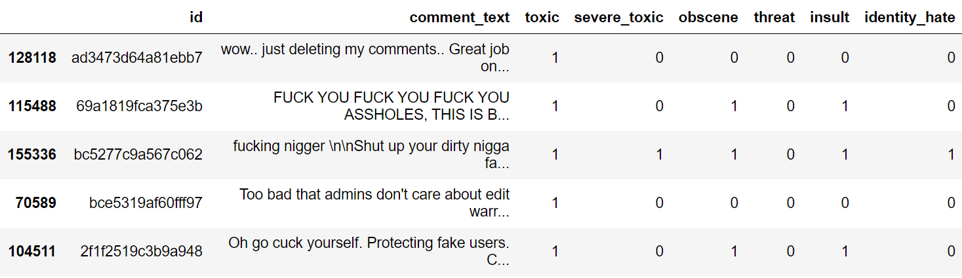
Dataset
Sample Records:
Notes:
5

Slide 6
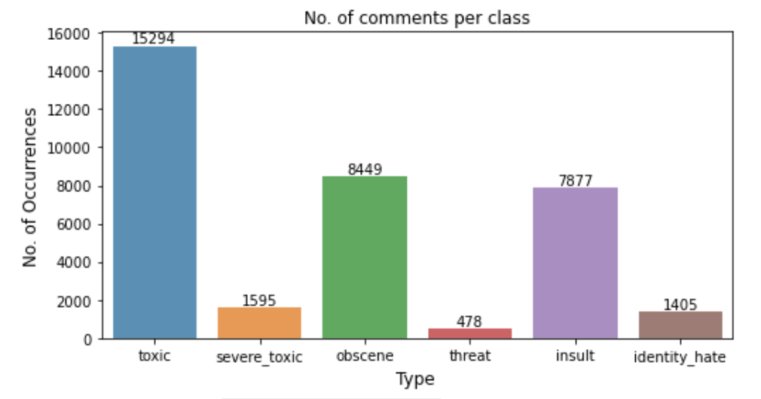
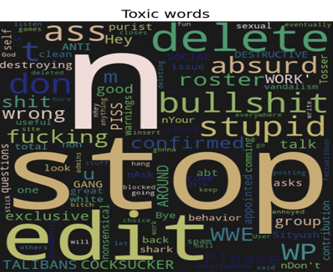
Data Analysis
About 90% of comments Class distribution are clean.
Word clouds for all toxic labels look very similar to each other.

Slide 7
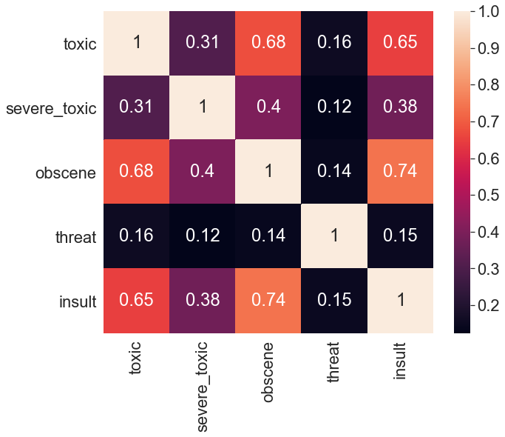
Data Analysis

Slide 8
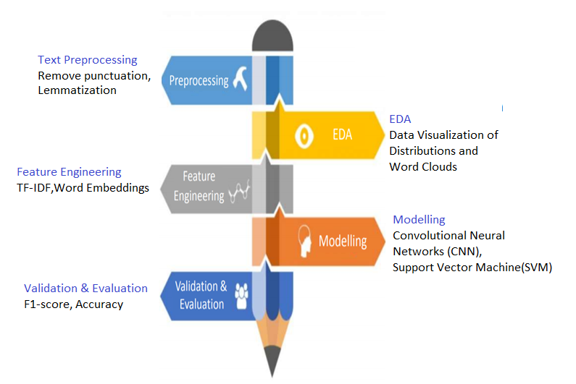
Approach
Notes:
8

Slide 9
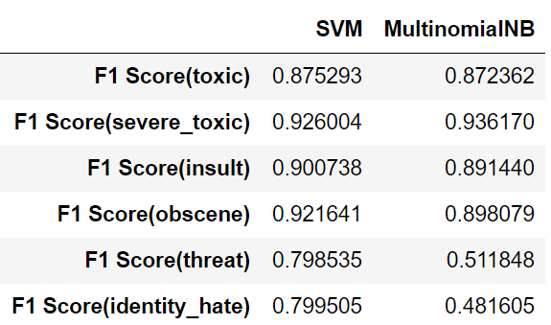
Results (Initial Approach)
1.TF-IDF+SVM/MultinomialNB

Slide 10
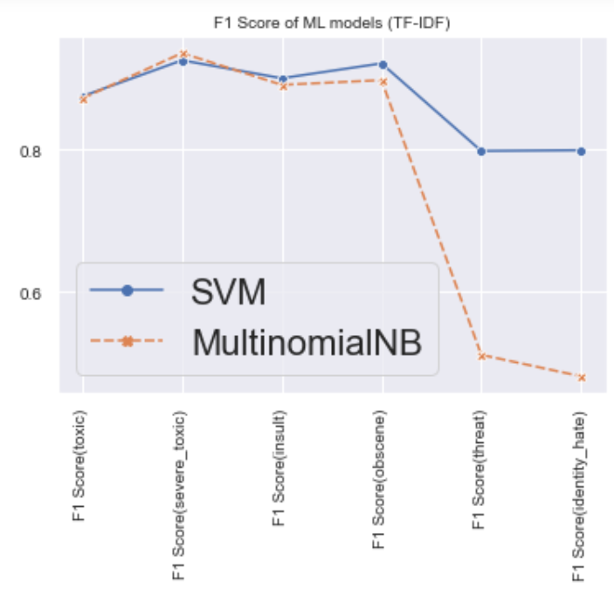
Comparison
Comparison of results between SVM and Multinomial-NB in graphical form

Slide 11
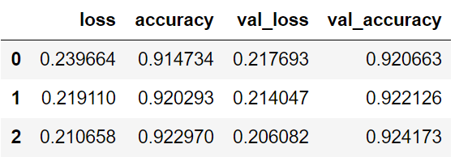
Results(Final Approach)
2.CNN(Convolutional Neural Network)

Slide 12
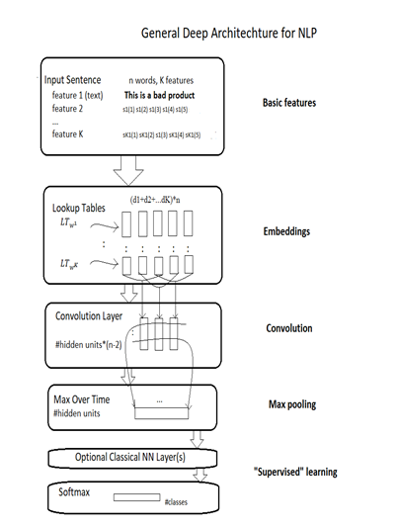
Flow Chart:

Slide 13
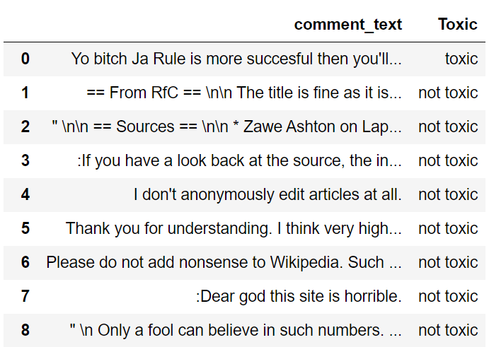
Prediction
Predicted values

Slide 14
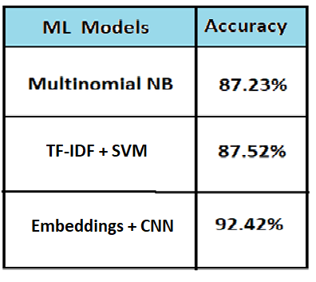
Observations:
It was observed that CNN is more suitable for the Toxic comment classification dataset.

Slide 15
Model Selection:
Best Performing Model: Embeddings + CNN
Model Selected: TF-IDF + SVM
Reasons:
• Less complex model at a cost of < 4.5% reduction in f1-score.
• Simpler features (TF-IDF vs. Embeddings)
• Greater interpretability of model’s results as feature
importance can easily be extracted with SVM unlike NB/CNN

Slide 16
THANK YOU!!

