Slide 1
Database Keys

Slide 2
Database Keys
Keys are very important part of Relational database. They are used to establish and identify relation between tables. They also ensure that each record within a table can be uniquely identified by combination of one or more fields within a table.
Super Key
Candidate Key
Primary Key
Foreign Key
Composite Key
Secondary or Alternative key
Non-prime Attribute

Slide 3
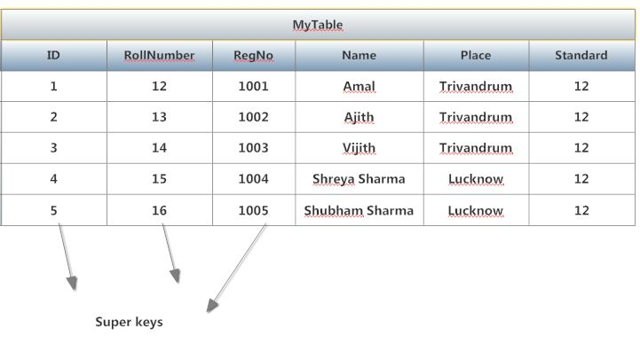
Super Key
Super Key
A Super key is any combination of fields within a table that uniquely identifies each record within that table.
Or
Super Key is defined as a set of attributes within a table that uniquely identifies each record within a table. Super Key is a superset of Candidate key.
15-12-001
16-13-002

Slide 4
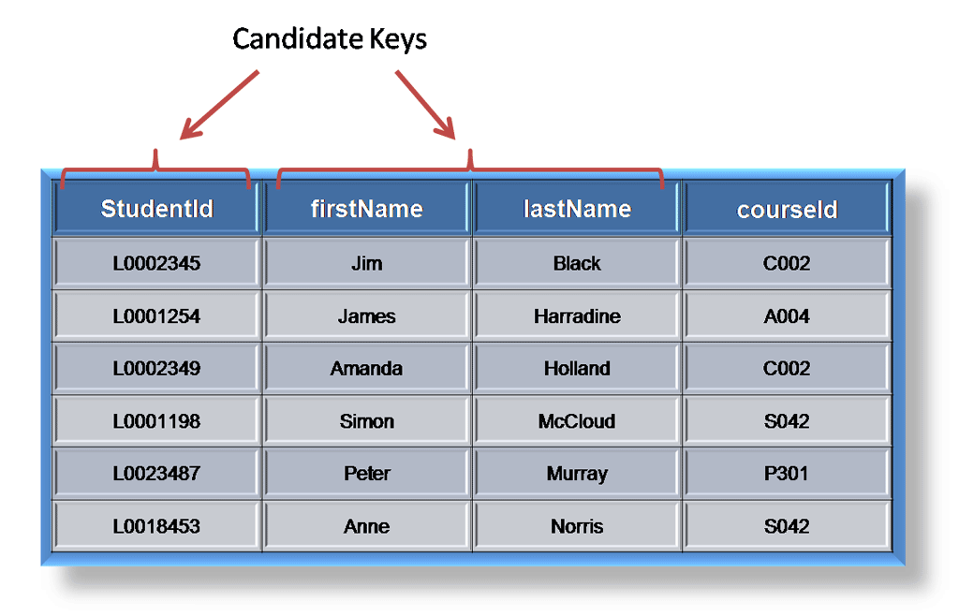
Candidate Key
Candidate Key
A candidate is a subset of a super key. A candidate key is a single field or the least combination of fields that uniquely identifies each record in the table.
Or
A Candidate Key can be any column or a combination of columns that can qualify as unique key in database. There can be multiple Candidate Keys in one table. Each Candidate Key can qualify as Primary Key
The least combination of fields distinguishes a candidate key from a super key. Every table must have at least one candidate key but at the same time can have several.

Slide 5
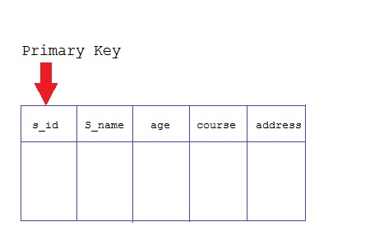
Primary Keys
Primary Keys
The primary key consists of one or more columns whose data contained within is used to uniquely identify each row in the table.
Or
A primary key is a column (or columns) in a table that uniquely identifies the rows in that table.
When a primary key is composed of multiple columns, the data from each column is used to determine whether a row is unique.

Slide 6
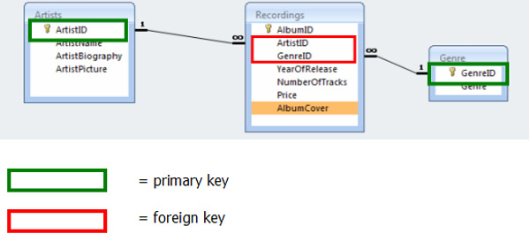
Foreign Key
Foreign Key
A foreign key is generally a primary key from one table that appears as a field in another where the first table has a relationship to the second.
Or
A foreign key is a set of one or more columns in a table that refers to the primary key in another table.
In other words, if we had a table A with a primary key X that linked to a table B where X was a field in B, then X would be a foreign key in B.

Slide 7
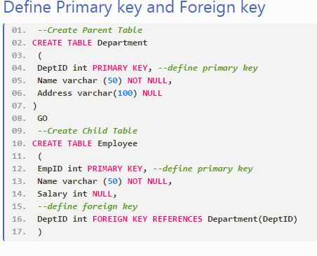

Slide 8
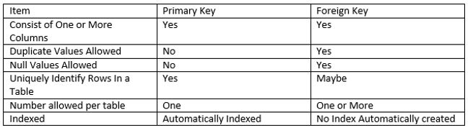
Comparison of Primary Keys to Foreign Keys

Slide 9
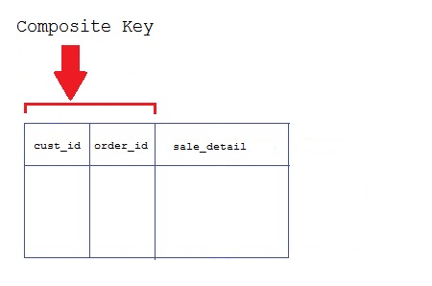
Composite Key
Key that consist of two or more attributes that uniquely identify an entity occurrence is called Composite key. But any attribute that makes up the Composite key is not a simple key in its own.
Secondary or Alternative key
The candidate key which are not selected for primary key are known as secondary keys or alternative keys
Non-prime Attribute
An attribute, which is not a part of the prime-key, is said to be a non-prime attribute.

