Slide 1
Chapter 2: Operating-System Structures

Slide 2
Chapter 2: Operating-System Structures
Operating System Services
User Operating System Interface
System Calls
Types of System Calls
System Programs
Operating System Design and Implementation
Operating System Structure
Virtual Machines
Operating System Debugging
Operating System Generation
System Boot

Slide 3
Objectives
To describe the services an operating system provides to users, processes, and other systems
To discuss the various ways of structuring an operating system
To explain how operating systems are installed and customized and how they boot

Slide 4
Operating System Services
One set of operating-system services provides functions that are helpful to the user:
User interface - Almost all operating systems have a user interface (UI)
Varies between Command-Line (CLI), Graphics User Interface (GUI), Batch Interface.
Program execution - The system must be able to load a program into memory and to run that program, end execution, either normally or abnormally (indicating error)
I/O operations - A running program may require I/O, which may involve a file or an I/O device
File-system manipulation - The file system is of particular interest. Obviously, programs need to read and write files and directories, create and delete them, search them, list file Information, permission management.

Slide 5
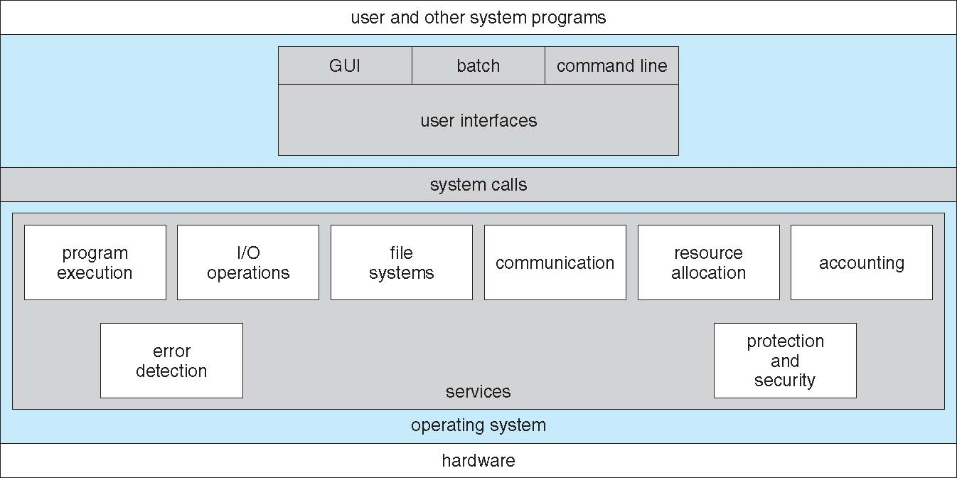
A View of Operating System Services

Slide 6
Operating System Services (Cont.)
One set of operating-system services provides functions that are helpful to the user (cont.):
Communications – Processes may exchange information, on the same computer or between computers over a network
Communications may be via shared memory or through message passing (packets moved by the OS)
Error detection – OS needs to be constantly aware of possible errors
May occur in the CPU and memory hardware, in I/O devices, in user program
For each type of error, OS should take the appropriate action to ensure correct and consistent computing
Debugging facilities can greatly enhance the user’s and programmer’s abilities to efficiently use the system

Slide 7
Operating System Services (Cont.)
Another set of OS functions exists for ensuring the efficient operation of the system itself via resource sharing
Resource allocation - When multiple users or multiple jobs running concurrently, resources must be allocated to each of them
Many types of resources - Some (such as CPU cycles, main memory, and file storage) may have special allocation code, others (such as I/O devices) may have general request and release code
Accounting - To keep track of which users use how much and what kinds of computer resources
Protection and security - The owners of information stored in a multiuser or networked computer system may want to control use of that information, concurrent processes should not interfere with each other
Protection involves ensuring that all access to system resources is controlled
Security of the system from outsiders requires user authentication, extends to defending external I/O devices from invalid access attempts
If a system is to be protected and secure, precautions must be instituted throughout it. A chain is only as strong as its weakest link.

Slide 8
User Operating System Interface - CLI
Command Line Interface (CLI) or command interpreter allows direct command entry.
Sometimes implemented in kernel, sometimes by systems program
Sometimes multiple flavors implemented – shells
Primarily fetches a command from user and executes it
Sometimes commands built-in, sometimes just names of programs
– If the latter, adding new features doesn’t require shell modification
Notes:
8

Slide 9
User Operating System Interface - GUI
User-friendly desktop metaphor interface
Usually mouse, keyboard, and monitor
Icons represent files, programs, actions, etc
Various mouse buttons over objects in the interface cause various actions (provide information, options, execute function, open directory (known as a folder)
Invented at Xerox PARC
Many systems now include both CLI and GUI interfaces
Microsoft Windows is GUI with CLI “command” shell
Apple Mac OS X as “Aqua” GUI interface with UNIX kernel underneath and shells available
Solaris is CLI with optional GUI interfaces (Java Desktop, KDE)

Slide 10
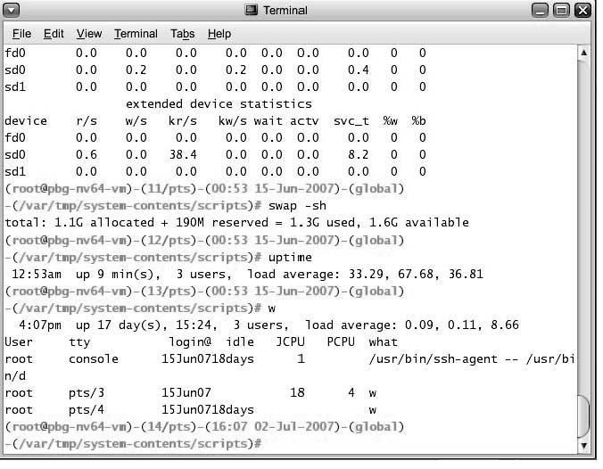
Bourne Shell Command Interpreter

Slide 11
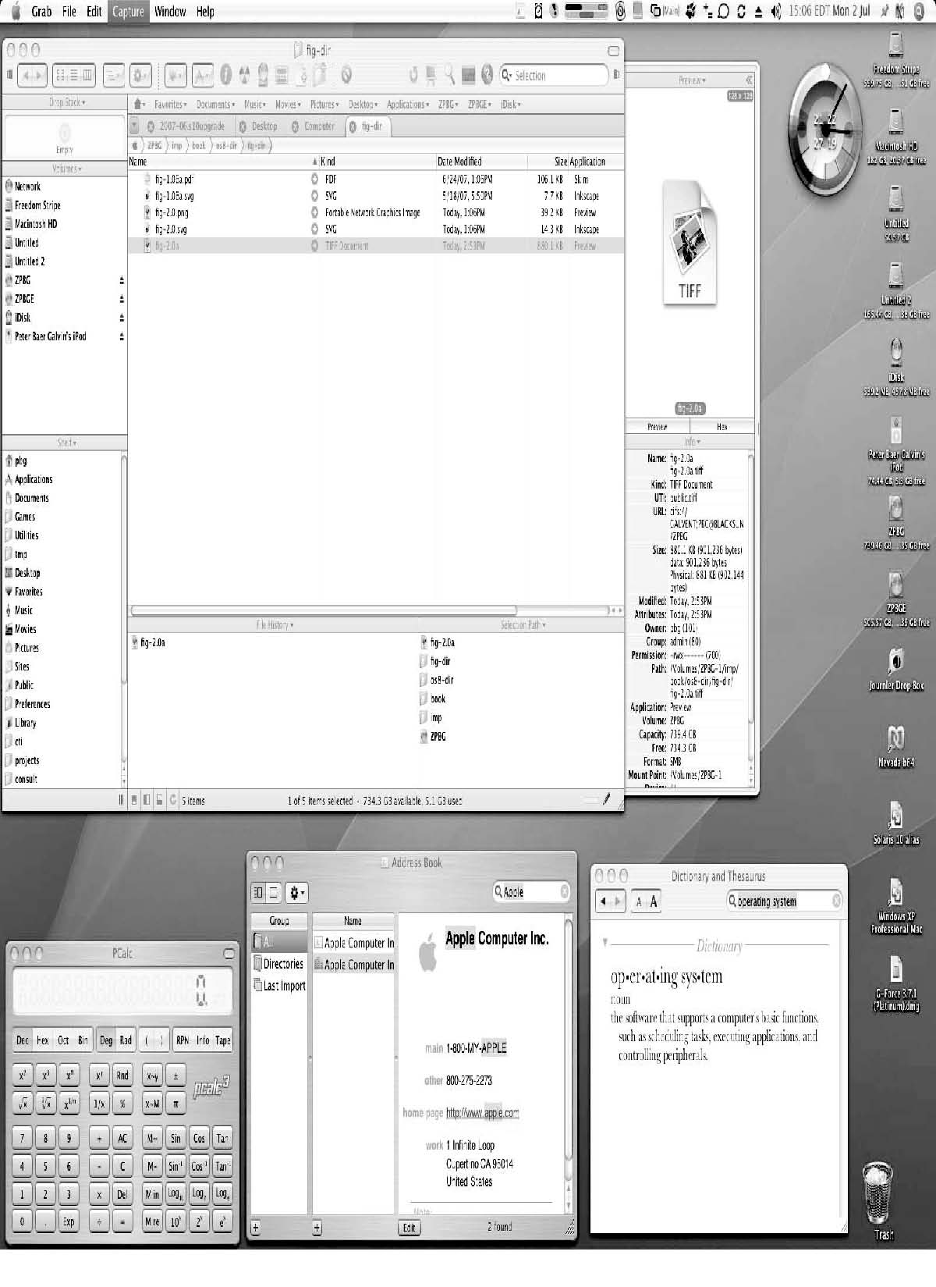
The Mac OS X GUI

Slide 12
System Calls
System Calls provide programming interface for user processes to request the services from the system made available by the OS.
System calls allow user-level processes to request services of the operating system
Typically written in a high-level language (C or C++)
Mostly accessed by programs via a high-level Application Program Interface (API) rather than direct system call use
Three most common APIs are Win32 API for Windows, POSIX API for POSIX-based systems (including virtually all versions of UNIX, Linux, and Mac OS X), and Java API for the Java virtual machine (JVM)
Why use APIs rather than system calls?

Slide 13
System Calls and API (Def.)
A System Call is an explicit request to the kernel made via a software interrupt by OS from user processes.
Application Programming Interface (API) is a set of functions, objects, protocols or data structures for the support of application development for developers/programmers.

Slide 14
API (Def.)
Operating Systems provide a library (or high-level Application Program Interface or API) that sits between normal programs and the rest of the operating system.
This library handles the low-level details of passing information to the kernel and switching to supervisor mode,

Slide 15
API (Def.) Cont.
It(API) is actually a kind of function definition which specifies how to make available of a specific service of the system/OS.
The API's are available from library or from Operating system itself.
API is used in high level programming to invoke system calls in low level architecture.

Slide 16
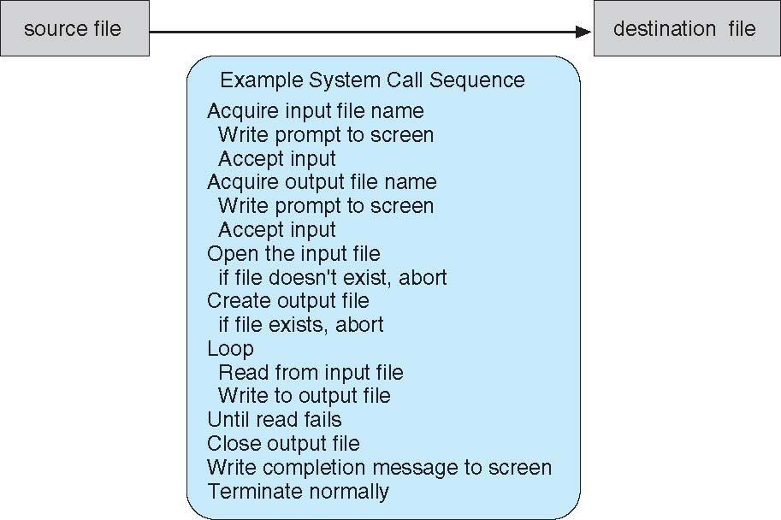
Example of System Calls
System call sequence to copy the contents of one file to another file

Slide 17
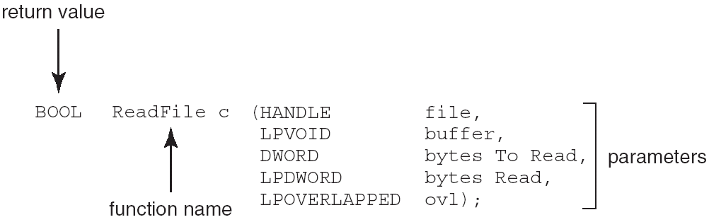
Example of Standard API
Consider the ReadFile() function in the
Win32 API—a function for reading from a file
A description of the parameters passed to ReadFile()
HANDLE file—the file to be read
LPVOID buffer—a buffer where the data will be read into and written from
DWORD bytesToRead—the number of bytes to be read into the buffer
LPDWORD bytesRead—the number of bytes read during the last read
LPOVERLAPPED ovl—indicates if overlapped I/O is being used

Slide 18
System Call Implementation
Typically, a number associated with each system call
System-call interface maintains a table indexed according to these numbers
The system call interface invokes intended system call in OS kernel and returns status of the system call and any return values
The caller need know nothing about how the system call is implemented
Just needs to obey API and understand what OS will do as a result call
Most details of OS interface hidden from programmer by API
Managed by run-time support library (set of functions built into libraries included with compiler)

Slide 19
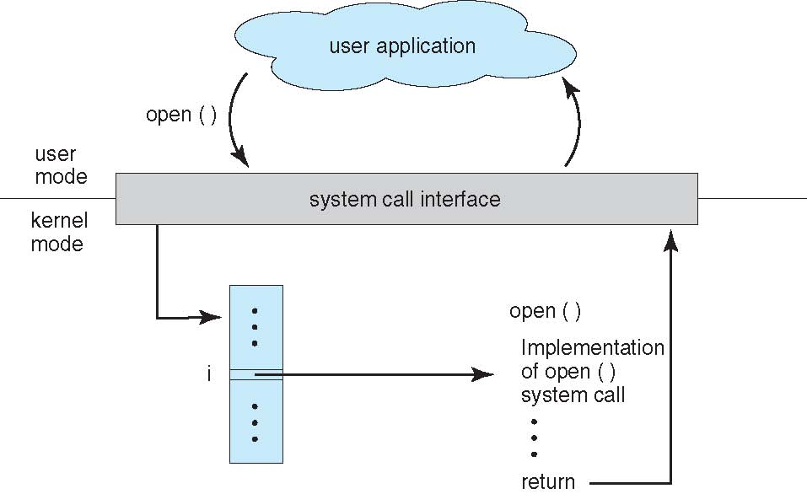
API – System Call – OS Relationship

Slide 20
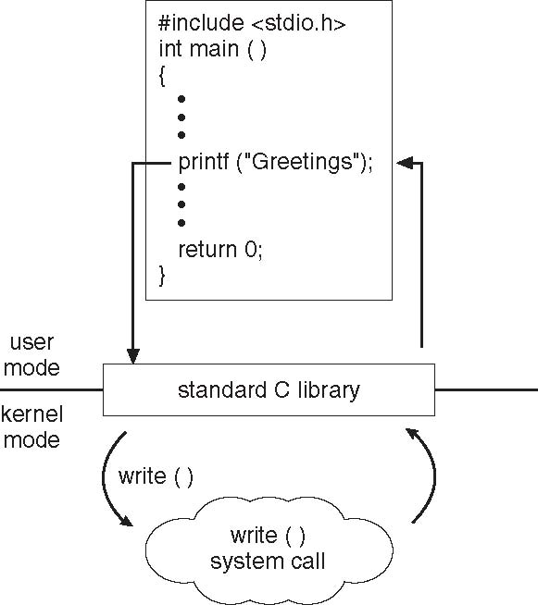
Standard C Library Example
C program invoking printf() library call, which calls write() system call

Slide 21
System Call Parameter Passing
Typically, each system call is associated with a number. When a system call is made, it triggers a software interrupt or trap which uses the number to find the proper system call in a lookup table.
Interrupts transfer control to the kernel so software simply needs to set up some register with the system call number they want and execute the software interrupt.

Slide 22
System Call Parameter Passing(Method)
Three general methods used to pass parameters to the OS
Simplest: pass the parameters in registers
In some cases, may be more parameters than registers
Parameters stored in a block, or table, in memory, and address of block passed as a parameter in a register
This approach taken by Linux and Solaris
Parameters placed, or pushed, onto the stack by the program and popped off the stack by the operating system
Block and stack methods do not limit the number or length of parameters being passed

Slide 23
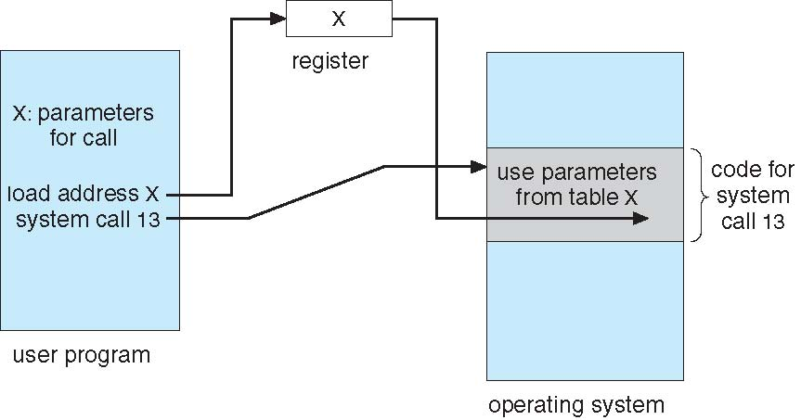
Parameter Passing via Table

Slide 24
REST API
A RESTful API -- also referred to as a RESTful web service -- is based on representational state transfer (REST) technology, an architectural style and approach to communication used in web services development.
An API for a website is code that allows two software programs to communicate with each another.

Slide 25
REST API
a RESTful API is an Application-Programmer Interface for communicating with an application across a network. ***
REST is a logical choice for building APIs that allow users to connect and interact with cloud services. RESTful APIs are used by such sites as Amazon, Google, LinkedIn and Twitter.

Slide 26
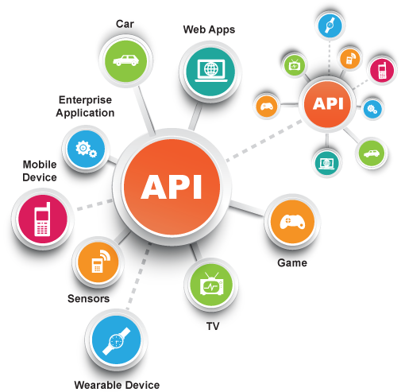
RESTful API

Slide 27
REST API
Twitter, Facebook, SalesForce and many others expose their services as RESTful APIs.
[This is usually done via an API Security Gateway which will convert web services message formats (i.e. SOAP) and protocols (i.e. JMS, ActiveMQ) into API formats, often REST-based (i.e. XML or JSON) and API protocols (often HTTP). Using an API Security Gateway provides the simplicity of connection, with the information assurance that some with the “security” part of the API Security Gateway.]

Slide 28
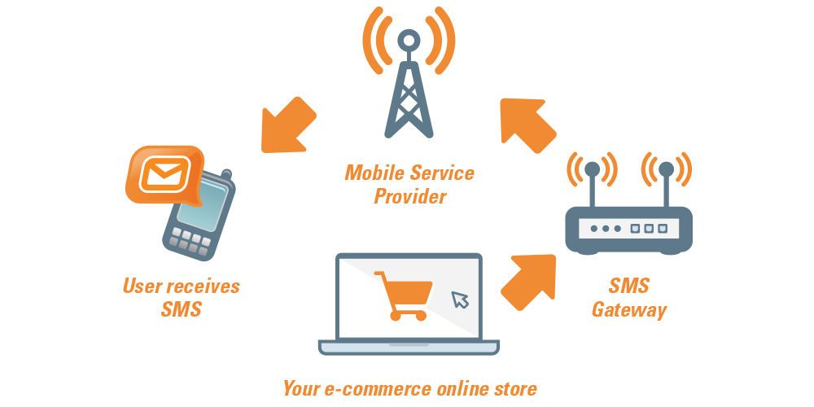
SMS API
An SMS API is mainly used to integrate an APP or a website to directly send messages from the APP or website.

Slide 29

How SMS API WORKS
Txtlocal Process
cURL submits POST data to Txtlocal
Arrives at cell/mobile!
Txtlocal.com/sendsmspost.php
sms.php
Submit POST variables through form
Put together URL to send to Txtlocal and submit using cURL

Slide 30
Types of System Calls
Process control
File management
Device management
Information maintenance
Communications
Protection

Slide 31
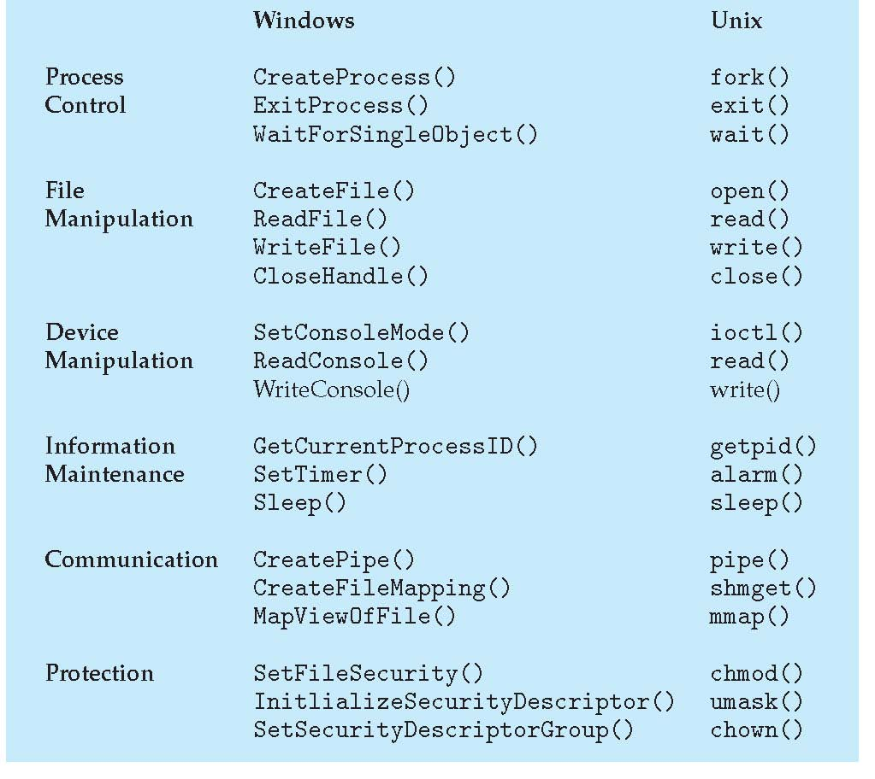
Examples of Windows and Unix System Calls

Slide 32
Operating System Design and Implementation
Design and Implementation of OS not “solvable”, but some approaches have proven successful
Internal structure of different Operating Systems can vary widely
Start by defining goals and specifications
Affected by choice of hardware, type of system
User goals and System goals
User goals – operating system should be convenient to use, easy to learn, reliable, safe, and fast
System goals – operating system should be easy to design, implement, and maintain, as well as flexible, reliable, error-free, and efficient

Slide 33
Operating System Design and Implementation (Cont.)
Important principle to separate
Policy: What will be done? Mechanism: How to do it?
Mechanisms determine how to do something, policies decide what will be done.
The separation of policy from mechanism is a very important principle, it allows maximum flexibility if policy decisions are to be changed later.

Slide 34
Operating System Design and Implementation
Selecting language for coding
Assembly language was used before
Adv: faster/ run fast directly due to directly hard coding
Disadv: More no of lines with large program
Now generally used C, C++ or Python.
Linux and windows OS are written mainly in C
Advantages of using higher-level language :
Code can be written faster
More compact
Easier to understand and debug
Improvements in compilation technology
Easier to port

Slide 35
Operating System Structure Simple Structure
MS-DOS – written to provide the most functionality in the least space
Not divided into modules
Although MS-DOS has some structure, its interfaces and levels of functionality are not well separated
No dual-mode and no hardware protection
Leave vulnerable to errant or malicious programs
Crashes entire program when user program fails

Slide 36
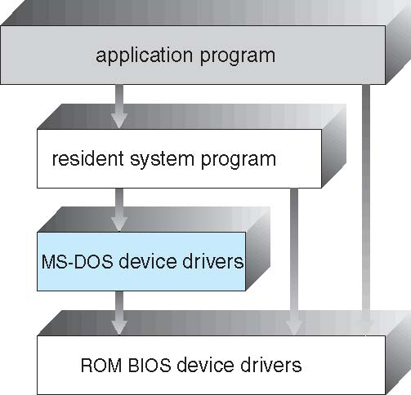
MS-DOS Layer Structure

Slide 37
Layered Approach
OS can be broken into smaller and more appropriate pieces creating modular operating system
With modularity, layers are selected such that each uses functions (operations) and services of only lower-level layers
More freedom in changing inner workings of the system

Slide 38
Layered Approach
The operating system is divided into a number of layers (levels), each built on top of lower layers. The bottom layer (layer 0), is the hardware; the highest (layer N) is the user interface.
With modularity, layers are selected such that each uses functions (operations) and services of only lower-level layers

Slide 39
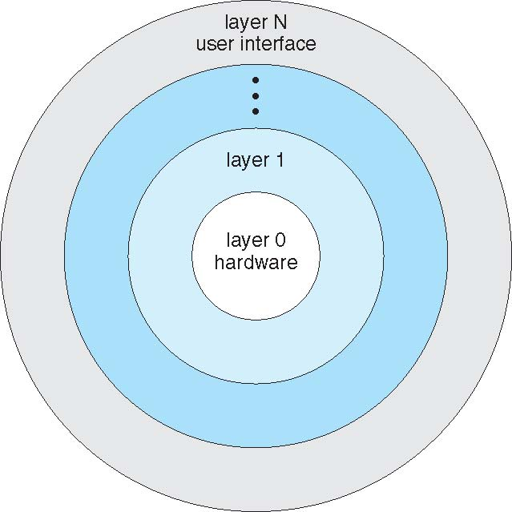
Layered Operating System

Slide 40
Layered Approach
Advantages:
Simplicity of construction and debugging
Design and implementation of the system is simplified
Each layer is implemented only those operation provided by its lower layer
Disadvantages:
Major difficulty involves appropriately defining each layer
Less efficient than others
An I/O request of user program adds overhead at each layer

Slide 41
Microkernel System Structure
A microkernel-based system puts only the bare minimum system components in the kernel and runs the rest of them as user mode processes.
Moves all non-essential components as much from the kernel into “user” space
Implementing as system and user level
Communication takes place between user modules using message passing

Slide 42
Microkernel System Structure
new protocol stacks, file systems, device drivers and other low-level systems located in the monolithic kernel which results to a lot of work and careful code management.
operating system functions, such as device drivers, protocol stacks and file systems, are typically removed from the microkernel itself and are instead run in user space.
Windows NT became a hybrid kernel is speed
Mac OS X kernel (Darwin) partly based on Mach

Slide 43
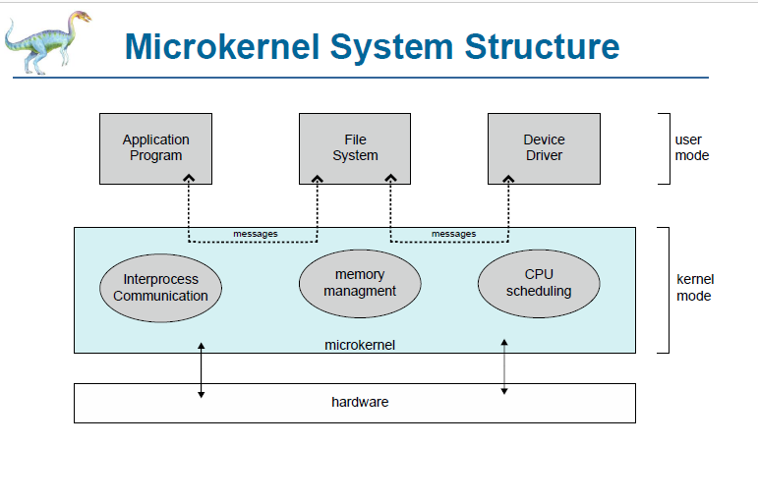

Slide 44
Microkernel System Structure
Benefits:
Easier to extend a microkernel
Easier to port the operating system to new architectures
More reliable (less code is running in kernel mode)
More secure
Demerits:
Performance overhead of user space to kernel space communication

Slide 45
Loadable Modules Architecture
The best current methodology for OS design is loadable kernel modules where the kernel has a set of core components and links in additional services via modules either boot time or during run time.
Kernel is provided to design core services
And other services dynamically is adding new features directly to the kernel (required kernel compilation every time)
Example: Solaris, Linux and Mac OS X.

Slide 46
Loadable Modules Architecture

Slide 47
Loadable Modules Architecture
Advantages
More flexible than a layered approach as one module can call another module.
More efficient than microkernel because modules do not need to invoke message passing to communicate
Disadvantages
the fragmentation penalty is a major disadvantage of loadable modules in the kernel. This means that every time a new kernel module code is inserted, the kernel becomes fragmented.[TLB (Transaction Lookaside Buffer)]

Slide 48
Hybrid Architecture
Most modern operating systems are actually not one pure model
Hybrid combines multiple approaches to address performance, security, usability needs
Linux and Solaris kernels in kernel address space, so monolithic, plus modular for dynamic loading of functionality
Windows mostly monolithic, plus microkernel for different subsystem personalities

Slide 49
Hybrid Architecture
Apple Mac OS X
iOS and Android (most prominent mobile OS)

Slide 50
Apple Mac OS X
Apple Mac OS X hybrid, layered, plus Cocoa programming environment
Top layers include Aqua User Interface
Cocoa environment specifies API for the Objective –C programming language-used for writing Mac OS X applications
below this layer kernel environment consists of Mach microkernel and the BSD UNIX kernel including I/O kit for device drivers and loadable modules(kernel extension)

Slide 51
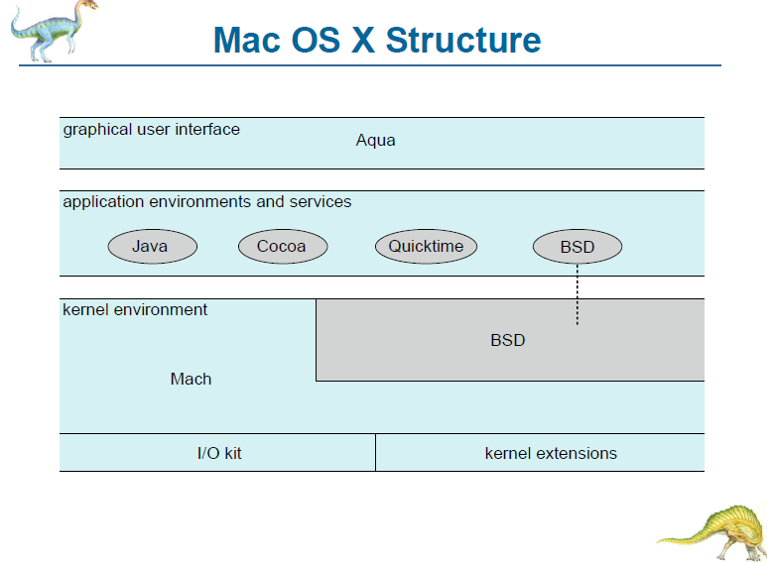
Apple Mac OS X

Slide 52
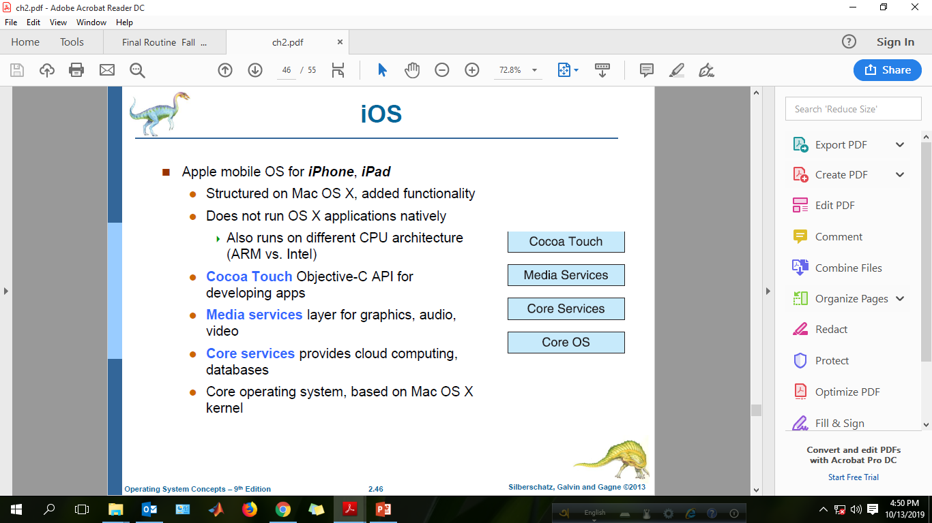

Slide 53
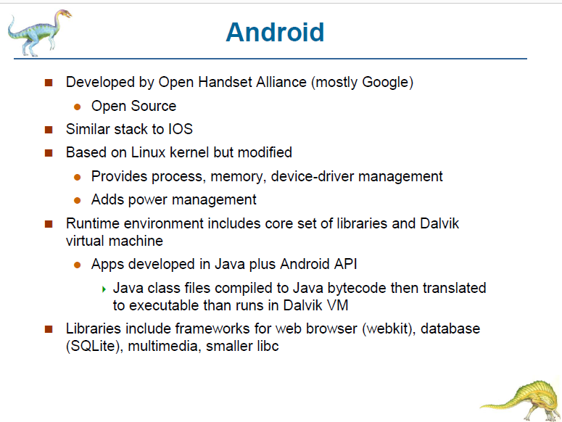

Slide 54
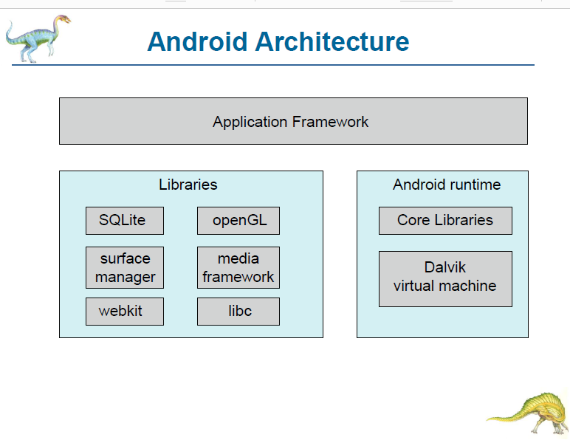

Slide 55
Virtual Machines
A virtual machine takes the layered approach to its logical conclusion. It treats hardware and the operating system kernel as though they were all hardware.
A virtual machine provides an interface identical to the underlying bare hardware.
The operating system host creates the illusion that a process has its own processor and (virtual memory).
Each guest is provided with a (virtual) copy of underlying computer.

Slide 56
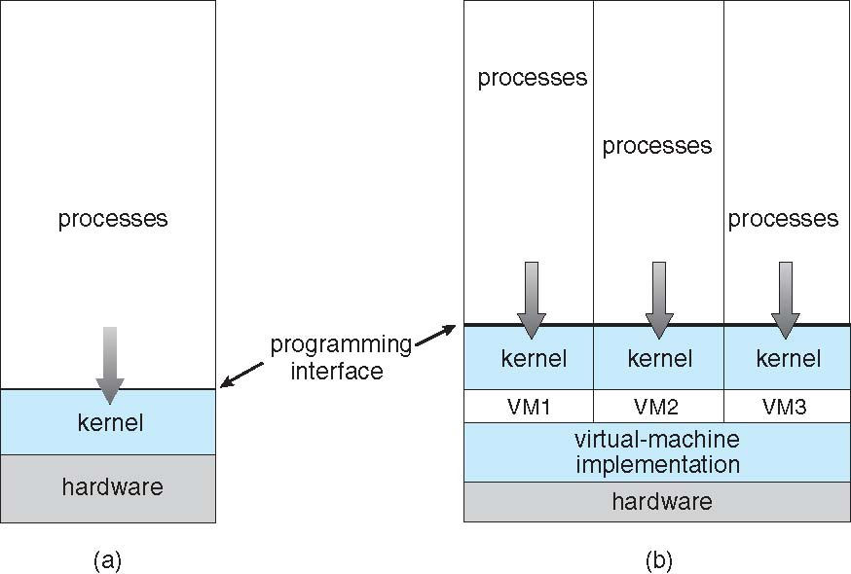
Virtual Machines (Cont.)
(a) Nonvirtual machine (b) virtual machine

Slide 57
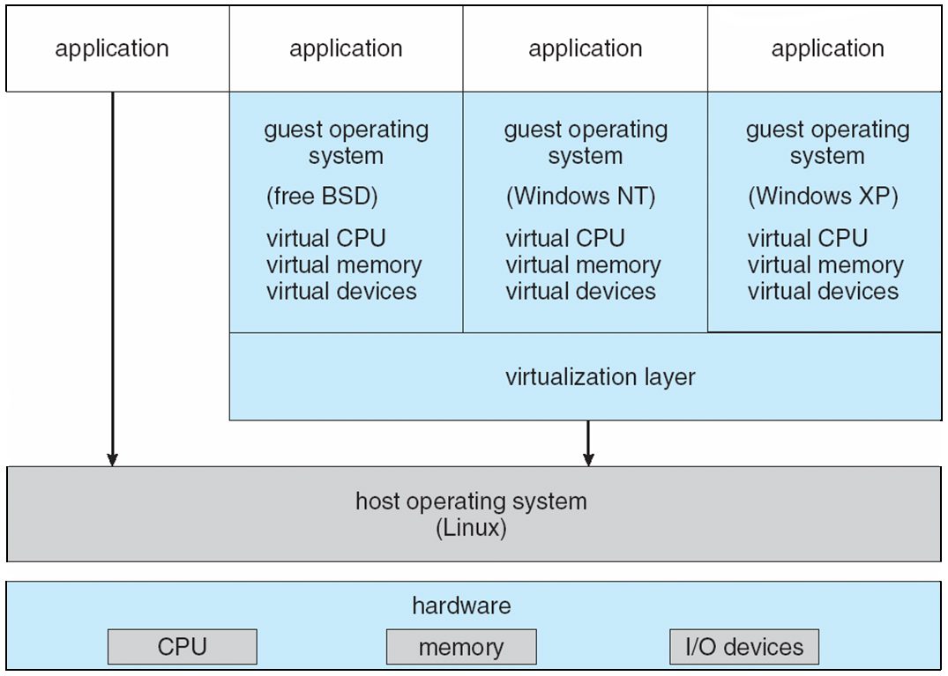
VMware Architecture

Slide 58
End of Chapter 2

