Slide 1
Welcome to project
Project Title: Online Sales and Payment System
Name of Project: BABY BOOKS & stationery Shop

Slide 2
Abstract
The project is planned to build up an online system titled seals and payment System for the Dhaka book shop Ltd. The company is using simple system for storing staff details that stored by using MS-Excel. below the condition company has decided to develop their seals and payment System into Online System for the reason that they have been suffering to produce smart result within due time beside imprecision as well as delay processing of work.

Slide 3
Study Background
Online book shop sales and payment system. This book shop name Dhaka book shop Ltd. Dhaka book shop Ltd is one of the leading buying book Shop in Bangladesh. Since its formation 2005.it is situated at uttara, Dhaka. Their main fear is to play roll as a buying shop of customer.

Slide 4
Followed specific areas
There are many kinds of book in this Shop such as ,History Book, poetry Book , academic subject book, university book, medical related book etc.

Slide 5
The main function of the current system
Sales function
Marketing function
Stock control
Account function
Financial function

Slide 6
Problem of the current system
It was a paper base
High cost
High time
Physical meet

Slide 7
The main function of the proposed system scope
To keep client details
To keep order details and delivery details
Easily online Book sales and payment
Time Save
Cost minimizations

Slide 8
The objective of the project
To review different types of popular books and identify the key advantages.
To reduce work of maintaining manual record keeping system.
Provide opportunity to get the books subject wise or author wise.
Make appointment process make easier
Administrators have all power to record keeping system.

Slide 9
Advantage of this System
Data Manage easily.
User queries Manage.
Judgment order online and via customers email.
And online payment by cart
Clear view of products item as well as current situation.
Keep records of all sorts of data.

Slide 10
Academic challenge of this project
I have many problem face for the project completed.
In academic field it will cover most of the advantaged for the students.

Slide 11
Procedure and Methodology
Object Oriented Methodology will include in this software. The stages are as below-
Initial study
Feasibility study
Requirement analysis
System analysis and specification
System design
System development
System Testing
System Implementation
Further scope and review

Slide 12
New skill to be learned
To gain knowledge about the buying shops functions.
Get together knowledge to apply a real life project.
Get together knowledge to contract with a number of people.
Possibly will be able to gain a lot of knowledge in analysis and designing.

Slide 13
Practical application and implementation indentified
Project documentation:
Microsoft word
Microsoft excel
Microsoft paint

Slide 14
Software development
Editor: Text Pad 4.0
Back-End Tools: MS-Access or my SQL
HTML and CSS3 for scripting
HTML5 and PHP for validation

Slide 15
Development Platform
Windows 2000 Professional
Windows Server 2003 Enterprise
Windows XP Professional

Slide 16
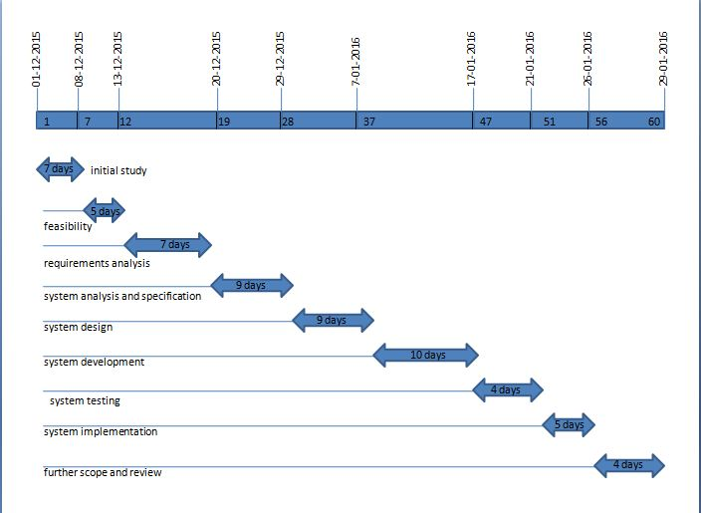
Project development milestones/Gantt chart

Slide 17
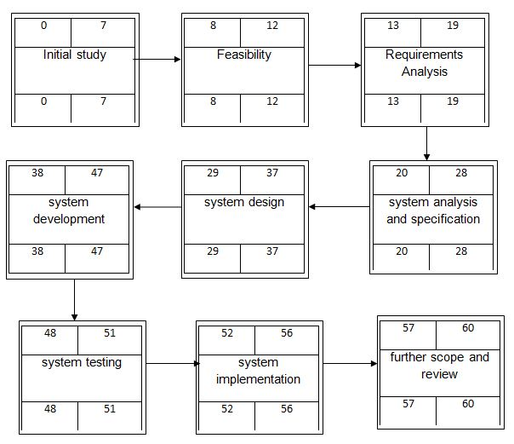
Activity Network Diagram

Slide 18
Thank You All
.

