Slide 1
Welcome to Project
Project Title: Hospital Management System(for Help Desk)
Project Name: Jahan Ara Clinic (PVT.) LTD

Slide 2
Introduction
The project is designed to build up hospital help desk from hospital management system. The project titled hospital management system (for help desk) for jahanara clinic (PVT.) LTD.
The clinic is using simple system for storing clients’ or patients and doctor details as well as they used paper based system.
At the present the hospital decided to develop their hospital management system for help desk.
Because the hospital management person are suffering daily life for client and doctor schedule. The software will be help to through making decision for schedule as their alarm for the hospital management of jahan ara clinic.
In the project I would like to introduce a web base client’s appointment their doctor and their time and schedule store in the software and their appointment time they will get by the mail or self phone.

Slide 3
Study background
Hospital management system (for help desk)).the hospital name is jahan Ara clinic.
Jahan Ara clinic is one of the best services hospitals in Bangladesh. It is situated house#2&4, rode#1, uttara model town, Dhaka-1230, Bangladesh. there are many service provider in this clinic.

Slide 4
Followed specific areas
My system service categories are: including-
Medicine
Surgery
Gynecology & obstetrics
Nephrology
Eye
ENT
Neuro medicine
Orthopedics
Pediatrics
Plastic surgery
Physiotherapy
Dental

Slide 5
The main function of the current system
Online appointment booking
Time save

Slide 6
Problem of the current system
It was Some Paper and some computer base
High time
High cost
Meet physically

Slide 7
The main function of the proposed system scope
Keep doctor information
Keep patient information
Keep office information
Keep payment information
Keep discount information
Save time
Minimization cost

Slide 8
Aim/Objective of the project
Administration have All power saw all information keeping system
The patient appointment process make easier
all the patient have Opportunity for chose doctor
all the patient have opportunity for chose day if doctor available
The system have keep patient details record system

Slide 9
Advantage of the project
General advantage:
Easily data mange
Easily user queries manage
Online appointment system
Know all information by online
Keep all the data records, like-
doctor information
patients information
office information
payment information
discount information
Technical and management advantage:
search system
communicate with admin
Any complain against of hospitals or doctor then they can communicate with hospital management person.

Slide 10
Academic challenge of this project
Jahana Ara Clinic hospital system is running physically. For keeping information they are use paper and some computer.
But there are no any information gets by online. It is big problem for patients.
So it is challenge to develop online information system. For the hospital information development system I have achieved knowledge by different book and different website.
I have Analysis different website for implementation with real project. Most important change to turn into a good system analysis by throwing the real project.
This is a most important challenge to develop the project within due time and also fulfill the hospital requirements. I have many problem faces for the project completed.

Slide 11
Process and methodology
I have used object oriented mythology in this system. Object oriented mythologies are included:
Initial study
Feasibility study
Requirement analysis
System analysis and specification
System design
System development
System Testing
System Implementation
Further scope and review

Slide 12
New skill to be learned
To gain knowledge about hospital function
Knowledge apply to get together a real project
Get together knowledge to contact with a number of people
A lot of knowledge gain in analysis and designing

Slide 13
Practical application and implementation identified
Project documentation:
Microsoft word
Microsoft paint
Microsoft excel
Software development:
HTML and CSS3 for scripting
HTML5 and PHP for validation
PHP for performing functions
MySQL server for database
Supporting Browser
Development Platform:
Windows XP Professional
Windows 2000 Professional

Slide 14
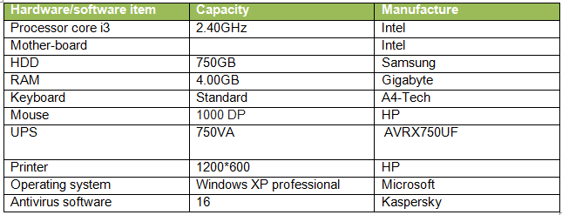
PC confirmation

Slide 15
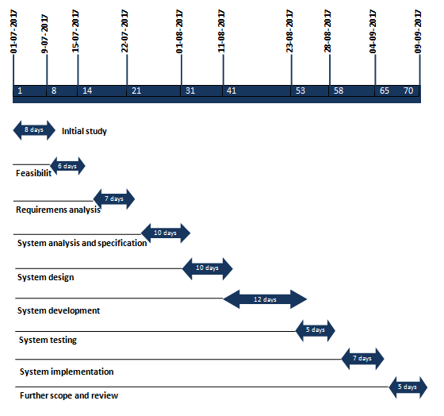
Project development milestone/grant chart

Slide 16
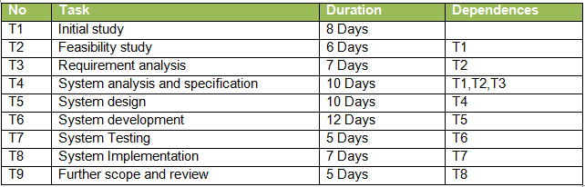
Task, Duration and dependences

Slide 17
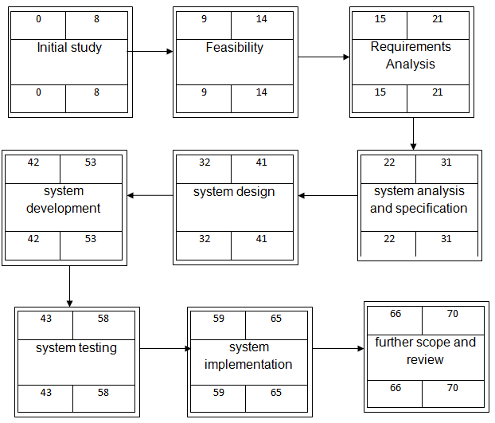
Activity network diagram

Slide 18
Thank You All
.

