Slide 1
REVIEW POINT
Team Wolfpack
Vamsi Krishna Muktevi
Avinash Penti
Vijay Tummala
Karthik ponnuru

Slide 2
Introduction
This app will provide a solution to store sensitive information among untrusted smartphones securely.
No less than ‘k’ no.of people among total number of people ‘n’ can extract the information.

Slide 3
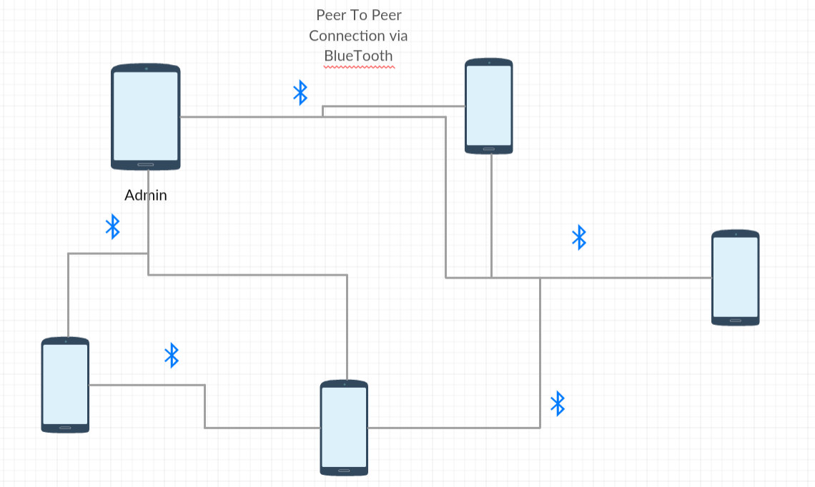
Architecture Diagram

Slide 4
Detailed Explanation
Admin logs in and shares the secret to all participants via Bluetooth connection.
Atleast ‘k’ users must collaborate to re-generate the original message.
Users can share their part of secret with other participants via Bluetooth.

Slide 5
Thank you
Any Questions ?

