Slide 1


Phishing URL Detection Using Machine Learning

Slide 2


Contents
Problem Statement
Proposed Solution
Methodology
Data Collection
Feature Extraction
Model Training
System Architecture and its components
Results
Conclusion

Slide 3

Problem Statement
We live in the digital era. This has steadily changed how you buy things, pay your bills, rent an apartment, watch a movie, and everything else. This project focuses on solving a most common cyber fraud called “Phishing”.
Phishing is a type of social engineering attack often used to steal user data.It happens when the attacker acts as a reliable source and tricks a victim into opening a text message, email, or instant messaging.

Slide 4
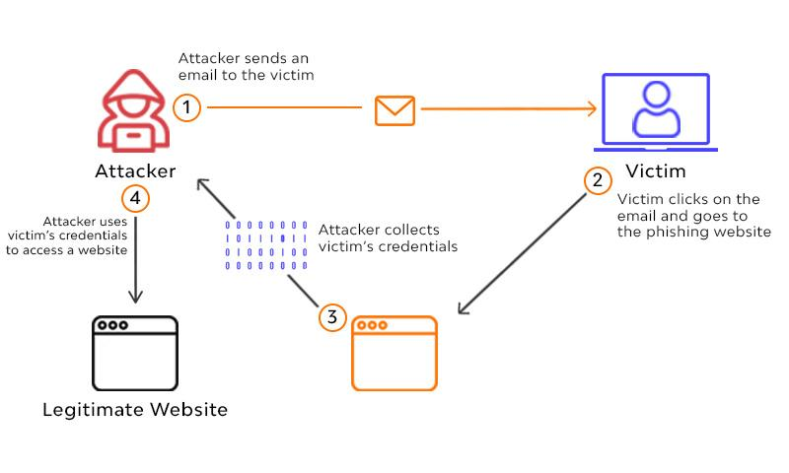
Problem Statement
The recipient is then tricked into clicking a malicious link, which can lead to the installation of malware, the freezing of the system as part of a ransomware attack, or the revealing of sensitive information.

Slide 5
Proposed Solution
The recipient is then tricked into clicking a malicious link, which can lead to the installation of malware, the freezing of the system as part of a ransomware attack, or the revealing of sensitive information.
As we discussed above, Most phishing attacks happen when a user clicks a malicious URL, so our primary goal should be to prevent the user from clicking any malicious So to prevent such phishing attacks we propose a Machine Learning solution that can automatically analyze incoming malicious URLs and classify the links on their own.
The objective of this project is to train machine learning models and deep neural nets on the dataset created to predict phishing websites. Both phishing and benign URLs of websites are gathered to form a dataset and from them required URL and website content-based features are extracted. The performance level of each model is measures and compared.

Slide 6

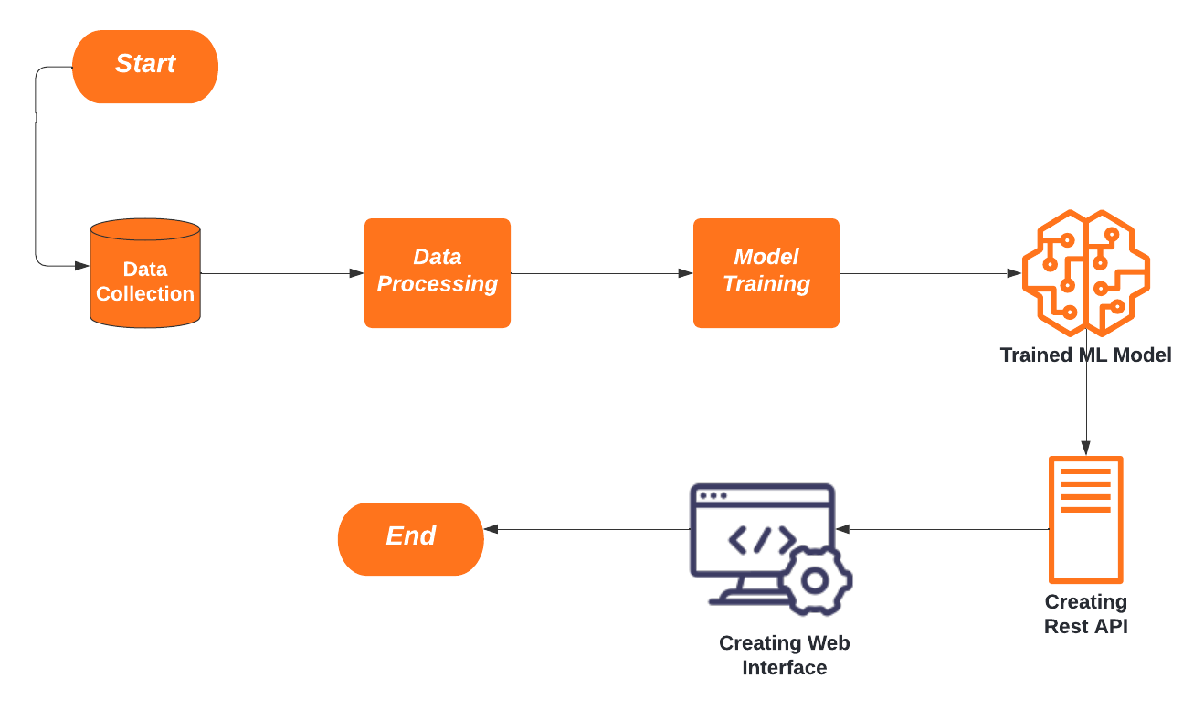
Methodology
These are the Series of tasks to be completed in this project

Slide 7
Data Collection
The dataset is borrowed from Kaggle, https://www.kaggle.com/eswarchandt/phishing-website-detector
A collection of website URLs for 11000+ websites. Each sample has 30 website parameters and a class label identifying it as a phishing website or not (1 or -1).
The overview of this dataset is, it has 11054 samples with 32 features.

Slide 8
Feature Extraction
Feature extraction is the process of identifying and quantifying relevant characteristics or patterns in raw data to make it understandable for machine learning models.
The main purpose of this feature extraction is to convert raw URL data into numerical features that the machine learning model can use for classification.
These features ensure the model can accurately predict whether a URL is phishing or legitimate.
Total 30 features are extracted from the above dataset.

Slide 9
Feature Extraction
The following category of features are selected:
Address Bar-based Features
Domain based Features
HTML & Javascript-based Feature
Address Bar based Features considered are:
Domain of URL
Redirection ‘//’ in URL
IP Address in URL
‘http/https’ in Domain name

Slide 10
Feature Extraction
‘@’ Symbol in URL
Using URL Shortening Service
Length of URL • Prefix or Suffix "-" in Domain
Depth of URL
Domain-based Features considered are:
DNS Record
Age of Domain
Website Traffic
End Period of Domain
HTML and JavaScript based Features considered are:
• Iframe Redirection • Disabling Right Click
• Status Bar Customization • Website Forwarding

Slide 11
Model Training
This is a supervised machine-learning task. There are two major types of supervised Machine learning problems are called classification and regression.
This data set comes under a classification problem, as the input URL is classified as phishing (1) or legitimate (0). The machine learning models (classification) considered to train the dataset in this notebook are:
Logistic Regression
k-Nearest Neighbors
Support Vector Classifier
Naive Bayes
Decision Tree
Random Forest
Gradient Boosting
xgboost
Multilayer Perceptrons

Slide 12
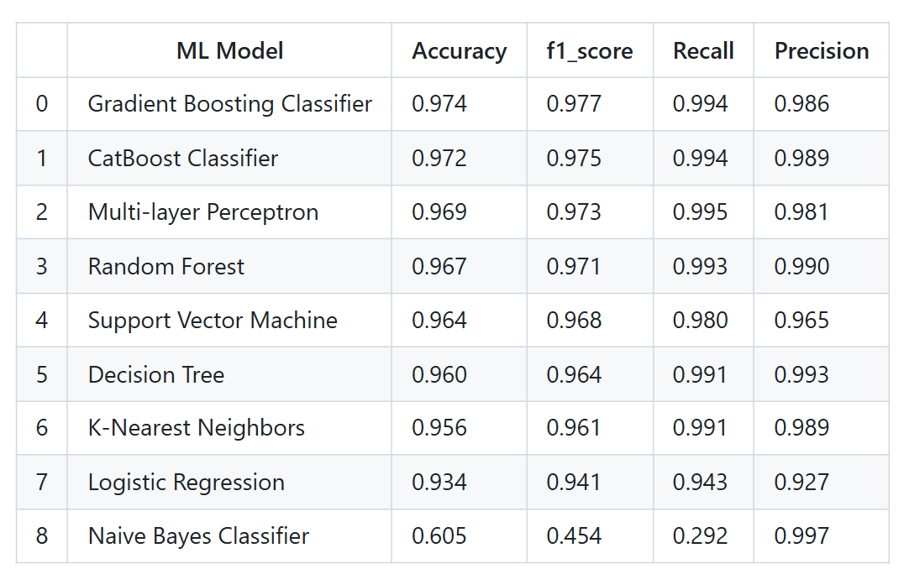
Model Training
The models are evaluated, and the considered metric is accuracy.
For the below, it is clear that the Gradient Boost Classifier model gives better performance. The model is saved for further usage.

Slide 13
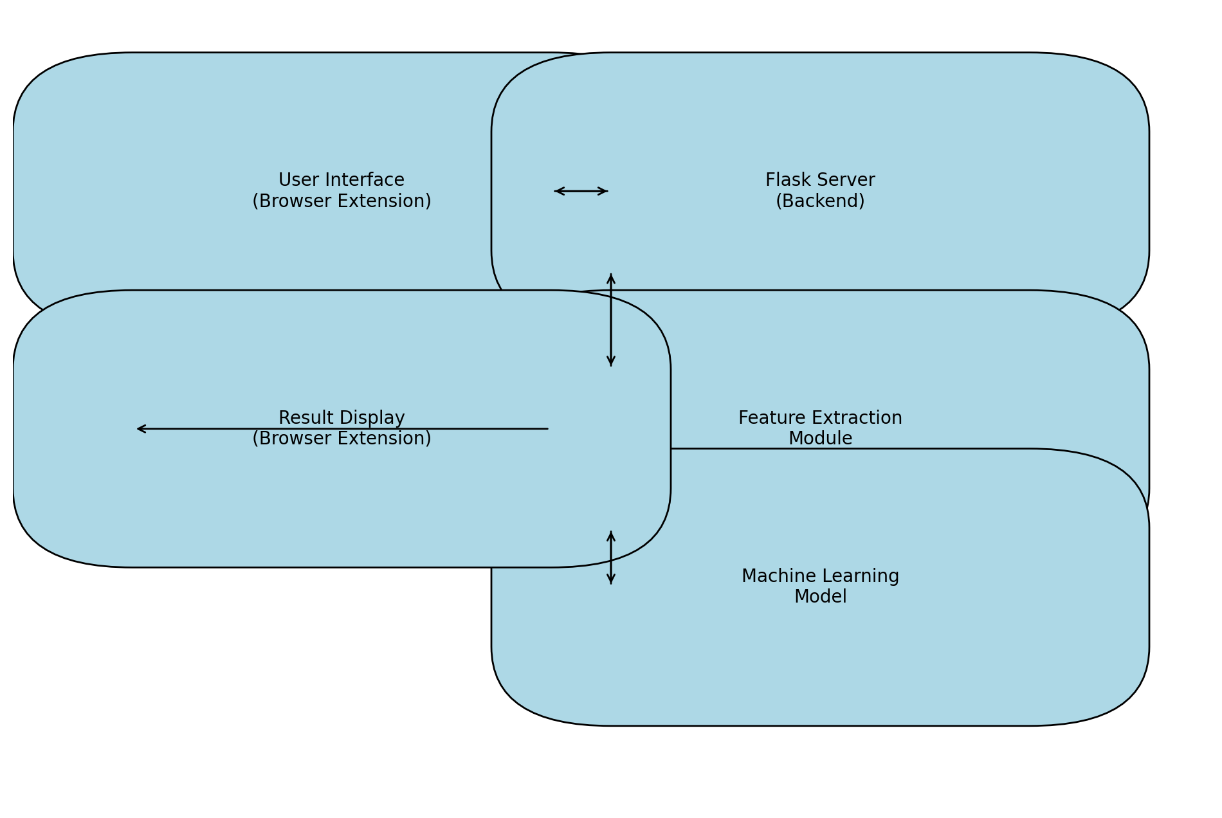
System Architecture and components

Slide 14
Components
User Interface (Browser Extension)
Acts as the primary interaction layer for users.
Collects URLs entered by users manually or fetched automatically from the active browser tab.
Displays results (Legitimate or Phishing) along with detailed feature-based explanations.
Workflow:
The user enters or navigates to a URL.
The extension sends the URL to the Flask server for analysis.
After receiving results from the server, the extension displays the outcome and explanations in an intuitive popup interface.

Slide 15
Components
Flask Server (Backend)
Serves as the backend API that processes incoming URL requests from the browser extension.
Manages communication between the extension and the machine learning model.
Workflow:
Receives the URL from the extension via a POST request.
Calls the Feature Extraction Module to analyze the URL and prepare data for the machine learning model.
Passes the extracted features to the Machine Learning Model for classification.
Packages the classification result, contributing features, and detailed feature data into a response.
Sends the response back to the browser extension.

Slide 16
Components
Feature Extraction Module
Analyzes the URL to generate meaningful numerical features used for classification.
Breaks down the URL into components and evaluates them based on predefined criteria.
Workflow:
Takes the raw URL as input.
Extracts 30 features (or more) to quantify the URL's security characteristics, such as:
Structural Features (e.g., Length, Subdomains, Symbols).
Behavioral Features (e.g., Website Traffic, Age of Domain).
Security Features (e.g., HTTPS usage, Presence in Google Index).
Examples:
UsingIP = -1: Indicates the use of an IP address instead of a domain name, which is risky.
HTTPS = 1: Indicates the URL uses HTTPS, which is a positive signal.

Slide 17
Components
Machine Learning Model
Analyzes the extracted features and classifies the URL as phishing or legitimate.
Workflow:
Receives the structured features from the Feature Extraction Module.
Uses the trained model (Gradient Boosting Classifier) to make a prediction.
Returns the prediction (Phishing or Legitimate) and highlights the features that influenced the decision.

Slide 18
Result Display (Browser Extension)
Displays the detection results in the popup interface for the user.
Provides transparency by showing:
Classification result (Legitimate/Phishing).
List of contributing risky features.
Detailed breakdown of all extracted features.
Workflow:
Receives the response from the Flask server.
Parses the data and updates the UI dynamically.
Allows users to understand why a URL was classified as phishing or legitimate.

Slide 19
Result Display
URL: https://mycourses.unh.edu/courses/113452
INFO - Extracted Features: [1, 1, 1, 1, 1, 1, 0, 1, -1, -1, 1, 1, -1, -1, -1, -1, -1, -1, 0, -1, -1, -1, 1, -1, -1, -1, -1, 1, 0, 1]
INFO - Prediction: Legitimate
URL: https://currently-att-12-02-2024.weeblysite.com/...
INFO - Extracted Features: [1, 1, 1, 1, 1, -1, -1, 1, -1, -1, 1, 1, -1, -1, -1, -1, -1, -1, 1, -1, -1, -1, 1, -1, -1, -1, -1, 1, 0, 1]
INFO - Prediction: Phishing

Slide 20
Conclusion
Working on this project is very knowledgeable and worth the effort.
Through this project, one can know a lot about the phishing websites and how they are differentiated from legitimate ones.
The system can be expanded to include phishing email detection, and malware-hosting URL detection.
Improve model accuracy using ensemble learning or deep learning techniques.

Slide 21
THANK YOU

