Slide 1
Pdf to
braille
Topic :Inclusivity and Accessibility in Governance

Slide 2
Introduction
One of the primary responsibilities of the government is to ensure that every individual has access to fundamental necessities, such as quality education and basic job security.
They provide many special helps to people with disability to achieve quality education

Slide 3
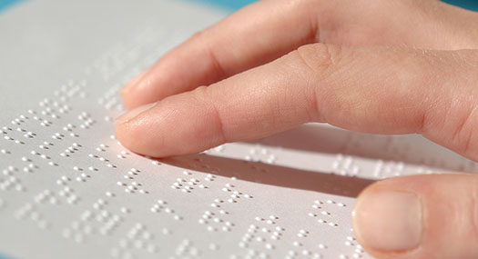
Introduction
Over 253 million people in the world are visually impaired, with 36 million people living with blindness.

Slide 4
Necessity of braille
Braille is the way of learning for the blind. All their textbooks are in braille.
But currently, the text book is entirely written using a braille converter and then verified twice or thrice before production.
This takes so much time and affects in them falling behind when the syllabus is updated.

Slide 5
solution
They use a special printer called braille empossers to print the texts and any books. They use a special format called brf (braille ready file).
We present an alternative for this process. A software to directly convert a pdf to a .brf file which can be directly used for printing.

Slide 6
Technology
Libluois Engine
Various Python libraries
Fitz
Tkinter
Louis
Pynput
os

Slide 7
Overview of the Process
Upload a PDF file
Extract text from PDF
Convert text to Braille code
Generate and download BRF/BRT file

Slide 8
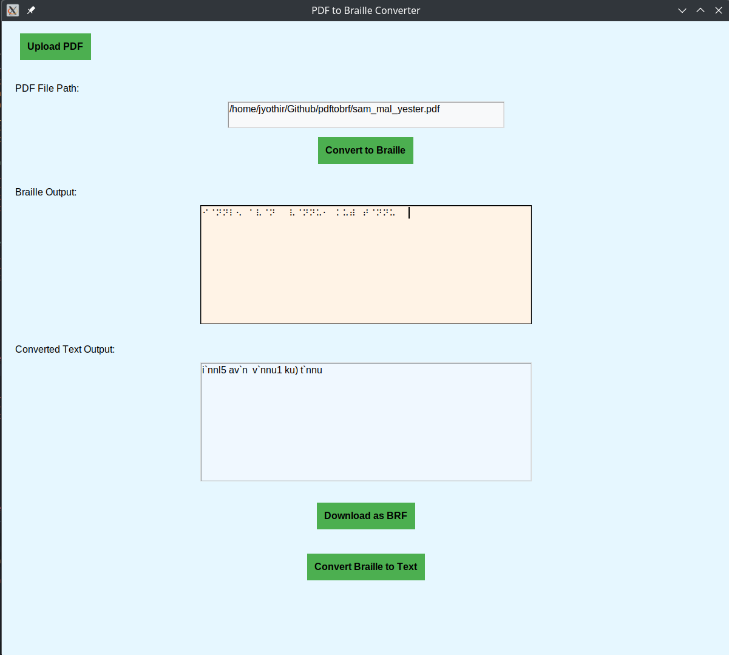
solution

Slide 9
Thank you
Team Binary
Jyothir adithya
Musthafal mukthar
Abhijith
vijeesh

